Slide 1
Turning Mininet/Open vSwitch into A Detailed OpenFlow Emulator
Yi-Jun Cheng
October, 2015
Notes:
各位教授同學大家好～～
我的碩論題目是跟改善OpenFlow emulator performance accuracy相關

Slide 2


Emerging Network Architecture
Software-Defined Networking provides network programmability and efficient network management
Researchers from academia and industry worked on developing innovative network services on SDN and OpenFlow
Behavior verifications and performance evaluations are necessary to examine the possibilities of the novel ideas
Notes:
Software defined networking 是一個新興的網路架構, 在SDN, switch control plane被抽離移到remote的controller上
ＯＮＦ制定了一套controller和switch溝通的protocol, OpenFlow
利用programmable的特性可以更有效率的管理network system
Researchers 致力於提供創新的network services, 從 infrastructure, control, 到 application layer 各方面都有相關的研究
在每個研究中, 驗證想法是否可行還有檢測網路效能是否有達到需求或期望的結果是很重要的
最直接的方式就是透過部署SDN-based network system

Slide 3
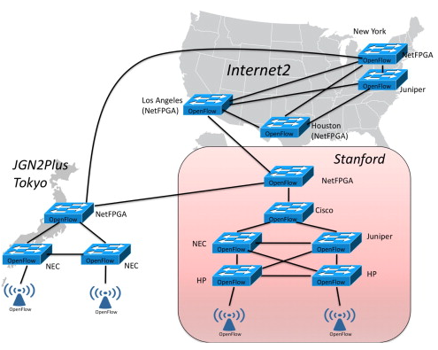
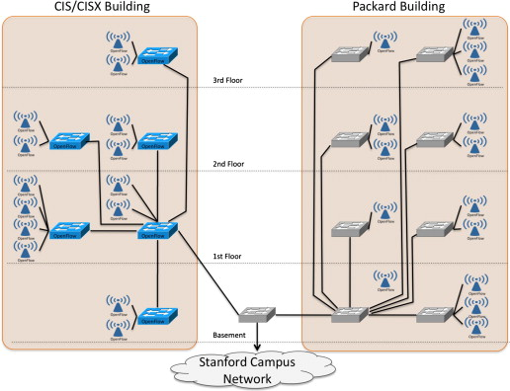
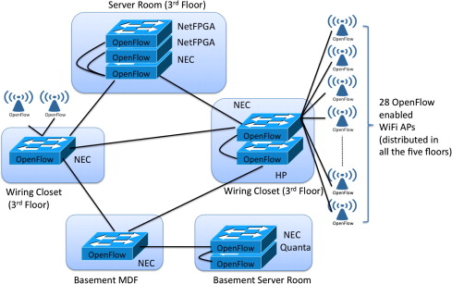
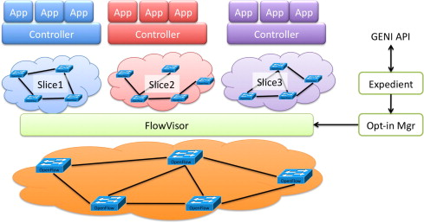
References:
[1] M. Kobayashi and S. Seetharaman and G. Parulkar and G. Appenzeller and J. Little and J. Reijendam and P. Weissmann and N. McKeown. Maturing of OpenFlow and Software-defined Networking through Deployments. Computer Networks, 61:151–175, November 2013.
Notes:
其中一篇SDN相關的paper提了幾個SDN相關的應用跟部署, 像是
Several deployments are made in this paper (campus, campus-to-campus, WiFi, network virtualization…etc)
Authors say: deployment process is resource intensive
http://www.sciencedirect.com/science/article/pii/S138912861300371X

Slide 4

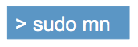







OpenFlow Simulators/Emulators
Testbeds are necessary, but deploying ones is costly, time-consuming, and labor-intensive
Run emulations/simulations beforehand
Several available emulators/simulators, but fail to consider control plane performances and different switch implementations
References:
[1] Mininet: an instant virtual network on your laptop (or other PC). http://mininet.org
Notes:
佈建 testbed 需要花錢買設備而 openflow switch又相當貴且需要很多人力來部署網路
而且部署會碰到許多問題需要再花更多時間調整
To save some time: 事先在模擬的環境下先確認是否可行
在這篇thesis, 我們認為control plane performance (如:flow table update delay) 和 data plane performance (如: packet forwarding delay) 都會影響到network system 的效能，都很重要
但是大部分的 emulators 都較重視 data plane performances
而且也沒有考慮到不同廠牌的 switch 不同的實作方式，在效能也會有差異

Slide 5
Goal
Accurately emulate both behaviors and performances of SDN-based networks and support different switch implementations
Design measurement studies for switch performances and propose performance benchmarks
Propose performance models and switch-dependent parameters,
Integrate with an OpenFlow emulator, Mininet/OVS
Preliminary Measurements
Offline Profiling
Switch
Pica8 P-3297
Open vSwitch
Parameter Configuration Files
Automatic Profiling Procedures
Measurement Study
Performance Models
Models
Switch-specific Parameters
Automatic Profiling Procedures
Accurate OpenFlow Emulation
Switch States
Emulator
Notes:
所以我們的目標是
1. 開發一個可以提供準確的 control plane and data performance的emulator
2. 並且會考慮市面上不同的廠牌的switch的效能差異
我們的步驟如圖所示
1. 首先我們會設計一組測量 switch performance 的實驗
2. 藉由測量的結果提出 performance model 和 switch-dependent parameters，然後測量的過程也會包裝成 switch performance benchmark
3. 每次有新的 switch 的時候再用我們的 benchmark 重新測量獲得 parameters
4. 最後，emulator implementation 我們會將 performance models 整合現有的emulator, Mininet/OVS

Slide 6






Measurement Methodology
Conduct measurement studies on OpenFlow switches, Pica8 P-3297 and Open vSwitch
Control plane performance measurements
Flow table update delay
Develop our testing modules based on OFLOPS
Data plane performance measurements
Packet forwarding latency and throughput
Use OFLOPS with packet replay and capture tools
OFLOPS
Notes:
在measurement study，我們會去測量 pica8 和 OVS, 其中
1. pica8 是 hardware switch + multiple tables
2. OvS 是 software-implemented switch
Control plane performance 主要會測量flow table update delay, 就是switch 收到flow_mod command 後需要多久時間可以update好table entry
1. 測量主要使用 OFLOPS 作為我們開發testing modules的framework
2. 原因是因為 OFLOPS 可以同時傳送 control plane messages 跟 data plane traffic, 可以藉由data plane traffic來確認table entry是否完成修改
Data plane perfromance 主要測量 forwarding latency + throughput
Measurement tool 也是主要以 OFLOPS 作為controller 再搭配 tcpreplay tool 來送各種不同的 data plane pcap trace

Slide 7
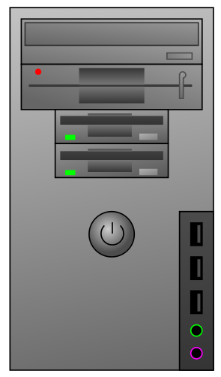
Measurement Setup
Dedicated control plane channel
Event Scheduler, Data Plane Traffic Generator, and Packet Handler are three main threads in OFLOPS framework
Control Plane Packets
Data Plane Packets
CPU: Intel i7 3.6 GHz
Memory: 8 GB
OpenFlow Controller
Events
Data Plane Traffic Generator
Packet Handler
Event Scheduler
Gigabit Ethernet
Switch Under Test
Data Plane Channels
Control Plane Channel
Notes:
這張圖是我們 measurment setup
1. Controller 是 i7 8G memory的 PC (click)
2. Switch 和controller 之間以gigabit ethernet 連接 (click)
3. 有control plane channel 專門作為switch和controller 之間的訊息交換 (click)
4. 還有data plane channel 作為data plane packets 傳送的管道 (click)
4. Controller 上主要有三個threads在運作: Event scheduler, data plane traffic generator, packet handler (click)

Slide 8
What Each Component Does
Event Scheduler defines how each event works
Data Plane Traffic Generator generates customized data plane packets and send them via data plane channels
Packet Handler captures packets from both data plane and control plane channels
Control Plane Packets
Data Plane Packets
OpenFlow Controller
Events
Data Plane Traffic Generator
Packet Handler
Event Scheduler
Switch Under Test
Data Plane Channels
Control Plane Channel
Notes:
Testing modules 裡我們可以自己定義須要的event (click)
1. 比如說：定義一個會送10 inserttion commands的event
2. 然後可以自己排定好哪個event 在什麼時候被執行
透過event 自定我們的control plane command
Data plane traffic generator則負責送相對應的packet
以packet handler 確認有沒有收到packet來確認flows是否已經update完成
Event scheduler 負責依排定好的行程執行相對應的 event (click)
Data plane traffic generator 則是可以自己定義 header 的 values, 比如說: …IP MAC address (click)
Packet handler 則可以檢查所有從control and data channels 送來的packets (click)

Slide 9
Control Plane Performance Measurement Studies and Modeling
Test Scenarios
Measurement Results
Performance Models
Model Validation
Notes:
Test
測量結果
Performance model
Model accuracy validation

Slide 10
Factor Considerations for Control Plane Performance Tests
Performance metrics
Flow table update delay
Flow_mod command types
Insertion, modification, and deletion commands
Number of existing flows
Priority distribution of existing flows
Descending, ascending, and same priority distributions
Number of batch commands
How many commands waiting for execution
Notes:
不同的command types, 處理過程不同, 所以delay也不會一樣
Switch flow table 有多少 flow 和 flow priority
在實驗中, 我們有三種 priority distribution
Descending: priority value 從65535 開始使用逐次遞減
Ascending: 501 逐次遞增
Same: 只使用501作為priority values
多少個command等待被處理：是想測量 batch processing 跟optimization 的影響

Slide 11




Control Plane Tests
Preinstall different number of flows with different priority distributions at first for each of the test
Insertion test
Send different number of insertion commands under different number of existing flows
Modification test
Send different number of modification commands under different number of existing flows
Deletion test
Send a wild-carded command to delete flows in the table
Show sample results from Pica8 in the following
Notes:
Test scenario 針對三種不同的command types去設計
每個test開始前會先insert 不同priority distribution的flows
目的：是測量不同existing flow size和 priority distributions 的影響
Insertion/modification test 會分別送不同數量的 insertion和modification commands, 然後測量update delay
Deletion test: 則是送 一個match 所有table flows的command, 然後測量刪掉不同數目的flows 時間的差異
Result: 接下來會show Pica8上得到的結果

Slide 12
Insertion Test Results on Pica8
Proportional to existing flow size
Different increasing rate for different batch command size
Increasing rate decreases with more batch commands
Similar observations in software table
Descending priority distribution
Same priority distribution
Notes:
如圖是 insertion test 使用 descending/same priority distribution 的結果
X-axis : table 有多少flow; Y-axis : per insertion command update delay
我們發現時間是 linear 成長
同樣的batch size 下descending/same distribution 有不一樣的increasing rate
不同batch size也是, 且batch size越大則increasing rate更低 (表示更多batch command, optimization效果更好)
在software table上也觀察到了類似的結果 (size over 4000)

Slide 13
Insertion Test Results on Pica8 (cont.)
Flows should be in priority order in TCAM
Flow shifting time dominates the insertion delays, so little differences observed among different batch command sizes
Ascending priority distribution
Notes:
因為TCAM裡的flow 需要案priority 的順序排序
在使用Ascending priority distribution的實驗, 每加新的 flow時, 原本在table裡priority較小的flows會需要移動讓新的flow 加入
因為需要移動flow的關係 ascending 的結果delay都較descending/same來的長
且不同batch size, increasing rate差別不大, 是因為移動flow的時間佔了大部分 insertion delay time
XXX: shift

Slide 14
Modification Test Results on Pica8
Proportional to existing flow size
Increasing rate decreases with more batch commands
Different increasing rates for different priority distributions
Ascending priority distribution
Same priority distribution
Notes:
Modification test 觀察到根insertion 類似的結果
圖上x-axis: no. existing flows, y-axis: per modification update delay
Delay是linear increasing
Increasing rate隨著batch size 越大而減少
Ascending 和same priority distrbution的increasing rate 也不同
Ascending 和 descending 的結果一樣所以這裡只show了ascending 的結果

Slide 15
Deletion Test Results on Pica8
Proportional to number of deleted flows
Existing flows with different priority distributions share same results
Ascending priority distribution
Same priority distribution
Notes:
Deletion test
x-axis: existing flow size, 刪掉的flow數目，y-axis: delete掉這麼多flow花的時間
Delay 跟 刪掉的flow數目 成正比
不同priority distributions結果差異很小

Slide 16
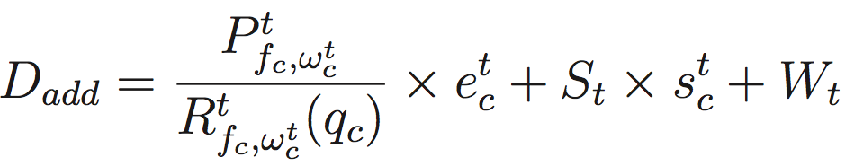
Insertion Time Model
c denotes the index of flow_mod command
t is the index of the table
Proportional to existing flow size → P
Decrease with more batch commands → R(q)
S is flow shifting time
W is the time to update a flow table entry
table, t
Priority distribution
Command type, f_{c}
# batch commands, q
# existing flows, e
Shifting times, s
Insertion Time Model
D_{add}
Notes:
在我們的model, 將不同table視為是不同的switch implementation, 所以則是用另一組parameter來區別不同table的performance
如圖顯示了insertion time model的所需的 input 跟output
P, R, S, W是switch-dependent parameters
因為 insertion time 和 existing flow size 成正比, P factor 代表 increasing rate
但不同的 batch command size , increasing rate減少所以用R(q) function 來調整
S則代表移動一個flow entry所花的時間而小s則是需要移動的flow數 （計算方式是去算所有priority 小於當前加進的flow的數目）
W則是modify flow table 一個flow entry的時間 ( modify: 包含了新增flow entry, modify flow entry或remove flow entry)
T則是指哪個table

Slide 17
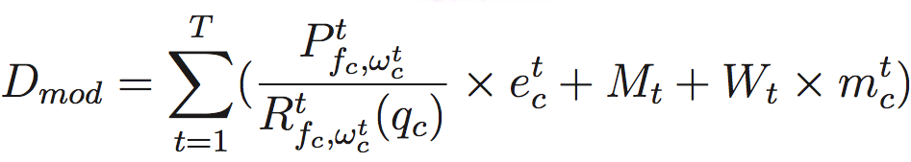
Modification Time Model
T denotes number of tables
Proportional to existing flow size → P
Decrease with more batch commands → R(q)
M is the time for searching matching flows
m denotes the number of matched flows
Priority distribution
Command type, f_{c}
# batch commands, q
# existing flows, e
# matched flows, m
Modification Time Model
D_{mod}
Notes:
Modification model
一樣有P factor代表increasing rate, R function 調整隨batch size 減少的increasing rate
M是search所有matching flows所需的時間, 小m是指match的flow數
所有table的table entry都需要被檢視, 大Ｔ指的是flow table的數目

Slide 18
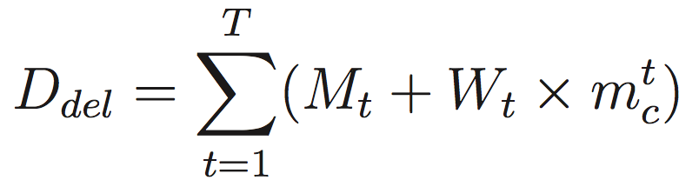
Deletion Time Model
# matched flows, m
Deletion Time Model
M → time for searching all matched m flows
W → time for updating a flow entry
D_{del}
Notes:
Deletion model則是
只考慮matching +和刪掉所有matching flows所需的時間

Slide 19
Validation Experiments
Test scenarios
Insertion tests
Modification tests
Deletion tests
Random tests
Random priorities, IP addresses, arrival time, and command types
Validation results from Pica8 and OvS
Notes:
Validation experiments 有insertion, modification, deletion, 和random tests
會去比較pica8, ovs 和model根據不同switch parameters算出來的結果

Slide 20
Insertion Test Validation
Validation results using ascending priority distribution
Modeled results follow the results of OpenFlow switches
Pica8 P-3297
Open vSwitch
Notes:
如圖分別是pica8和ovs的結果圖
紅色sample是實際上在pica8和ovs上得到的insertion delay
藍色線是根據前面的model 搭配得到的pica8 和ovs的parameter分別去算出model結果
接下來分別還有modification, deletion test的比較
那可以看到我們的model的結果大致上都有follow switch的趨勢且value也很接近

Slide 21
Modification Test Validation
Validation results using ascending priority distribution
Modeled results follow the results of OpenFlow switches
Pica8 P-3297
Open vSwitch

Slide 22
Deletion Test Validation
Validation results using ascending priority distribution
Modeled results follow the results of OpenFlow switches
Pica8 P-3297
Open vSwitch

Slide 23
Random Test Validation
Random commands, priorities, IP addresses, and arrival time
Arrival time follows Poisson process with 100 flows/sec
16 random configurations for each command size
Error rates are mostly under 20% on Pica8 and OvS
Pica8 P-3297
Open vSwitch
Notes:
Random tests的部分
我們隨基地產生 command, priority, IP addresses, 漢每個command的arrival time
Arrival time是以Poisson process random 產生
我們跑了不同的number of commands
每個sample都跑了16組不同的random configuration
結果圖顯示不同number of commands, 實際switch和model結果算出來的errorrate
Pica8, ovs errorrate都在20以下

Slide 24
Data Plane Performance Measurement Studies and Modeling
Test Scenarios
Measurement Results
Performance Models
Model Validation

Slide 25
Factor Considerations for Data Plane Performance Tests
Different matching fields used of tables flows
L2, L3, and both L2 and L3
Number of existing flows in the flow table
Inter-packet time
Time difference between last packet and current packet arrival time
Packet size
Notes:
Data plane measurement 考慮了
Table flows 不同 matching fields 使用, 實驗裡用了三種: only L2, only L3, L2/L3
不同的 existing flow size
Data plane packet 有不同的inter-packet time和packet size

Slide 26
Data Plane Tests
Performance metrics
Forwarding delay
Throughput
Preinstall corresponding flows for data plane traffic, with:
Different existing flow size
Different matching fields used
Send data plane traffic, with:
Different packet size
Different inter-packet time
Notes:
Data plane test 主要測量 forwarding delay / throughput
Insert flows
Send data plane traffic

Slide 27
Packet Sizes and Matching Fields
Larger packet sizes result in higher forwarding delays
Delay time varies with different matching fields used
Pica8 P-3297
Open vSwitch

Slide 28
Existing Flow Sizes
Existing flow sizes have little impact on forwarding delays
Pica8 P-3297
Open vSwitch

Slide 29
Inter-packet Time
Multi-levels of forwarding delays with different inter-packet time
Pica8 P-3297
Open vSwitch

Slide 30
Packet Forwarding Delay Model
k denotes the index of the data plane packet
denotes the base time
: increasing rate for inter-packet time, a_{k}
: increasing rate for existing flow size, e_{k}
: increasing rate for packet size, b_{k}
Inter-packet time, a
Existing flow size, e
Packet size, b
Packet Forwarding Delay Model
D_{delay}
Notes:
Base time, 在特定的inter-packet time, existing flowsize, packet size下的delay time
Gamma: increasing rate 根據inter-packet time, existing flow size, packet size去調整 delay time

Slide 31
Validation Experiments
Test scenarios
Different packet sizes
Different existing flow sizes
Different inter-packet time
Real world data plane traffic
Pcap trace collected from an educational site
Validation results from Pica8 and OvS
Notes:
接下來 validation experiments
Test固定其他factor, 在不同的packet size, existing flow size, inter-packet time, switch和model的結果比較
漢用真實世界的dataplane packets trace, model和switch的差異會多大

Slide 32
Validation Results - Different Packet Sizes
500 flows with L2/L3 matching fields used in the table
Inter-packet time of 100 us packets sent
Modeled results follow the result of real OpenFlow switch
Pica8 P-3297
Open vSwitch
Notes:
如圖顯示了pica8和ovs的validation 結果
紅色點均為實記載switch量到的 forwarding delay, 藍色線則是model算出來的delay time
接下來則是分別show 了不同existing flowsize…

Slide 33
Validation Results - Different Existing Flow Sizes
L2/L3 matching fields used in the table
Packet size of 128 bytes, inter-packet time of 100 us packets are sent
Pica8 P-3297
Open vSwitch
Notes:
Existing flow size

Slide 34
Validation Results - Different Inter-packet Time
500 flows with L2/L3 matching fields used in the table
Packet size of 128 bytes are sent
Pica8 P-3297
Open vSwitch
Notes:
不同inter-packet time
Model和switch結果比較
我們的model有follow switch 的結果跟趨勢

Slide 35
Validation Results - Real World Data Plane Traffic
Traces collected from a educational organization, with hundreds of students and employees in 2007, and over 200,000 packets captured
Randomly select packets among 200,000 packets
16 different ranges for each number-of-packet sample
Pica8 P-3297
Open vSwitch
Notes:
另外, 我們也用真實世界拿到的trace來測量並比較switch和model的差異多大
Trace是從一個小型的education organization capture
Education site 有幾百個使用者, 收集到的trace有超過20萬個packets
我們每次都從這20萬個packets 隨機選取一個區間作為測量的trace
用不同數目的packets去做測量
每個數目的packet 取了16個不同的區間作為測量trace
結果圖顯示不同number of packets, 得到的mean error rate
那pica8和ovs的error rates 大部分在20%以下

Slide 36
Emulator Implementations and Evaluations

Slide 37
Emulator Implementation
OpenFlow Event Detector extracts flow_mod events from controller/switch message and put them into OpenFlow Event Queue
OpenFlow Event Handler fetches events from the queue and manipulate the events
Clock Time Manager calculates modeled time and adjusts the time
Switch State Maintainer updates switch states
Statistics Reporter records each command information and performance
controller/switch messages
OpenFlow Event Detector
Add, modify, delete commands
OpenFlow Event Queue
Add, modify, delete commands
OpenFlow Event Handler
Add, modify, delete commands
Clock Time Manager
Switch State Maintainer
Statistics Reporter
Configuration File
Control Plane
Statistics
Notes:
如圖顯示emulator design, 紅色區塊是我們加到openvswitch的部分
因為controller/switch之間會有各種message交換 (1click), detector 負責將 flow_mod event 挑出放到event queue (2click)
Handler從event queue裡取得flow_mod event 然後處理 (3click)
Clock time manager負責根據不同的switch states和parameter計算modeled time然後調整時間 (4click)
Switch state maintener要update switch states 像是existing flow size, priority distribution (5click)
Statistic reporter會將每個command 的資訊和delay time記錄到file裡 (6click)

Slide 38
Evaluations
Insertion/modification command tests
Performance accuracy is much better than original Mininet/OvS
Insertion
Modification
Notes:
Evaluation 的部分跑了 Insertion/modification/deletion test
比較Pica8, Ｍininet, 和modified Mininet的結果
Performance accuracy比起原本的Mininet好, 且結果很貼近Pica8的結果
這裡顯示了insertion, 和modification test結果

Slide 39
Evaluations (cont.)
Deletion tests
No differences between our emulator and real Pica8 results
Deletion
Notes:
還有deletion 結果

Slide 40
Conclusion and Future Work
Switch Performance Benchmark Propose automatic procedures for switch performance benchmarking
Performance Model and Switch-dependent Parameters Propose control plane and data plane performance models for diverse OpenFlow switches
Emulator Implementation Integrate performance models with OpenFlow emulator, Mininet/OvS
Future directions
Adjustments on control plane performance models
Emulator implementation for data plane performance model, and thorough evaluations of the emulator using real-world traces
Update OFLOPS for OpenFlow higher versions support

Slide 41
Thanks much for your listening!
Q
A
&

Slide 42
Different Priority Distributions

Slide 43
Why OFLOPS?
Barrier reply message should notify the completion of a series of commands sent before the barrier request message
Not correctly implemented in all OpenFlow switches

Slide 44
Switch Benchmark Tool
Benchmark tool
Data plane profiling experiments
Control plane profiling experiments
Any OpenFlow switch
Flow insertion time
Flow modification time
Flow deletion time
Packet forwarding latency
Throughput
Sample figures

