Slide 1
Mobile Cloud Offloading on Crowdsensing Platforms
Ting Yi Lin

Slide 2
Outline
Introduction
Efficient Crowdsensing System With Offloading
Offloading Applications To Cloud
Contributions
Offloading Applications To Cloud
Architecture
Problem Statement
Algorithm
Experiments
Offloading Event Analysis Algorithms: Using IsCrowded And IsNoisy As Case Studies
Implementation
Case Studies
Evaluations
Conclusion And Future Work

Slide 3
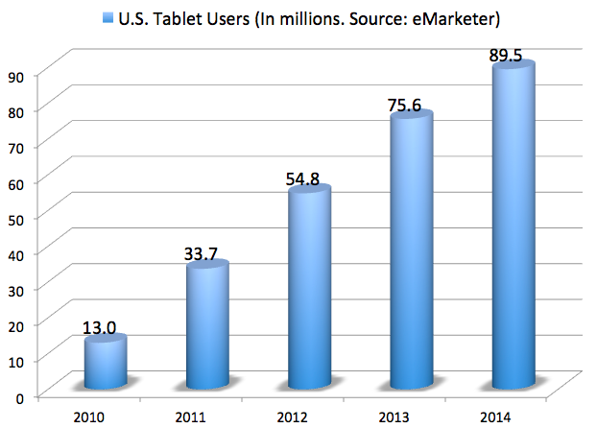


Population of Mobile Device, Wireless Network, and Cloud Platform
Mobile devices are more and more popular
Smart phone, tablet, etc
1.75 billion smartphone users (2014)^{[1]}
Wireless network coverage
The number of access points and the bandwidth are increasing
Provide service to user through the network
[1] http://www.emarketer.com/Article/Smartphone-Users-Worldwide-Will-Total-175-Billion-2014/1010536
Notes:
Recent year, mobile device is more and more popular. The mobile devices, such as smart phone and tablet can see in everywhere and becomes an important part of our life. We can run applications as we do on desktop but it is portable, you can bring them anywhere with you.

Slide 4

What Is Crowdsensing ?
Smartphones are now equipped with multiple sensors
GPS, accelerometer, microphone, gyroscope, etc.
The crowds provide useful information for each others
Events are detected through processing the sensory data
Ask questions
Answer questions or provide sensor data

Slide 5
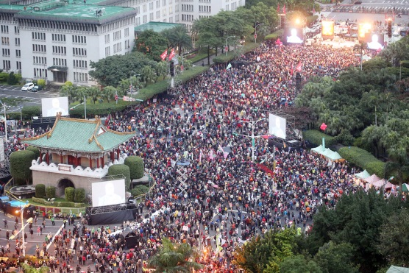
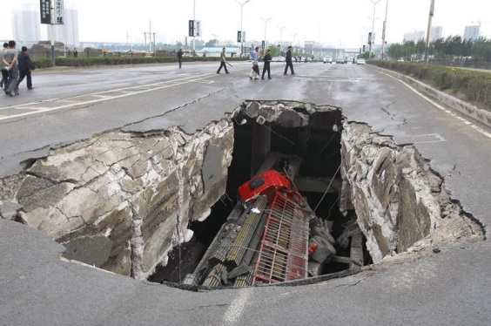
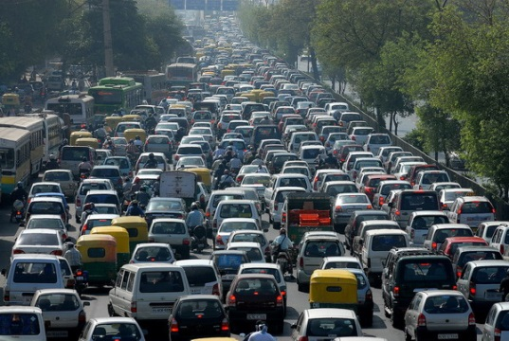
Why Is Crowdsensing Interesting?
It has many applications
It has many advantages
Users can ask questions which are hard for algorithms to answer
Improving the coverage of traditional sensor networks
Lowering the deployment and maintenance cost for companies

Slide 6
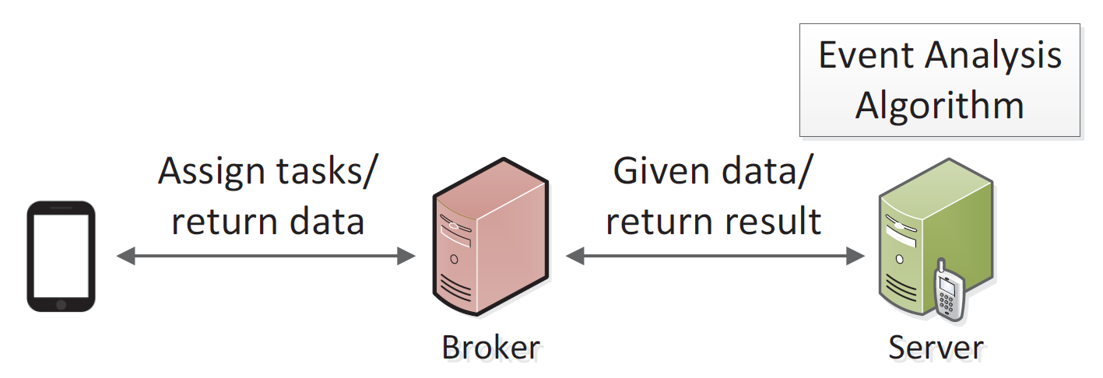
What Is The Most Efficient Execution Flow?
Most of the crowdsensing systems analyze the sensory data on broker/server
It is not efficient
The computation capability and network bandwidth of servers and mobiles are different
Offloading is a good solution
Network Type | Wifi | 3G | Local
Current (mA) | 9.2619 | 285.3662 | 24.0448
Time (ms) | 224.99 | 3559.85 | 299.34

Slide 7
Mobile Cloud Offloading
Mobile devices has limited resources
CPU, memory, GPU, battery lifetime, etc.
Cannot run resource-intensive applications
Cloud service can be used to address on the issue
Cloud servers have large amount of resources
Can be accessed easily through network
Using powerful server to do the heavy computations
Mobile
Send Heavy Tasks To Cloud
Cloud
Light Computations
Heavy Computations
Get Results From Cloud
Notes:
So, we know that mobile device has limited computation resources. Such as the cpu capability, memory space, battery lifetime and so on. The limited resources make the mobile device may surfer from the user response delay or impossible for running some computation-intensive tasks. The battery lifetime is also a big problem for users.
relative to the mobile device, the cloud server has abundant computation resources and can easily accessed through network. As you can imagine, the cloud servers let us have a chance to improve the application performance and longer the battery lifetime.
Such a technique is called Offloading, that is, we offload (or you can say migrate) the tasks on mobile device to a more powerful cloud server. Using the cloud server’s computation resources to do the computation for the mobile device.

Slide 8
Contributions
We propose an offloading decision algorithm [MCC’13]
We develop an APK analysis tool to analyze and modify APK files
We offload existing third-party applications to show offloading is feasible in existing applications
We integrate offloading into a crowdsensing prototype system to show the performance gain from offloading [PIMRC’14]

Slide 9
Outline
Introduction
Efficient Crowdsensing System With Offloading
Offloading Applications To Cloud
Contributions
Offloading Applications To Cloud
Architecture
Problem Statement
Algorithm
Experiments
Offloading Event Analysis Algorithms: Using IsCrowded And IsNoisy As Case Studies
Implementation
Case Studies
Evaluations
Conclusion And Future Work

Slide 10
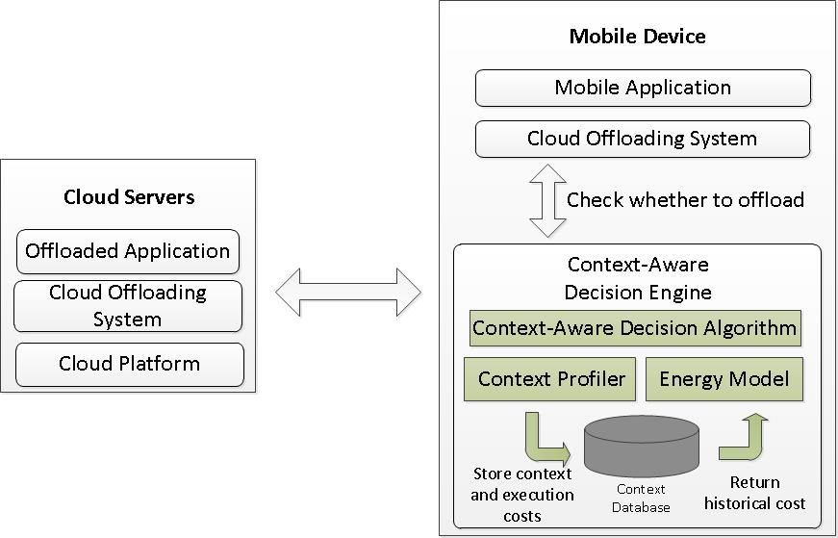
Architecture
Notes:
Describe what is decision engine

Slide 11
System Execution Flow
Application
Method A
Cloud
Decision
Method B
Yes
No
Method B
Store the cloud execution cost
Store the local execution cost
Database

Slide 12
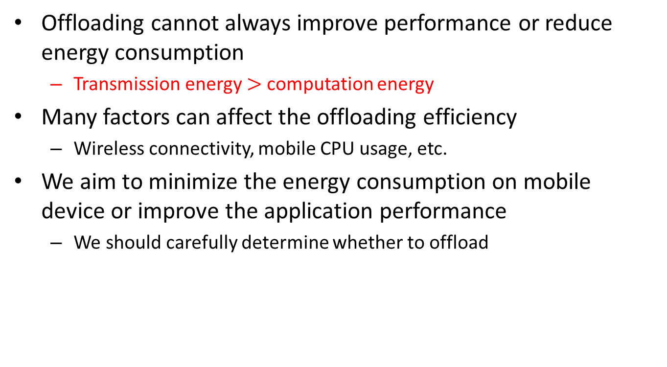
Why We Need A Decision Engine?
Offloading cannot always improve performance or reduce energy consumption
Transmission energy $>$ computation energy
Many factors can affect the offloading efficiency
Wireless connectivity, mobile CPU usage, etc.
We aim to minimize the energy consumption on mobile device or improve the application performance
We should carefully determine whether to offload
Notes:
Though offloading can save energy or reduce the execution time, it is not always true. Why it don’t work under some circumstances? It is because if we want to use the cloud server to do the computation, we need to transmit the code, input data, and program state. It intuitive that if the transmission energy is larger than the computation energy, offloading cannot save energy and even consume more energy on transferring the computation.
There are many factors that can affect the offloading efficiency, such as wireless connectivity, cpu usage and so on.
In order to determine whether to offload, we propose the context-aware decision algorithm to help the system making the right decision. As aforementioned, if system makes a wrong decision, then user cannot save energy and consume more energy.

Slide 13
Offload? Not Offload?
The decision algorithm should not introduce heavy overhead
We proposed the context-aware decision algorithm to determine whether to offload the computation
Context is the information of user and mobile device
CPU usage, network connectivity, etc.
Considered context
Signal strength
Throughput
Time-of-day
Location

Slide 14
Why We Use These Four Contexts?
To predict whether offloading has positive or negative impact
To estimate the energy consumption of tasks
Execution energy and transmission energy
Throughput and signal strength can be used to model transmission energy
Many factors affect the offloading efficiency
Data size, transmission time, computation complexity, etc.
Time-of-day and location may imply the user behaviors and other factors
Image 1
Throughput
Image Processing
The execution time can be very different
Energy Model
Signal Strength
Image 2
Notes:
diagram

Slide 15

Existing Energy Model
Based on PowerTutor^{[2]}
The model assumes a constant power level and may lead to inaccurate estimations
We need a better model
[2] L. Zhang et al. , “Accurate online power estimation and automatic battery behavior based power model generation for smartphones.” In Proc. of International Conference on Hardware/Software Codesign and System Synthesis, 2010.
Notes:
Why we need energy model

Slide 16
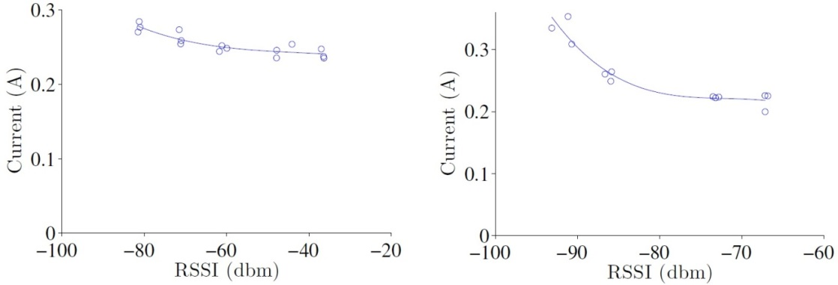
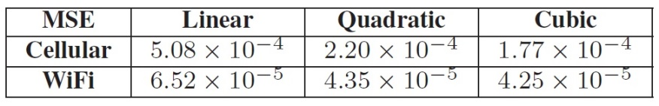
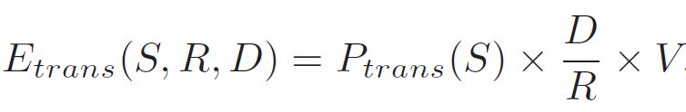
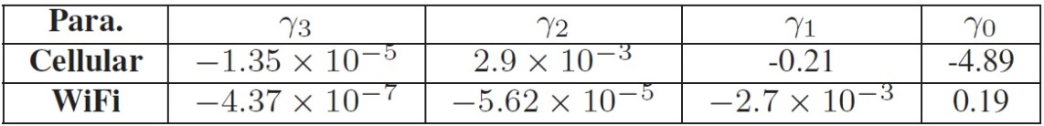
Proposed Context-Aware Energy Model
We measure the mobile device’s current flow with Agilent 66321D power meter
Replace communication energy model with our model
Notes:
What mobile device we use? We use XE sensation to measure it
The methodology can be applied to any mobile device

Slide 17
If We Only Have APK Files
APK file is an install file used in Android system
It is not easy to get source code of most of the applications
We develop a tool to help us modifying the third-party applications to offload version
Analyze and modify the APK files

Slide 18
APK Analysis Tool Work Flow
We use apktool to decompile/compile the Smali code
Smali is the register language used in Dalvik VM
Find methods that can be offloaded
Decompile the APK file
Smali files
Find candidate methods
Modify the target method
Sign the APK file
Compile the modified Smali to APK
Modified APK

Slide 19
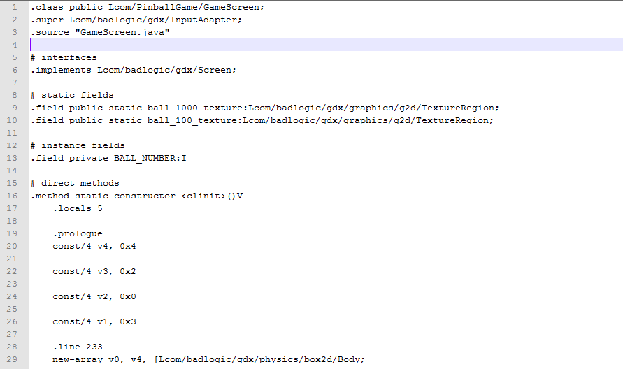
Smali Code Example

Slide 20
Context-Aware Decision Algorithm
Q(T, L) : query database with time T and location L for previous execution cost
Cost can be execution time or energy consumption
If cloud/ local has no record
If cloud/ local still has no record
Q(T, L) for cloud and local
Q(null, L) for local/ cloud
Try to execute on cloud/ local
Do not have record
Compare the cost of cloud and local
Try to execute on cloud
Execute on cloud/local

Slide 21
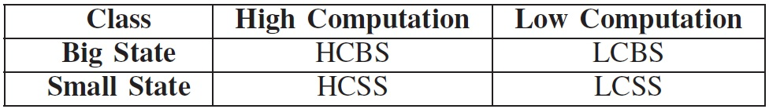
Experiment Setup
HTC one X (client) and android X86 (server)
We recruit 5 users to use the client in a week
HCBS: image transfer and face detection
LCBS: image transfer and color-space conversion
HCSS: nested for-loops
LCSS: simple for-loop
Prediction accuracy, performance gain, overhead

Slide 22
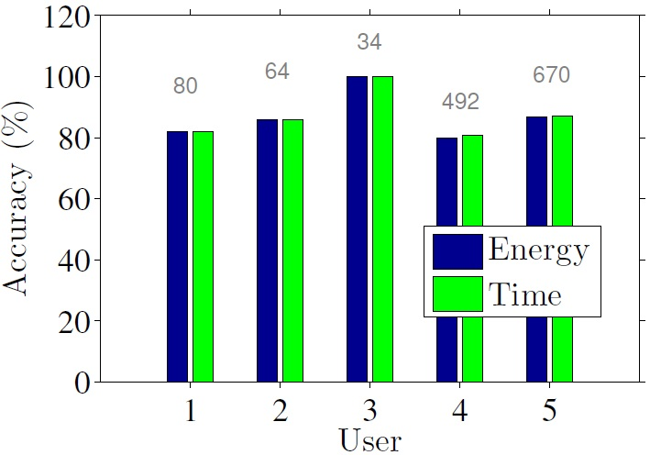
Decision Accuracy
Take out the first two rounds which are considered as training rounds
At least 80% across all users
At least 80%

Slide 23
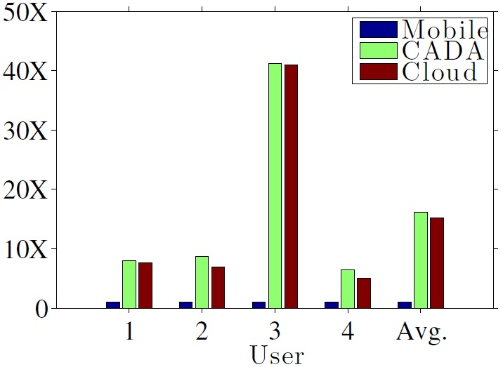

Performance Gain
Most of the executions benefit from cloud executions, and our CADA algorithm successfully identifies the few executions which cannot benefit from cloud
At least 7X
Time improvement
Energy improvement
Notes:
At least 7 times imporvement

Slide 24
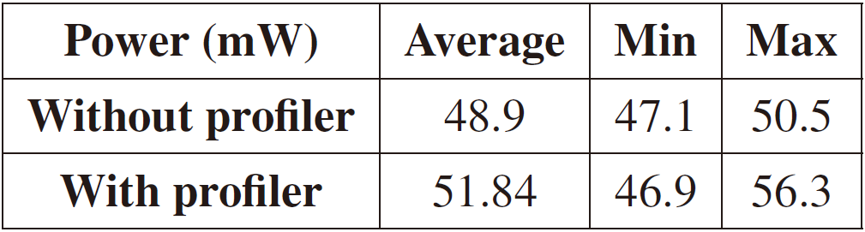
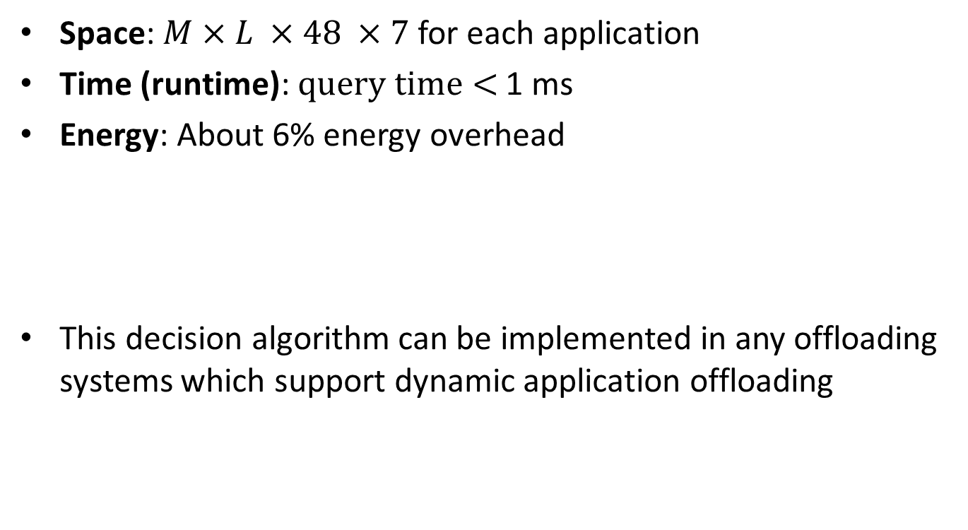
Overhead
Space: $M×L ×48 ×7$for each application
Time (runtime):$query time<$ 1 ms
Energy: About 6% energy overhead
This decision algorithm can be implemented in any offloading systems which support dynamic application offloading

Slide 25
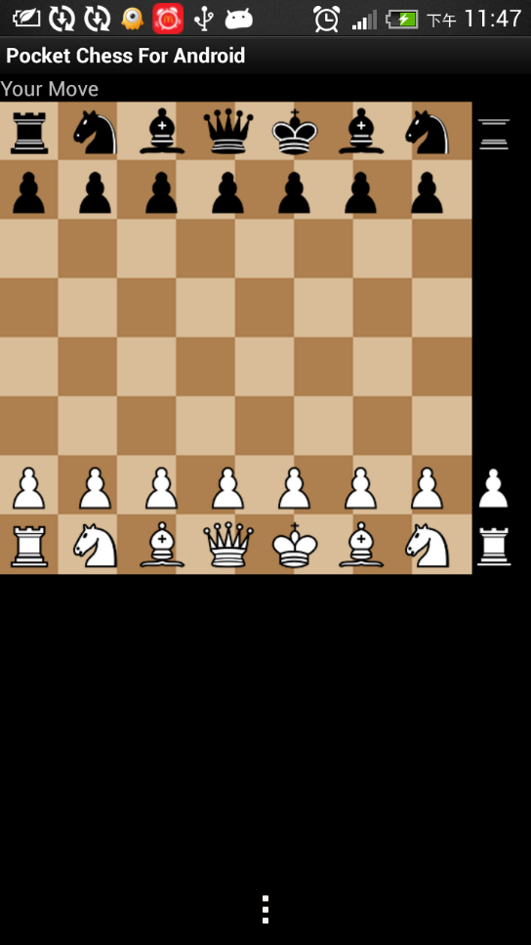
Results of Offloading Third-party Applications
We download four applications from Internet
Packet Chess
Offload: 1742.5 ms
Local: 2641.5 ms

Slide 26
Outline
Introduction
Efficient Crowdsensing System With Offloading
Offloading Applications To Cloud
Contributions
Offloading Applications To Cloud
Architecture
Problem Statement
Algorithm
Experiments
Offloading Event Analysis Algorithms: Using IsCrowded And IsNoisy As Case Studies
Implementation
Case Studies
Evaluations
Conclusion And Future Work

Slide 27
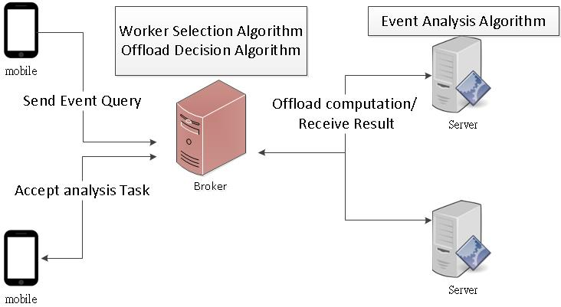
System Overview

Slide 28
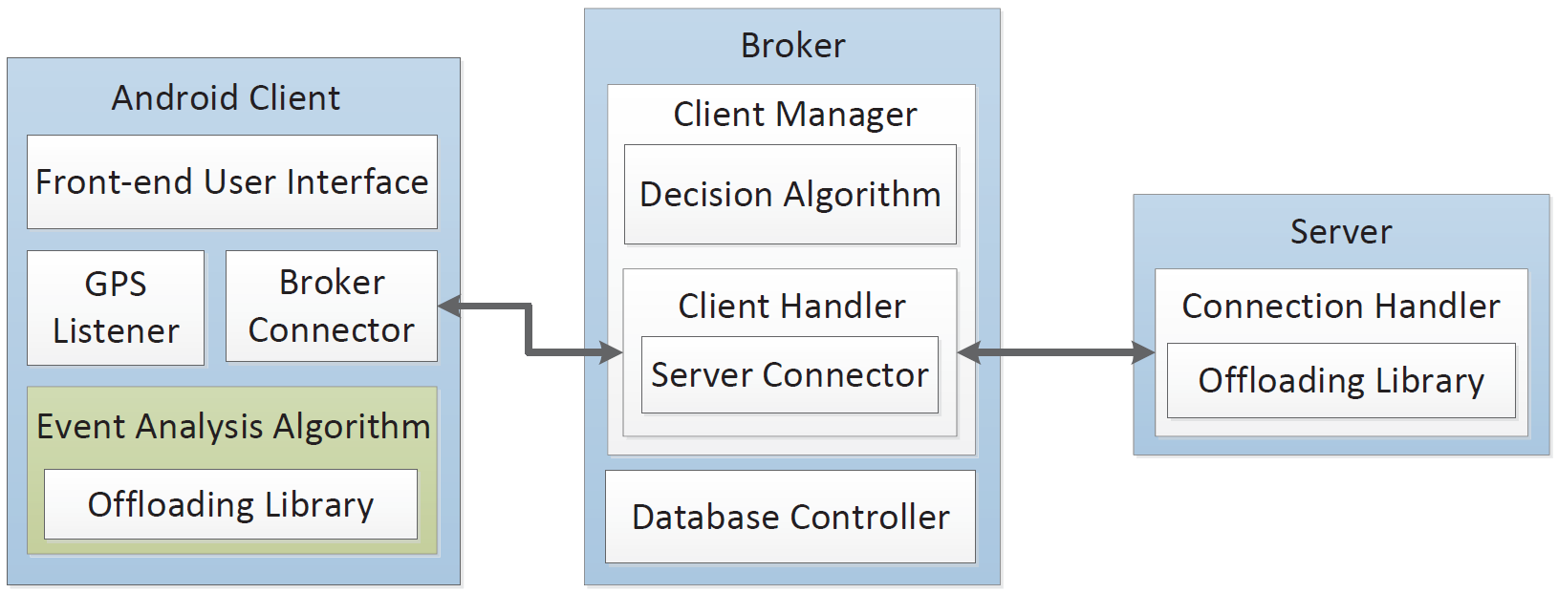
Prototype Architecture

Slide 29
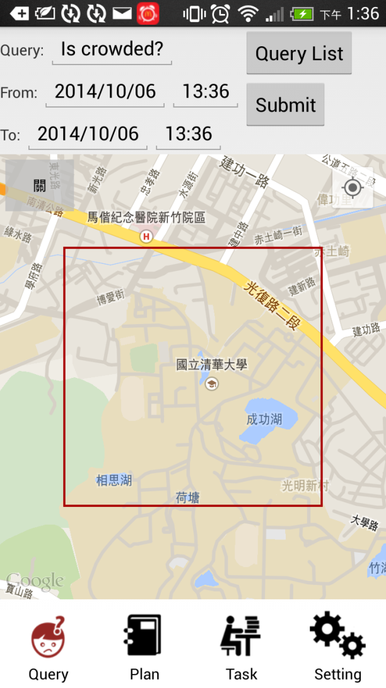
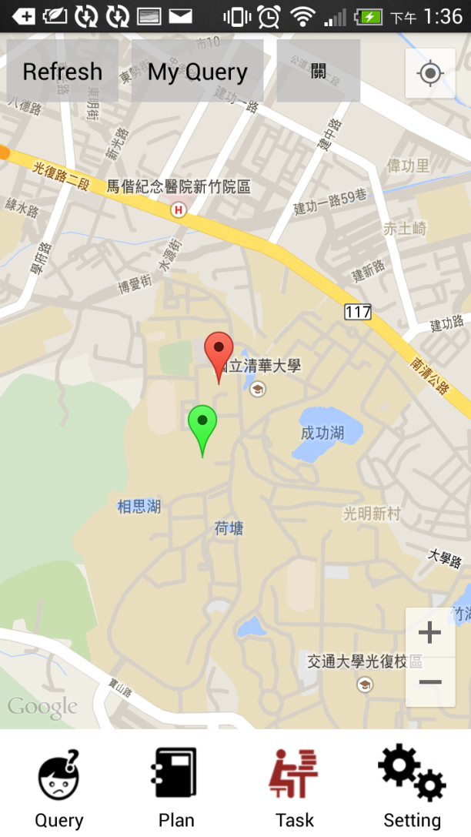
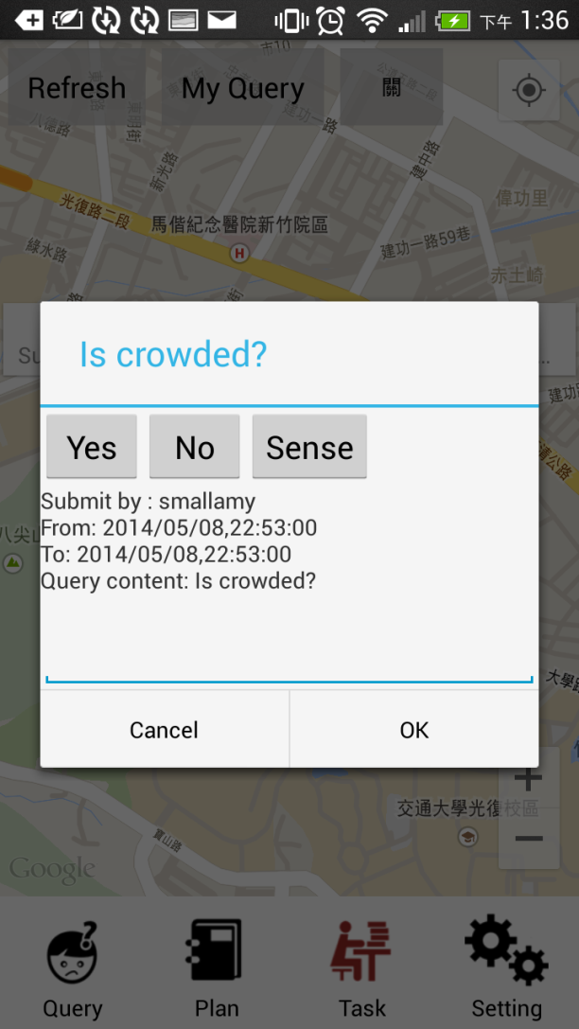
Screenshots

Slide 30
Event Analysis Algorithms
IsCrowded
Human detection
HOG + SVM
Histogram of Oriented Gradients
SVM is trained by OpenCV
We use OpenCV to do the image processing
IsNoisy
Record the noise by microphone
Compute the mean db

Slide 31
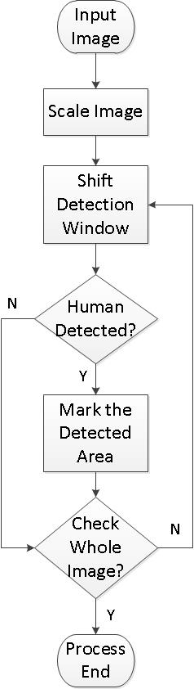
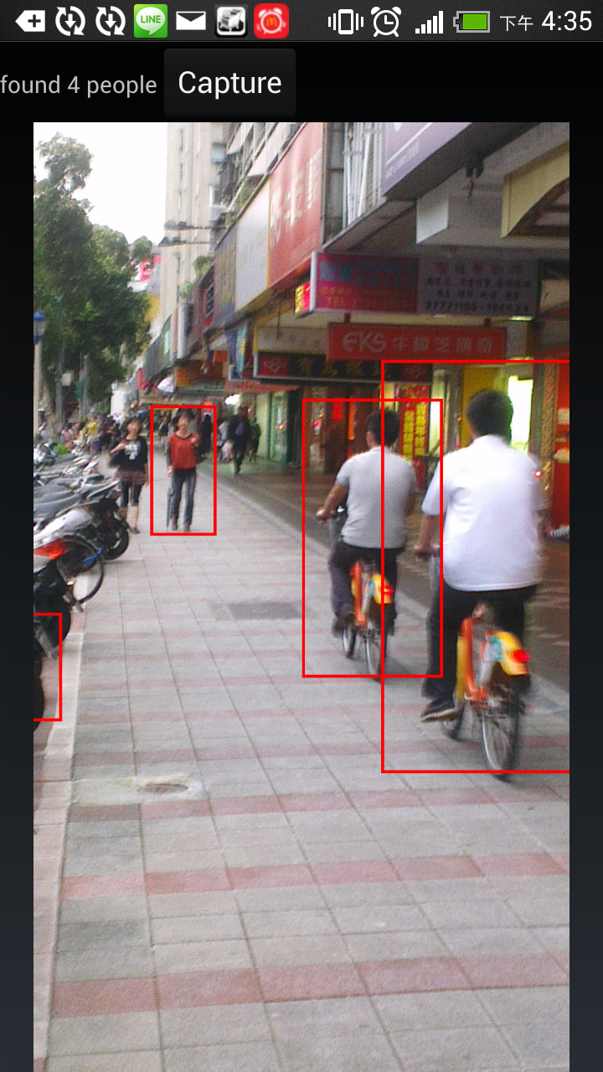
HOG Workflow And Example

Slide 32
Setup
Broker and server
VMs on Desktop PC
OS: Android-x86
Client
HTC smartphone
Database
MySQL database
We put a PC with dummynet between the broker and client
Network delay = [0, 50, 100, 200, 400] ms
Packet loss rate = [0, 2, 4, 8, 10] %
Bandwidth = [256, 512, 1024, 2048, 4096] kbit/s
We run each setting 5 times

Slide 33
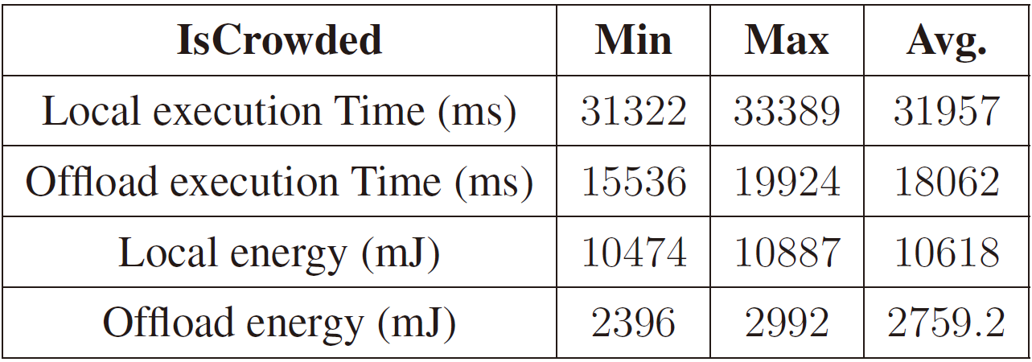
IsCrowded (Ideal Case)
Offloading use only 56.5% processing time and 25.9% energy consumption

Slide 34
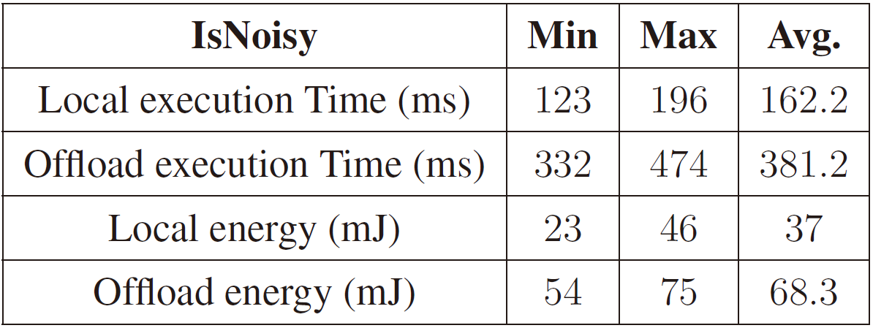
IsNoisy (Ideal Case)
Offloading uses 235% processing time and 184% energy consumption

Slide 35
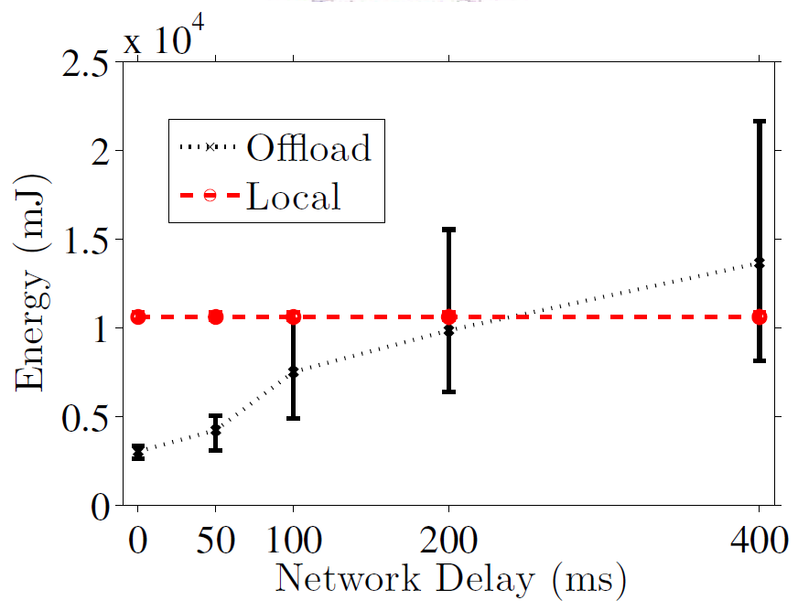
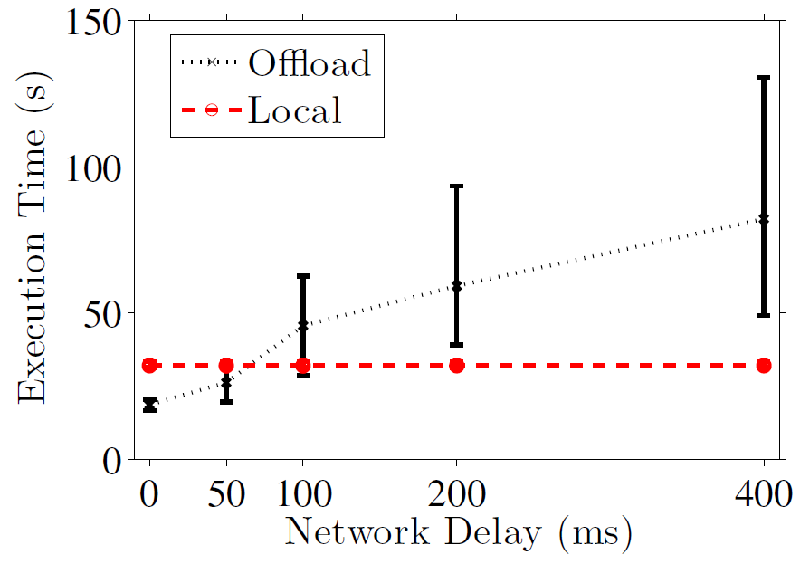

Varying Network Delay
Performance gain
Time: when delay $≤$ 50 ms
Energy: when delay $≤$ 200 ms

Slide 36
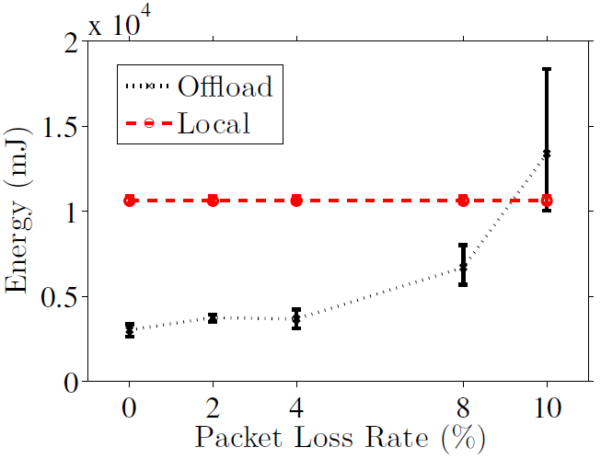
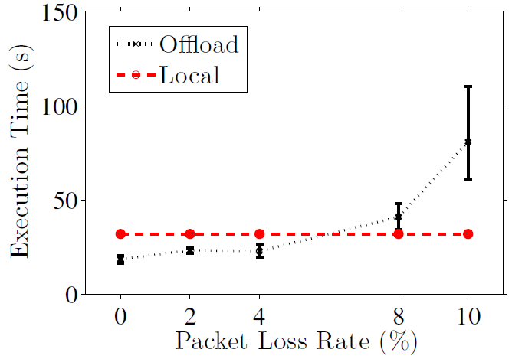

Varying Packet Loss Rate
Performance gain
Time: when loss rate $≤$ 4%
Energy: when loss rate $≤$ 8%

Slide 37
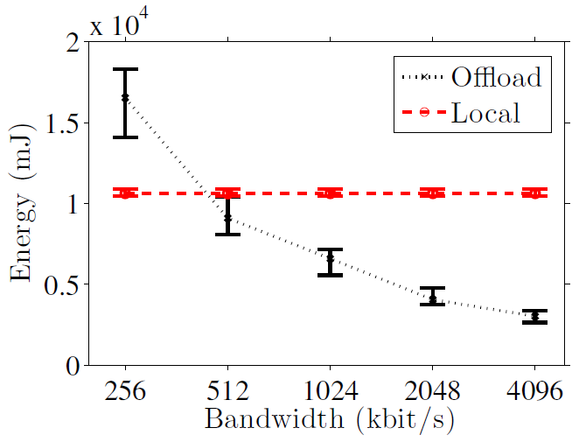
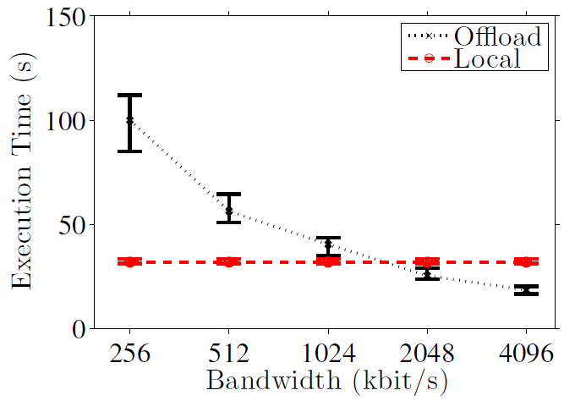

Varying Bandwidth
Performance gain
Time: when bandwidth $≥$ 2048 kbit/s
Energy: when bandwidth $≥$ 512 kbit/s

Slide 38
Summary of The Results
The network condition significantly affects the offloading benefit
Network delay: energy and time (< 50 ms), energy (< 200 ms)
Packet loss rate: energy and time (< 4 %), energy (< 8 %)
Bandwidth: energy and time (> 2048 kbit/s), energy (> 512 kbit/s)
Offloading decision is necessary

Slide 39
Outline
Introduction
Efficient Crowdsensing System With Offloading
Offloading Applications To Cloud
Contributions
Offloading Applications To Cloud
Architecture
Problem Statement
Algorithm
Experiments
Offloading Event Analysis Algorithms: Using IsCrowded And IsNoisy As Case Studies
Implementation
Case Studies
Evaluations
Conclusion And Future Work

Slide 40
Conclusion
We strive to minimize the energy consumption and execution time of crowdsensing systems using offloading system
We propose a novel algorithm to determine whether to offload the computation
The accuracy is at least 80%
We develop an APK analysis tool to help us analyze and modify the APK files
We offload third-party applications and show that offloading is feasible in existing applications
We implement a crowdsensing prototype system and show that offloading improves the system performance

Slide 41
Future Work
Find out other contexts that can have high accuracy for most of the mobile device users and applications
Try to offload methods that contain local resource, for example, camera and GPS.

Slide 42
Thank You For Your Listening

