Slide 1

Optimizing Mobile Middleware for Coordinated Sensor Activations
Ting-Fang Hou
Notes:
Hi, 大家好我是侯XX, 我的題目是Optimizing ...
提供一個優化的middleware提供整合性Sensor 的使用方法

Slide 2
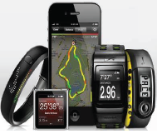
Motivation
Increasingly more context-aware applications (apps) leverage the rich set of sensors on the smartphones.
These applications directly control sensors which lead to redundant activations and energy waste

Slide 3






Introduction
We can find some examples in our lives:
  Case1: Different apps may require same contexts
  Case2: Use different sensors to sense same contexts
How to select the most efficient sensing strategy ?
  Satisfy all apps’ requirements
  Minimize energy consumption
OSM Middleware
Notes:
As we know there are more and more context-aware applications come out, like NIKE+ and Google Now, they use the sensor on smartphone to record user’s motion activity or location. But we can observe that these apps may active sensors uncoordinatately , It may cost resundent energy sonsumption . Different the previous work, Like the figure blow, there two apps want to know user’s location , they don’t need to know which sensors be actived and they also can receive the location message!
So the main problem in our work is how to select efficeient sensing strategy to satisfy
So we propose the OSM
現在有越來越多的 context-aware apps , 像是 NIKE+、GoogleNow ，他們運用手機上許多的Sensor 來記錄 使用者的 Motion, Activity or Location.
這麼多的context –aware apps 可能會不定時的開啟多種sensor用來推測重複的context,
像是下面這兩個APP 同時向 Middleware要求 location 的資訊 ， Middleware 可以依需求 選出適合的Sensor 提供資訊!
所以我們主要討論的問題是要如何選出最有效率的sensor組合
“滿足所有APP的需求”並且”減少energy 的消耗”
換頁: 為了達成這個目的，因此我們提出了

Slide 4
Contributions
We achieve coordinated and optimized usages of sensors
For a single smartphone[middleware14 under review]:
  Consider the tradeoff between energy and accuracy
  Present the middleware with scheduling algorithms
  Propose four optimal/efficient algorithms
  Rigorously solve the scheduling problem with sensory data caches
For multiple smartphones[PIMRC14 under review]:
  Design, implement, and evaluate a crowdsensing system
  Consider the tradeoff between carbon footprint (cost of traveling and sensing) and complete ratio of tasks
  Propose two optimal/efficient algorithms
Notes:
我們將這個機制分別應用在兩個部分
第一個應用在單一手機上
Coordinated and optimized usage of sensors on single device
Selectively activate energy-efficient sensors by using a centralize sensor scheduling
According to the frequency of apps’, we extensively consider the caching problem on single device
Dynamically fix the sampling rates of sensors to reduce the energy consumption
For the extensive application:
Cooperate sensors from multiple devices - Crowdsensing
Select the workers and schedule the sensors

Slide 5
Previous work
Chun-Lin Lin’s work [1]
  Solved a similar but simpler problem
  Proposed two heuristic algorithms
  Implemented the algorithms on smartphones
Improvement
  Mathematically formulate two scheduling problems
  Improve and extend his algorithms
  Leverage the relationship between the frequency of requests and sensor sampling rates
  Develop a simulator to do larger experiments
  Apply the sensor scheduling algorithms to multiple smartphones
[1] C.-L. Lin. An Energy/Accuracy-Optimized Framework for Context Sensing on
Smartphones. Master’s thesis, National Tsing Hua University, Taiwan, 2013

Slide 6
System Overview
We proposed an Optimal Sensor Management (OSM) middleware
The OSM middleware sits between apps and the hardware
OSM middleware :
  Provides API to connect apps
  Maintains a database of active requests
  Determines which sensors should be activated
Notes:
我們提出了OSM middleware,
“提供API讓APP可輕鬆的和middleware溝通
“記錄所有APP的需求”
並且“決定如何開啟sensor”
換頁 : 接著是我們middleware 的整體架構

Slide 7
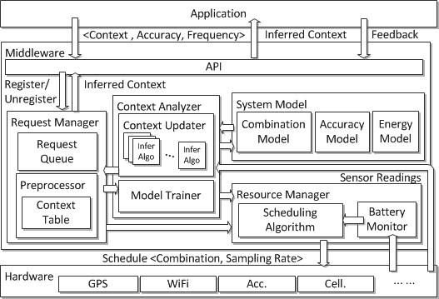
System Architecture
Joint with C. Lin
API:
Register()/Unregister()
Feedback()
Request Manager
Manages a Request Queue
Preprocess the requests
Context Analyzer
Context Updater
Model Trainer
Sensory Data
Infer Algo
Context
System Model
Combination/Accuracy/Energy
Resource Manager
Battery Monitor
Scheduling Algorithm
Notes:
API : 讓APP可以簡單的註冊 和取消註冊並且利用feebackfunction回報問題
Request Manager
他會儲存現有application 的要求
並對要求做第一步的處理以降低問題的複雜度\
Inference Algo
接著是context Analyzer
他會利用context updater 儲存許多的inference algo
為了使用我的的系統我們提出了一些system model

Slide 8
System Model
Combination model
  The sensor combination of each inference algorithm
Accuracy model
  The precision (accuracy) of each inference algorithm
Energy model
  The energy consumption of each sensor
Example:
  IsMeeting { <Acc. Mic. Wifi.> < 80% > <265mW> }
Notes:
Precision 測出來成立的情況下 有幾次是和ground truth 相同
Recall 在所有ground truth 成立的情況下 我測出來幾次
Precision is defined as the ratio between the number of correctly inferred contexts and the total number of contexts reported by the inference algorithms.
Recall is defined as the ratio between the number of correctly inferred contexts and the actual number of the contexts according to the ground truth.
******We can take this example
“IsMeeting” is a context analyzer to check whether user is meeting or not
this context analyzer use Acc, wifi and Mic and this analyzer cost 265mW and provide 80% accuracy to predict the answer

Slide 9
System Architecture
Joint with C. Lin
API:
Register()/Unregister()
Feedback()
Request Manager
Manages a Request Queue
Preprocess the requests
Context Analyzer
Context Updater
Model Trainer
Sensory Data
Infer Algo
Context
System Model
Combination/Accuracy/Energy
Resource Manager
Battery Monitor
Scheduling Algorithm
*Coordinated and efficient sensor usage !
*Avoid redundant energy waste !
Notes:
API : 讓APP可以簡單的註冊 和取消註冊並且利用feebackfunction回報問題
Request Manager
他會儲存現有執行中的request
接著是context Analyzer
他會利用context updater 儲存許多的inference algo
為了使用我的的系統我們提出了一些system model

Slide 10

Scheduling Problem
Joint with C. Lin
Support two optimization criteria:
  Energy Minimization (EM):
  Minimize the energy consumption
  Satisfy all the apps’ requirements
  Accuracy Maximization (AM):
  Maximize the overall accuracy
  within an energy budget
Notes:
Before we talk about our formualtion
We first introduce some sensor model for you

Slide 11
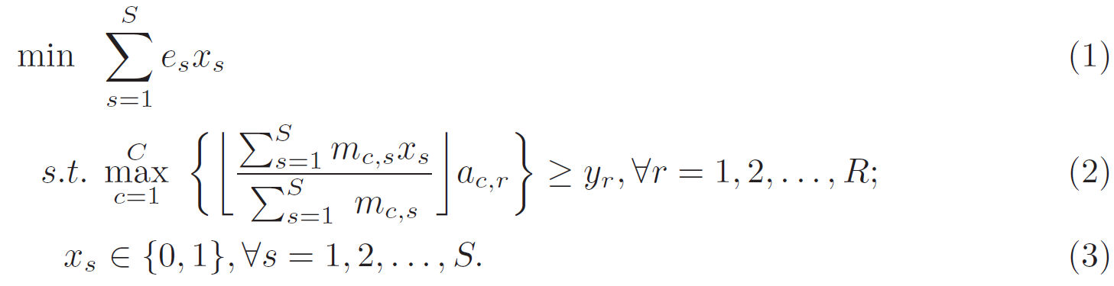
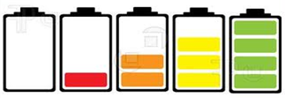

Problem Formulation
Decision variable: $x_{s}∈\{ 0, 1\}$
$x_{s}$ indicates whether the sensor $s$ should be activated
Energy Minimization :
Minimize energy
Satisfy all requirements
Notes:
Decision variable : x_s

Slide 12
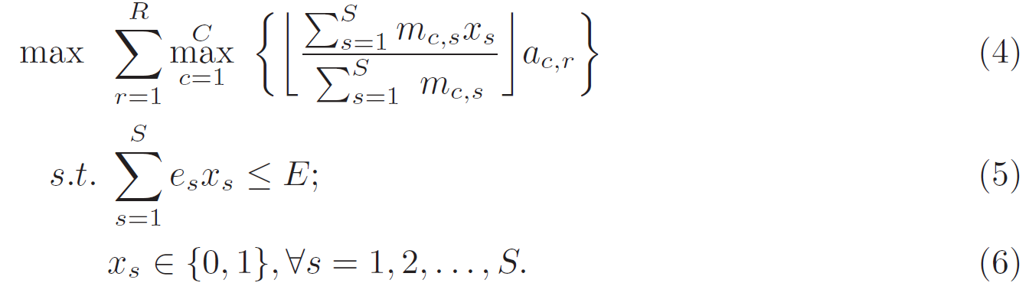


Problem Formulation
Decision variable: $x_{s}∈\{ 0, 1\}$
$x_{s}$ indicates whether the sensor s should be activated
Accuracy Maximization :
Maximize accuracy
Energy budget

Slide 13
Proposed Scheduling Algorithms
Optimal algorithms :
  The formulations are “Integer Programming Problem”
  We use commercial optimization CPLEX solver which is developed by IBM
  Energy Minimization Algorithm (EMA)
  Accuracy Maximization Algorithm (AMA)
* Good performance * Small scale case
Efficient algorithms :
Efficient Energy Minimization Algorithm (EEMA)
Efficient Accuracy Maximization Algorithm (EAMA)
* Less running time * Designed for smartphones

Slide 14
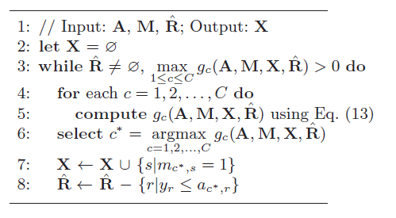

Efficient Energy Minimization
Algorithm (EEMA)
Joint with C. Lin
EEMA is inspired by the Set Cover Problem
Define the utility function $g_{c}^{}$ :
=> The combination c has higher $g_{c}^{}$ means it satisfies more requests and less costs
Calculate and Update the g_{c}
Choose the most efficiency combination
Notes:
g_c考慮到

Slide 15
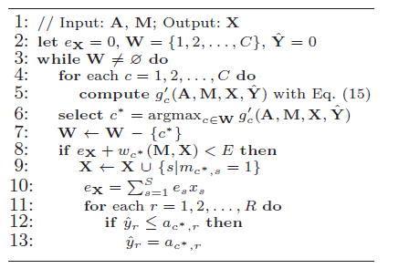


Efficient Accuracy Maximization Algorithm (EAMA)
Joint with C. Lin
EAMA is inspired by the 0/1 knapsack Problem
Redefine the utility function : $g_{c}^{′}$
=> The combination c has higher${ g}_{c}^{′}$ means it provides the higher accuracy and less costs
Calculate and Update the $g_{c}^{′}$
Choose the most efficiency combination
Check the energy budget

Slide 16


Heterogeneous Frequencies/Sampling Rates
Extend the EEMA and the EAMA with heterogeneous frequencies/sampling rates as EEMA* and EAMA*
$h_{r}$ : the accuracy degradation rate of the context r
Ex: The context r requires 70 % accuracy in every minute
, and the accuracy which decreases 10% per minute
The scheduling algorithm provides 80% accuracy
80%
*Efficiently cache the
sensory data !
*Reduce energy
consumption !
70%
70%
60%
0 1 2 3 4 5
Time (m)
Notes:
We thought the inferred accuracy will degrate over time, so we let hr as
then we use an example to explain our thought
There is
In original work we should active sensor in every minute
but in our work we consider the degration rate , so we can see the accuracy in second time is lower than required accuracy , so we only active sensor in every two minute
we also implement this solution in simulation and get some results
hr : 每分鐘的下獎速率
Ac,r : schedule後提供的accuacy
Yr: context r 要求的accuracy
Fr: 要求context 的頻率
Context r 要求 每分鐘要一筆70%的資料且 下降速率為每分鐘10%
假設每五分鐘shceduling algo 提供80% 的Accuracy 給context r
我們可以發現 在第二分鐘時 accuracy 低於 70% ，這時我們就需要 snesor 重新sample一次以確保 可以滿足context 的需求
我們也將這個解法考慮到 simulation

Slide 17
Simulation
Developed an event-driven simulator in Java
Baseline algorithm :
  Selects sensors with the highest accuracy for each context
Compare scheduling algorithms :
  Optimal : EMA / AMA
  Efficient : EEMA / EAMA
  With frequencies/sampling rates : EEMA* / EAMA*
  Baseline

Slide 18
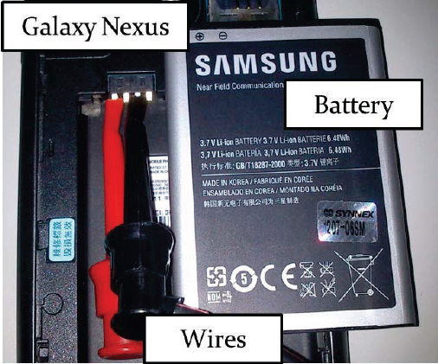
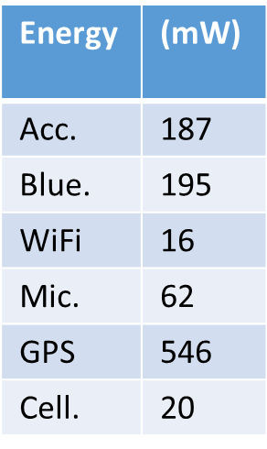
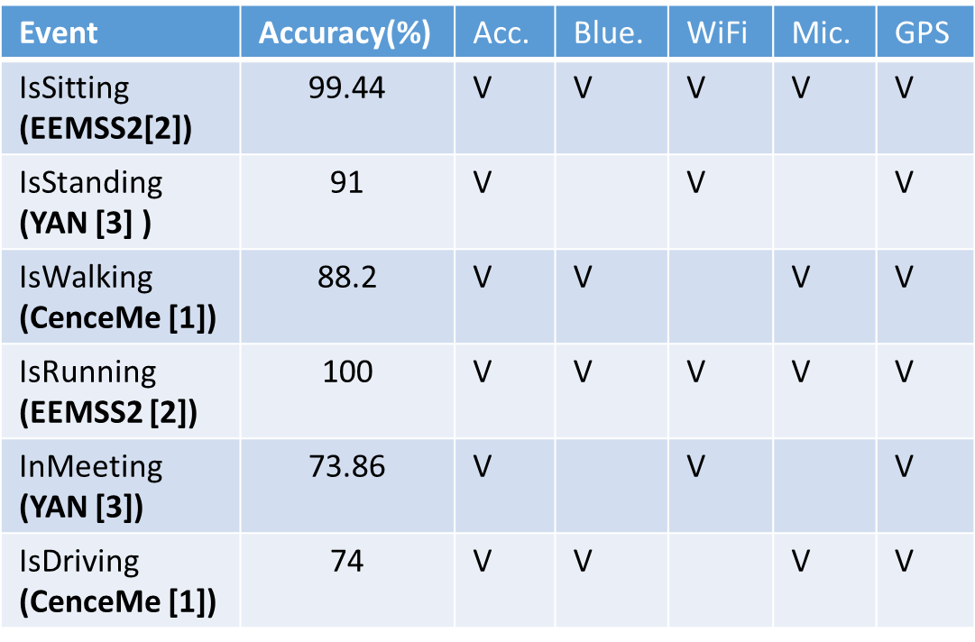
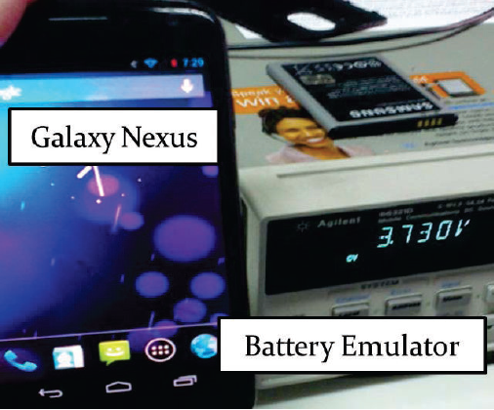
Data Collection
1. Collect active apps in the Android activity stack
from 5 users in three weeks
2. Collect inference algorithms (from existing papers)
3. Create the energy model
*Use Agilent 66321D
battery emulator on a
Galaxy Nexus phone
[1] Sensing meets mobile social networks:the design, implementation and evaluation of the CenceMe application.
[2] A framework of energy efficient mobile sensing for automatic user state recognition
[3] Energyefficient continuous activity recognition on mobile phones: An activity adaptive approach
Notes:
我們收集五個 user 在三個禮拜裡 app的使用情況
並從現有的paper 中找到可能的combination 以及對應的accuracy
以及在手機上測量不同的sensor 的耗電量
接著針對不同的problem 我們也考慮不同的參數
讓每次schedule 間隔五分鐘
set a = 25 50 75 90 表示 context 可能的accuracy 會在 ~100之間
Set Energy budget in 表示每次Schedule energy 的限制
同時我們也考慮到，在未來可能會有更多不同的context 應用在手機上 ，所以也考慮不同數量的context 對 algo 的影響
接這是實驗結果

Slide 19


Parameter
Set a fixed scheduling time T = 5min
Set E as the Energy budget in a scheduling time
  E= {45, 52.5, 60, 67.5, 75}J
Notes:
讓每次schedule 間隔五分鐘
set a = 25 50 75 90 表示 context 可能的accuracy 會在 ~100之間
Set Energy budget in 表示每次Schedule energy 的限制
同時我們也考慮到，在未來可能會有更多不同的context 應用在手機上 ，所以也考慮不同數量的context 對 algo 的影響
接這是實驗結果

Slide 20
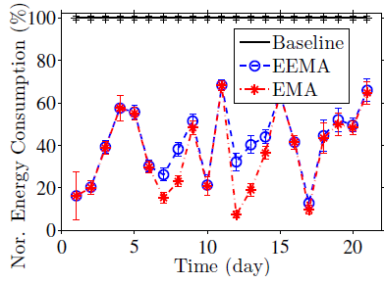
Energy Saving in EM
The average energy consumption with 5 users in 21 days
* Saves at least 30%
* EEMA achieves a small
gap with EMA
* EMA terminates in 50ms and EEMA terminates in 1ms
Notes:
在Em problem中節省電量的表現
8 combination 6 context 6 sensors

Slide 21
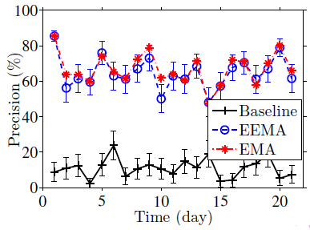
Improvement of Accuracy in EM
The precision with 5 users in 21 days
* EEMA achieves at least
30% higher accuracy
* EEMA achieves a small
gap with EMA
Notes:
提升至少30%並和optimal algorithm 的解很相近

Slide 22
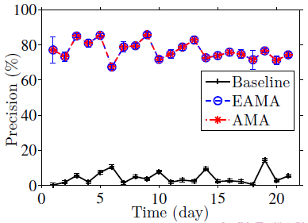
Accuracy Improvement in AM
The average accuracy with 5 users in 21 days
E= 52.5J
* Accuracy is 72.38% higher than the baseline
* EAMA achieves a
~0.1% gap with AMA
* AMA terminates in 5000ms and EAMA terminates in 1ms

Slide 23
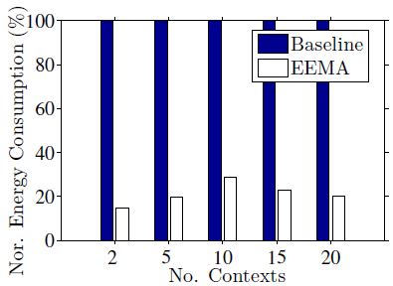
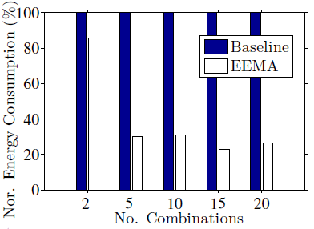
Energy Saving with Variant No. Contexts/Combinations in EM
Comparison of the average energy saving between EEMA and the baseline
E = 60 J
* EEMA saves at least 71.03% in energy
* EEMA saves more energy when combinations increase
Notes:
在不同數量的 context和combination 下省點的表現
在變動context的部分 我們可以發現EEMA可以至少省下71.03%的電量

Slide 24
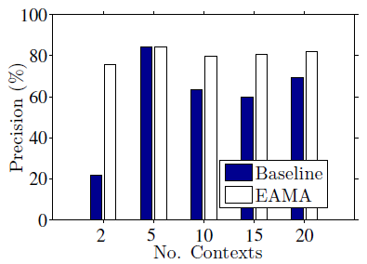
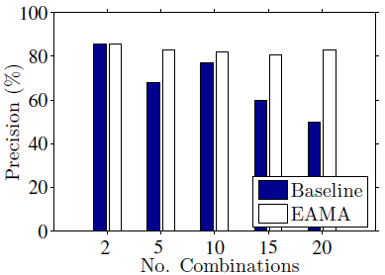
Accuracy Improvement with Variant No. Contexts/Combinations in AM
Comparison of the average energy saving between EAMA and the baseline
E = 60 J
* EAMA achieves at most 53.71% in the precision
* EAMA achieves less when the problem is small

Slide 25
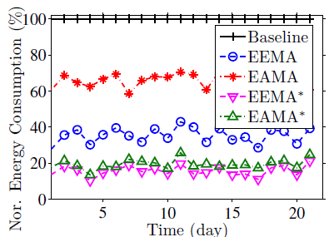
Energy Saving with Heterogeneous Frequencies/Sampling Rates
* EEMA saves 64.58%
EEMA* saves 84.66%
* EAMA saves 33.68%
EAMA* saves 80.48%
* Higher performance in EAMA*
=> high precision which is achieved by EAMA
Notes:
which grants more space for the EAMA∗ to reduce the
sampling rates to save more energy.
---------------------------------
In this figure we callthe EEMA with exteding solution as EEMA*
After we consider the frequency an d sampling rate , Our EEMA can save 64% energy
Then after we add extend solution, the EEMA* can save more energy about 87%
換業!!!!After all this result we also implement our algorithm in real smartphone
我們把 frequency 和 sampling rate考慮到 EEMA 的演算法當中
我們可以發現 EEMA可以節省 ６４％的電量
若是加上上一張討論的解法更是可以節省 ８７％的電量
最後我們也將我們的 ｍｉｄｄｌｅｗａｒｅ 時做到手機上測試效能

Slide 26
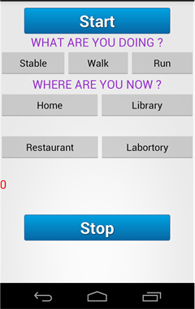
Implementation
Joint with C. Lin
Implement OSM with two efficient algorithms on the Android system
* EEMA :
Prolongs battery life two times
Achieves accuracy : 93.94%
* EAMA:
Prolongs battery life 1.5 times
Achieves accuracy : 94.85%
* Execution times :
EEMA and EAMA at most 306 ms and 503 ms
Notes:
在執行行時間方面包含整體middleware的運作 最多只需要 503ms
除此之外我們還可慮了在不同scheduling window size下的

Slide 27
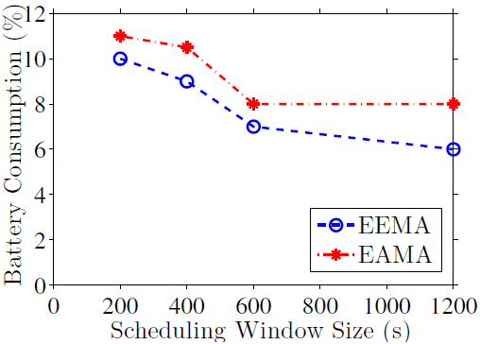
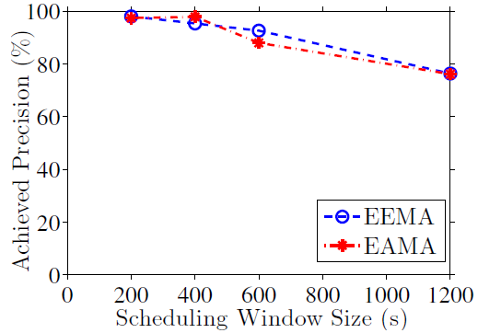
Benefit of Variant Scheduling Window Sizes
* When the size increases, EEMA and EAMA save more energy but expense of lower precision
* EEMA constantly saves more energy compared to EAMA
* EEMA and EAMA achieve very high precision

Slide 28
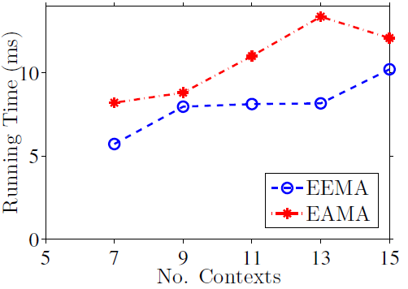
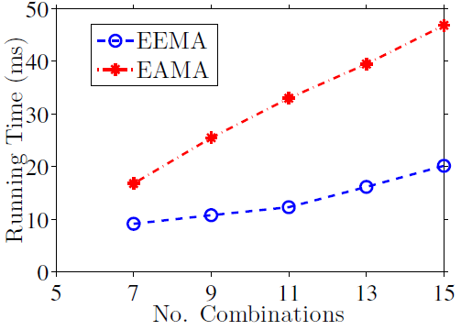
Benefit of Running Time with Variant No. Contexts/Combinations
* While the contexts and combinations increase
  The running time increases
  EEMA and EAMA algorithms are always efficient

Slide 29

Sensor Scheduling for Multiple Devices
Smartphones are widespread and equipped with rich sensors
Extend the sensor scheduling for multiple smartphones
Apply to the “Crowdsensing system”
  Utilize the strength of smartphone users
  Cooperate sensors on multiple smartphones
  and infrastructure sensors
Notes:
隨著手機普遍的被使用，我們將“sensor schedujling” 推廣到多支手機上 ，
並且將它應用到“crowdsensing ”系統中， crowdsensing 的系統中
會**集合smartphone users 的力量
並**整合使用多支手機上的sensor 和 infrastructure sensors 的資料
以達成工作需求
這邊有個小例子

Slide 30



Crowdsensing System
Scenario:
Task: Which one facility is the most popular in the amusement park?
Context : Is the facility Crowded ?
but it may be hard finished by a worker who is far away from the amusement park or whose smartphone is lack of energy
How to assign tasks in the most efficient strategy?
  Satisfy all tasks’ requirements
  Minimize the cost of carbon footprints
Notes:
當有個task 想知道在遊樂園裡哪個設施最受歡迎
**(雖然偵測人群的context1不難偵測，但對於在距離很遠或是手機電量不足時)

Slide 31
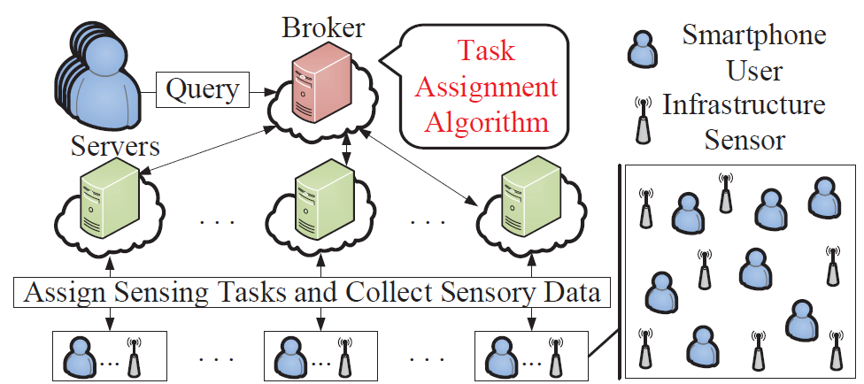
Crowdsensing System Overview
Workers
Notes:
User 對broker query 一個問題
再由broker執行algorithm
並分配公做給下一個level的server
由server和worker做溝通
其中我們的worker包刮smartphone user 和infrastructure sensor
他們的差別是 smartphone user 可以移動並有電量的限制
而infrastructure sensor 則是固定不動的 並有無限的電量

Slide 32
Task Assignment Problem
Task Assignment Problem has two parts:
(i) Worker selection problem
(ii) Sensor scheduling problem
Consider workers’ locations and abilities (ex. The battery level of smartphones)
  Schedule tasks to workers with working paths
  Achieve tasks’ requirement
  Minimize the cost of carbon footprints
  -> which consists of sensing and traveling costs
Notes:
在Task assignment problem 中 我們會考慮 worker的位子和能力
來分配工作和工作的路縣
並滿足工作和降低碳排放量

Slide 33
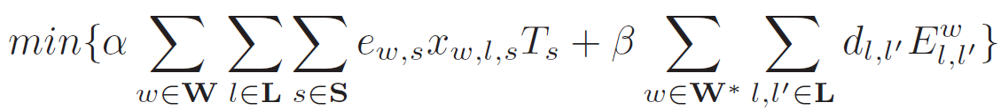






Problem Formulation (1/2)
Decision variables: $x_{w,l,s}∈Z, E_{i,j}^{w}∈\{ 0, 1\}$
$x_{w,l,s}$ indicates how many times that worker w turns on the sensor s at the
location l
$E_{i,j}^{w}$ indicates whether the worker w moves from the location i to the location j
Objective :
Task Constraints :
Sensing energy
Traveling cost
( distance )
Minimize the total carbon footprints
Ensure tasks are satisfied
Energy threshold
*Carbon footprint transform coefficients :$α, β$

Slide 34




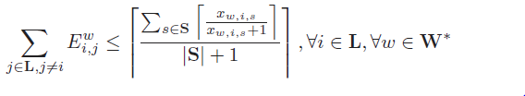
Problem Formulation (2/2)
Path Constraints:
  Start location:
  In-degree:
  Out-degree:
  Other locations:
  In-degree:
  Out-degree:
Visit locations which have sensing tasks
Notes:
在路現的限制方面
我們限制worker有起點出發 並以最短路進京郭需要工作的地點

Slide 35
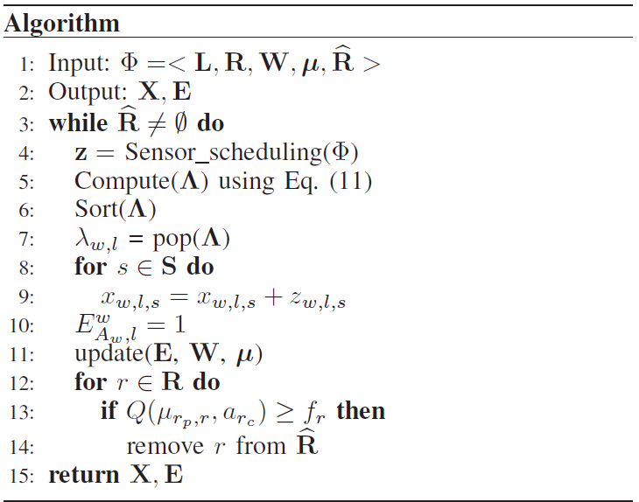


Efficient Task Assignment Algorithm (ETA)
ETA is inspired by the Set Cover Problem
Define the task ratio $λ_{w,l}$ :
=> The worker w has higher $λ_{w,l}$ at the location l means it satisfies more tasks and less costs
Calculate and update the $λ_{w,l}$
Choose the most efficient worker

Slide 36
Simulation
Develop an event-driven simulator in Java
  Baseline
    1. Infrastructure sensors only (IS)
    2. Opportunistic sensing (ISOS):
    Consider infrastructure’ and mobile’ sensors
    Workers move by the random waypoint
Optimal algorithm (OPT):
  Developed by the IBM CPLEX solver
Efficient Task Assignment Algorithm (ETA)
Notes:
接著我們用JAVA開發了一個simulator 用來模擬系統的運作
並提出兩個baseline algo和一個optimal algo 來做比較
第一個baseline 是Infrastructure sensor only 只使用 infrastructure sensor 的資料
第二個是

Slide 37
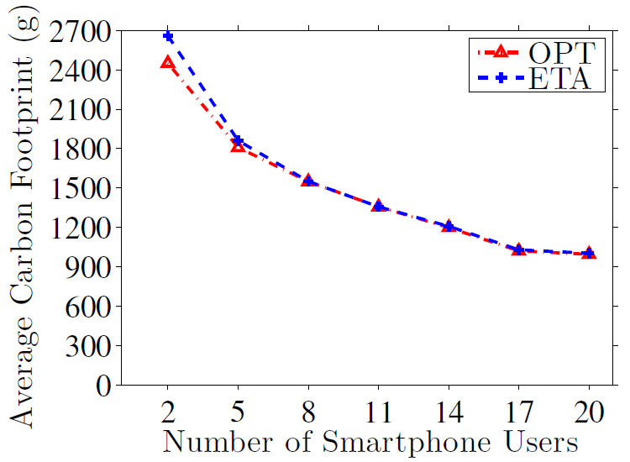
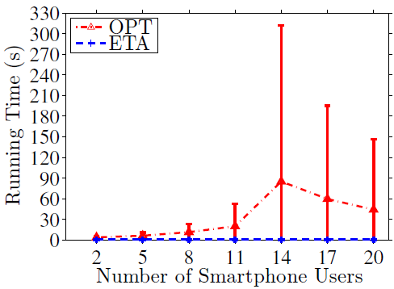
Optimization Gap in Carbon Footprints between ETA and OPT
Variant numbers of
users with 10 queries
* ETA achieves a small gap of ∼2% with OPT
* The running time of
ETA is 1333 times
faster than OPT

Slide 38
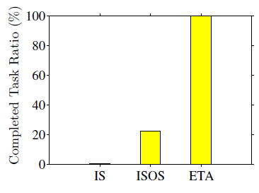
Improve Completed Task Ratio by ETA
Comparison of the completed task ratio between ETA, IS, ISOS
* ETA achieves higher completed task ratio than IS and ISOS

Slide 39
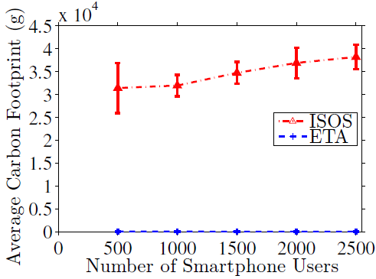
Save Carbon Footprints by ETA
Comparison between ETA and ISOS in larger scale
* ETA saves 364 times
costs more than ISOS

Slide 40
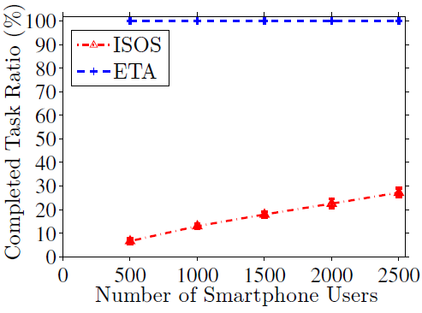
Improve Completed Task Ratio by ETA
Comparison between ETA and ISOS
* ETA achieves 5 times
ratio higher than ISOS

Slide 41
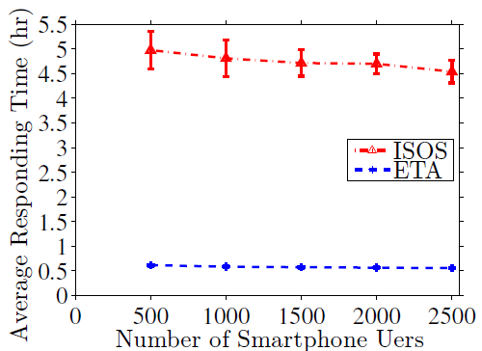
Improve Responding Time by ETA
Comparison between ETA and ISOS
* The responding time
of ETA is 8 times
faster than ISOS

Slide 42
Conclusions
For sensor scheduling problem :
  EEMA/ EAMA have a gap as small as ~3% with EMA/AMA
  EEMA/ EAMA run in real-time
  EEMA/ EAMA lead to a better performance than the baseline
For task assignment problem :
  ETA has a gap as small as ~2% with OPT
  ETA runs faster than OPT
  ETA leads to a better performance than ISOS

Slide 43
Backup
Notes:
Add slide no

Slide 44
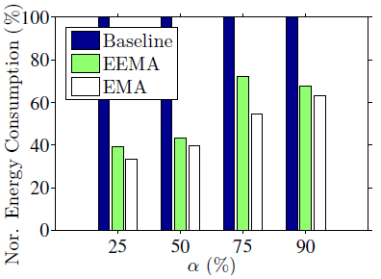
Energy Saving with Variant α in EM
The average energy consumption which is normalized to the baseline with 5 users in variant α
* When α increases, the gap with the baseline will decrease

Slide 45
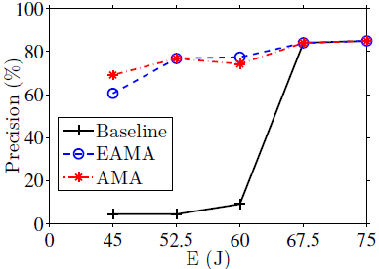
Accuracy Improvement with Variant E in AM
Consider the average energy consumption with 5 users
* AMA always higher
Than the baseline
* EAMA performs well
when the energy
budget is lower
Notes:
因為可以選擇的context 和combinaiton 種類太少，導致我們可以Schedule 的範圍減少
使得三個algorithm 結果幾乎一樣

Slide 46
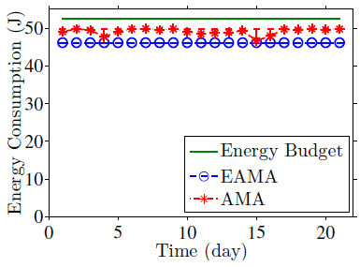
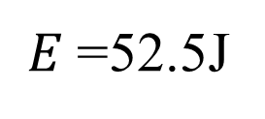
Energy Budget in AM
The average energy consumption with 5 users in 21 days
E= 52.5J
* EAMA is always within the energy budget
$E$=52.5J
Notes:
我們的EAMA 不僅擁有好的accuracy 也同時可以減少電量的消耗

Slide 47
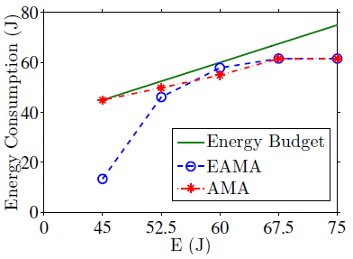
Variant Energy Budget in AM
The average energy consumption with 5 users in 21 days
E= 52.5J
* EAMA saves more energy when E decreases

Slide 48
Data Collection
1. Collect posts from BBS as our queries
  The time of post => the time of query
  The IP address of post => the location of query
2. Convert the IP address into location using IPInfoDB
*Use Agilent 66321D
battery emulator on a
Galaxy Nexus phone
[1] Sensing meets mobile social networks:the design, implementation and evaluation of the CenceMe application.
[2] A framework of energy efficient mobile sensing for automatic user state recognition
[3] Energyefficient continuous activity recognition on mobile phones: An activity adaptive approach
Notes:
我們收集五個 user 在三個禮拜裡 app的使用情況
並從現有的paper 中找到可能的combination 以及對應的accuracy
以及在手機上測量不同的sensor 的耗電量
接著針對不同的problem 我們也考慮不同的參數
讓每次schedule 間隔五分鐘
set a = 25 50 75 90 表示 context 可能的accuracy 會在 ~100之間
Set Energy budget in 表示每次Schedule energy 的限制
同時我們也考慮到，在未來可能會有更多不同的context 應用在手機上 ，所以也考慮不同數量的context 對 algo 的影響
接這是實驗結果

Slide 49
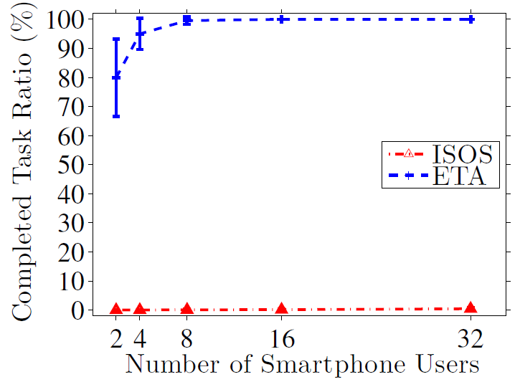
Improvement Completed Task Ratio by ETA
Comparison between ETA and ISOS
* ETA always completes more tasks than ISOS

