Slide 1
A Load-Balanced Video Multicast Routing System in Software-Defined Networks
Meng-Wei Lee 李孟葳
2015/10

Slide 2
Outline
Motivation
System Overview
Problem Formulations & Proposed Solutions
Testbed
Experiments in Mininet
Conclusion

Slide 3
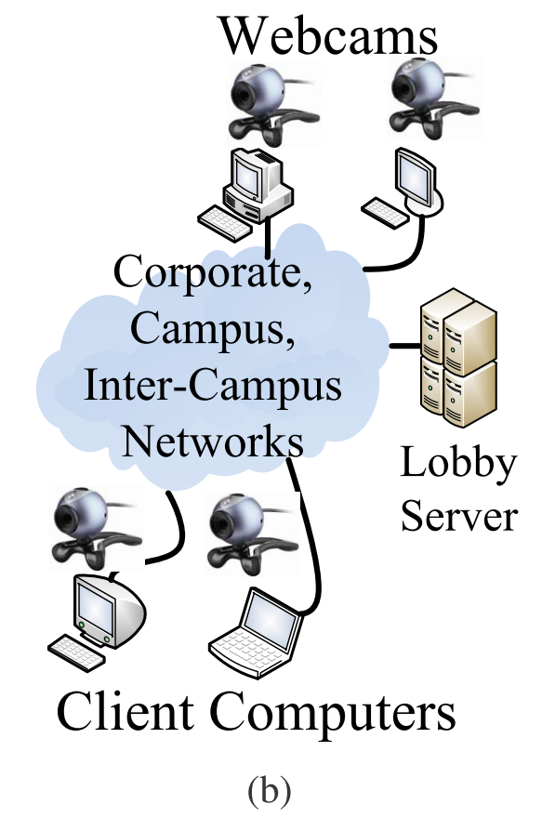
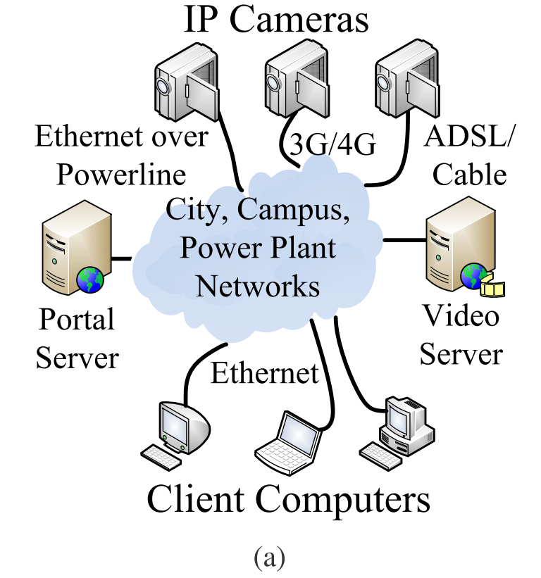
Motivation
Video streams dominate the Internet traffic:
  IP video traffic will be 80% of all IP traffic by 2019, up from 67% in 2014 [1]
Usage scenarios
  (a) Video surveillance networks
  (b) Video conferencing services
[1] Cisco visual networking index: Forecast and methodology, 2014-2019

Slide 4

Motivation (cont.)
Real-time streaming imposes strict Quality of Service
  Requirements on connections of latency, packet loss rate, and bandwidth …
How to reduce redundant streams and video bandwidth requirements?

Slide 5






Current Solution
IP multicast
  Complex operation – IGMP, PIM, MOSPF, and DVMRP
  Need costly devices
Streaming Server
Client
Computers

Slide 6


Our Solution
Software-Defined Networks (SDNs)
Controller
Switches

Slide 7
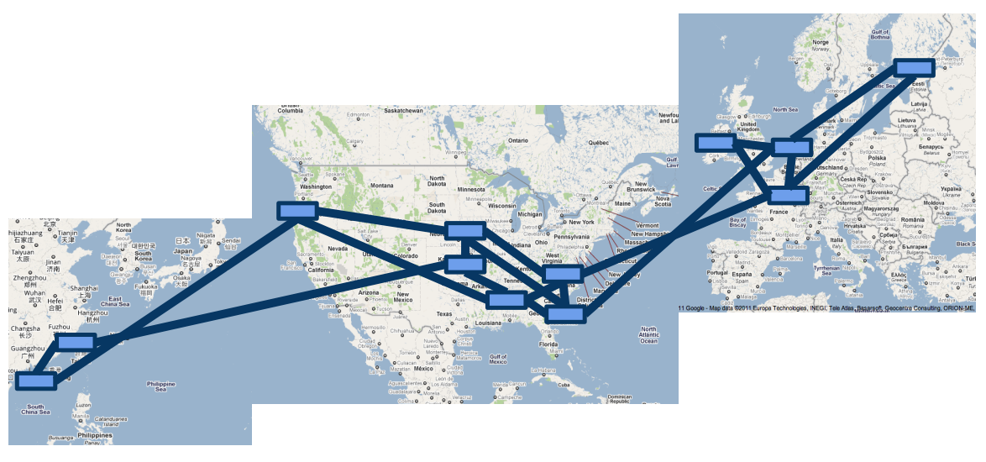
Successful Case
Google's SDN (OpenFlow) WAN (2010 - 2012)
Source: Google

Slide 8
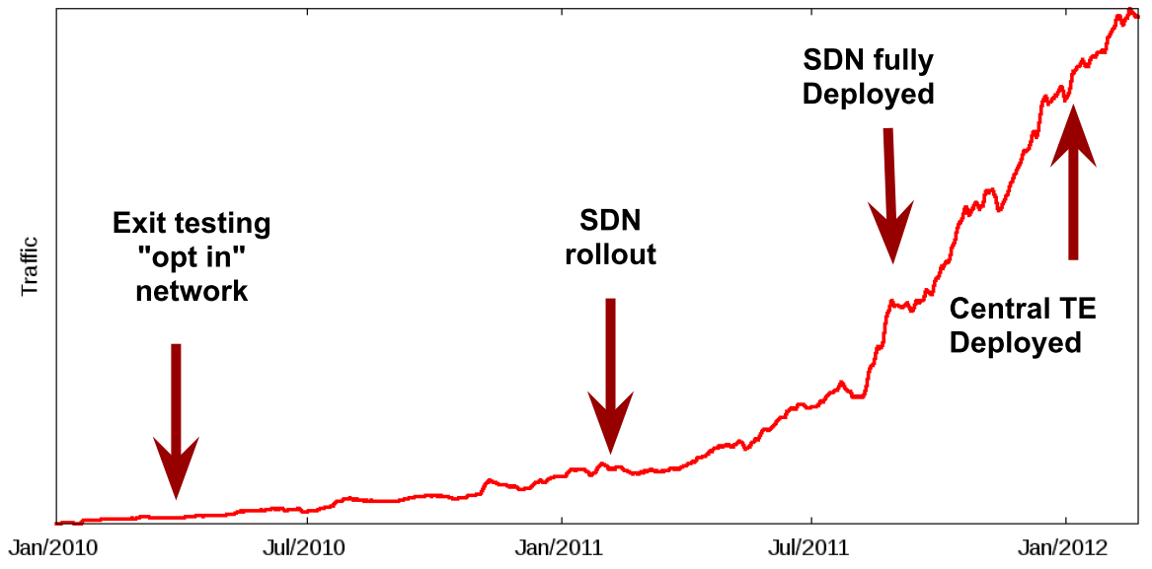
Successful Case
Google's SDN (OpenFlow) WAN (2010 - 2012)
Source: Google

Slide 9



Benefits of Using SDNs
Centralized multicast routing algorithm
Lower network overhead
Lower setup cost and maintenance cost
Controller
Streaming Server
Client
Computers
Switches

Slide 10
Related Work
Multicast in SDNs
  [37] proposes a multi-party video conferencing system
  [20] focuses on customizing the multicast services
  They only discuss the performance of existing multicast routing algorithms
  We design the centralized multicast routing algorithms, which aims to balance the load among the network links
  Utilize Multiple Description Coding (MDC) for robust multipath multicast routing
[37] M. Zhao, B. Jia, M. Wu, H. Yu, and Y. Xu., “Software defined network-enabled multicast for multi-party video conferencing systems,” in Proc. of IEEE International Conference on Communications (ICC’14), Sydney, Australia, June 2014
[20] S. Liao, X. Hong, C. Wu, B. Wang, and M. Jiang. “Prototype for customized multicast services in software defined networks,” In Proc. of IEEE Software, Telecommunications and Computer Networks (SoftCOM’14), Split, Croatian, September 2014

Slide 11
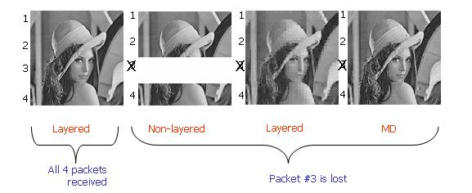
Multiple Description Coding (MDC)
Separate a frame into several descriptors
Any subset of descriptors can be decoded
Transmitted over separate channels
Provide error resilience to media streams
An image transmitted in 4 descriptors by MDC
(a) 4 descriptors received
(b) Descriptor #3 is lost
Quality improves while more descriptors received
(a)
(b)
BARNETT, Eran; KASPI, Yoni. Multiple Description Image Coding. 2005.

Slide 12





Design Objectives
Multipath multicast routing system in SDNs
  Robustness
  Load Balancing
  Adaptation
  Reliability
  SDN Compatible

Slide 13
Outline
Motivation
System Overview
Problem Formulations & Proposed Solutions
Testbed
Experiments in Mininet
Conclusion

Slide 14


System Overview
Topology Monitor
Forwarding Agent
Multicast Routing
Application
Multicast
Tree
Algorithms
ARP Proxy
Multicast Management
Multicast
Request
Controller
OF Control Channel
IP-in-IP Tunnel
Streaming
Server
Client
Computers
Switches

Slide 15
Outline
Motivation
System Overview
Problem Formulations & Proposed Solutions
Testbed
Experiments in Mininet
Conclusion

Slide 16
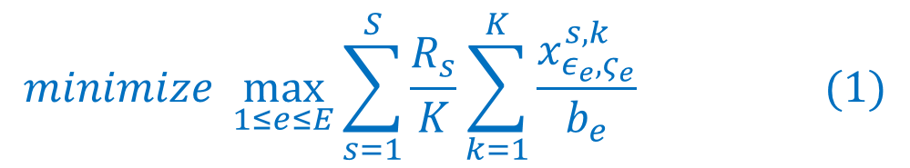

Problem Formulation - Objective
We consider the network topology as a directed graph
$G=\left(V,E\right)$
A switch, a source, or a sink
A network link between two vertices
Objective:
Minimize the maximal link utilization
x=1, if the link is one of
the multicast tree edge
bandwidth of the link
link utilization

Slide 17
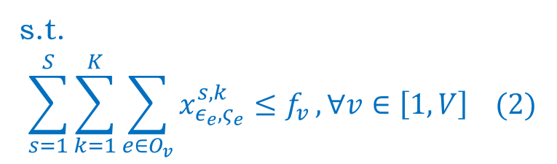
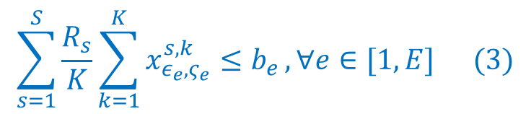
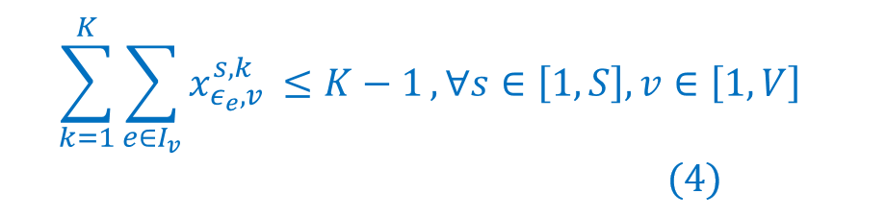
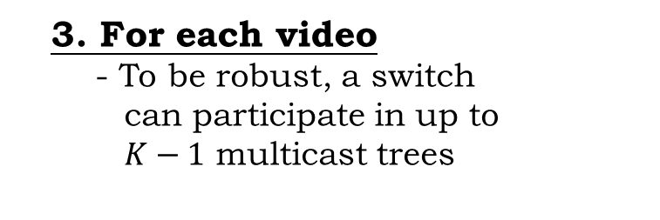
Problem Formulation – Constraints
  1. For each vertex
  - Limit the number of
  ﬂow-entries
  2. For each edge
  - The traffic flow must be less
  than its bandwidth
  3. For each video
  - To be robust, a switch
  can participate in up to
  $K−1$ multicast trees

Slide 18


Robust Multipath Multicast Routing
It is an Integer Programming (IP) problem
We use IBM CPLEX to solve the optimal solution of network load balancing
The solution may contain cycles

Slide 19

Cycle Elimination
Whenever the cycle occurs
  Add more constraints to the formulation
  Save more time rather than prevent cycle in advance
Optimal solution of multipath multicast trees
Abbreviated as RMMR*
  Optimal Robust Multipath Multicast Routing Algorithm
But it is still time consuming in large networks
  Need a more efficient solution!

Slide 20
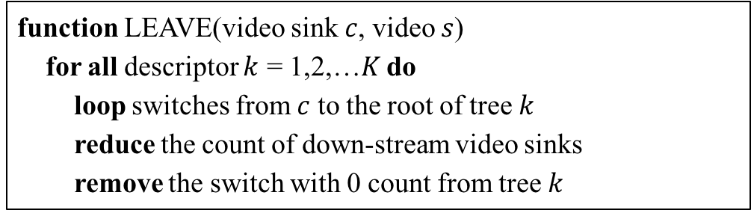
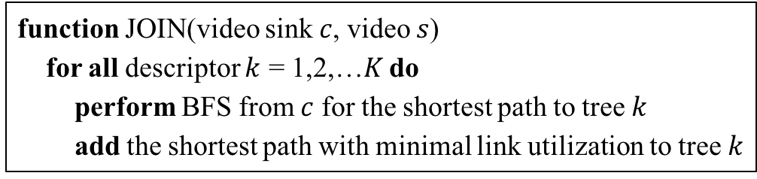
Route Adaptation Heuristics
Only modify a part of multicast trees for sinks join/leave
  RMMR: Efficient Robust Multipath Multicast Routing Algorithm
  Call RMMR* for optimal multicast trees first
  Run above heuristics to update multicast trees
function JOIN(video sink $c$, video $s$)
for all descriptor $k$ = 1,2,…$K$ do
perform BFS from $c$ for the shortest path to tree $k$
add the shortest path with minimal link utilization to tree $k$
Heuristic:
Sink joins
function LEAVE(video sink $c$, video $s$)
for all descriptor $k$ = 1,2,…$K$ do
loop switches from $c$ to the root of tree $k$
reduce the count of down-stream video sinks
remove the switch with 0 count from tree $k$
Sink leaves

Slide 21
Robust Multipath Multicast Routing Algorithms
  RMMR*
    Optimal Robust Multipath Multicast Routing Algorithm
  RMMR
    Efficient Robust Multipath Multicast Routing Algorithm

Slide 22
Outline
Motivation
System Overview
Problem Formulations & Proposed Solutions
Testbed
Experiments in Mininet
Conclusion

Slide 23
Testbed Setup
4 OpenFlow switches – Pica8 P3297
1 OpenFlow controller - Ryu
1 video source - VLS
3 video sinks - VLC
2 video streams represent 2 descriptors

Slide 24
Testbed

Slide 25
Higher Link Utilization Causes Longer Latency
Link bandwidth: 10 Mbps
We stream two 4 Mbps videos from source
Average packet latency increases about 0.4 sec while link congestion

Slide 26
Our System Incurs Short Response Time
Report:
0.071 sec
Leave:
0.084 sec
2.5 ms
Flow insertion time ranges from 1 to 4.5 ms
IGMP messages response time ranges from 0.023 to 0.15 sec

Slide 27
Outline
Motivation
System Overview
Problem Formulations & Proposed Solutions
Testbed
Experiments in Mininet
Conclusion

Slide 28
Experiments in Mininet
Link bandwidth: 1~5 Mbps
Algorithm comparison
  - RMMR* - optimal
  - RMMR - heuristic
  - IPM - IP multicast
  (PIM-SM)
Topology | Switch | Source | Sink | Descriptor
Small | 9 | 1 | 6 | 2
Large | 24 | 4 | 12 | 4

Slide 29
Experiment Setup
MDC video traces and their bit rates:
  - Mobile 1.22 Mbps
  - Hway 0.27 Mbps
  - Paris 0.5 Mbps
  - Tempete 0.91 Mbps
We conduct 10-min experiments with RMMR*,RMMR, and IPM
The sink join/leave rates = 2 (sinks/minute)
MDC video traces from ASU

Slide 30
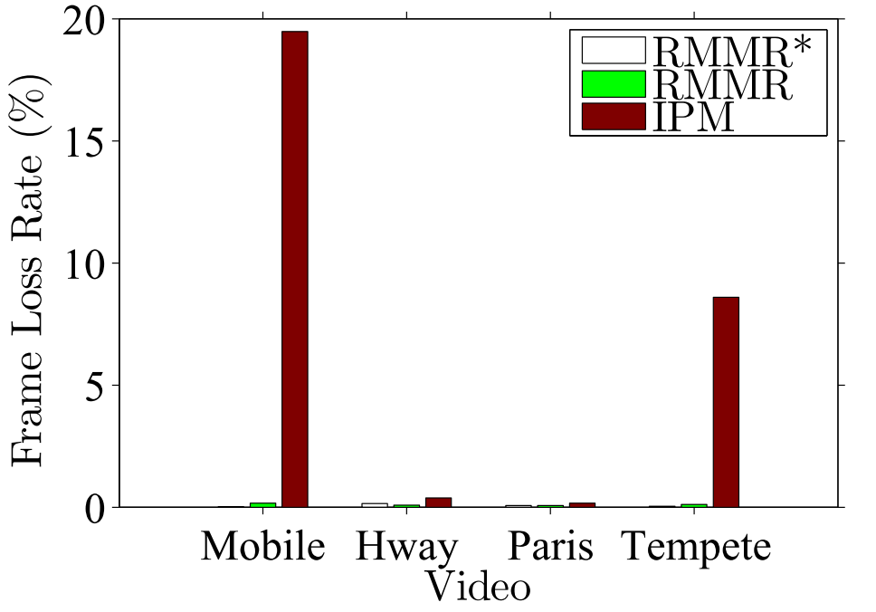
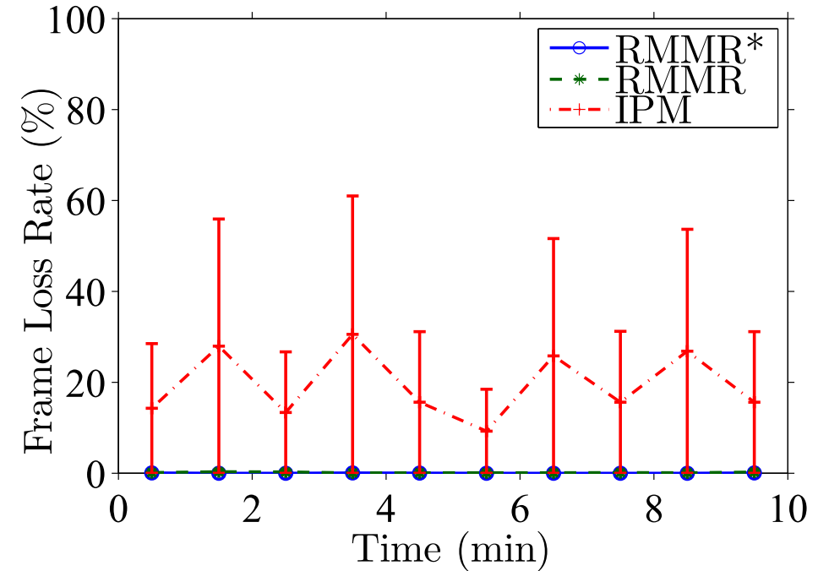
Our Algorithms are Bandwidth-aware
Mobile
Max
Mean
Min
Large bit rate videos get higher frame loss rates using IPM
Our algorithms result in almost zero frame loss rate

Slide 31
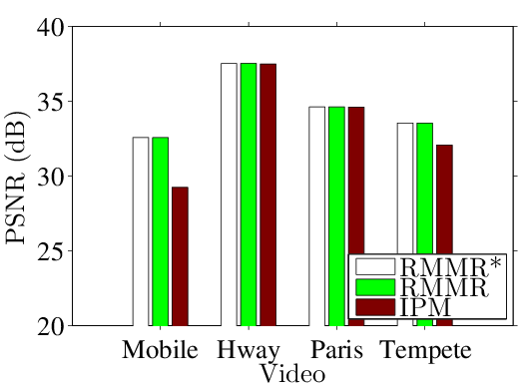
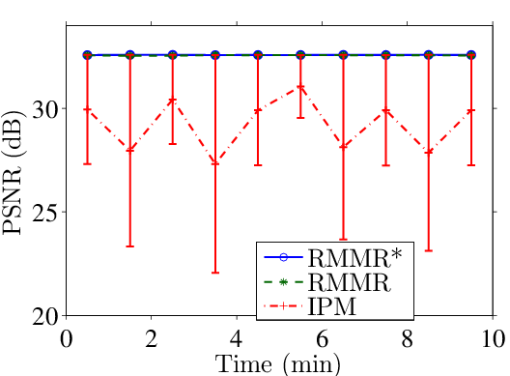
Our Algorithms Achieve Higher Video Quality
Gaps between RMMR(*) and IPM with
Mobile (4 dB) and Tempete (1 dB)
IPM leads to at most 10 dB quality fluctuation

Slide 32
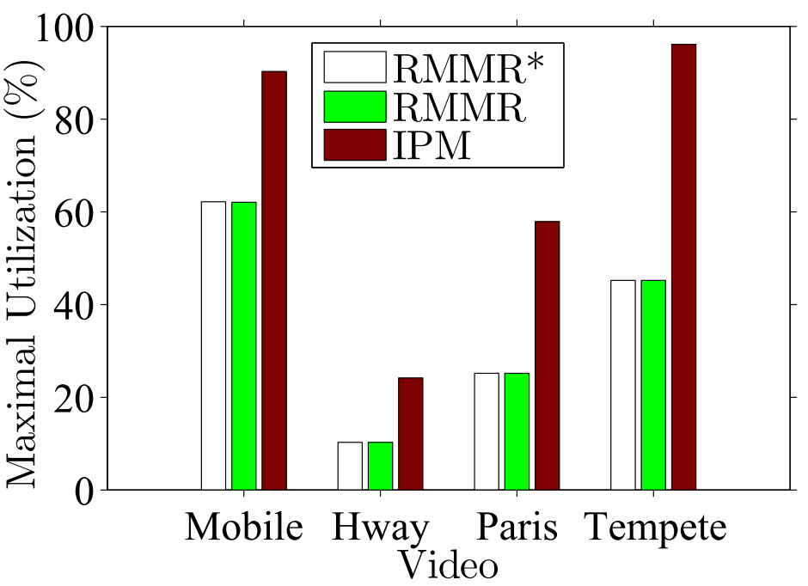
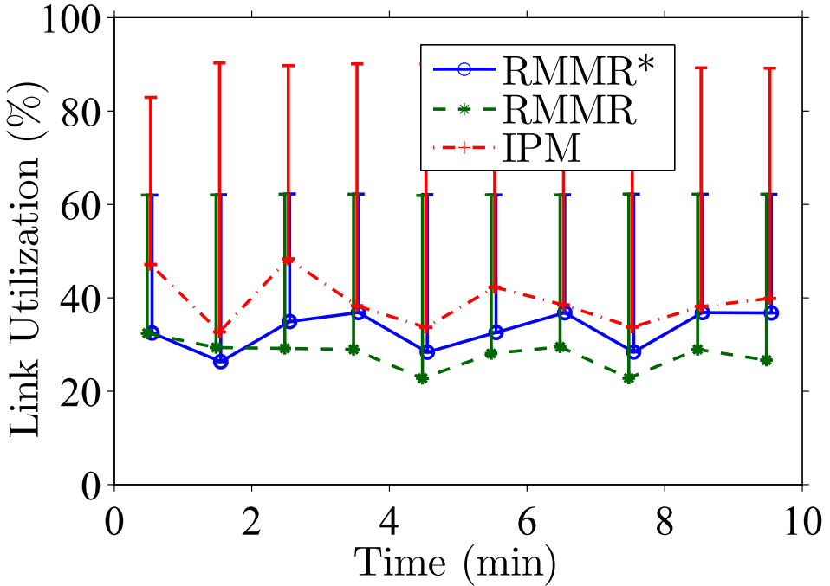
Our Algorithms Reduce Max Link Utilization
Max
Mobile
30%
50%
Mean
Reduce max link utilization
up to 50%
Reduce max link utilization 20~30%

Slide 33
Our Proposed Algorithms are Robust Against Switch Failures
We shutdown switch 1 at 65 sec
Our system recovers the routes in few seconds after switch failure

Slide 34
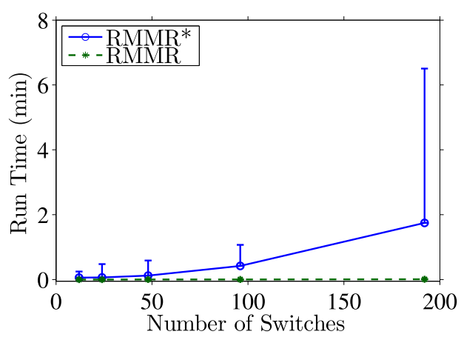
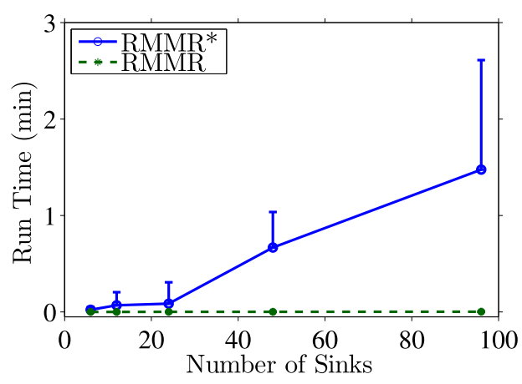
The Scalability of Our Algorithms
Running Time
Running Time
RMMR always terminates in < 0.2 sec

Slide 35
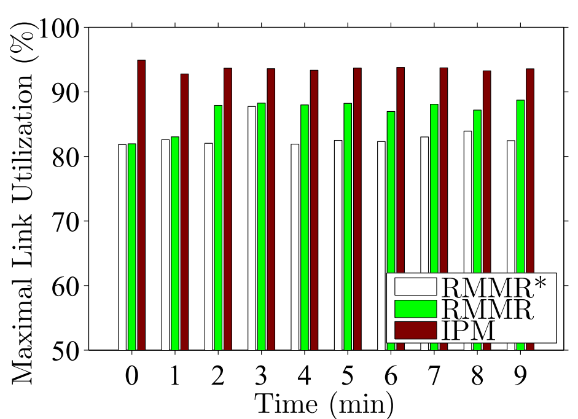
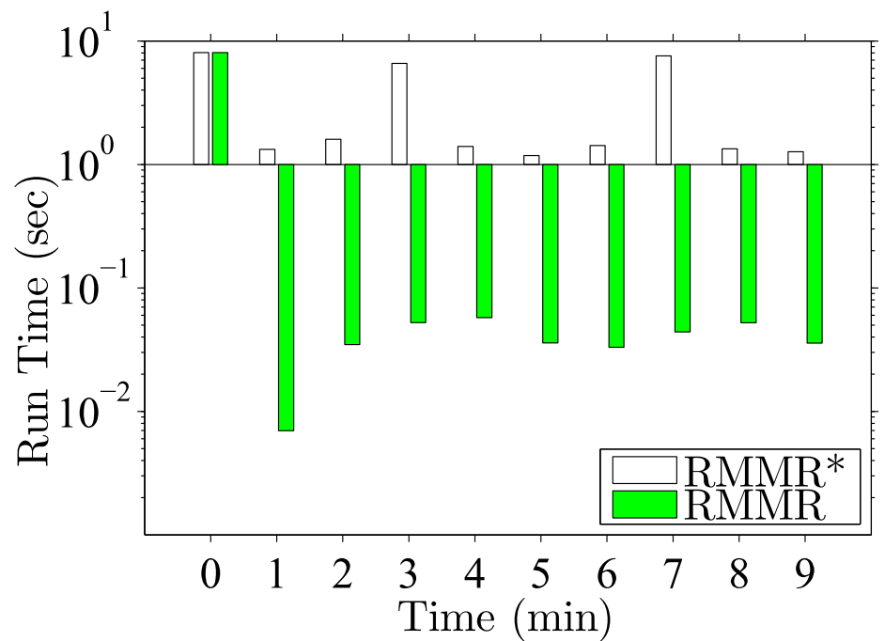
Tradeoff Between Optimality and Running Time
8 sec
6%
Running Time
50 ms
RMMR* has higher optimality:
Reduce max link utilization up to 6%
RMMR is more efficient:
Reduce running time from 8 sec to 50 ms

Slide 36
Outline
Motivation
System Overview
Problem Formulations & Proposed Solutions
Testbed
Experiments in Mininet
Conclusion

Slide 37
Conclusion
Multicast on SDNs
  Reduce setup cost and maintenance cost
  Use a global view to get an optimal solution for multicast routing
RMMR^{(*)} algorithm
  Robust, load balanced, and flexible
  RMMR*: Optimal solution, suitable for smaller and more static networks
  RMMR: Efficient solution, suitable for larger and more dynamic networks

Slide 38
Future Work
Consider background traffic to compute the multicast routing depends on the current traffic
Design an adaptive algorithm, which automatically makes decisions on when to update the multicast routing with optimal solution

Slide 39
Thank you！

Slide 40

Software-Defined Networks
Feature
Feature
Network OS
Control Data Plane Interface
(e.g., OpenFlow)
Software-Defined
Networks
Feature
Feature
Traditional
Networks
Operating
System
Feature
Feature
Specialized Packet Forwarding Hardware
Operating
System
Feature
Feature
Specialized Packet Forwarding Hardware
Operating
System
Feature
Feature
Specialized Packet Forwarding Hardware
Operating
System
Feature
Feature
Specialized Packet Forwarding Hardware
Operating
System
Specialized Packet Forwarding Hardware
Source: ONF Slides

Slide 41
SDN Multicast Related Work
M. Zhao, B. Jia, M. Wu, H. Yu, and Y. Xu., “Software defined network-enabled multicast for multi-party video conferencing systems,” in Proc. of IEEE International Conference on Communications (ICC’14), Sydney, Australia, June 2014
  Proposed a multicast multi-party system in SDNs and discuss the performance of existing multicast routing algorithm.
S. Liao, X. Hong, C. Wu, B. Wang, and M. Jiang. “Prototype for customized multicast services in software defined networks,” In Proc. of IEEE Software, Telecommunications and Computer Networks (SoftCOM’14), Split, Croatian, September 2014
  Focused on customizing the multicast services and only discuss the performance of existing multicast routing algorithms
  We propose, implement the multicast system in SDNs and design the centralized multicast routing algorithms to balance the overhead among the network links.

Slide 42
SDN Multicast Related Works (cont.)
Iyer, A.; Kumar, P.; Mann, and V., "Avalanche: Data center Multicast using software defined networking," in Proc. of IEEE Communication Systems and Networks (COMSNETS’14), Bangalore, India, January 2014
  Proposed algorithm to minimize the size of multicast tree and increase the path diversity to avoid congestion.
L.-H. Huang, H.-J. Hung, C.-C. Lin, and D.-N. Yang. “Scalable and bandwidth-efficient multicast for software-defined networks,” In Proc. of IEEE Global Communications Conference (GLOBECOM’14), Austin, USA, December 2014
  Proposed a Branch Aware Edge Reduction Algorithm for multicast routing for SDNs.
Complementary to the existing OpenFlow-related multicast research, our proposed algorithm utilizes MDC for robust multipath multicast routing among multiple video sources and sinks

Slide 43
SDN Multicast Related Works (cont.)
K. A. Noghani and M. Oguz Sunay. “Streaming multicast video over software-deﬁned networks.” in Proc. of IEEE Mobile Ad Hoc and Sensor Systems (MASS’14), Philadelphia, USA, October 2014
  Distributed the multicast videos with Multiple description coding and leverage the benefits of MDC, which provide potential of lower link utilization and better error resilience in transmission.
We also leverage the centralized view of SDNs to design the optimal and its corresponding heuristic to improve the multicast routing algorithms for load balancing

Slide 44
Challenges on Multipath Routing
The benefits of using multipath
  Fault tolerance
  Increased bandwidth
Drawback
  If the client can not receive the data in time, the rest portion of video would be useless

Slide 45
System Overview
Multicast Management
Topology Monitor
Multicast
Request
Multicast Routing
Application
Algorithms
ARP Proxy
Forwarding Agent
Multicast
Path
Controller
OF Control Channel
IP-in-IP Tunnel
Streaming
Server
Client
Computers
Switches

Slide 46
Design Objectives
Multipath multicast routing algorithm in SDNs
  Robustness
    Provide high video quality even in unstable networks
  Load balancing
    Avoid network congestion
  Adaptation
    Dynamically adapt to network changes
  SDN Compatible
    Complying the limit of OpenFlow switches
  Reliability
    Route recovery while network failure

Slide 47
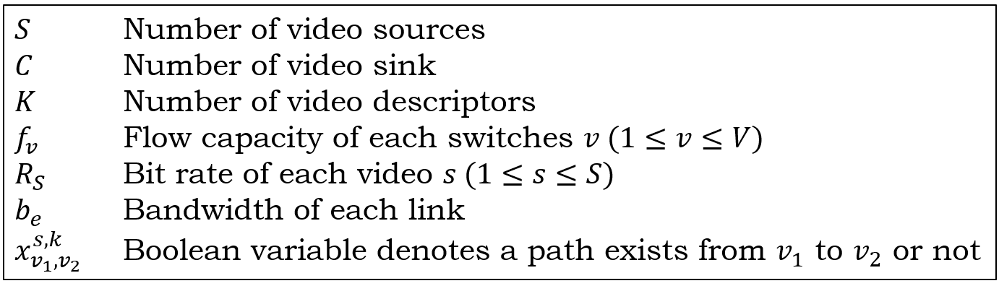

Problem Formulation - Notation
We consider a video multicast system and modeled it as a directed graph$G=(V,E)$
Our problem is to compute the multicast trees for optimal min-max load balancing
A source, a sink or a switch
A network link between two vertices

Slide 48
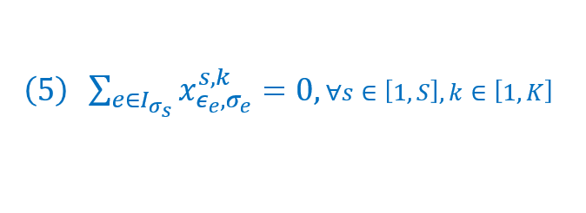
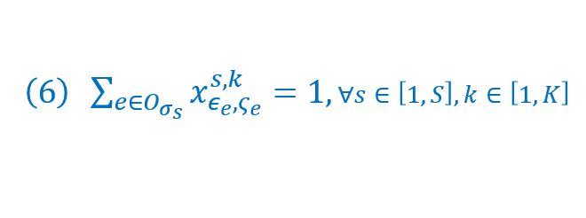
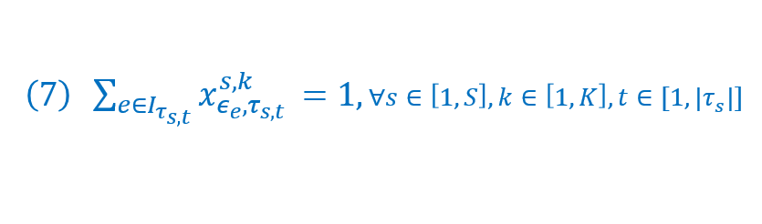
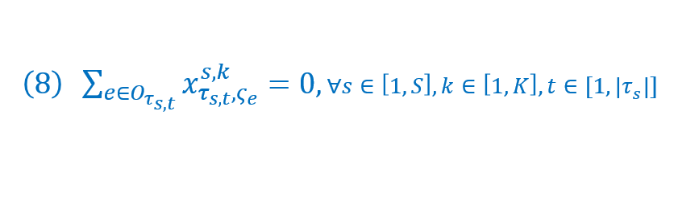
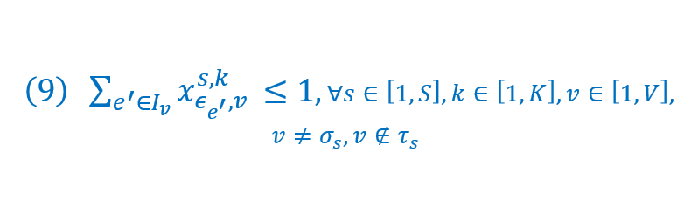
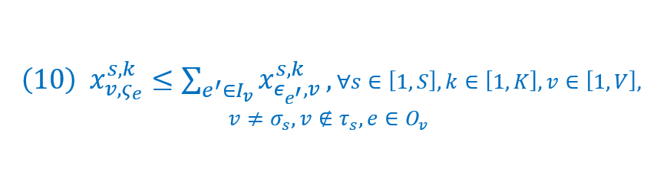
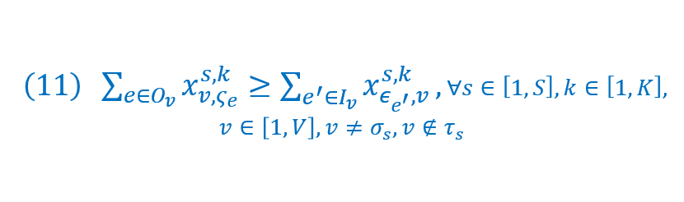
Problem Formulation – Constraints (cont.)
Ensure that video sources and sinks are indeed the roots and leaves of the multicast trees
Allow the intermediate vertices to avoid receiving duplicated descriptors from multiple links
Ensure that a vertex sends a descriptor only if it’s received
Ensures that a vertex must send a descriptor once it’s received

Slide 49
Problem Formulation – Constraints (cont.)

Slide 50
SDN Architecture
Source: SDN White Paper

Slide 51
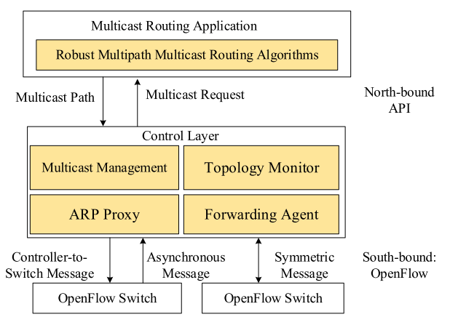
System Architecture

Slide 52
Outline
Motivation
System Overview
Problem Formulations & Proposed Solutions
Implementation
Testbed
Experiments in Mininet
Conclusion

Slide 53

Implementation
Multipath multicast routing system
  Ryu
    Component-based framework
  OpenFlow 1.3

Slide 54
Component Diagram
IP packet-in
multicast packet-in/IGMP packet-in
ARP packet-in

Slide 55
Component Diagram
LLDP packet-in/ARP packet-in
ARP packet-in

Slide 56
Component Diagram

Slide 57
Testbed Result

Slide 58
Link Utilization and Latency
Link bandwidth: 10Mbps
Two 3Mbps videos
Short latency while link utilization is low

Slide 59
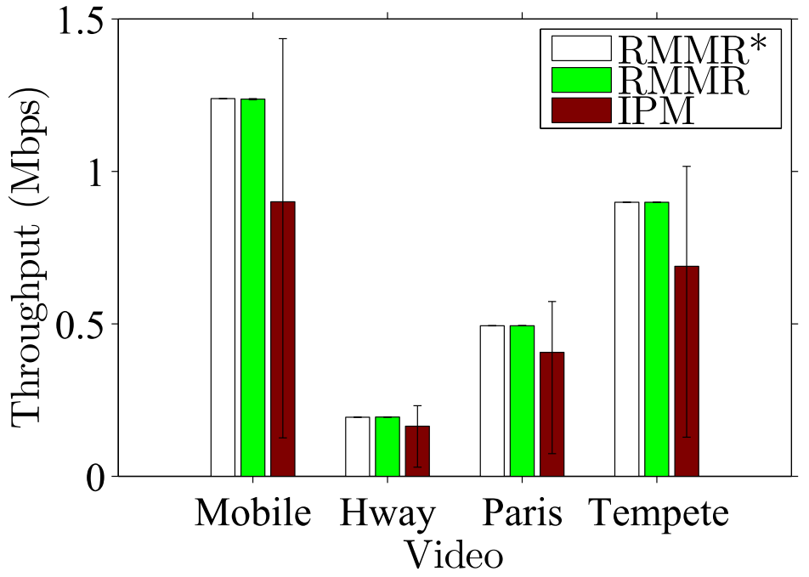
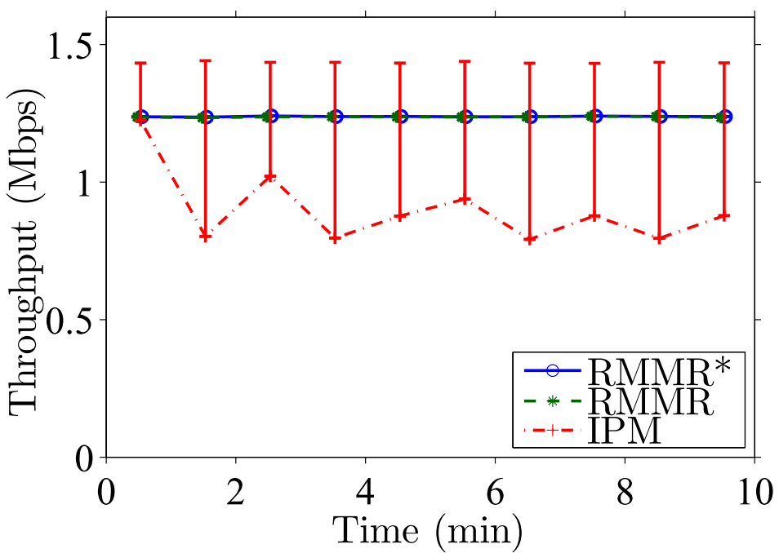
RMMR(*) Algorithms Result in Consistent Throughput
Max
Max
Mobile
1.22
Mean
0.89
0.5
Mean
Min
0.2
Throughputs in RMMR^{(*)} are all around video bitrates.
In IPM, some sinks get duplicated packets, some sinks lose lots of packets.

Slide 60
The Scalability of RMMR(*) Algorithms

Slide 61
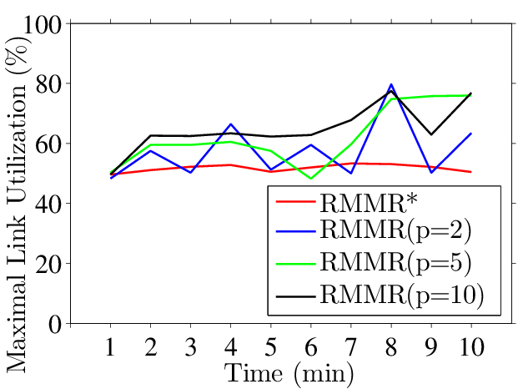
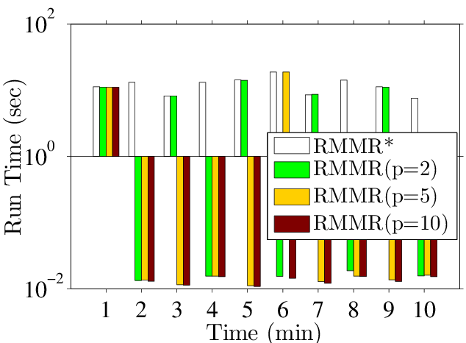
Tradeoff of Optimality in Different Periodical Parameter
p: the periodical parameter to regularly update the multicast routes with optimal solution
Update optimal solution more frequently results in less link utilization but costs more time

Slide 62
Future Work
Consider background traffic to compute the multicast routing depends on the current traffic
Design an adaptive algorithm, which automatically makes decisions on when to update the multicast routing with optimal solution

