Slide 1
Traffic-Engineering in Software Defined Networks Using Label Switching
在軟體定義網路下利用標籤交換之流量工程系統
Chen-Nien Mao
Advisor: Cheng-Hsin Hsu
Networking and Multimedia System Lab
CS Dept. , National Tsing Hua University

Slide 2
Outline
Introduction
Label Switching
System Architecture
Routing Mechanism
Tunnel Table Construction
Path Table Construction
Dynamic Modules
Evaluation
Conclusion

Slide 3
Introduction

Slide 4
Idle Resource in Networks
Explosive traffic flow comes from different services has brought many challenges on
Quality of Service (QoS)
Quality of Experience (QoE)
Traditional core networks perform Interior Gateway Protocol (IGP)
Shortest path routing
Idling resources

Slide 5
Software-Defined Networks (SDN)
Decoupling the control plan & data plan
The routing rules are decided by a central controller
Application Layer
API
Control Layer
Infrastructure Layer

Slide 6
Is SDN sufficient ?
Controller can change the routing behaviors => Are the problems solved by SDN?
Challenges:
Initialization time in large networks
Core networks are vulnerable to delay
Scalability
Decoupling the data flow and control flow brings the scalability issues
Flexibility & Efficiency
The cost of changing routing behavior is high and complex

Slide 7
Contribution
Propose label routing algorithms to solved the traffic engineering problems in SDNs
Minimize the initialization delay
Perform load balancing
Perform fast recovering
Develop a flexible network architecture
Virtualize physical links with virtual paths
Simplify routing mechanisms inside the core networks
Core Networks
Routing
Routing

Slide 8
Label Switching

Slide 9
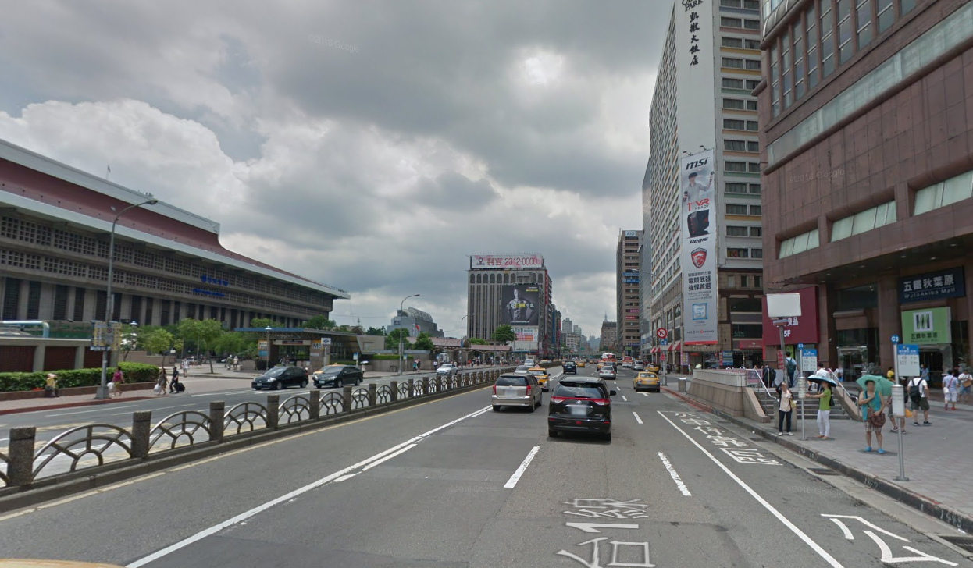
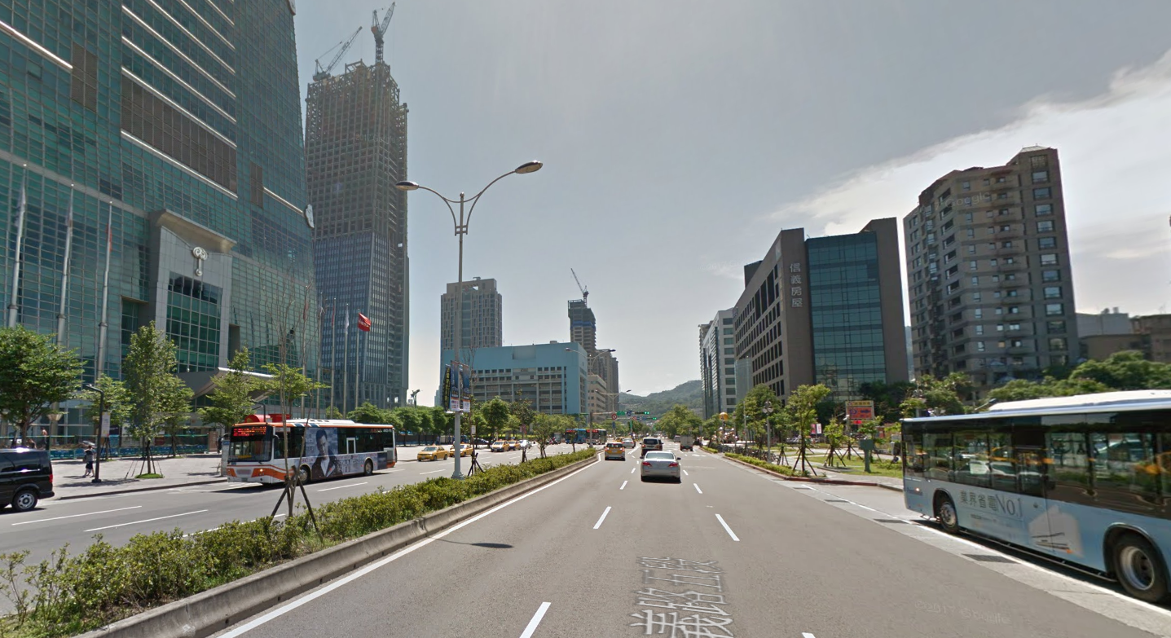
Example to illustrate label switching
Traveler wants to visit Taipei 101 from Taipei Main Station
Passerby A : “I am not sure. Maybe you can go to next stop first”
Passerby B : “I am not sure. Maybe you can go to next stop first” …..

Slide 10
Example to illustrate label switching
If there is a smart guy who knows the best route.
Smart guy : “Take the bus line 22, and you will arrive 101 without traffic gam”

Slide 11
Difference between traditional approaches
Let me see
Let me see
Let me see
Let me see
Traditional IP-Networks
A
I will ask
I will ask
I will ask
I will ask
A
Client A
Client B
Legacy SDN Networks
I will ask
Proposed MPLS Solution

Slide 12
Multiprotocol Label Switching
Forwards the packets according to the label without looking up the network address
MPLS Label
Label Distribution Protocol
Stackable, providing higher extensibility,
Fixed length, allowing more efficient matching
Supported in OpenFlow protocol
MPLS shows its strength on Traffic Engineering in legacy IP network
Resource Reservation Protocol
Reserve bandwidth for QoS
Notes:
Label Distribution Protocol (LDP) and RSVP-TE under a MPLS domain

Slide 13
MPLS in SDN
Difficulties of performing MPLS in traditional network
Scope of the whole system
Hierarchy of MPLS system
Path attributes of label switching paths
Some issues can be solved in SDNs
Global view of the system => Optimized the Path selection
Ability to coordinate each switches => Assign Label & handle hierarchy
We can build a our system without lower level protocols !

Slide 14
Label Switching
MPLS labels
Extract MPLS protocols
Represent a virtual tunnel ( multiple physical links )
Routing actions in proposed system:
Push at Ingress
Swap at Medium
Pop at Egress
Push Label
Swap Label
Pop Label
…
…
Ingress Switch
Core Switches
Egress Switch

Slide 15
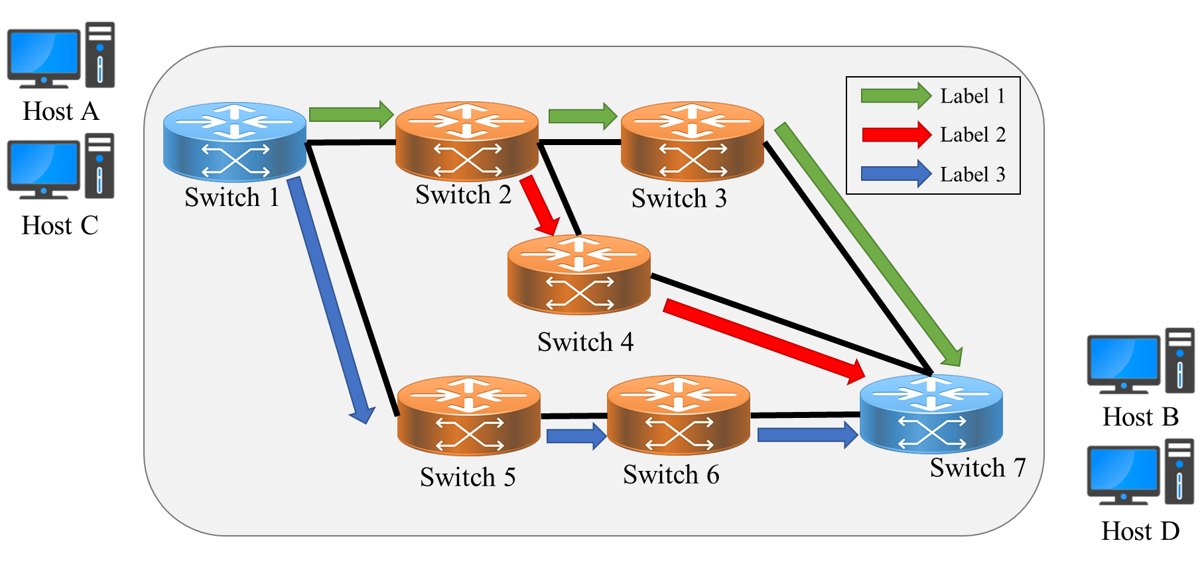
Benefits of using Label Switching
Perform Traffic engineering easily
Labels => routing decision
Changing routing behaviors by changing labels
Balance traffic by “switching label”

Slide 16
Routing inside the core networks
Simplify routing mechanisms inside core networks
Complex routing decisions are made in edge switches
Switches in core network only focus on packet-forwarding
Core Networks
Push Label
Pop Label
Ingress Switches
Egress Switches

Slide 17
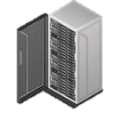
Use case
Tunnel Info
SDN Controller
ISP Server
SDN Controller
Server B
…
Core Switches
Core Switches
Tunnel provided by ISP
Edge switch
A
Site A subnetwork
Site B subnetwork
C
Client A
Client C

Slide 18
System Architecture

Slide 19
Problem statement
Initialization Delay
Use pre-build tunnels
Avoid congestion and packet loss
Load Balancing
Offload the traffic to idling links
Error Resilience
Fast-rerouting
Dynamic traffic assigner

Slide 20
Controller Components
Tunnel Constructor
Admission Controller
Tunnel Table
Dynamic Tunnel Finder
Dynamic Traffic Assigner
Tunnel Table
Traffic Status
Static Tunnel Finder
Static Traffic Assigner
Topology
Tunnel Table
Unexpected events
Traffic Table
Traffic Request
Proactive Switch Module
Main Control Logic (OpenFlow Events Handlers)
Flow Command Dispatcher
MPLS-enabled Network

Slide 21
Tunnel Constructor
Tunnel Constructor
Dynamic Tunnel Finder
Tunnel Table
Construct Tunnels inside SDN domain
Static Tunnel Finder (STF)
Find tunnels among every two nodes
Pre-built tunnels in networks (System setup or topology change )
Dynamic Tunnel Finder (DTF)
Take link usage into consideration
Recover tunnels
Connect new edge switches to the network
Static Tunnel Finder
Proactive Switch Module

Slide 22
Admission Controller
Admission Controller
Dynamic Traffic Assigner
Traffic Status
Static Traffic Assigner
Allocate traffic into the system
Dynamic Path Assigner (DPA)
Real-time traffic assigner (Label Tagger)
Handle new traffic request
Handle unexpected traffic re-route
Static Path Assigner (SPA)
Load Balancer
Consider Link utilization & Perform load balance
Avoid congestion
Proactive Switch Module

Slide 23
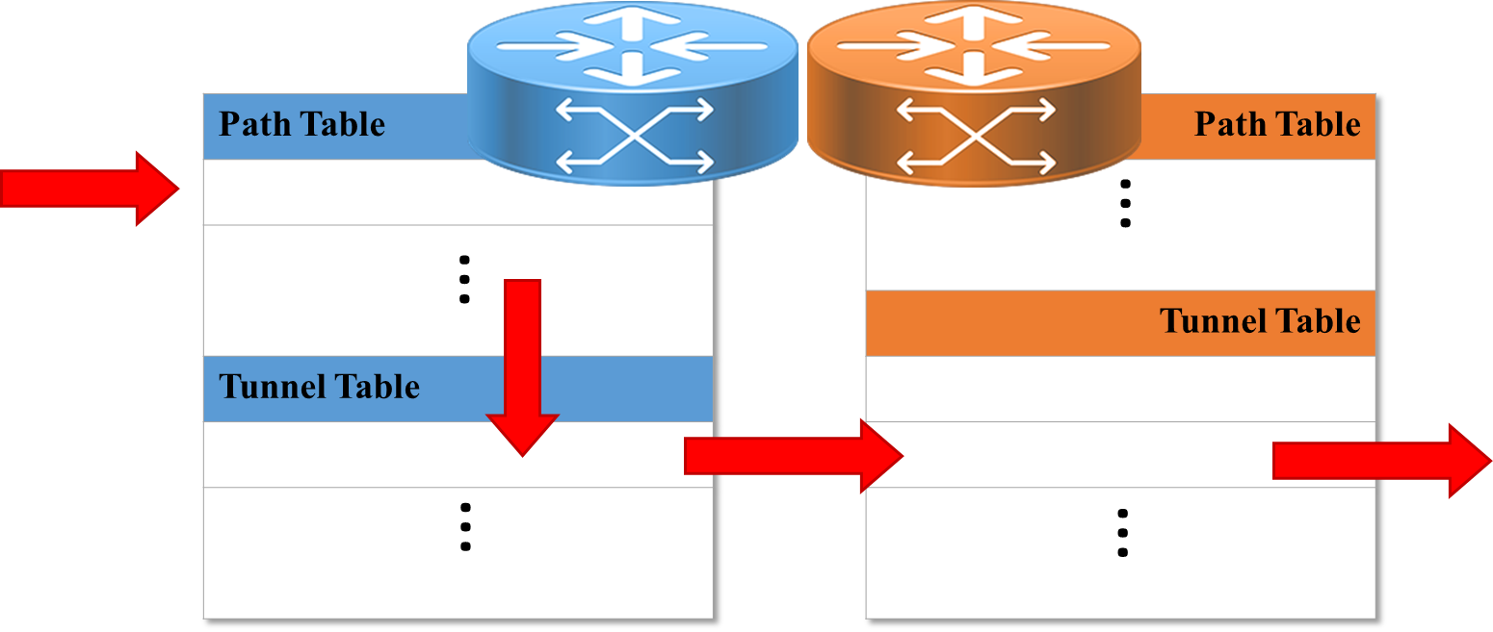
Decoupled Flow Tables
Tunnel table (Lower Table)
Store pre-built tunnels information (label info.)
Path table (Upper Table)
Store the bindings between labels (tunnels) and the traffic flows

Slide 24
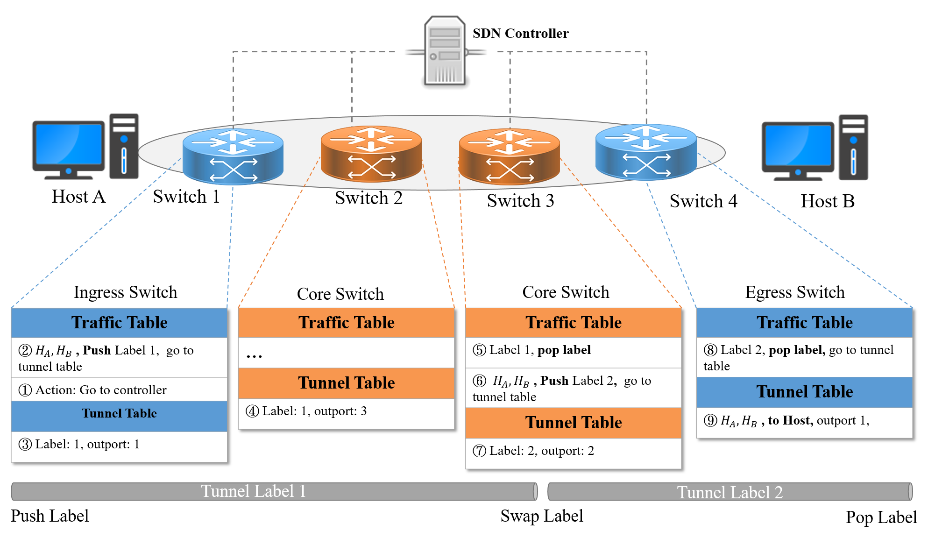
Packet Forwarding

Slide 25
Routing Mechanism

Slide 26
Controller Components
Tunnel Constructor
Admission Controller
Tunnel Table
Dynamic Tunnel Finder
Dynamic Traffic Assigner
Tunnel Table
Traffic Status
Static Tunnel Finder
Static Traffic Assigner
Topology
Tunnel Table
Unexpected events
Traffic Table
Traffic Request
Proactive Switch Module
Flow Command Dispatcher
MPLS-enabled Network

Slide 27
Tunnel Table Problem Formulation
Goal: to find mutually disjoint tunnels between each switch pairs
Maximize the available bandwidth among each switch pairs
Reliable and Flexible
Constraint:
$stretch facotr= \frac{\sum_{l=1}^{L}{m_{p,l}}}{shortest path hop}$
$k=stretch facotr$ * $shortest path hop$
Length of tunnels

Slide 28
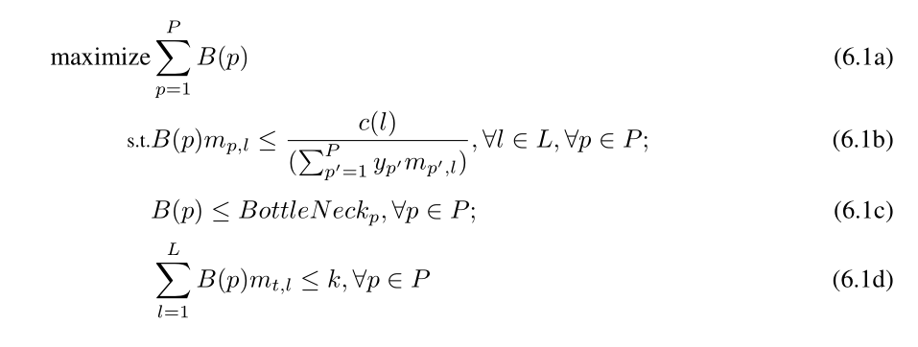
Path Table
Network Topology
Static
Tunnel
Finder
Set of
Tunnels
Maximize bandwidth of each paths
Path capacity is less than or equal to the minimum link share
Minimal link capacity among all the links
Length of selected tunnel will never exceed k
Notes:
Todo: p’ in 6.1c
->[] ->
Goal: maximum bandwidth of each paths
Eq 6.1b: maximum number of paths between two nodes~(n,m) is x
Eq 6.1c: Each link is shared by several paths ,and thus the path capacity is less than or equal to the minimum link share among the links used by the path
Eq. 6.1.d: We define the bottle neck of each path, $p$, by the minimal link capacity among all the links in the given topology
Eq. 6.1.e: we make sure the length of selected tunnels will never exceed the constraint $k$ to gain better efficiency

Slide 29
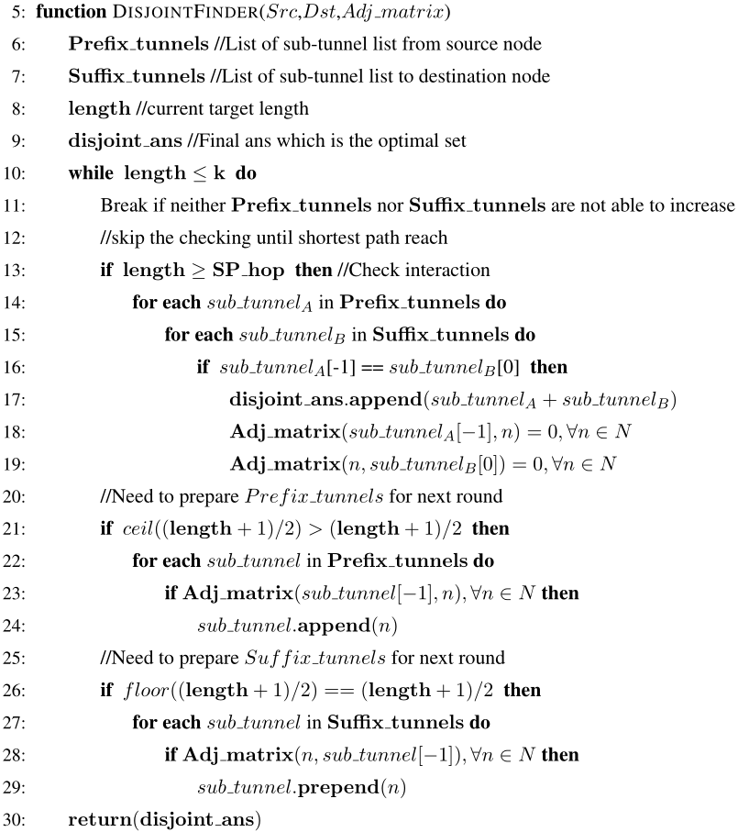
Heuristic Algorithm for Tunnels finding
Check Intersection
Update Adjacency Matrix
Move start indicator forward
Move end indicator backward
D. Torrieri. “Algorithms for finding an optimal set of short disjoint paths in a communication network”. IEEE Transactions on Communications, 1992.

Slide 30
Controller Components
Tunnel Constructor
Admission Controller
Tunnel Table
Dynamic Tunnel Finder
Dynamic Traffic Assigner
Tunnel Table
Traffic Status
Static Tunnel Finder
Static Traffic Assigner
Topology
Tunnel Table
Unexpected events
Traffic Table
Traffic Request
Proactive Switch Module
Main Control Logic (OpenFlow Events Handlers)
Flow Command Dispatcher
MPLS-enabled Network

Slide 31
Path Assigner
Goal: Minimize the links utilization
Balance the traffic load inside the system
We assume that all the traffic can be handled by current tunnels (Admission Control)
Find a suitable path for each traffic flows
$x_{t,f}$ , whether tunnel is assigned to traffic flow

Slide 32
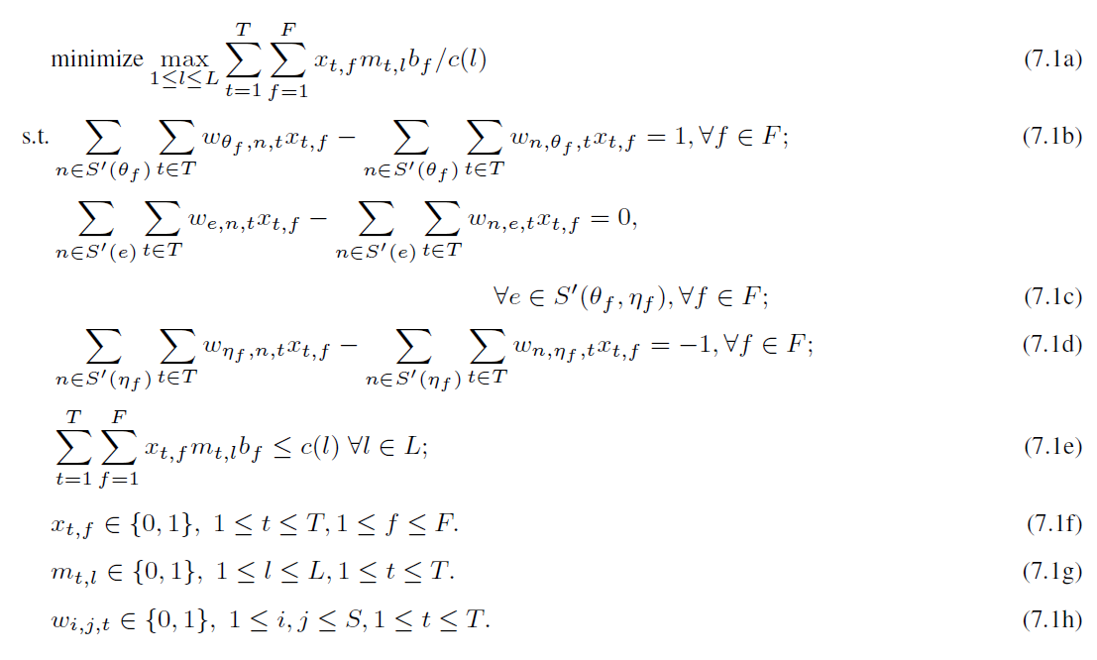
Load balancer
Tunnels
Static
Path
Assigner
Traffic
Assignment
Traffic
Minimize the maximal tunnel utilization
Traffic flows always reach their destination
Traffic flows will not leave from the middle nodes
Traffic flows never leave its destination
Traffic over a link does not exceed its capacity
Notes:
7.1a minimize the maximal tunnel utilization in our system
7.1b the traffic flow never returns to the source of the traffic
7.1c none of the intermediate sites consume the traffic flow
7.1d the traffic flow enters the destination and never leaves it
7.1e the traffic over a link does not exceed its capacity

Slide 33
How to find best utilization?
Path Finding:
Find a shortest path to carry the traffic (set of tunnels)
Constrained BFS
$\sum_{t=1}^{T}{\sum_{f=1}^{F}{x_{t,f}m_{t,l}b_{f}}}≤c\left(l\right)α , \bigvee{l }\text{∈}L$
$$0≤α≤1$$
A flow can only flow through tunnel when:
$$C_{l}+b_{f}≤c\left(l\right)α$$
How to find best $α$ elgently?
Adopt Binary Search
If the tunnel can accept traffic, and its total utilization doesn’t exceed $α$

Slide 34
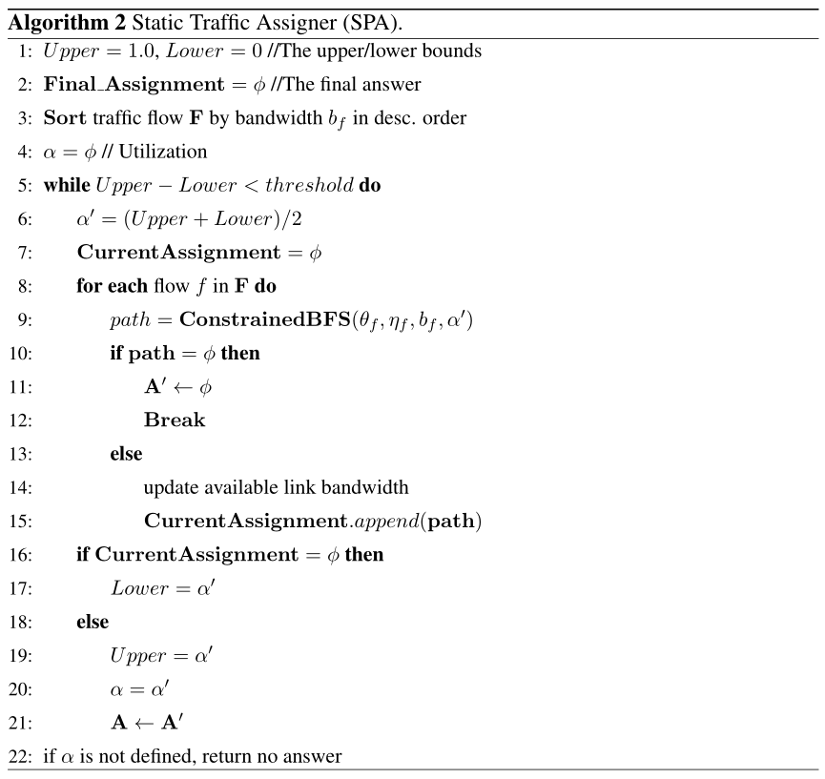
Heuristic Algorithm for Paths finding
Binary search
Assign traffic into system
Adjustα$\left\{\begin{aligned}\text{α}=\frac{\text{α}+lower}{2}, success \\ \text{α}=\frac{upper+\text{α}}{2}, failed\end{aligned}\right.$

Slide 35
Controller Components
Tunnel Constructor
Admission Controller
Tunnel Table
Dynamic Tunnel Finder
Dynamic Traffic Assigner
Tunnel Table
Traffic Status
Static Tunnel Finder
Static Traffic Assigner
Topology
Tunnel Table
Unexpected events
Traffic Table
Traffic Request
Proactive Switch Module
Main Control Logic (OpenFlow Events Handlers)
Flow Command Dispatcher
MPLS-enabled Network

Slide 36
Dynamic Path Assigner
Determine the routing path in real time
New traffic request
Unexpected Events -> traffic flows need to be re-allocated
Decide whether the network can handle traffic
Quick response to minimize delay
Leave the utilization optimizing to SPA

Slide 37
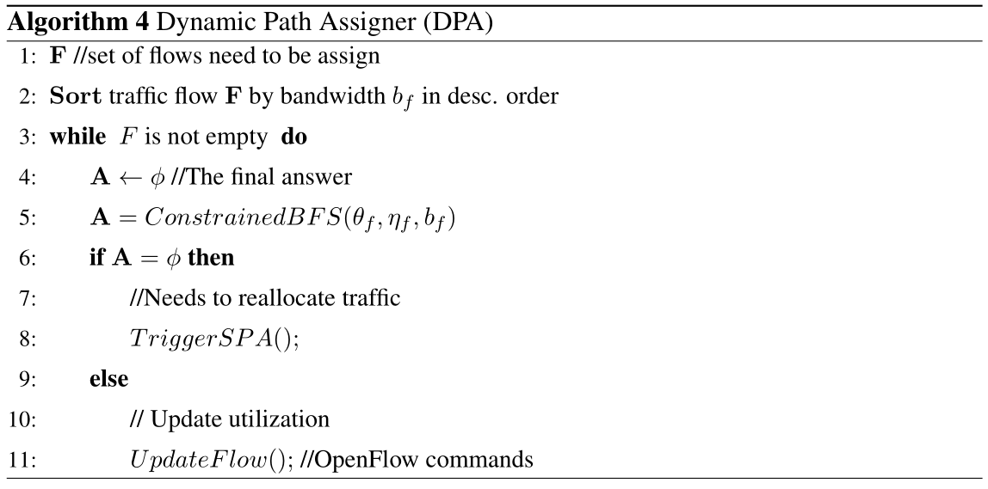
Find a path in real-time
Goal: find sufficient path to fit the traffic
Using the same BFS module in Static Path Assigner

Slide 38
Controller Components
Tunnel Constructor
Admission Controller
Tunnel Table
Dynamic Tunnel Finder
Dynamic Traffic Assigner
Tunnel Table
Traffic Status
Static Tunnel Finder
Static Traffic Assigner
Topology
Tunnel Table
Unexpected events
Traffic Table
Traffic Request
Proactive Switch Module
Main Control Logic (OpenFlow Events Handlers)
Flow Command Dispatcher
MPLS-enabled Network

Slide 39
Switch Dynamic
Goal: to find a tunnel with lowest utilization
Consider link utilization => govern more traffic
Connect New edge switches to the network
Find lowest utilization tunnels to all the nodes
Recover failed tunnels
Create virtual nodes => connect two tunnels with overlapping points
Virtual Node S
Virtual Node E
Notes:
Animate

Slide 40
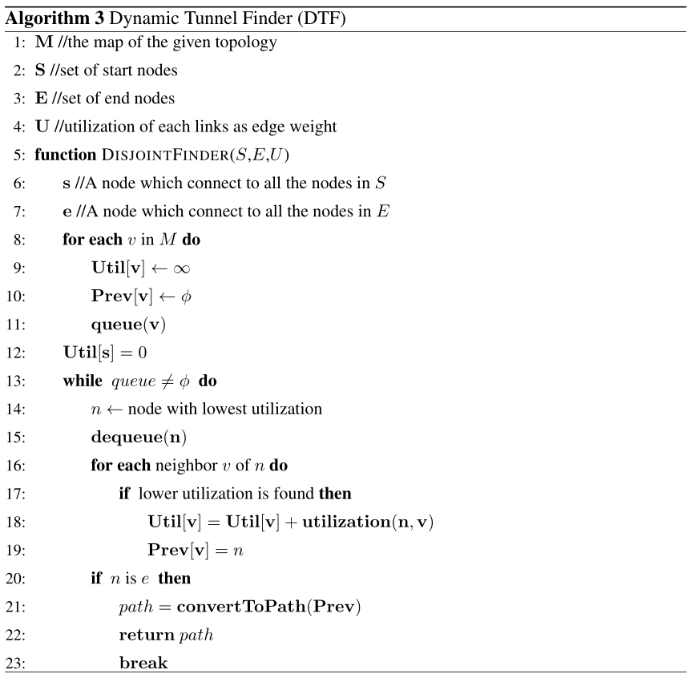
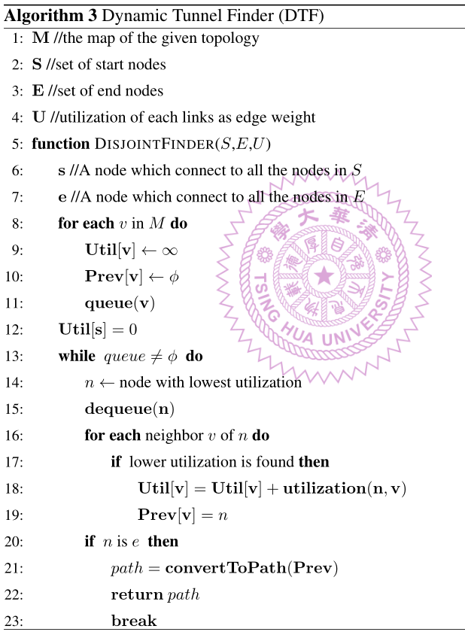
Dijkistra to find path
Weight <- Current link util.

Slide 41
Evaluation

Slide 42
Implementation
TE with
Label Switching
Segment
Routing
IGP
Ryu
Simple
Routing
Ryu Controller
User-defined
Applications …
Built-in Applications
Ryu Libraries
OpenFlow Protocols
IP Network Protocols
Mininet
OpenVSwithc
OpenFlow Switches

Slide 43
Application in RYU
Traffic Engineering with Label Switching (TEL)
Optimize traffic by proposed algorithms
Proactively install disjoint paths in system
Segment Routing with IGP (SRI)
Cisco Pathman[1]
Shortest Path Routing
Proactively install paths in system
Choose path with lowest link usage
Ryu Simple Routing (RSR)
Spanning Tree Protocols
[1] OpenDaylight Pathman SR App from cisco. https://github.com/CiscoDevNet/pathman-sr.
Notes:
[cite] cisco pathman

Slide 44
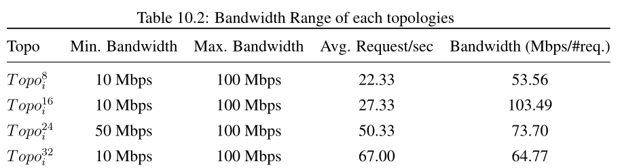
Experiment setup
Mininet network emulator
OpenVSwich
Real traffic flows generated by iPerf
4 different sizes, each size has 5 different topologies
Conduct experiments for 10 times
UDP packets

Slide 45
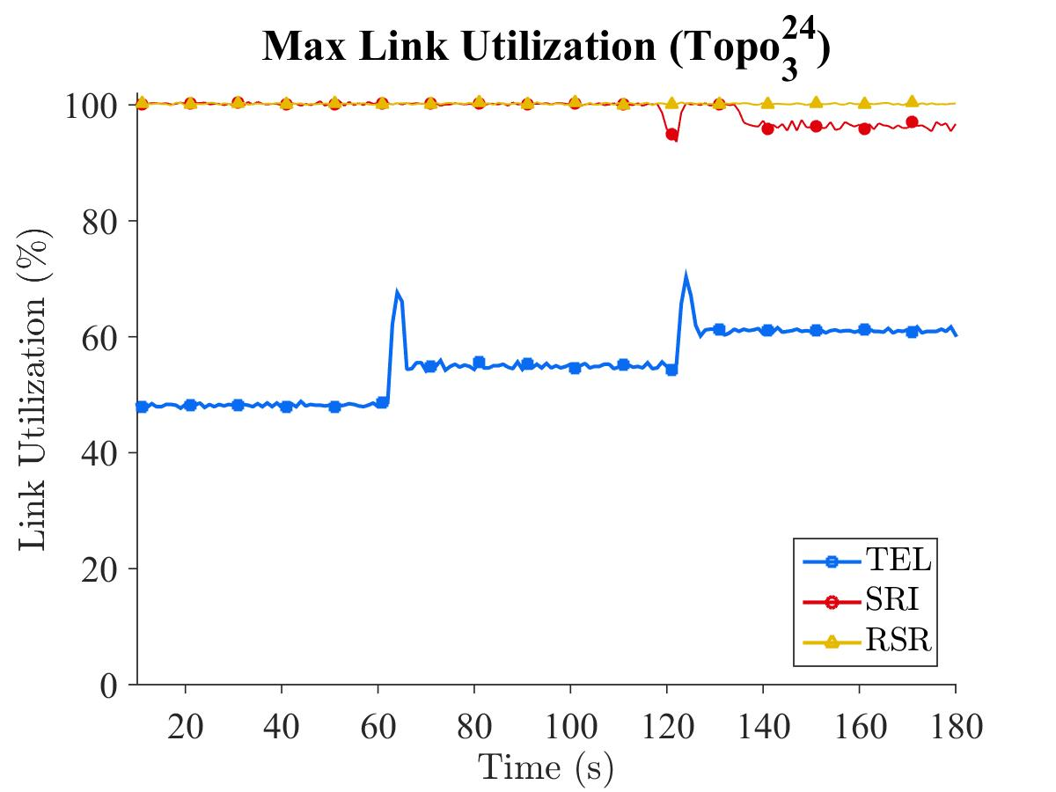
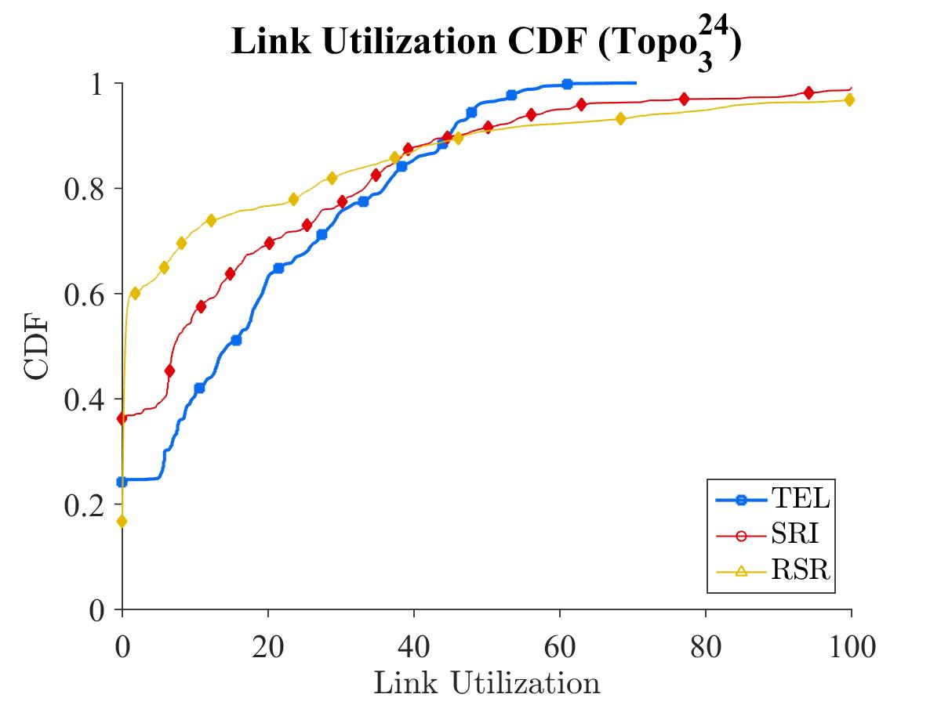
TEL optimizes the max. link utilization
TEL optimize the traffic
TEL always achieve the lowest max. link utilization
90% of links have less than 50% link usage

Slide 46
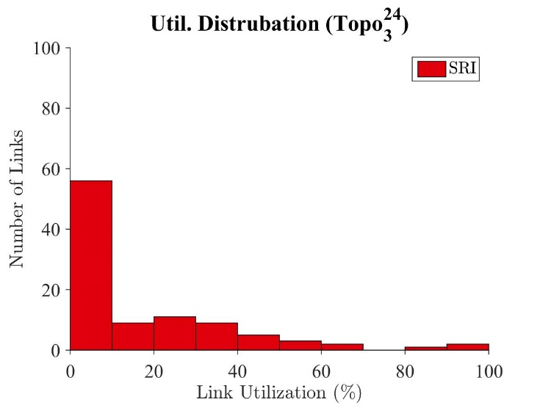
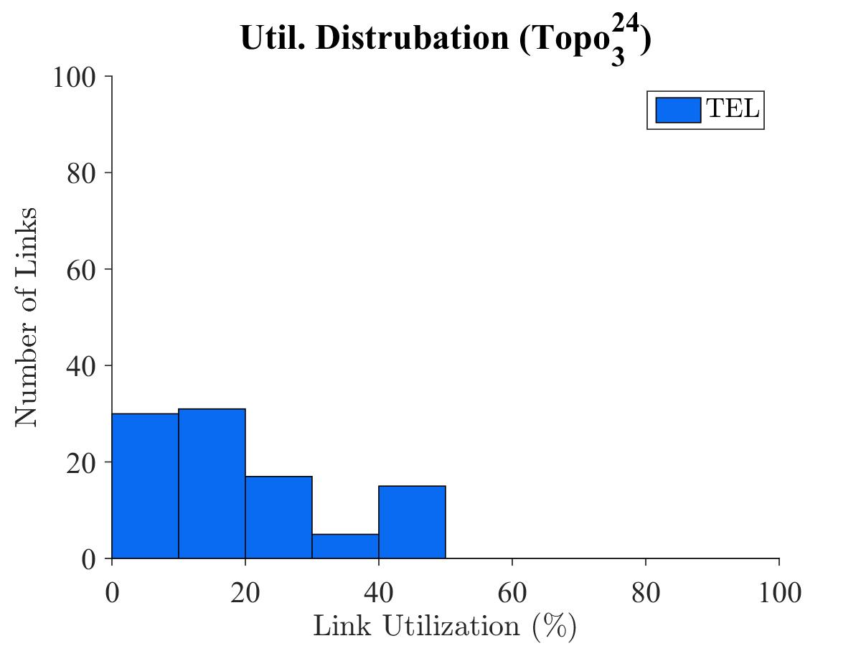
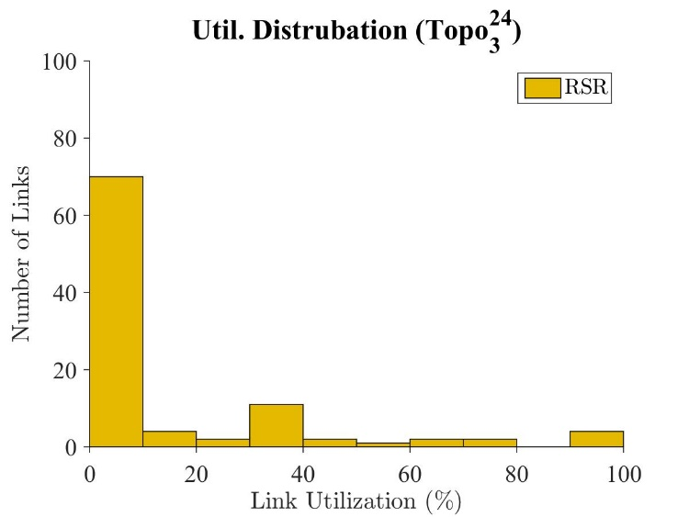
Utilize Idle resources
TEL uses idle resources to balance the traffic
More links are used
Minimize utilization

Slide 47
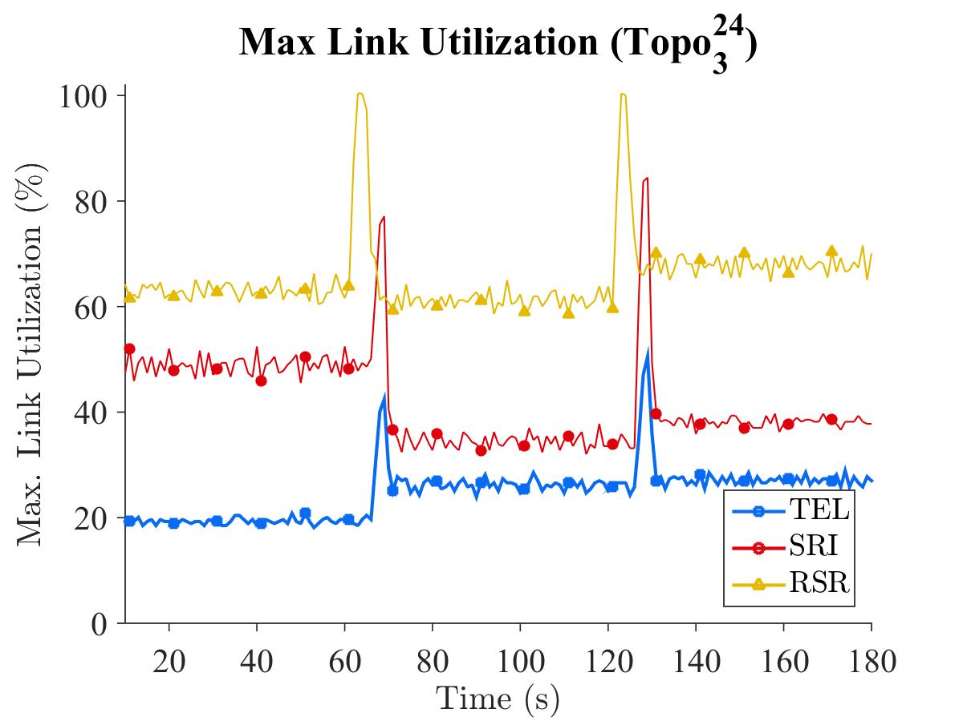
Heavy and Light traffic
TEL is able to minimize the traffic in both heavy traffic & light traffic
Light traffic : 28.96 Mbps
Heavy traffic : 73.70 Mbps

Slide 48
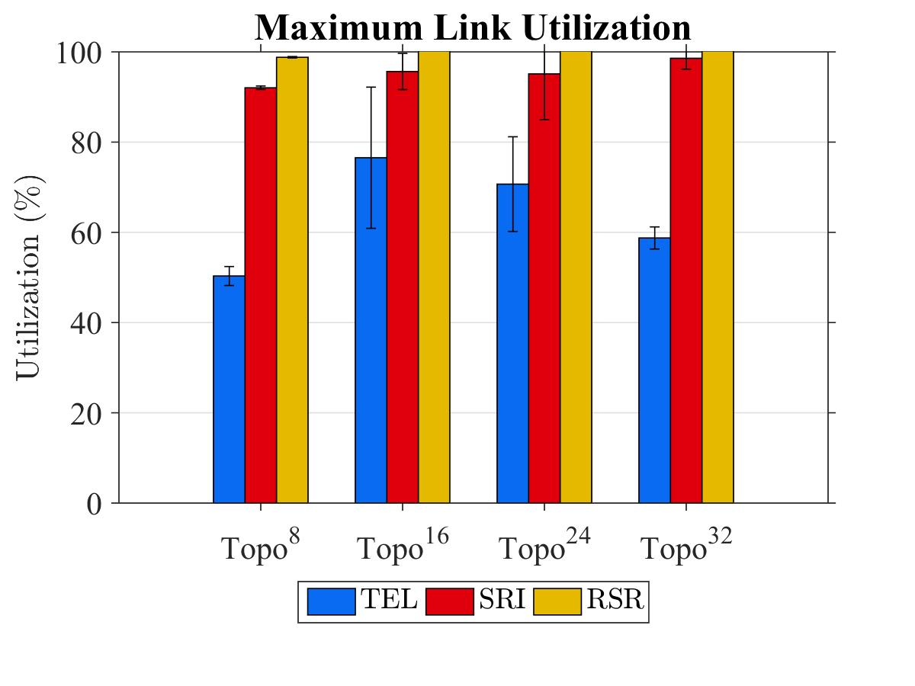
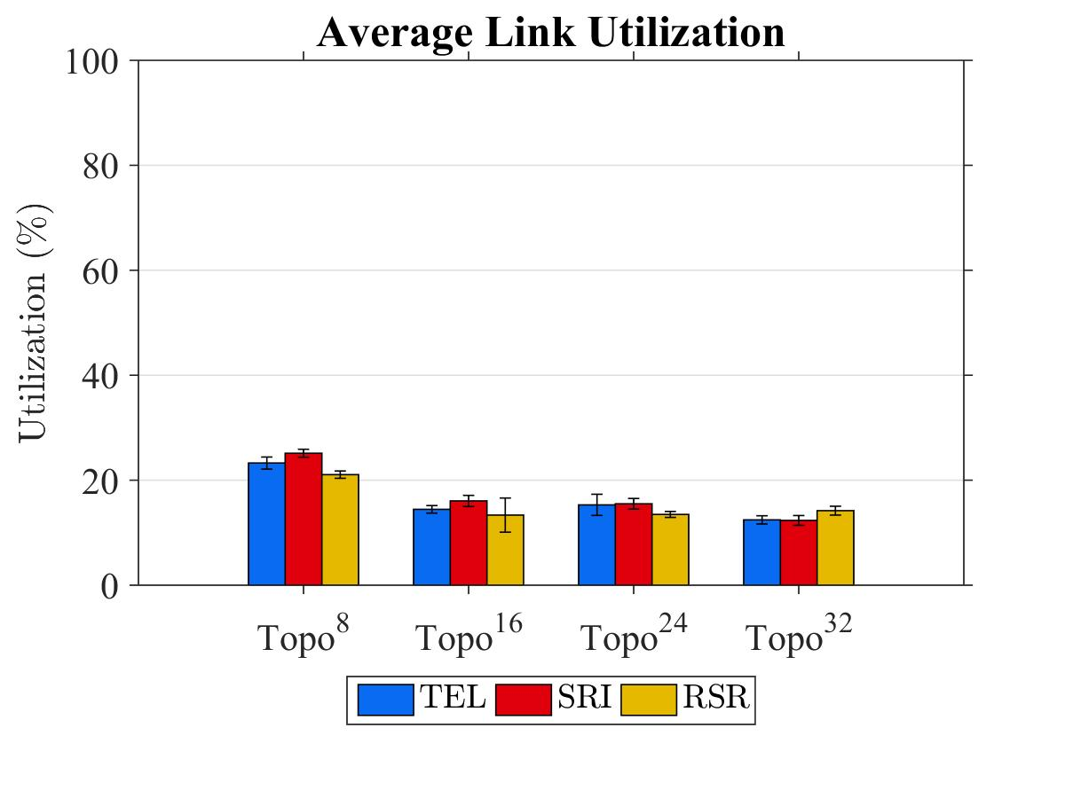
TEL balances the traffic in different topologies
TEL reduces maximal link utilization over
SRI between 20% ~ 46%
RSR between 30% ~ 50%
-20%
-46%

Slide 49
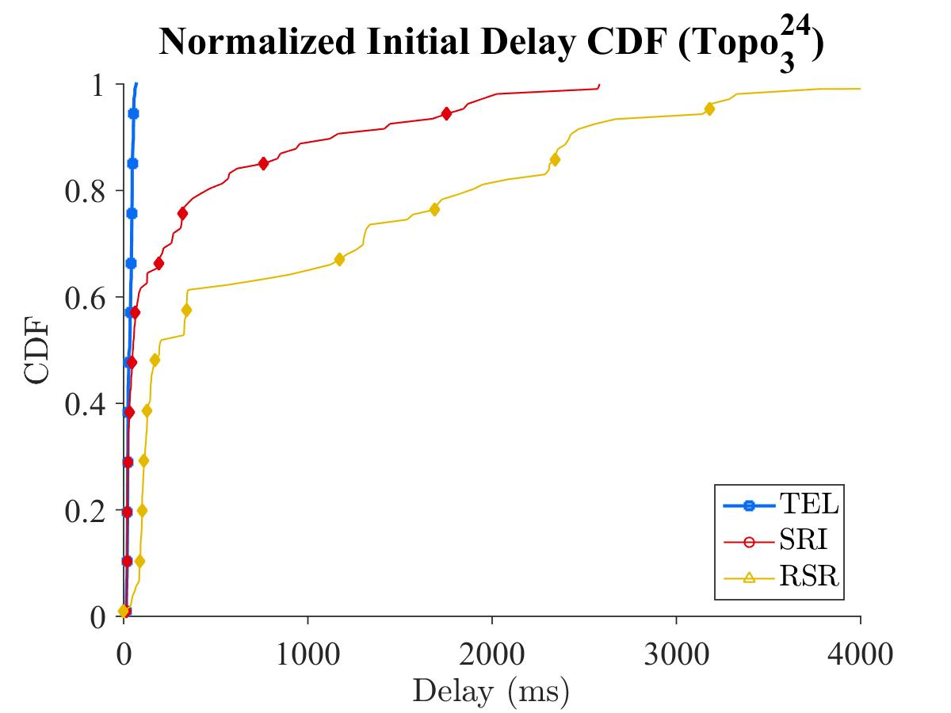
TEL achieves the lowest Init. delay
TEL achieves lowest initialization delay
Both SRI and RSR suffer from congestion, and the delay is relatively high

Slide 50
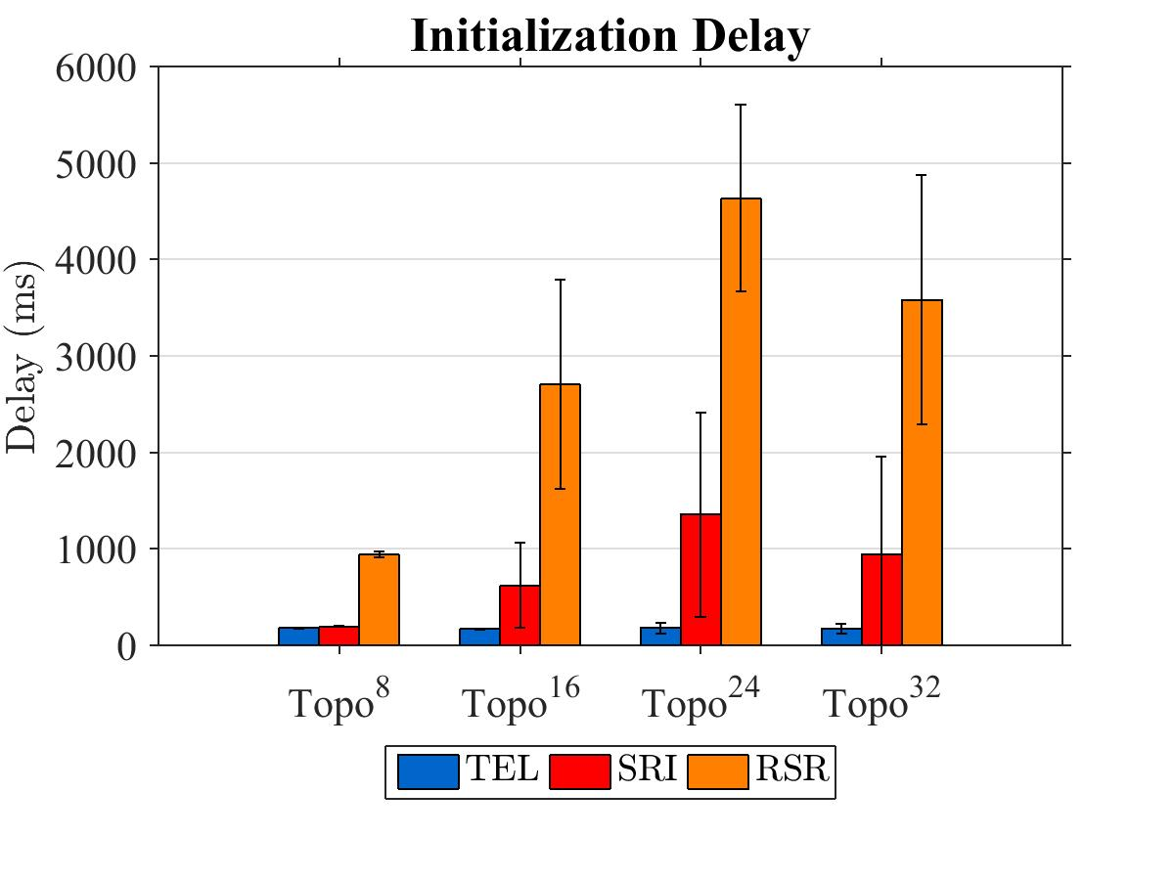
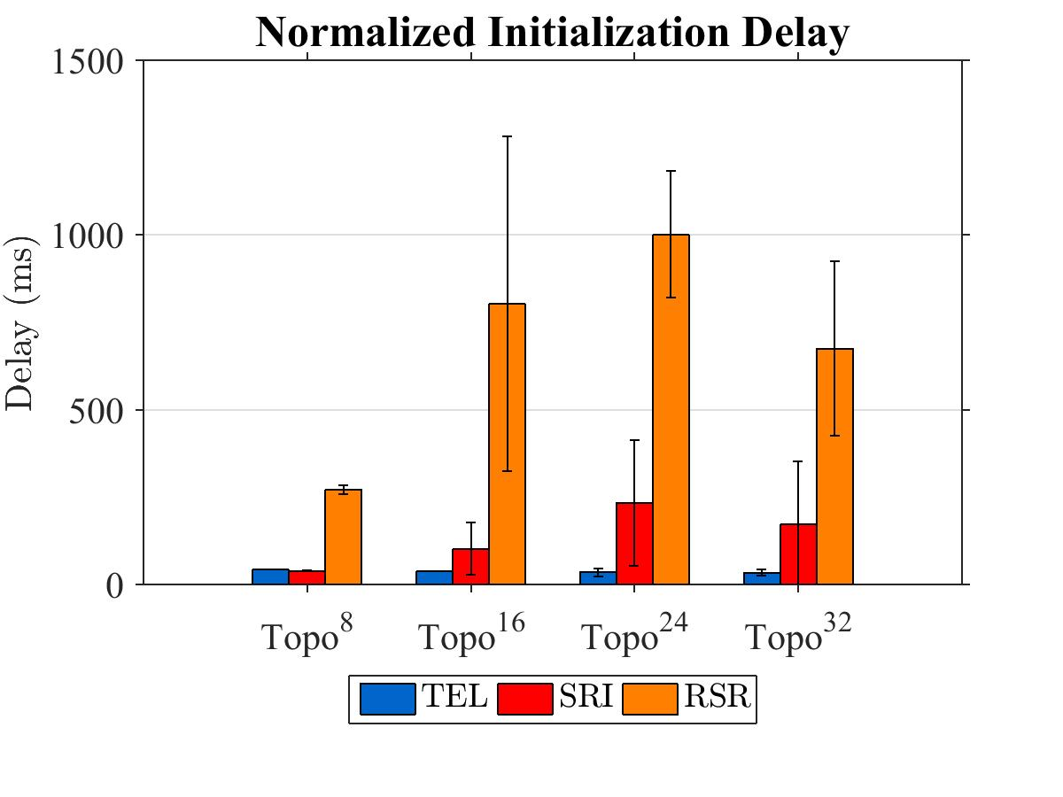
Congestion increases the delay
Initialization delay is reduced by 39.02% and 93.22% compared to the SRI and RSR
Delay increases along the size
Heavy congestion in $Topo^{24}$ ( 9% of links suffer from congestion) 3-5% others
Notes:
Show congestion

Slide 51
TEL takes more time on pre-built tunnels
We don’t need to compute the tunnels constantly
The state changes only if the topology changes

Slide 52
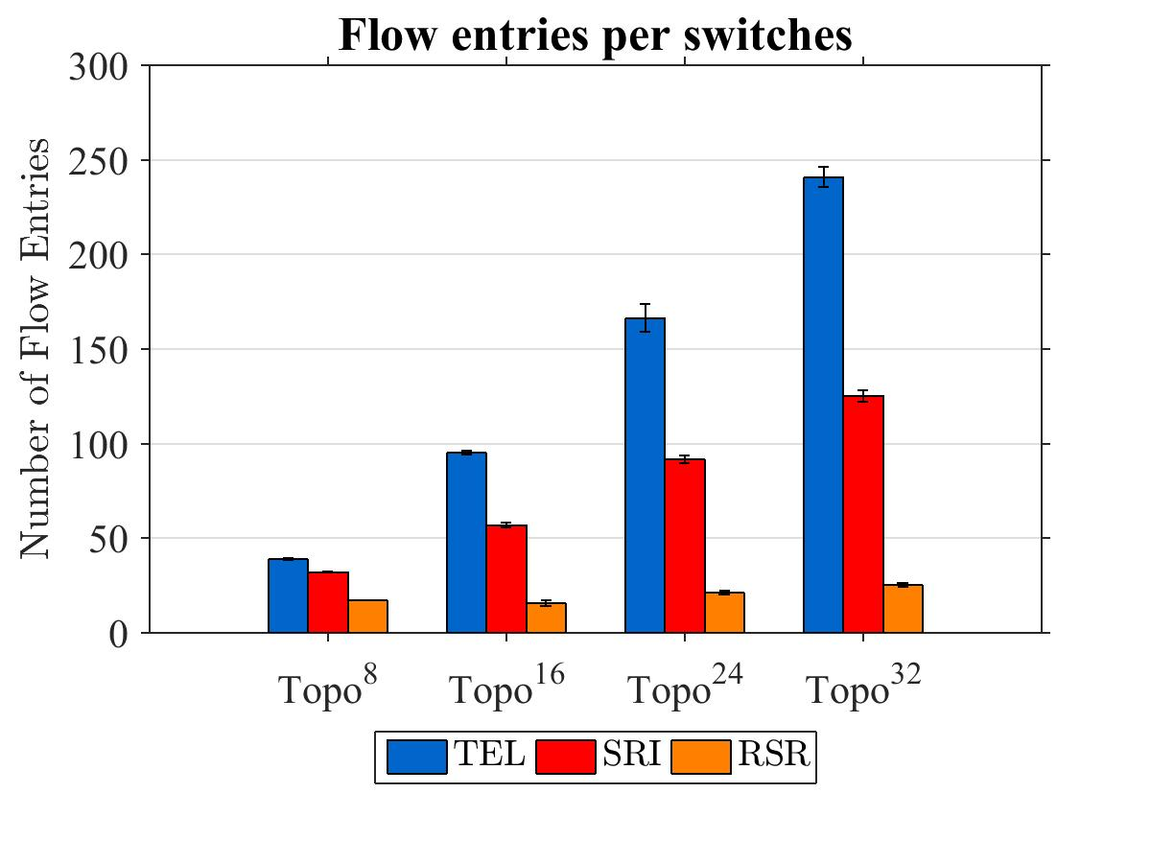
TEL consumes more flow entries
TEL consume more flow entries
Reductant flow rules => quick response, error resilience
Tunnels can be further optimized (Future works)

Slide 53
Recover path with backup
$$S_{2}$$
$$S_{4}$$
$$S_{1}$$
$$S_{6}$$
$$H_{1}$$
$$H_{2}$$
$$S_{3}$$
$$S_{5}$$

Slide 55
Recover using DPA
$$S_{2}$$
$$S_{4}$$
$$S_{1}$$
$$S_{6}$$
$$H_{1}$$
$$H_{2}$$
$$S_{3}$$
$$S_{5}$$

Slide 57
Wait for edge reconnecting
$$S_{2}$$
$$S_{4}$$
$$S_{6}$$
$$S_{1}$$
$$H_{1}$$
$$H_{2}$$
$$S_{3}$$
$$S_{5}$$

Slide 59
Conclusion

Slide 60
Conclusion
Purposed a label switching for solving Traffic Engineering in SDNs
Flexibility, Load balancing and Error resilience
Purposed algorithms for the label switching
2 Tunnel finder algorithm
1 Load balancer, and 1 admission controller
Emulation results shows that Purposed TEL:
Reduce the max. link utilization in different condition (Using idle resources)
Minimize initialization delay
The dynamic algorithm provide error resilience

Slide 61
Thanks for listening
Q & A

Slide 62
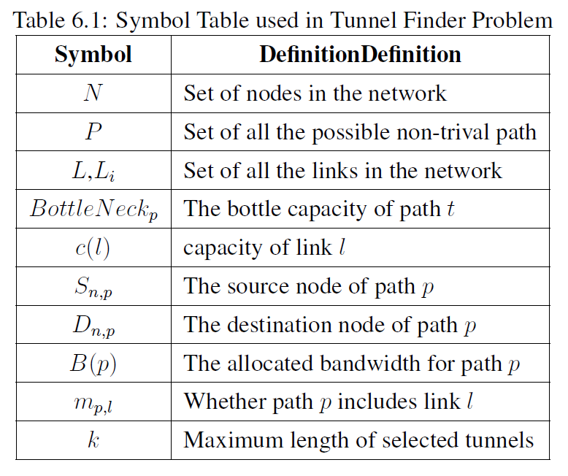
Symbol Table

Slide 63
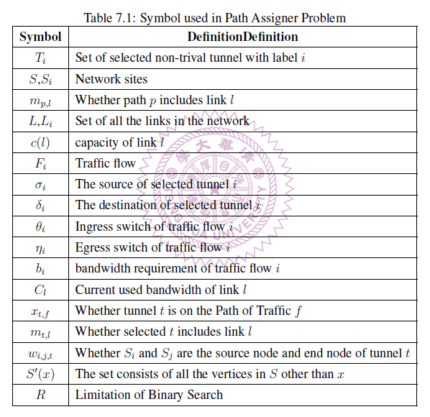
Symbol Table

