Slide 1
Placing virtual machines to optimize cloud gaming experience
Hua-Jun, Hong
June, 2014

Slide 2
Publications
H. Hong, D. Chen, C. Huang, K. Chen, and C. Hsu, “QoS-aware virtual machine placement for cloud games,” in Proc. of ACM Annual Workshop on Network and Systems Support for Games (NetGames), Denver, CO, December 2013.
H. Hong, D. Chen, C. Huang, K. Chen, and C. Hsu, “Placing virtual machines to optimize cloud gaming experience,” submitted to IEEE Transactions on Cloud Computing, April 2014.
H. Hong, C. Lee, K. Chen, C. Huang, and C. Hsu, “GPU consolidation for cloud games: Are we there yet?,” submitted to a double-blinded conference, under review, April 2014.

Slide 3
outline
Introduction
Problem Formulation
QDH Algorithm
Testbed
Trace-Driven Simulations
Measurement Study of Modern GPU

Slide 4

The new approach to play games
Cloud gaming system
Play any game at anytime, anywhere on any device!
The increasing market!
8 Billion USD!
2017

Slide 5


Financial difficulty of providers
Cloud gaming providers
Gaikai
Ubitus
Onlive – runs into the financial difficulty
…
The financial problem may cause by…
Network latency
Resource allocation of each VM
Non-mature GPU virtualization
…

Slide 6
Problem statement
Diverse gaming hardware requirements may lead to wasted hardware resources
Consolidating different games results in different profits and gaming quality
Hence, we propose a VM placement policy to maximize the profits while achieve just-good-enough QoE
Also, we conduct a measurement study to make sure that if the modern GPU is powerful enough for the cloud gaming system

Slide 7

Goals
Find the best tradeoff between gaming Quality-of-Experience and profits
Answer the question that “Are modern GPUs ready for cloud gaming?”

Slide 8
outline
Introduction
Problem Formulation
QDH Algorithm
Testbed
Trace-Driven Simulations
Measurement Study of Modern GPU

Slide 9









Notations
Network Latency:
Frame Per Second:
Processing Delay:
CPU Utilization:
GPU Utilization:
Hourly fee:
Operational Cost:
Memory of Server:
Uplink of Datacenter:

Slide 10




Models
CPU utilization, GPU utilization, frame rate, and processing delay can be modeled as sigmoid functions of the number of VMs on a physical server

Slide 11
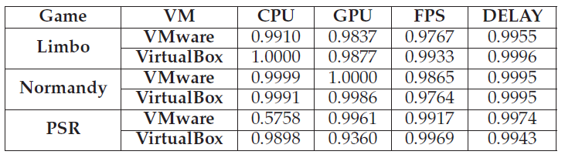
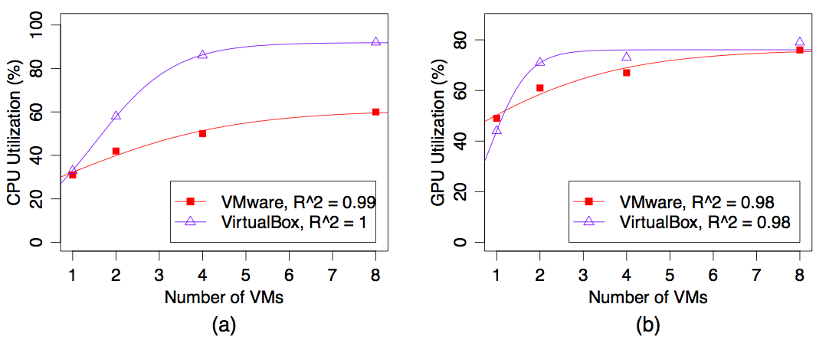
How close are the sigmoid functions
The table shows the R-square values of different games/VM
The figure shows the curve fitting results with different number of VMs

Slide 12
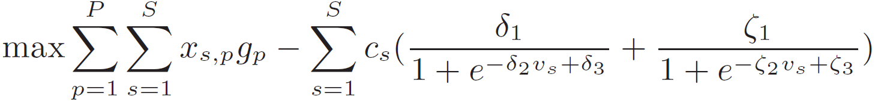
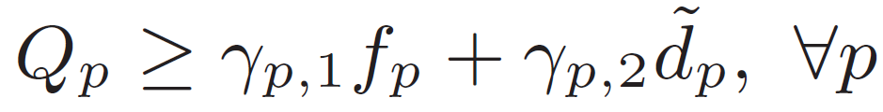
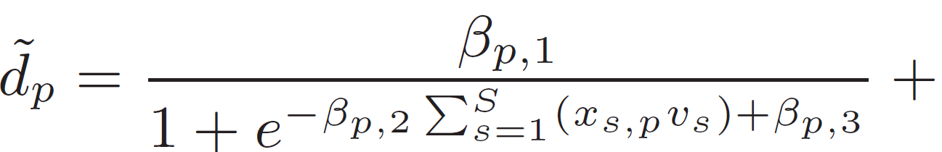
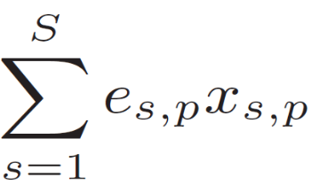
Problem formulation
Decision variable:
Objective Function: Maximize Profits
Constraint: QoE Degradation
Frame Per Second
Delay

Slide 13



Other Constraints

Slide 14
outline
Introduction
Problem Formulation
QDH Algorithm
Testbed
Trace-Driven Simulations
Measurement Study of Modern GPU

Slide 15
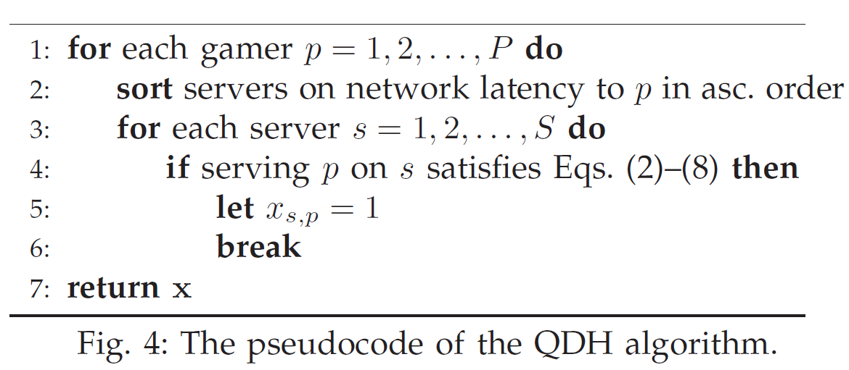
Quality-driven heuristic (QDH)
Consolidate more VMs on a server
Do not exceed the user-specified maximal tolerable QoE degradation
Pseudocode
Notes:
For each gamer, the algorithm first sorts all servers on the network latency to that gamer. It then iterates through the servers in the ascending order and creates a VM for the gamer on the first server that can support this gamer without violating constraints in Eqs. (4.2)–(4.9). It is clear that the QDH algorithm runs in polynomial time.

Slide 16

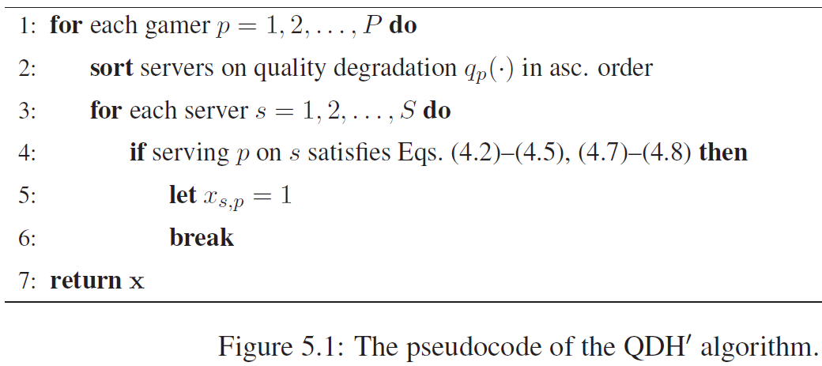
QDH’ – Alternative algorithm
Alternative Formulation and Algorithms for Closed Systems
Objective Function:
Pseudocode
Notes:
For each gamer, the algorithm first computes its quality degradation levels on individual servers. It sorts the servers on the quality degradation if serving that gamer using each server. Then, the algorithm iterates through the servers and creates a VM for the gamer on the first server that can support the gamer without violating any constraints in Eqs. (2)–(5), (7)–(8). QDH′ runs in polynomial time

Slide 17
outline
Introduction
Problem Formulation
QDH Algorithm
Testbed
Trace-Driven Simulations
Measurement Study of Modern GPU

Slide 18
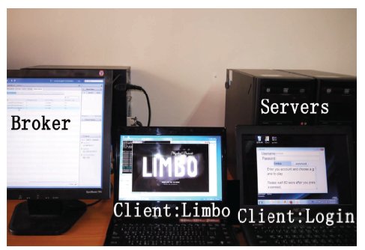
Components of our system
Broker
VMware vCenter 5.1
Single-Sign-On: authentication
Inventory Service: managing/monitoring the VMs on ESXi servers
Physical Servers
VMware ESXi 5.1
GA Client/Servers
GA is the first open source
cloud gaming system
Each VM host one
GA server

Slide 19
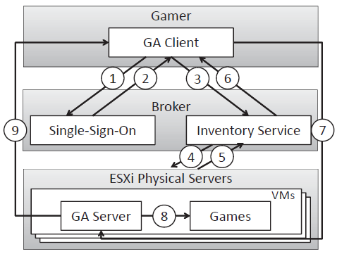
Flow of our system
GA client sends the account and password from gamer to broker
The broker authenticates the gamer
GA client sends the user-specified game to the broker
The broker determines where to create a new VM and instructs the chosen physical server to launch a VM
Physical server sends the VM’s IP address to Broker
Broker Forwards the IP address to GA client
GA client connects to the GA server
GA server launches the game
GA server streams the game to gamer

Slide 20
SET up – hardware
Physical Servers
CPU: i5 3.5 GHz
GPU: Nvidia Quadro 6000
Memory: 16GB
Broker
CPU: i7 3.2 GHz
Memory: 16GB
Clients
CPU: i5
Memory: 4GB
VMs
Equally allocate the CPU and Memory to VMs

Slide 21
Set up - scenario
Join and leaving a game session with D% and (1-D)% probability (D% = 90%) in every minutes
Game: Limbo, PSR, and Normandy
Randomly select game
Up to 2 VMs for each physical server
Total time: 15 minutes

Slide 22
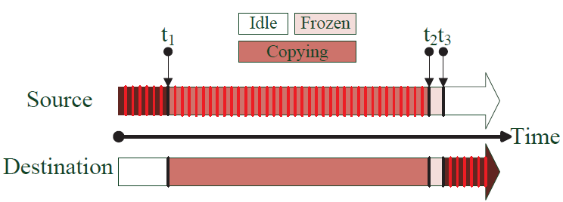
Practical concern
Migration time of 20, 30, and 40 GB VM images are about 6, 9, 11 minutes
Double resources will be consumed between t1 to t3 while we do live migration
Decrease the profits
Decrease the QoE
Hence, we consider an migrationless version of proposed QDH/QDH’ algorithms
Only place the VMs of incoming gamers to avoid the degradation caused by migration time
Live Migration

Slide 23
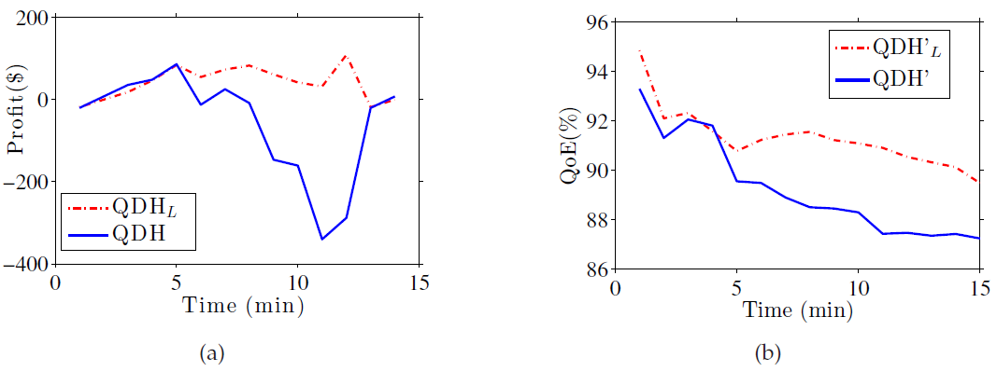
Migrationless Algorithms are better
Outperforms QDH up to 396$ and 4% QoE

Slide 24
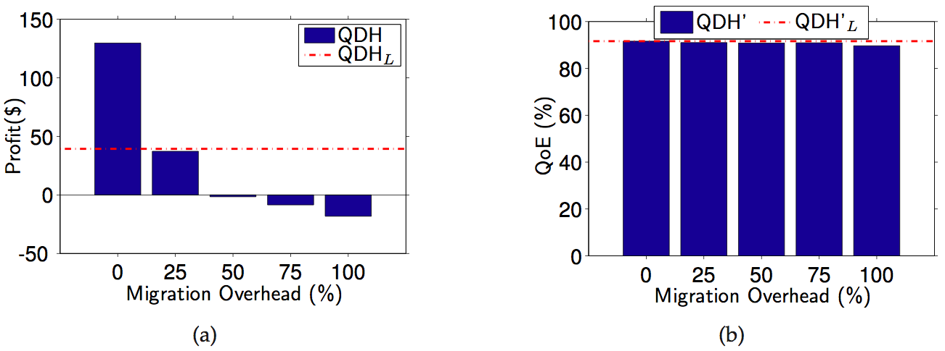
Performance of migrationless algorithms with different migration overhead
25% migration overhead will achieve the same profit
Due to the increasingly higher computing power, the migration overhead will be gradually reduced and the performance gains may be diminishing

Slide 25
Conclusion of testbed
At this time, we do not consider QDH algorithm in the rest of the thesis
QDH algorithm will be useful in the future while the migration time is reduced

Slide 26
outline
Introduction
Problem Formulation
QDH Algorithm
Testbed
Trace-Driven Simulations
Measurement Study of Modern GPU

Slide 27
Set up
Network latencies: KING
Server IP: OnLvie data center
Client IP: BitTorrent
WoW traces
Arrival time and leaving time of gamers
Games
Limbo, PSR, and Normandy
Computer:
CPU: I7-3770 3.2 GHz
Memory: 16GB
VMs:
Equally allocate the CPU and Memory to VMs

Slide 28
Baseline algorithm
Location Based Placement (LBP) algorithm:
LBP places each VM on a random game server that is not fully loaded and the data center geographically closest to the gamer

Slide 29
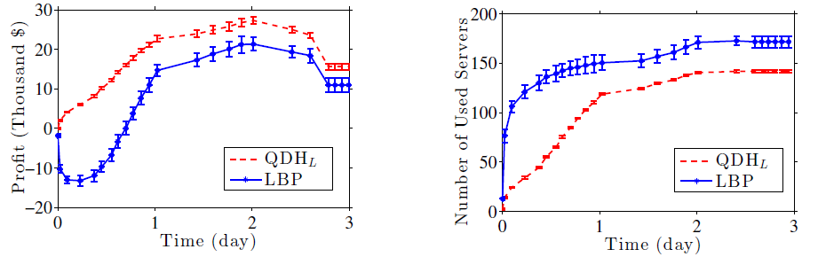
Results of Provider centric algorithm
Earn more money, up to 20+ thousand dollars
Shutdown more servers
(a) (b)
Simulation results with WoW traces: (a) net profits and (b) used servers

Slide 30
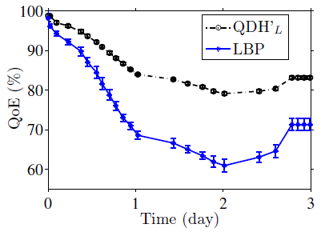
Results of gamer centric algorithm
Outperform LBP algorithm up to 130% QoE

Slide 31
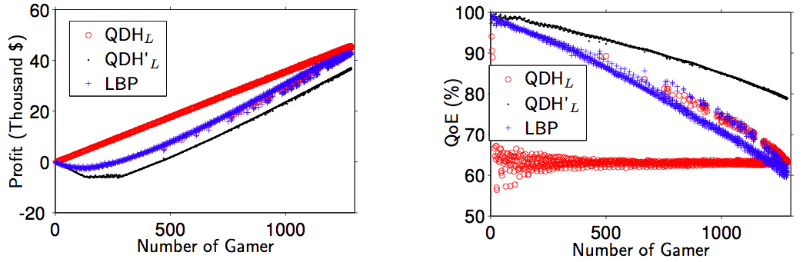
Impact of number of gamers
The figure shows that more gamers lead to higher profits and lower QoE levels, and QDHL/QDH′ L successfully achieve their design objectives

Slide 32
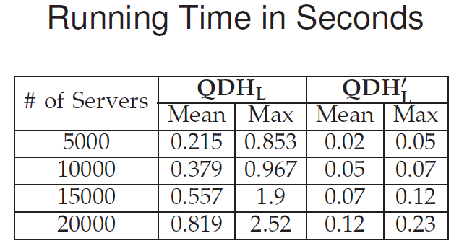
Running time
The efficient algorithms terminate in < 2.5 s on a commodity PC even for large services with 20000 servers and 40000 gamers

Slide 33
outline
Introduction
Problem Formulation
QDH Algorithm
Testbed
Trace-Driven Simulations
Measurement Study of Modern GPU

Slide 34
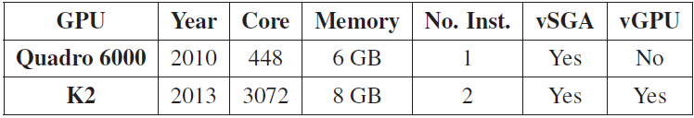
Modern GPU
Nvidia Quadro 6000
Released in 2010
Nvidia K2
Released in 2013
Support vGPU
Each instance can be configured to:
Pass-through
vGPU with up to 2,4,or 8 VMs
Specifications of Two GPUs

Slide 35
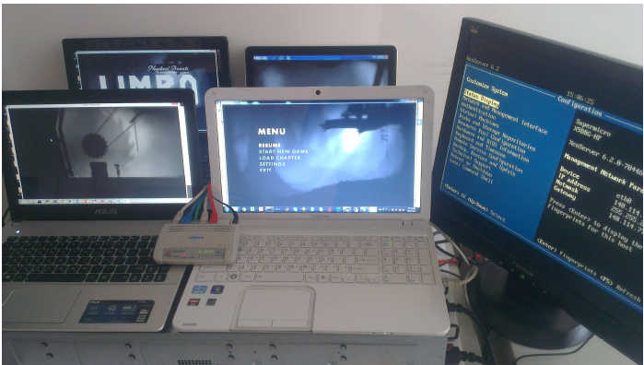
Set up
Cloud gaming server:
OS: XenServer 6.2
CPU: Xeon 2.1 GHz
Memory: 64 GB
VM:
By default, the XenServer allocates 1 CPU core and 2GB memory to Dom0, which is responsible for managing VMs
The remaining CPU cores and memory are equally divided among the VMs running Windows 7

Slide 36
Workload
Game:
Limbo: scroll-based puzzle game
Fear2: first person shooter game
LEGO Batman: action game
Benchmark:
Sanctuary: GPU benchmark
Cadalyst: 2D versus 3D
Tinytask:
A program to record the mouse and keyboard inputs of each game
We record 3 minutes for each game and replay the same inputs to ensure fair comparisons

Slide 37
Performance metrics
Frame Per Second
The number of rendered frames per second
Context Switch
The number of context switches in Dom0
CPU Utilization
The CPU load of Dom0 (CPUdom0) and each VM (CPUvm).
GPU Utilization
The load of GPUs

Slide 38
Measurement Utilities
Fraps: To measure the FPS of the foreground window
Sar: To measure the number of context switches
Xentop: To measure the CPU utilization of Dom0 and VMs
Nvidia-smi: To measure the GPU utilization under vGPU
GPU-Z: To measure the GPU utilization of pass-through GPUs

Slide 39
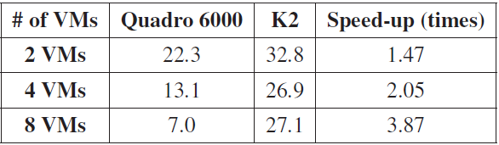
Performance of two modern GPUs
This table shows that K2 outperforms Quadro 6000 with up to 3.87 times of FPS increases
Scalability: FPS of K2 does not drop too much even with 8 VMs
Huge edge of vGPU (mediated pass-through) over vSGA (software-based virtualization)
we no longer consider Quadro 6000 and vSGA in the rest of this thesis
Achieved frame rates on two considered GPUs

Slide 40
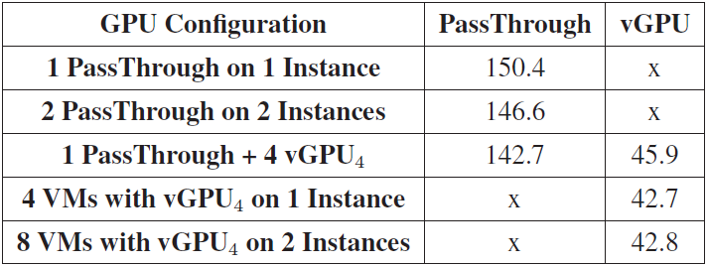
Independence of the two k2 GPU instances
Performances of passThrough are the same in different configurations. vGPU has the same observation
The results show the two instances are independent
Sanctuary Scores in FPS from Diverse GPU Configurations

Slide 41
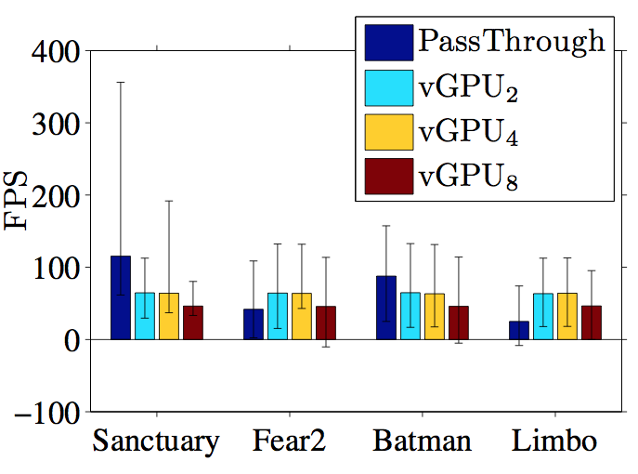
Shared GPUs may outperform dedicated GPUs
vGPU results in higher FPS than pass-through when executing Limbo and Fear2
Comparing the pass-through and vGPU: resulting FPS

Slide 42
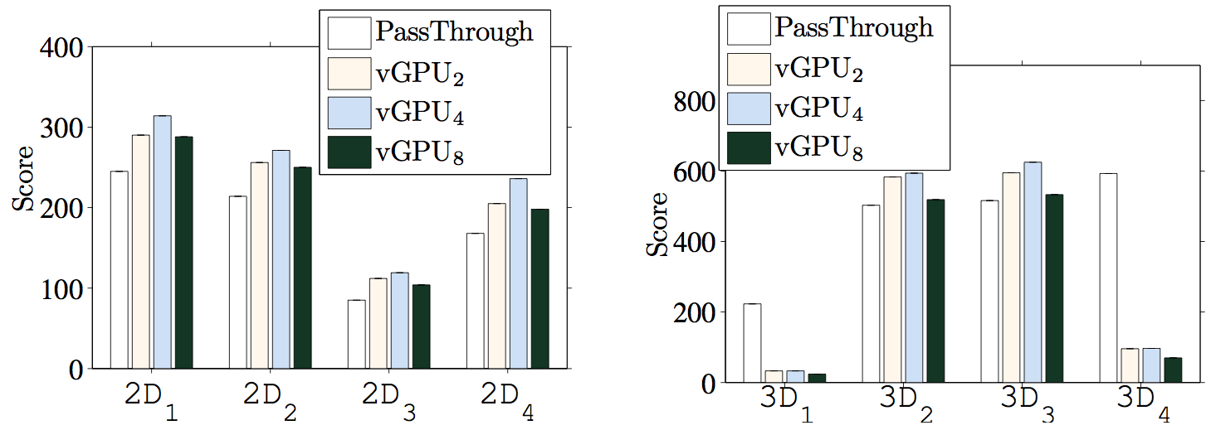
2D/3D performances
vGPU2 outperforms pass-through …
All 2D operations up to 15%
Part of 3D operations
Similar observations are also true for vGPU4 and vGPU8
(a) (b)
Comparing the pass-through and vGPU: (a) 2D benchmark scores and
(b) 3D benchmark scores.

Slide 43
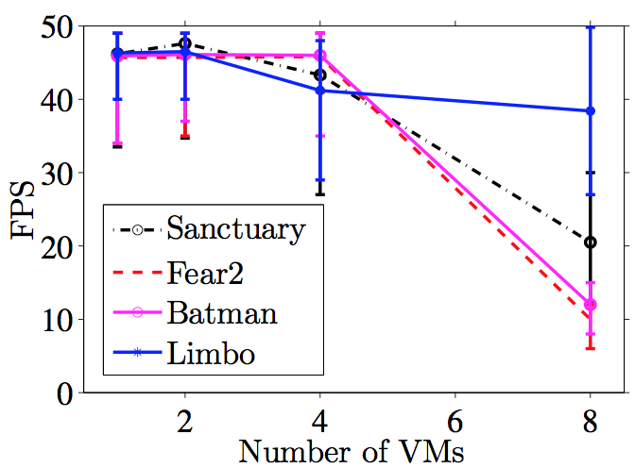
Consolidation overhead
Limbo does not suffer from consolidation overhead, while all other games/benchmark do
GPU consolidation overhead: resulting FPS

Slide 44
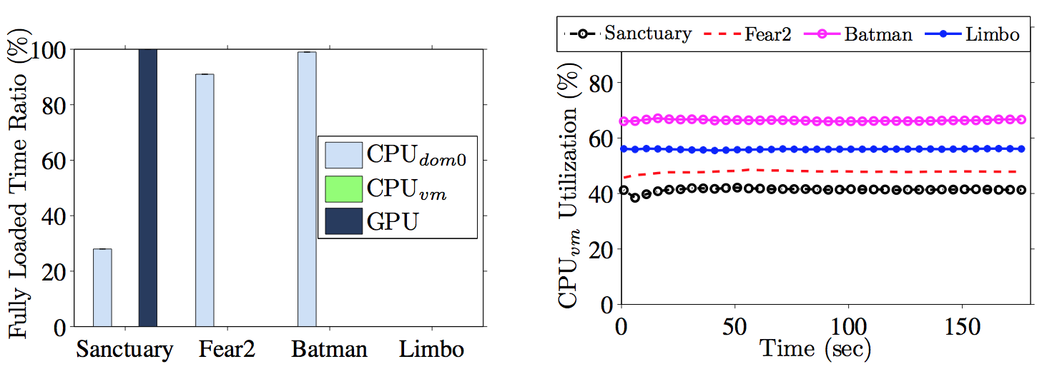
Consolidation overhead caused by…
The figure shows that Sanctuary is bounded by GPU, while Fear2 and Batman are bounded by CPUdom0
Allocating more CPU cores to Dom0 to alleviate the high consolidation overhead for more complex games.
(a) (b)
GPU consolidation overhead: (a) fully loaded time ratio from vGPU8,
and (b) CPUvm from vGPU8.

Slide 45
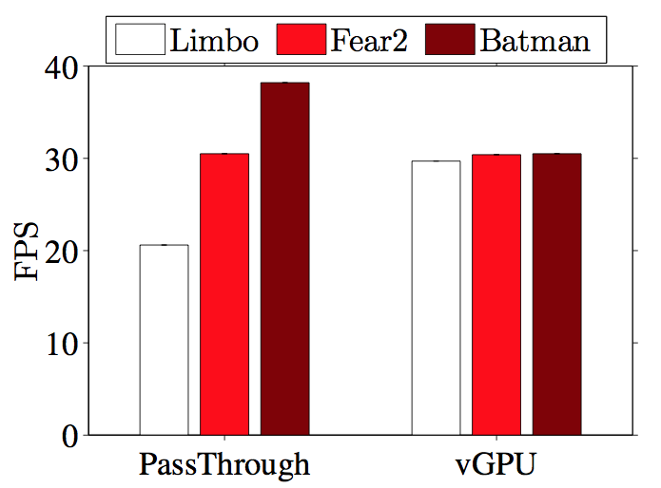
End-to-end cloud gaming performance
Only 1 VM
Open source cloud gaming system: Gaming anywhere
Not good-enough quality which between 20~42 fps
End-to-end performance of a cloud game platform: resulting FPS

Slide 46
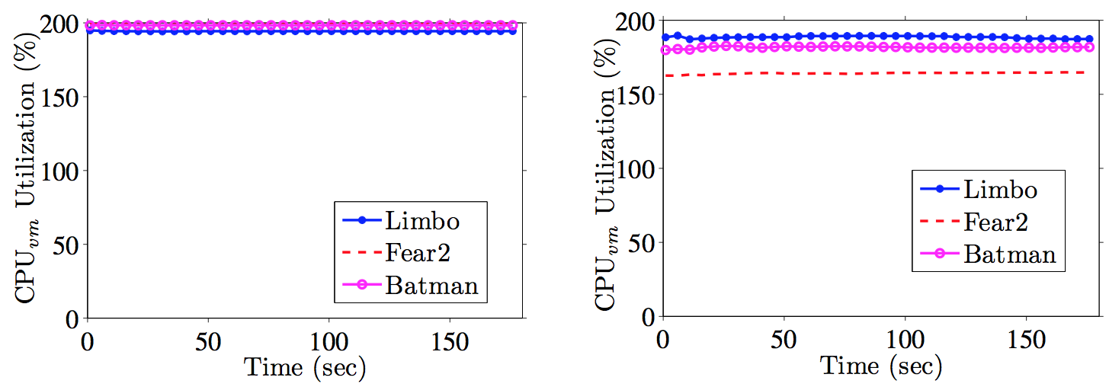
Reason of the low gaming quality
Real-time video encoding relies on computing power of CPU
Leverage the hardware codec on K2 GPU to improve it
(a) (b)
End-to-end performance of a cloud game platform: (a) CPUvm utilization with
pass-through GPU and (b) CPUvm utilization with vGPU2.

Slide 47
Conclusion
VM placement algorithms [NetGames’13 short and IEEE TCC’14]:
Migrationless algorithms outperform the state-of-the-art algorithm up to 20+ thousand dollars in net profits and 130% performance in QoE
The efficient algorithms terminate in 2.5 s on 20000 servers and 40000 clients
GPU measurement [MM’14 short under review]:
Shared GPUs may outperform dedicated GPUs
Shared GPUs are rather scalable to the number of VMs
Modern GPUs can be shared by VMs running GPU-intensive computer games

Slide 48
Future work
Hardware codec
Leveraging the hardware H.264 codecs to improve the performance of real-time encoding
More comprehensive system models
Other types of resources
Heterogeneous server types

Slide 49
Q&A

