Slide 1
Detour Planning Problem on Mobile Crowdsensing Systems
Chen-Chih Liao
Slides: 39 pages

Slide 2
Outline
Introduction
  Motivation
  Crowdsensing
  Research Problems
Related Work
Detour Planning Problem
  Formulation
  Solution
  Evaluation
Multi-user Detour Planning Problem
  Formulation
  Solution
  Evaluation
Conclusion and Future Work

Slide 3




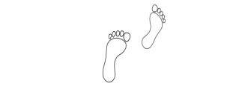
Motivation
Smartphone users are ubiquitous, and smartphones provide powerful computing and sensing abilities
  Smartphones are capable to perform some tasks
  (e.g.: shooting photos/videos, reading sensory data, and etc.)
Ideas to make good use of smartphones and let smartphone users contribute their effort for some rewards
Crowdsensing
Notes:
Free image: http://openclipart.org/

Slide 4
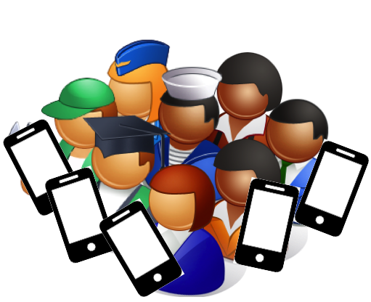
What is Crowdsensing?
Mobile sensing
  Opportunistic sensing
  Participatory sensing
Limitation
  Mobile sensing could not serve a large number of sensing tasks
Crowdsensing
  Human-in-the-loop
    Similar to crowdsourcing

Slide 5

Geospatial Information Gathering
A new class of crowdsensing systems
Requesters: companies and organizations
    Submit geospatial and temporal-dependent tasks (specific time and location)
    Task: capturing videos/pictures or collecting sensor readings
Workers: smartphone users
    Report their destination and deadline
    They wouldn’t mind to take some detour routes for small rewards

Slide 6


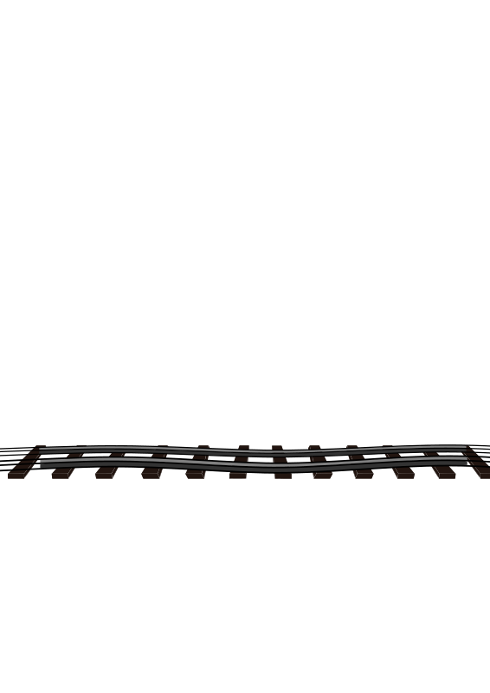
Usage Scenario #1
When the smartphone user is at the train station, and he is waiting the train which will arrive at 1 to 2 hours
What can he do in this free time?
  Perform some tasks which are near the station
Station

Slide 7

Usage Scenario #2
When the smartphone user is traveling, and he expect that he will arrive at his destination in 2 hours
What can he do in this traveling time?
  Perform some tasks which are near the expected route
Destination

Slide 8

Key Research Problem:
Detour Planning Problem
Problem: How to make a good use of the abilities of ubiquitous smartphone users?
Goal: We plan to let smartphone users well utilize their smartphones and earn the maximum rewards in their available time
Solutions:
  (Single-user) Detour Planning Algorithm [MoVid’13]
  Multi-user Detour Planning Algorithm
[MoVid’13] C. Liao and C. Hsu. A detour planning algorithm in crowdsourcing systems for multimedia content gathering. In Proc. of Workshop on Mobile Video (MoVid’13)

Slide 9
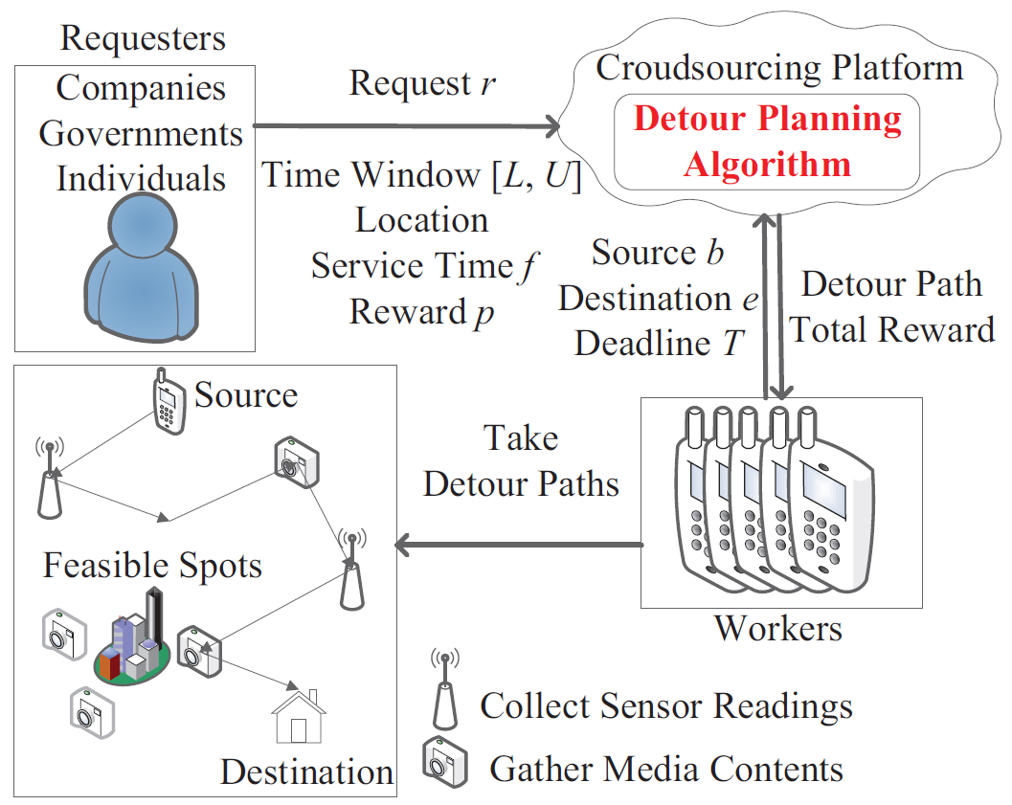
System Architecture
Crowdsensing Platform
Notes:
Explain how the system works

Slide 10
Contribution
The systems produce a detour path for each new worker.
The systems compute the detour paths to maximize total worker profit.
The systems simultaneously consider multiple users to make a good use of all users.
The systems concern the energy consumption and sensor accuracy when assigns requests to workers.

Slide 11
Outline
Introduction
  Motivation
  Crowdsensing
  Research Problems
Related Work
Detour Planning Problem
  Formulation
  Solution
  Evaluation
Multi-user Detour Planning Problem
  Formulation
  Solution
  Evaluation
Conclusion and Future Work

Slide 12
Related Work
Crodwsourcing
  [36] Task matching in crowdsourcing
  [1] Mechanism design for spatio-temporal request satisfaction in mobile networks
  [3] On task assignment for real-time reliable crowdsourcing
  We consider mobile multimedia/sensing, and our solution gives optimal paths
Crowdsensing
  [12] A location-based incentive mechanism for participatory sensing systems with budget constraints
  [5] Truthful auction for location-aware collaborative sensing in mobile crowdsourcing
  [23] Toward optimal allocation of location dependent tasks in crowdsensing
  We consider more time constraints of multimedia/sensing requests and workers, and we also take account of reward, traveling/energy costs, and accuracy.
Notes:
Sorcing
-3 real-time assign, and receive reliable results
Sensing
-2 min energy cost
-3 max reward, energy cost:X, time-widow:X, traveling cost:O

Slide 13
Outline
Introduction
  Motivation
  Crowdsensing
  Research Problems
Related Work
Detour Planning Problem
  Formulation
  Solution
  Evaluation
Multi-user Detour Planning Problem
  Formulation
  Solution
  Evaluation
Conclusion and Future Work

Slide 14
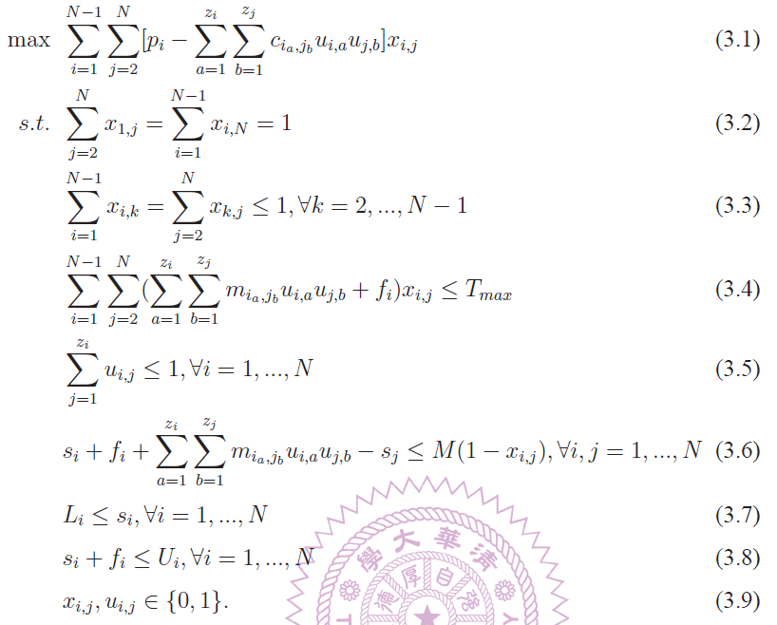
Problem Formulation
Maximize overall profits
Start and end points
No rep. each request
Arrive destination in time
Visit one feasible spot
of each request
Timeline of each request
Start time of each request
Finish time of each request

Slide 15
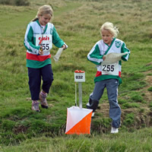
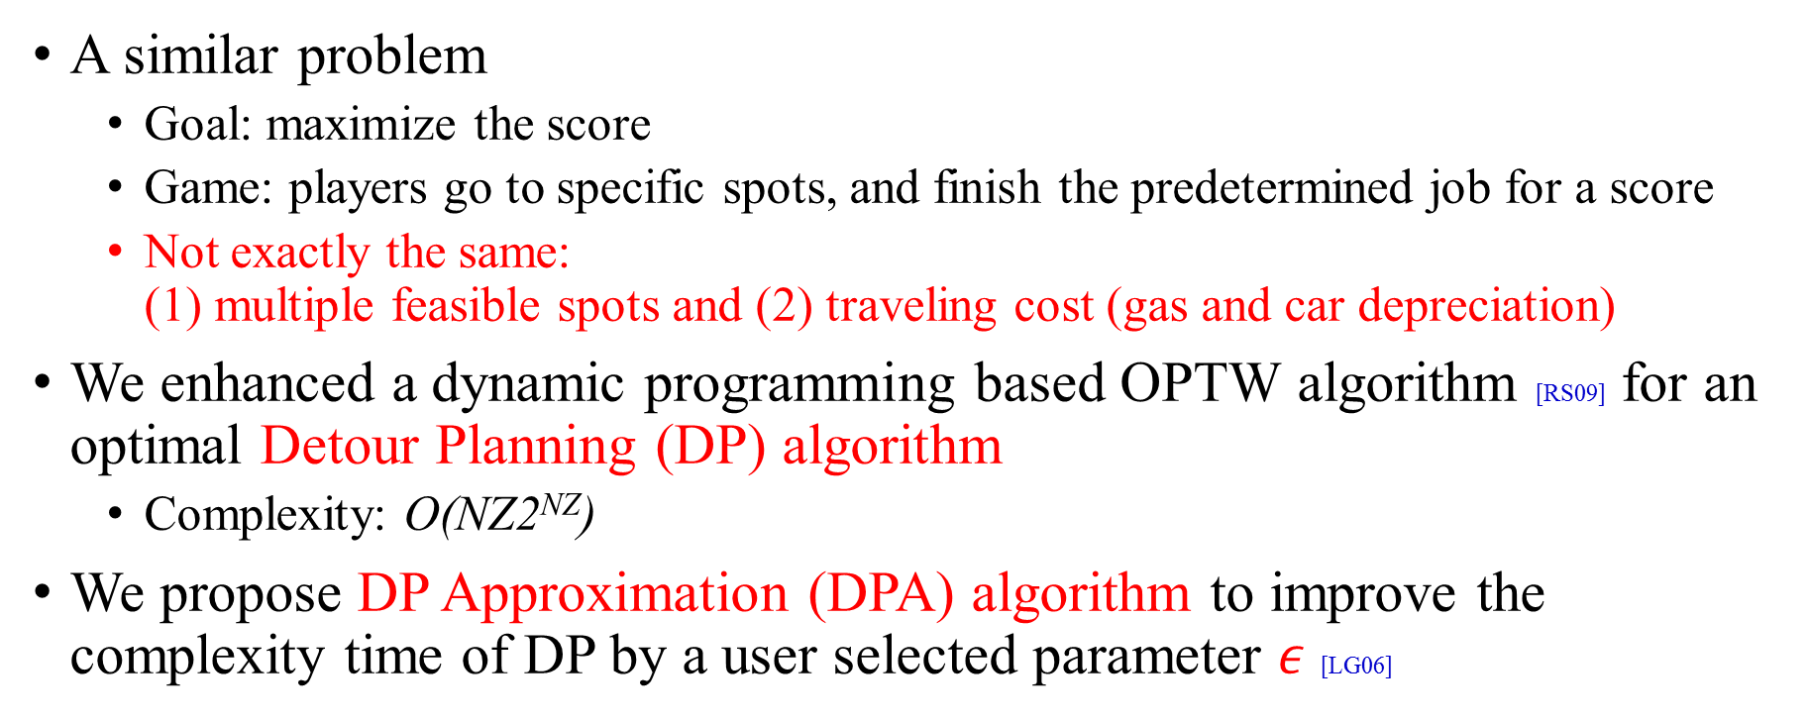
Orienteering Problem with
Time Window (OPTW)
A similar problem
  Goal: maximize the score
  Game: players go to specific spots, and finish the predetermined job for a score
  Not exactly the same:
  (1) multiple feasible spots and (2) traveling cost (gas and car depreciation)
We enhanced a dynamic programming based OPTW algorithm [RS09] for an optimal Detour Planning (DP) algorithm
  Complexity: O(NZ2^{NZ})
  We propose DP Approximation (DPA) algorithm to improve the complexity time of DP by a user selected parameter $ε$ [LG06]
[RS09] Decremental state space relaxation strategies and initialization heuristics for solving the orienteering problem with time windows with dynamic programming. Computers and Operations Research, 36(4):1191–1203, April 2009.
[LG06] K. Lai and M. Goemans. The knapsack problem and fully polynomial time approximation schemes (FPTAS). http://math.mit.edu/~goemans/18434S06/knapsack-katherine.pdf,
Notes:
$N= \sum_{k=0}^{n−2}{\left(n−1\right)C\left(n−2,k\right)}= O\left(n2^{n}\right)$.

Slide 16
Collecting Feasible Spots
Find 25 landmarks in Taipei (http://taipeitravel.net) and Vancouver (http://hotels.com)
Use Flickr API to download the pictures tagged with each landmark, and retrieve the longitude/latitude
Use hierarchical clustering algorithm to group these photos at the granularity of blocks (~100 m) ← gives us the feasible spots
Employ Google map to compute the distance between any two feasible spots

Slide 17
Simulator Implementation
We implement a trace-driven simulator in C
It supports five algorithms
  The proposed DP algorithm
  Four heuristic algorithms
    Highest-Reward (HR) ← mimic human behavior
    Closest-Request (CR) ← mimic human behavior
    Highest-Reward with Ontime (HROT)
    Closest-Request with Ontime (CROT)

Slide 18
Simulation Design
Parameters
  N: number of requests: {5, 10, 15, 20, 25}
  T: deadline: {1, 2, 4, 8, 16} (hr)
  C: travel cost: {0, 0.06, 0.12, 0.24, 0.48} ($/km)
Metrics
  Total profit
  Running-time
  Ontime-ratio

Slide 19
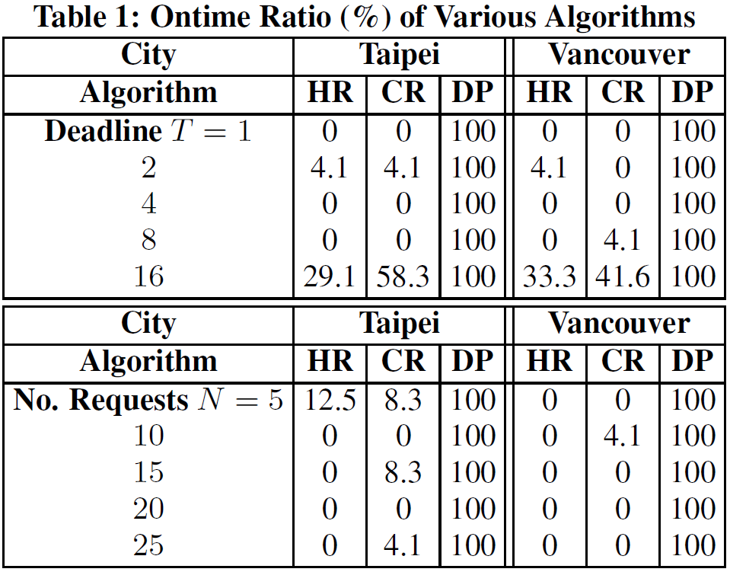
Ontime Ratio
HR and CR (mimicking humans) → low ontime ratios!

Slide 20
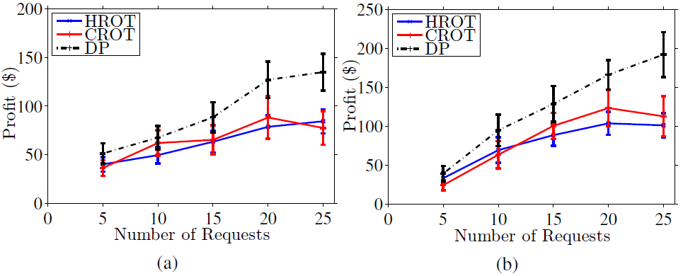
Total Profits
Although HROT and CROT guarantee ontime arrival, they suffer from low profits
Compared to HROT and CROT, DP doubles the profit with 25 requests
  More requests → larger gap!

Slide 21
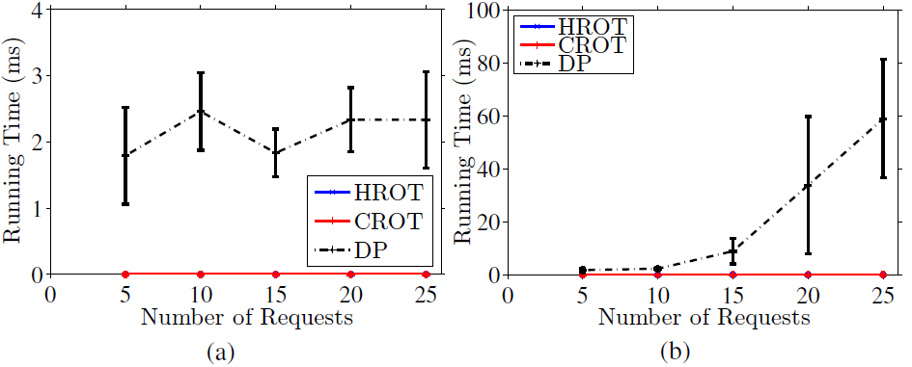
DP is Efficient
Terminates in less than 60 ms
Slower for Vancouver (right) ← up to total 162 feasible spots
  Taipei (left): 49
Notes:
15+3+1+3+2+1+1+1+1+1+1+1+1+1+1+3+1+3+1+1+1+2+1+1+1= 49
2+4+3+8+4+1+6+1+1+1+8+10+3+3+31+17+10+3+4+2+5+23+3+7+2= 162

Slide 22
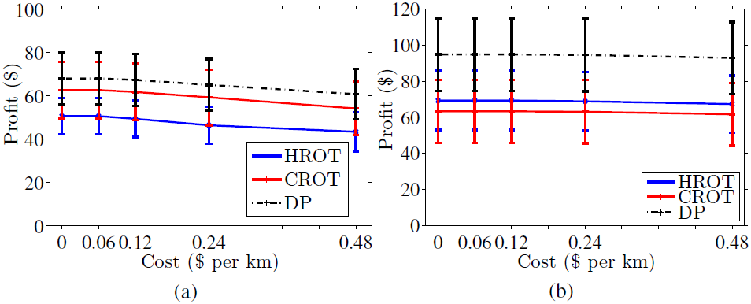
Implication of Travel Cost
Higher profits when per-km cost is lower

Slide 23
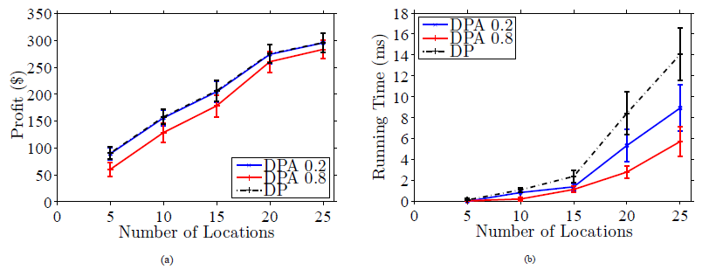
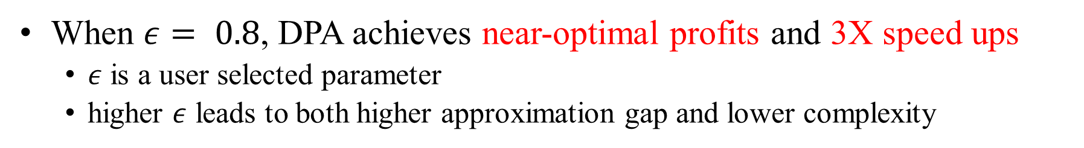
DPA Improves the Running Time with Near-optimal Results
When $ε= 0.8$, DPA achieves near-optimal profits and 3X speed ups
  $ε$ is a user selected parameter
  higher $ε$ leads to both higher approximation gap and lower complexity

Slide 24
Discussion
Algorithm |  | Contribution
DP | MDP
V | V | 1. The systems produce a detour path for each new worker.
V | V | 2. The systems compute the detour paths to maximize total worker profit.
 | V | 3. The systems should simultaneously consider multiple users to make a good use of all users.
 | V | 4. The systems should concern the energy consumption and sensor accuracy when assigns requests to workers.
DP: Detour planning algorithm
MDP: Multi-user detour planning algorithm
Notes:
We complete the first two items. The last two items will be concerned in multi-users detour planning problem.

Slide 25
Outline
Introduction
  Motivation
  Crowdsensing
  Research Problems
Related Work
Detour Planning Problem
  Formulation
  Solution
  Evaluation
Multi-user Detour Planning Problem
  Formulation
  Solution
  Evaluation
Conclusion and Future Work

Slide 26

Multiple Detour Planning Problem
The real system must simultaneously consider all workers
  DP computes a detour path for a worker at a time
  Workers can balance or reduce the traveling cost
We further consider the energy cost (battery level) and the accuracy of sensory data [EMASC’14]
  Energy model
  Accuracy model
[EMASC’14] C. Liao, T. Hou, T. Lin, Y. Cheng, A. Erbad, C. Hsu, and N. Venkatasubramanian. Smartphone augmented infrastructure sensing for public safety and sustainability in smart cities. In Proc. of Workshop on Emerging Multimedia Applications and Services for Smart Cities (EMASC’14)

Slide 27

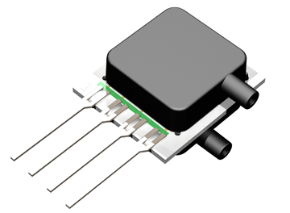

Models
Energy model
  Compute the total consumption of smartphone sensors
Accuracy model
  Perform how much times for achieving the accuracy of tasks
  Decide how many workers for collecting enough
  result to achieve the quality of tasks

Slide 28
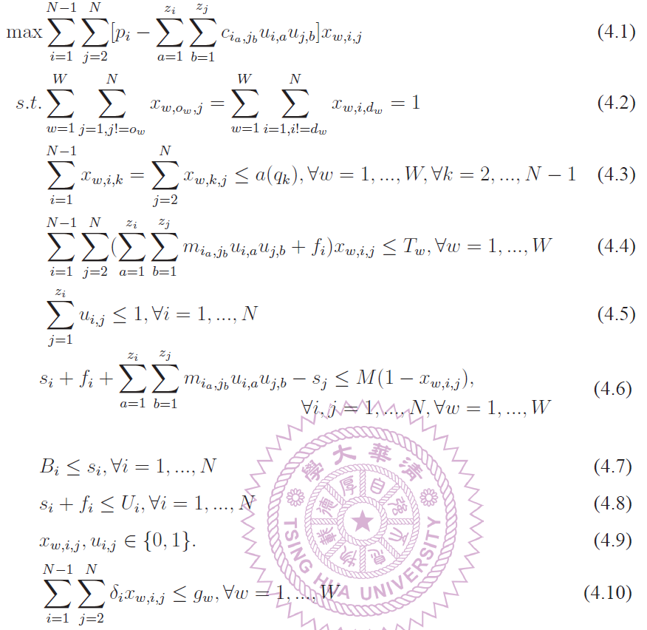

MDP
Formulation
Maximize overall profits
A new dimension
Start and end points
Assign many times to different workers
for achieving the required quality
Arrive destination in time
No rep. feasible spots
Timeline of each request
Start time of each request
Finish time of each request
Satisfy the battery level
Notes:
A new dimension in x

Slide 29

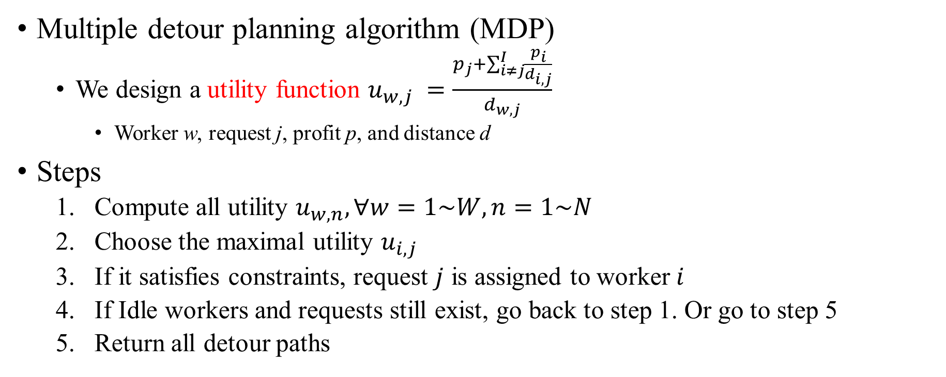
Proposed Solutions
Multiple detour planning algorithm (MDP)
  We design a utility function $u_{w,j} =\frac{p_{j}+\sum_{i≠j}^{I}{\frac{p_{i}}{d_{i,j}}}}{d_{w,j}}$
    Worker w, request j, profit p, and distance d
Steps
  Compute all utility $u_{w,n}, ∀w=1\sim W, n=1\sim N$
  Choose the maximal utility $u_{i,j}$
  If it satisfies constraints, request $j$ is assigned to worker $i$
  If Idle workers and requests still exist, go back to step 1. Or go to step 5
  Return all detour paths

Slide 30
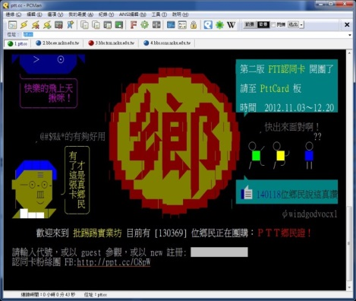
Collecting real trace data
Find 5700 posts from PTT in 10 days (4/11~4/20, 2014)
  Contents include title, IP, and posted time
Transfer IPs to locations
  Filter out the IPs which are not in Taiwan by IPInfoDB
  Hire three servers to ping the IP
    Check network latency ⇨ Estimate the distance
  Partition Taiwan into 1 km² grids
    Compute the Mean-Square-Error (MSE) of each grid’s and the IP’s distances to servers
  The precise locations are then randomly assigned within the grid

Slide 31
Simulator Implementation
The following trace-driven simulators are implemented in JAVA
It supports three algorithms
  MDP algorithm
  DP algorithm
  A baseline algorithm – CROT

Slide 32
Simulation Design
Parameters
  N: number of requests: {50, 100, 200, 400, 800}
  W: number of workers: {50, 100, 200, 400, 800}
Metrics
  Average profit
  Average traveling cost
  Completed requests ratio

Slide 33
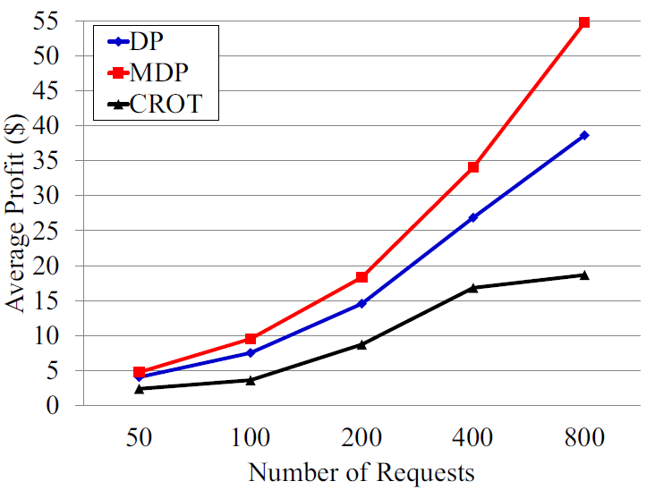
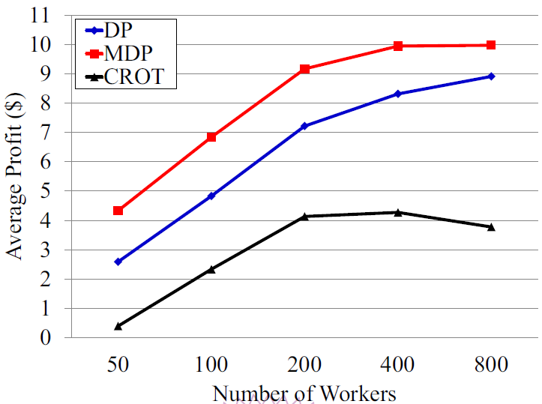
Average Profit
MDP achieves 2.64 times the profit of the baseline

Slide 34
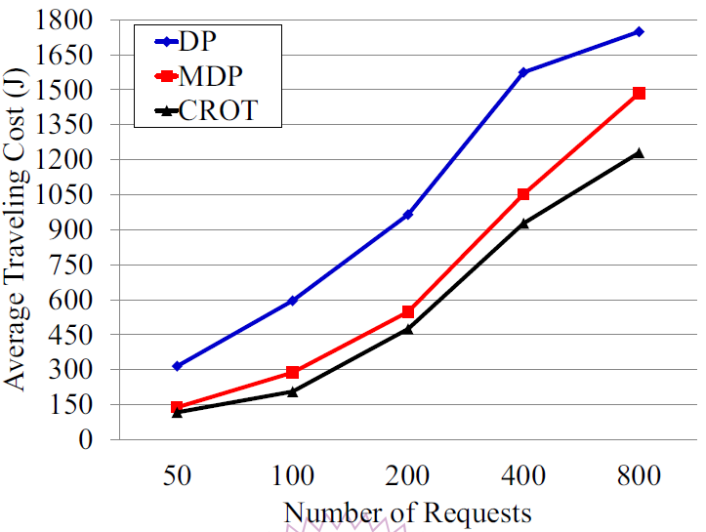
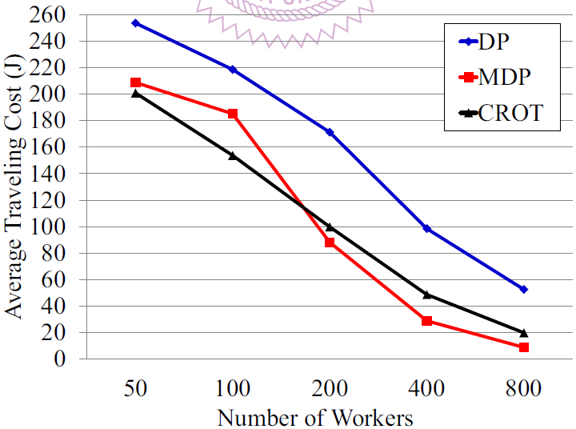
Average Traveling Cost
MDP saves 51% traveling cost compared to DP

Slide 35
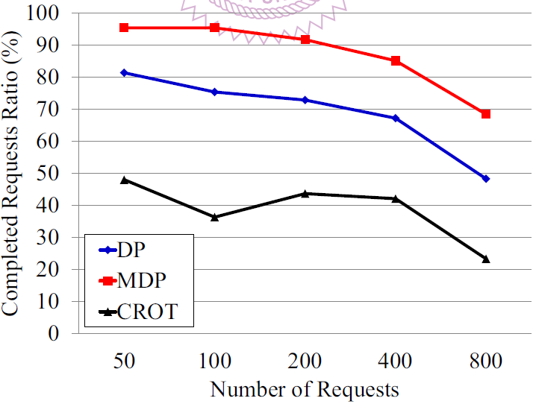
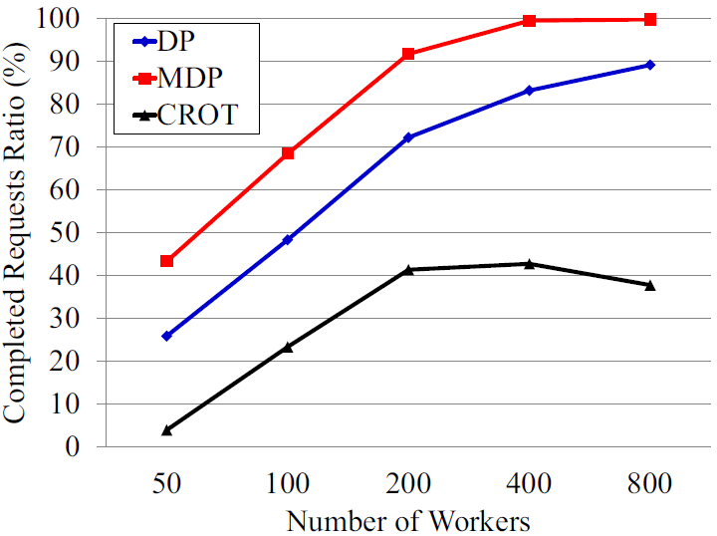
Completed Requests Ratio
MDP achieves almost 100% completed requests ratio at 400 workers

Slide 36
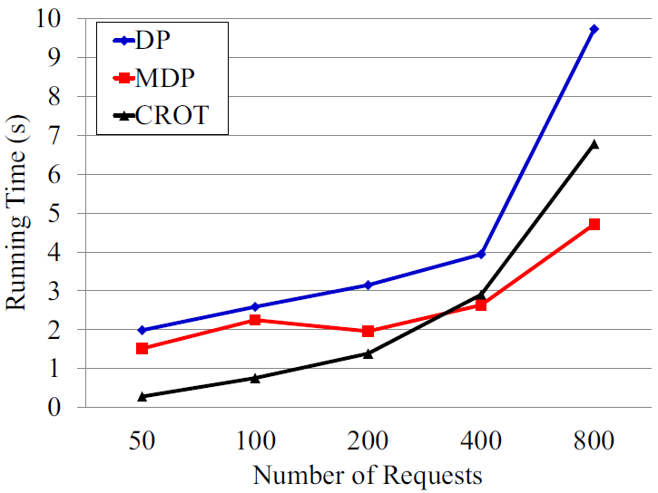
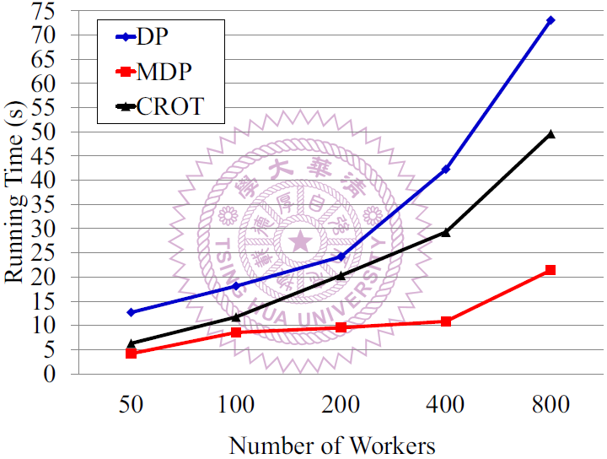
Running Time
MDP outperforms others at every cases

Slide 37
Outline
Introduction
  Motivation
  Crowdsensing
  Research Problems
Related Work
Detour Planning Problem
  Formulation
  Solution
  Evaluation
Multi-user Detour Planning Problem
  Formulation
  Solution
  Evaluation
Conclusion and Future Work

Slide 38
Conclusion
We propose a mobile crowdsensing system (MCS), and we discuss and formulate detour planning problem and multi-users detour planning problem.
We address detour planning algorithm (DP), approximation detour planning algorithm (DPA) and multi-users detour planning algorithm (MDP) for solving the proposed problems.
We implemented traced-driven simulators, and the results show:
(1) DP achieves optimal profit, and DPA runs efficiently
(2) MDP outperforms other algorithms in average profit and traveling cost
Contribution | 1 | 2 | 3 | 4
Detour planning algorithm (DP) | V | V
Multi-user detour planning algorithm (MDP) | V | V | V | V

Slide 39

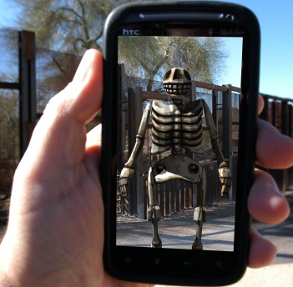

Future Works
Gamified crowdsensing
  Combine games and requests for attracting workers to play and earn rewards
  Challenges:
  (1) Unify games to the system, and players play games smoothly
  (2) Use augmented reality to let players shoot photos to trigger a new game event
Design the result upload mechanism and verification for better performance
  Challenges:
  (1) How to efficiently upload results in different network conditions (e.g. 3G, and WiFi)
  (2) Whether the results are real or fake (e.g. timestamp, and GPS)
  (3) There are privacy issues about tracking locations of workers
  Apply to Urban Computing
Notes:
火災 擁擠程度 車禍
Workers may abandon some requests by some conditions (e.g. traffic congestion), and city planner could plan future constructions according to analyzed conditions from workers.收集、整合和分析 環境惡化、交通擁擠、空氣污染、公共災害

Slide 40
Demo, and Q & A
http://youtu.be/9WFfQjq8pTs

Slide 41
END

