Slide 1
MPEG-DASH Standard with SVC Video Streaming on Android Mobile Devices
Chien CHang Chen

Slide 2
Outline
Introduction
Background
SVC
MPEG-DASH
System Architecture
Implementations
Multi-Core SVC Decoder on Android
MPEG-DASH with SVC Decoder on Android
Experiments
Multi-Core SVC Decoder
MPEG-DASH with SVC Streaming
Conclusion and Future Work

Slide 3
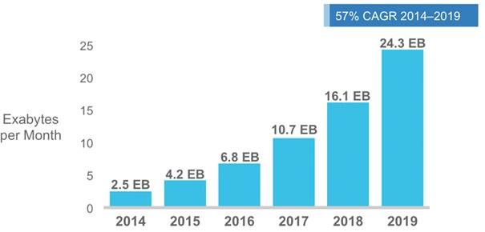
Mobile Data Traffic
Cisco expected that^{[1]} the mobile data traffic in 2019 will be 10 times the traffic in 2014
[1] http://www.cisco.com/c/en/us/solutions/collateral/service-provider/visual-networking-index-vni/white_paper_c11-520862.html

Slide 4
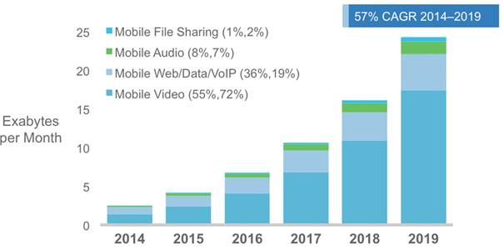
Traffic Data for Mobile Video Streaming
Over 70% of mobile data traffic is video streaming
It is getting more and more important to provide better mobile video streaming service

Slide 5
SVC is More Suitable for Heterogeneous Mobile Streaming
Non-scalable video codecs are not suitable for mobile devices
Devices are heterogeneous
Different power computation and screen size
Wireless network conditions are dynamic
Can’t receive entire media data when bandwidth is insufficient
Scalable Video Codec (SVC)
Divided videos into dependent layers
Request proper layers
There is no existing SVC chip
We implemented the pioneering SVC decoder on Android devices

Slide 6

Efficient Approach for Transferring Video
Dynamic Adaptive Streaming over HTTP (MPEG-DASH)
Video is divided into segments with the same length
Reuse existing technologies: → proxies, caches, codecs, container
Switch events are decided by client side: → more accurate decisions
Use common apache web server → easy to extend
Without NAT traversal problem
We port MPEG-DASH client from PC to android and integrate it with SVC decoder
High frame-rate and high throughput
Better user experience

Slide 7
Contributions
We implement the pioneering SVC decoder on android phones
Leverage multi-threading to enhance decoding performance
We integrate MPEG-DASH client into our SVC decoder
Our DASH client achieves high throughput
Publicize our source codes on Github

Slide 8
Outline
Introduction
Background
SVC
MPEG-DASH
System Architecture
Implementations
Multi-Core SVC Decoder on Android
MPEG-DASH with SVC Decoder on Android
Experiments
Multi-Core SVC Decoder
MPEG-DASH with SVC Streaming
Conclusion and Future Work

Slide 9
Scalable Video Codec - SVC
SVC is extended by H.264/AVC
Supported Scalability
Temporal (Frame-rate)
Spatial (Resolution)
Quality (QP)
Features
Videos are encoded into dependent layers
Based layer is necessary
More enhancement layers → better video quality

Slide 10
Non-Scalable Video Content
One copy for each combination of video encoding parameters
Duplicate data among multiple copies

Slide 11
SVC Video Content
Without duplicate data among multiple layers
SVC is more suitable for heterogeneous devices

Slide 12
Outline
Introduction
Background
SVC
MPEG-DASH
System Architecture
Implementations
Multi-Core SVC Decoder on Android
MPEG-DASH with SVC Decoder on Android
Experiments
Multi-Core SVC Decoder
MPEG-DASH with SVC Streaming
Conclusion and Future Work

Slide 13
MPEG-DASH
Dynamic Adaptive Streaming over HTTP
Features
Videos are divided into segment with the same length
Requesting unit is segment
MPD (Media Presentation Description) is manifest file
Use existing technologies
Container
Codec
Proxy
Etc.
Enable seamless switching to multiple bit-rate streams

Slide 14
MPEG-DASH with SVC Streaming
MPEG-DASH with SVC streaming provides more flexible video streaming service

Slide 15
Outline
Introduction
Background
SVC
MPEG-DASH
System Architecture
Implementations
Multi-Core SVC Decoder on Android
MPEG-DASH with SVC Decoder on Android
Experiments
Multi-Core SVC Decoder
MPEG-DASH with SVC Streaming
Conclusion and Future Work

Slide 16
System Architecture
The components in our system
MPD Generator
DASH Content
MPD Parser
Segment Requester
Extractor
SVC Decoder
Renderer
Switch Event Handler
Data Recorder

Slide 17
MPD Generator
SVC Videos Encoding
Encode videos into raw format
Encode raw video into SVC video
For MPEG-DASH Streaming
Chop SVC videos into segments and generate corresponding MPD

Slide 18
DASH Content
Place MPDs and segments
Requested by accessible URL over HTTP

Slide 19
MPD Parser
Parse MPD file
URL of segments
Codec
Resolution
Dependency id
Bit-rate
Information used for Segment Requester

Slide 20
Segment Requester
Request segment according to
Information in MPD
Selected layer number
The ISO base media file format (ISOBMFF)
A number of different boxes
Decoder does not know this format

Slide 21
Extractor
In charge of ISOBMFF
Parse ISOBMFF
Remove the boxes
Obtain the media data
Reconstruct frame data
Interleave frame data from multiple layers
Make frame data compatible with SVC Decoder

Slide 22
Switch Event Handler
Triggered by
User preference
Algorithms
Send Notification to
Segment Requester to change the number of layers for requesting
Extractor to cancel the segments if layer number exceeds the selected layer number
Decoder to change the decoding parameters

Slide 23
Data Recorder
Measure the information
Throughput
Frame-rate
Delay
Used for
Switching algorithms
Performance analysis

Slide 24
Outline
Introduction
Background
SVC
MPEG-DASH
System Architecture
Implementations
Multi-Core SVC Decoder on Android
MPEG-DASH with SVC Decoder on Android
Experiments
Multi-Core SVC Decoder
MPEG-DASH with SVC Streaming
Conclusion and Future Work

Slide 25

Port SVC Decoder to Android Devices
Single-thread SVC decoders are not real-time for mobile devices
Ex: JSVM^{[1]}, OpenSVC^{[2]}
We implemented multi-thread SVC decoder on Android devices
Use OpenSVC as our SVC decoder library
OpenSVC does not support multi-thread
We focus on avoiding race condition problem when invoking the decoder function
Compare JSVM with OpenSVC (running on OS X with Intel i5 2.3 GHz CPU)
Decoder | doc | jeux | soap | sport | talk
JSVM | 17.75 (FPS) | 20.36 | 19.44 | 17.44 | 19.11
OpenSVC | 18.79 | 27.03 | 20.79 | 18.71 | 24.26
[1] http://www.hhi.fraunhofer.de/en/fields-of-competence/image-processing/research-groups/image-video-coding/svc-extension-of-h264avc/jsvm-reference-software.html
[2] http://www.opensvc.com/

Slide 26
Multi-Core SVC Decoder
Two main components of multi-core SVC decoder ^{[YCT+13]}
Java Front-End
Native Decoder
① Java Front-End
Use JNI as interface between Java and Native Decoder
Interact with Android framework by Android SDK
② Native Decoder
Coded Frame Buffer (CFB) → stores packets from source
Multiple decoder threads
Decoded Frame Buffer (DFB) → stores decoded frames
①
②
[YCT+13] Y. Li, C. Chen, T. Lin, C. Hsu, Y. Wang, and X. Liu. An end-to-end testbed for scalable video streaming to mobile devices over http (ICME’13)

Slide 27
Replace Renderer with SDL Library
SDL^{[1]} is a popular C/C++ library
An open-source library
Support hardware rendering
Easier to handle events such as screen touch
and video display than Android API
Integrate SDL into our SVC decoder
Directly display frame data in native side
To solve new race condition problem
To avoid deadlock
[1] https://www.libsdl.org/

Slide 28
Outline
Introduction
Background
SVC
MPEG-DASH
System Architecture
Implementations
Multi-Core SVC Decoder on Android
MPEG-DASH with SVC Decoder on Android
Experiments
Multi-Core SVC Decoder
MPEG-DASH with SVC Streaming
Conclusion and Future Work

Slide 29
MPEG-DASH Client
Our DASH Client is based on libdash^{[1]}
An open-source library
Port libdash from PC to Android platform
QT Application
Switch from QT to Android GUI
Design user interface for android
MPD parser doesn't support SVC format
Request segments from one of the multiple streams
Extractor
ISOBMFF parser
Integrate with decoder
[1] https://github.com/bitmovin/libdash

Slide 30
Switch from QT to Android UI
libdash is highly dependent on QT library
QT User Interface
Switch QT UI to Android UI
Design interface between UI and DASH Client
QT Renderer
Replace QT Renderer with SDL Renderer
Design interface between Decoder and Renderer
Notes:
QT application size is larger at least 5 times than Android
Need to install uncompressed QT libraries
Not support VFP and NEON
Each APK only support one platform (x86, armv6, armv7 etc.)
Android GUI is more ease to use than QT GUI
The performance the same for QT and Android
Our previous version of decoder is Android based application

Slide 31
Make libdash Supportable to SVC
libdash doesn’t support MPD structure for SVC
This format is defined by MPEG
Modify MPD parser to support this format
Multi-layer requester
libdash only requests segments from one of the streams
Support simultaneously requesting segments from multiple layers

Slide 32
Extractor Implementation
Segment is ISOMBFF
Segment can’t be directly decoded
Parse ISOBMFF
Trace GPAC source code
Implement simple Extractor according to GPAC
Remove boxes’ header and obtain media data
Reconstruction
The dependency layers segments need to be reconstructed
Decoder is able to decode reconstructed media data

Slide 33
Outline
Introduction
Background
SVC
MPEG-DASH
System Architecture
Implementations
Multi-Core SVC Decoder on Android
MPEG-DASH with SVC Decoder on Android
Experiments
Multi-Core SVC Decoder
MPEG-DASH with SVC Streaming
Conclusion and Future Work

Slide 34
Experiment Setup for Multi-Core SVC Decoder
Video configuration
Five HD videos: doc, jeux, soap, sport, and talk
GOP: 16 frames
Three spatial layers: 960x544, 480x272, and 240x144
Repeat 5 times
Experiment Devices
Dual-core tablet with 1.4GHz CPU, 1 GB memory, and 1280x800 screen
Quad-core smart phone with 1.5 GHz CPU, 1 GB memory, and 1280x720 screen

Slide 35
Video Description
Video | Description
doc | a documentary video talking about a woman who lost her house
jeux | a live show video about the guessing games
soap | an action style soap video
sport | a sports news video including volleyball, basketball, swimming, etc.
talk | a talk show video

Slide 36
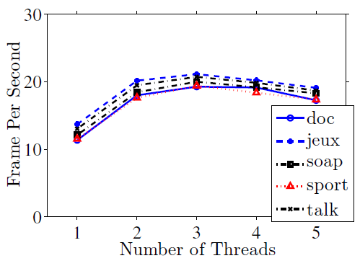
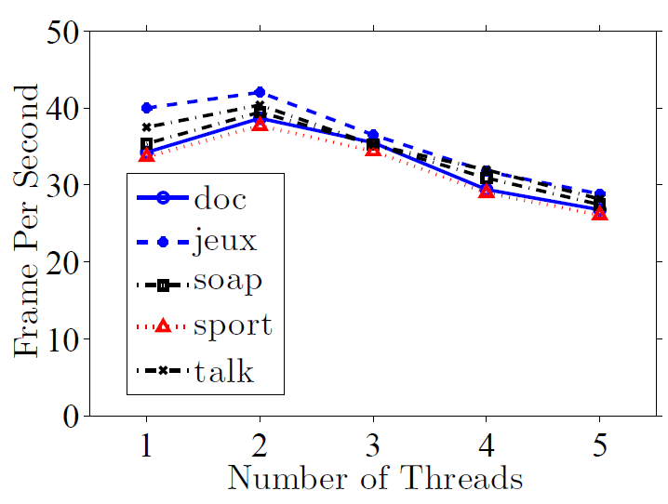
Performance of Multi-core SVC Decoder
Using 960x544 spatial layer
Using 480x272 spatial layer
Best FPS with 3 decoder threads
Best FPS with 2 decoder threads

Slide 37
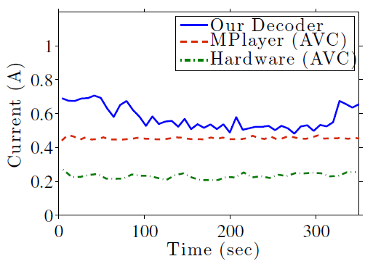
Power Consumption
Use Agilent 66321D mobile communications DC
We measure the power consumption of our decoder, mplayer, and hardware decoder on the smart phone
Our SVC decoder only incurs small power overhead, as low as 7%, compared to mplayer

Slide 38
Outline
Introduction
Background
SVC
MPEG-DASH
System Architecture
Implementations
Multi-Core SVC Decoder on Android
MPEG-DASH with SVC Decoder on Android
Experiments
Multi-Core SVC Decoder
MPEG-DASH with SVC Streaming
Conclusion and Future Work

Slide 39
MPED-DASH with SVC Streaming Setup
Video Configuration
Five HD videos: doc, jeux, soap, sport, and talk
GOP size: 16 frames
Each segment has 8 GOPs
Three spatial layers: 320x180, 640x360, and 1280x720
Repeat 5 times
Experiment Device
Quad-core smart phone with 1.5 GHz CPU, 1 GB memory, and 1280x720 screen
Performance Metrics
Frame Per Second (FPS)
Throughput

Slide 40
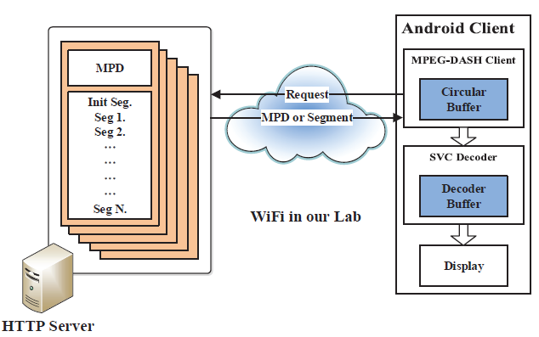
Architecture of Experiment Setup

Slide 41
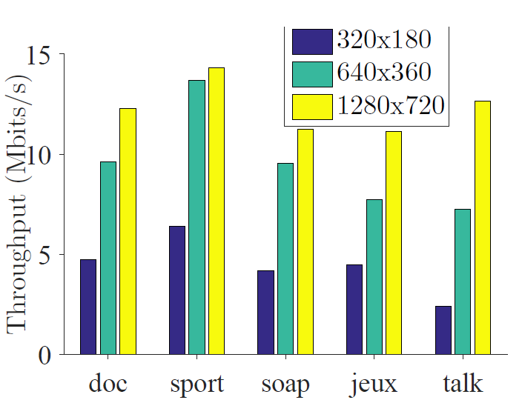
Throughput of MPEG-DASH Client
MPEG-DASH Client provides high bandwidth requirement streaming

Slide 42
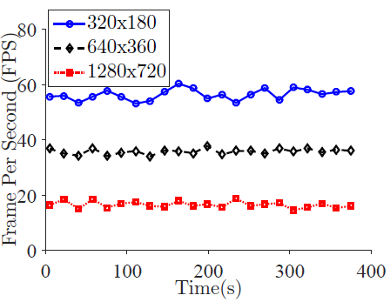
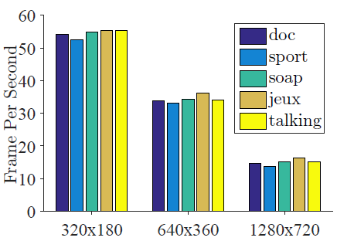
FPS Performance of SDL Renderer
Decoder achieves 50+, 30+, and 15+ FPS for 320x180, 640x360 and 1280x720, respectively
Instantaneous sample points of sport

Slide 43
Outline
Introduction
Background
SVC
MPEG-DASH
System Architecture
Implementations
Multi-Core SVC Decoder on Android
MPEG-DASH with SVC Decoder on Android
Experiments
Multi-Core SVC Decoder
MPEG-DASH with SVC Streaming
Conclusion and Future Work

Slide 44
Conclusion
We implemented the pioneering software-based H.264/SVC decoder for Android mobile device
As low as 7% power consumption overhead compared to mplayer
Leverage multi-threading to enhance decoding performance
We also integrate MPEG-DASH standard and SDL library into our client
The experimental results demonstrate the benefits in real testbeds
DASH client achieves high throughput and supports high bandwidth requirement streaming
SVC decoder achieves 50+ FPS and 30+ FPS for 320x180 and 640x360 streaming, respectively

Slide 45
Future Work
Our testbed can be used for large-scale user study to provide flexible Quality of Experience (QoE) model
To Dynamically select video quality according to
Current bandwidth, delay jitter, packet loss rate, buffer state, etc.
To choose the best quality for user
PNSR, Mean Opinion Score (MOS)
Enhance our SVC decoder
Use NEON instructions to speed up decoding
Design more efficient multi-threading decoding structure
Leverage more efficient scalable video coding standards such as H.265/SHVC

Slide 46
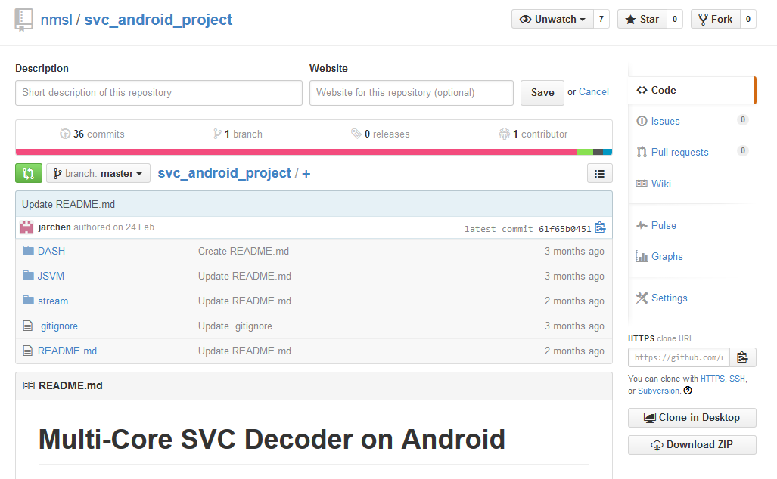
Our SVC Decoder is Public on Github
Available on: https://github.com/nmsl/svc_android_project

Slide 47
End

