Slide 1
User Experience of Gamified Mobile Crowdsourcing in Smart Cities
Aylada Khunvaranont
Advisor: Cheng-Hsin Hsu
Networking and Multimedia Systems Lab
Institute of Information System and Applications, NTHU

Slide 2
Outline
Introduction
Problem Statement
Mobile applications
User Study
Conclusion

Slide 3
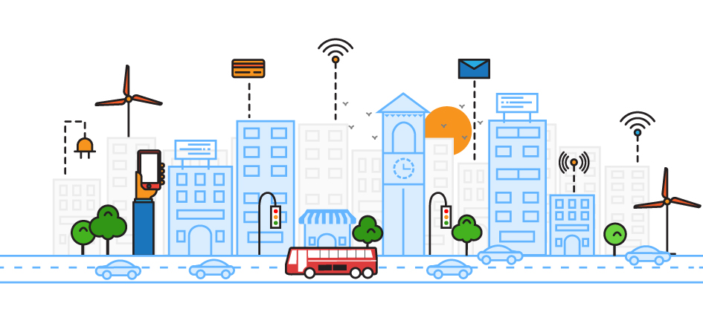
Introduction
Smart cities concept utilize the information and communication technology in sensing and analysis that provide data for monitoring and create awareness in running a city.
The market forecast predicts that it will grow and reach 1.45 trillion USD in 2020.

Slide 4
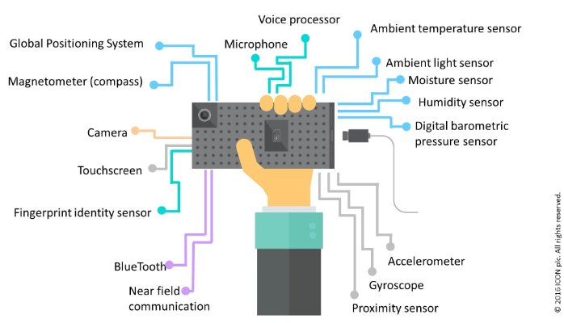
Introduction
Mobile phone users in urban area are ubiquitous and smartphones are equipped with various sensors.
Determining the suitable payment for crowdsourced sensing tasks is a difficult problem.

Slide 5
Introduction
Gamification might be a substitute incentive as many researchers claimed that gamification can help increase user engagement and motivation.

Slide 6
Introduction
“Gamification is the use of game elements and game design techniques in non-game contexts.”
Designing and implementing gamification system is to create gamified environment with realistic purposes.

Slide 7
Outline
Introduction
Problem Statement
Mobile applications
User Study
Conclusion

Slide 8
Problem Statement
The purpose of this study is to investigate how gamification effects:
user enjoyment
routing behavior
perception on monetary incentive

Slide 9
Background
When designing gamification, the use of game elements varies to the purpose and expected outcome from the application.
Common game elements are:-
Point
Badges
Leaderboards

Slide 10
Types of Motivation
Intrinsic
- Autonomy
- Belonging
- Curiosity
- Learning
- Mastery
- Meaning
Extrinsic
- Badges
- Competition
- Money
- Points
- Rewards

Slide 11
Hypothesis
To evaluate that mobile game can take place as alternative incentives for mobile crowdsourcing
To investigate the effect of gamification
H0: There is no difference in terms of enjoyment in a gamified version of mobile crowdsourcing application
H1: There is a significant difference in terms of enjoyment in a gamified version of mobile crowdsourcing application

Slide 12
Outline
Introduction
Problem Statement
Mobile applications
User Study
Conclusion

Slide 13
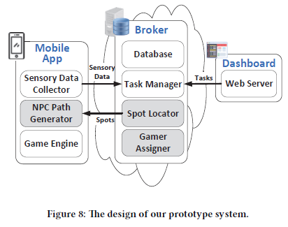
System Architecture
The mobile application is implemented based on this prototype system.
Mobile App
Broker
Dashboard

Slide 14
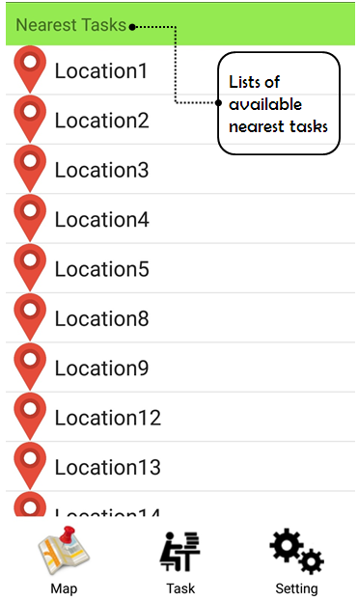
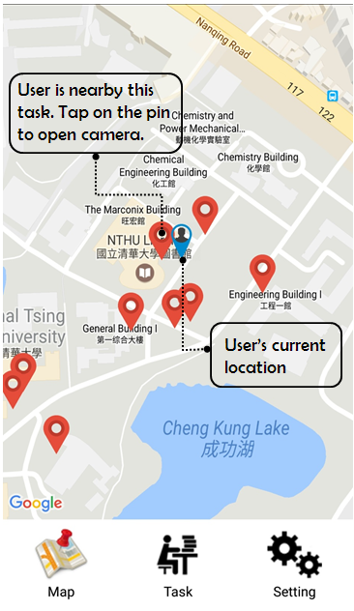
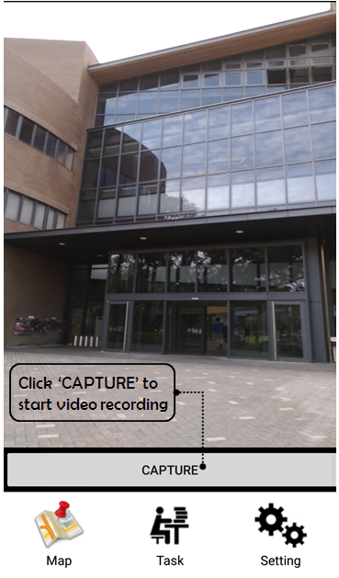
Ordinary App

Slide 15
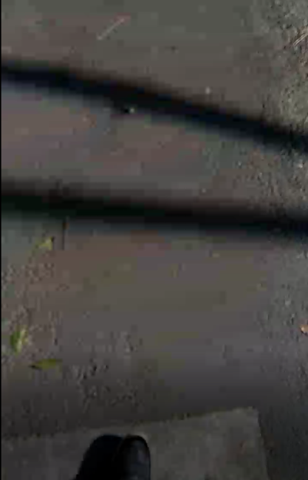
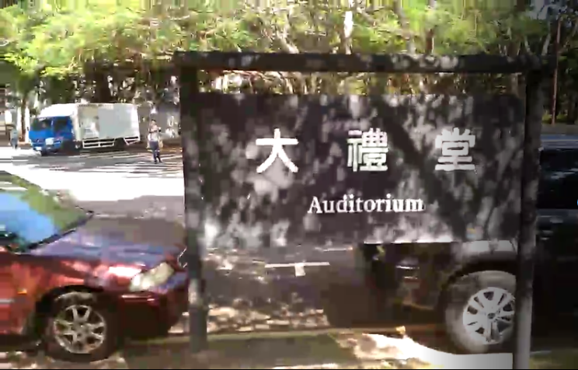
Ordinary App
The goal is to cover 360 degree of the location, we need more than one user.
Some might record useless result, we need to guide the user.

Slide 16
Advanced System Architecture ^{[1]}
Optimal Spot Locator
To locate the least number of spots to finish a task
Nearest Gamer Assigner
To assign gamers to nearest tasks
Nature NPC Path Generator
To create the paths to guide the gamers
Y. Chen, H. Hong, S. Yao, A. Khunvaranont, and C. Hsu. Gamifying Mobile Applications for Smartphone Augmented Infrastructure Sensing. In Proceedings of the 15th Annual Workshop on Network and Systems Support for Games (NetGames’17). June , 2017.

Slide 17
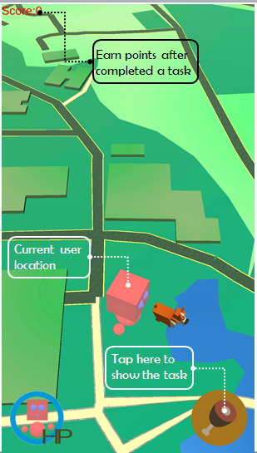
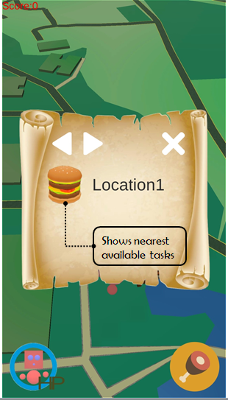
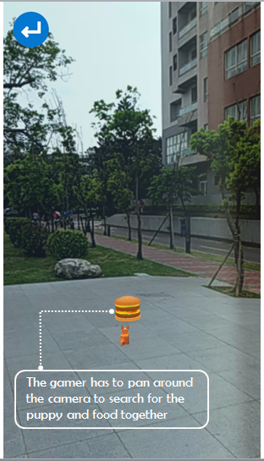
Gamified App

Slide 18
Outline
Introduction
Problem Statement
Mobile applications
User Study
Conclusion

Slide 19
User Study
Location: NTHU Campus
Tasks: 20 locations
Participants: 14 people
7 male and 7 female in their twenties
43% are international students and 57% are local Taiwanese students in NTHU

Slide 20
User Study
Participants are given a smartphone with our 2 apps pre-installed
They have to complete all the tasks (20 locations) within one day for each app
After each run, they will fill in a questionnaire measures by using 5-point Likert scale

Slide 21
Questionnaire
7 questions measuring enjoyment from Intrinsic Motivation Inventory (IMI)
5 questions about usage behavior and UI
1 open question for other comment or feedback

Slide 22
Intrinsic Motivation Inventory (IMI)
A multidimensional measurement tool that aims to assess user’s subjective experience
Has total of 7 subscales (45 items)
Interest/enjoyment subscale is mainly for measuring intrinsic motivation

Slide 23
Intrinsic Motivation Inventory (IMI)
7 Items from enjoyment subscale
I enjoyed doing this activity very much
This activity was fun to do.
I thought this was a boring activity. (R)
This activity did not hold my attention at all. (R)
I would describe this activity as very interesting.
I thought this activity was quite enjoyable.
While I was doing this activity, I was thinking about how much I enjoyed it.

Slide 24
Discovering new route
Gamified app
14%
64%
user say they discovered new route when using the app
Ordinary app
Deviate from daily route
of Gamified app user say they did went out from their daily route
57%
of Ordinary app user say they did not went out from their daily route
Perceived monetary incentive
79% of Ordinary app & 70% of Gamified app
user thinks that they will be more motivated if presented with monetary incentive

Slide 25
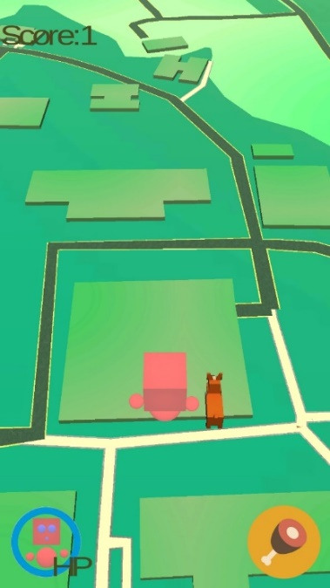
User Friendliness
43%
of user says Ordinary app
is difficult to use
29%
of user says Gamified app
is difficult to use
Preference
71%

Slide 26
Quantitative Result
Total Completion time
Total time spend to complete all the tasks
In-app usage time
Time user/gamer spends on the app
Video duration time
The duration time of the video recorded by the gamer
Walking distance
The distance that the user/gamer walked during the experiment.

Slide 27
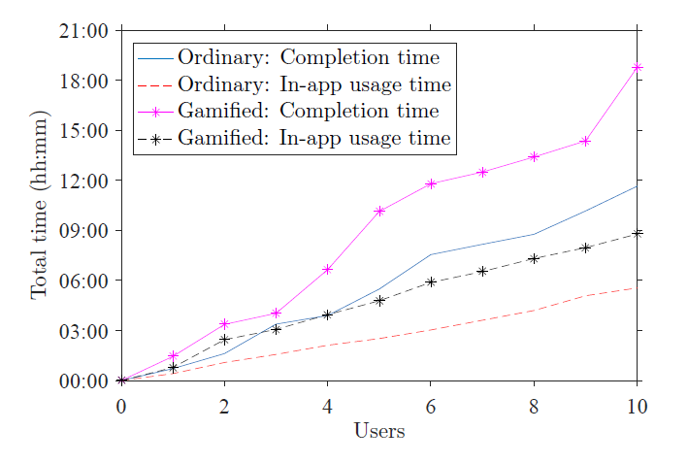
Comparing Completion time and In-app usage time between Ordinary and Gamified app
Completion time
In-app usage time
2x
Gamified app
Ordinary app
1.6x

Slide 28
Video recording time
Gamified app
Ordinary app
MAX
35s
MIN
1s
2.5x
Total
34.22 km
MAX
6.66 km
MIN
2.21 km
Walking distance

Slide 29
Outline
Introduction
Problem Statement
Mobile applications
User Study
Conclusion

Slide 30
Limitation and Recommendation
Weather is biggest obstacle!
Internet connection needs to be strong and stable.
GPS accuracy
Participants might not represent all the population.

Slide 31
Conclusion
We conducted the user study to prove that user enjoy using gamification version of the application.
Overall, user study results are positive towards gamification.

Slide 32
Thank you!

