Slide 1
Department of Computer Science National Tsing Hua University
CS 5262: Multimedia Networking and Systems
Media On Demand and Live Broadcast
Instructor: Cheng-Hsin Hsu
Acknowledgement: The instructor thanks Prof. Mohamed Hefeeda at Simon Fraser University for sharing his course materials

Slide 2
Introduction
Media on demand
Playback audio or video
Control over start time, and other interactive controls
Live Broadcast
Tuning in to a radio or TV program
Limited control (join / leave)
Both scenarios exist today on the internet
2
Notes:
2

Slide 3
Outline
Introduction
Multimedia Architecture, Protocols, and Files Formats
Live Broadcast
Fundamental Abstractions
Streaming Media over Packet Networks
3
Notes:
3

Slide 4
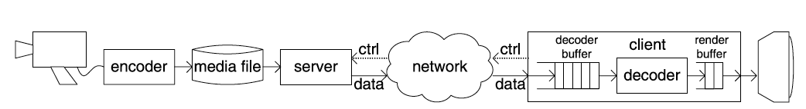
Architectures
Streaming Media on Demand
Multimedia over IP and Wireless Networks. Pg 454, Fig 14.1 (a)
Media source
Streaming Protocols
“Client Buffer”
Relatively long
network jitter compensation
error recovery …
Media is encoded off line
File format to support streaming
Only to buffer relatively large decoded frames

Slide 5
Architectures
Streaming Media on Demand
The entire file is available on the server (flexibility)
“progressive downloading” is possible
Maximum download speed, real time playback speed.
Large client buffer
Limited buffer devices can use TCP flow control.
Only when network bandwidth > source coding rate
Multimedia over IP and Wireless Networks. Pg 454, Fig 14.1 (a)

Slide 6
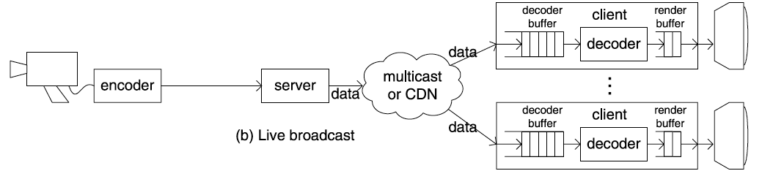
Architectures
Multimedia over IP and Wireless Networks. Pg 454, Fig 14.1 (b)
Live broadcast
NOT possible:
to allow VCR-like control for clients.
to adapt one transmission rate for a particular client.
to use retransmission-based error control.
Limited buffer
minimize end-to-end delay

Slide 7
Outline
Introduction
Architectures
Media on Demand
Live Broadcast
Communication Protocols
File Formats
Live Broadcast
7
Notes:
7

Slide 8
Communication Protocols
Many protocols, at different levels
Content discovery
Auxiliary files, content description
Streaming control protocol
Data transfer protocol
Transmission rate control
Error control

Slide 9
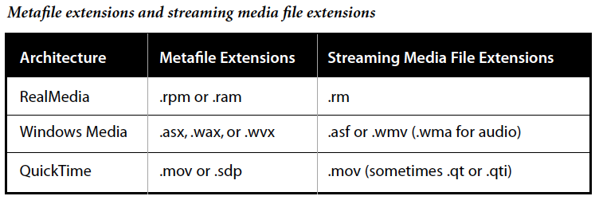
Communication Protocols
Content discovery
Usually through URLs
Typically have a form such as http://www.microsoft.com/directory/contentname.asx http://www.realnetworks.com/directory/contentname.ram http://www.apple.com/directory/contentname.mov
Adobe. Streaming Media Primer. Pg 37.

Slide 10
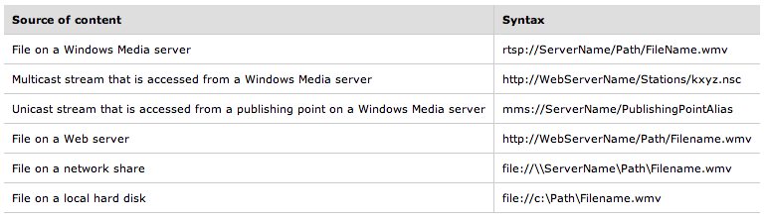
Communication Protocols
ASX Meta Files (basic) <ASX version="3.0”> <ENTRY> <REF HREF="Path"/> </ENTRY> </ASX>
Microsoft. Introduction to Windows Media Metafiles. 2004.

Slide 11
Communication Protocols
ASX Meta Files (advance)
Ad Insertion
Server or Protocol rollover
<ASX version="3.0”> <ENTRY>
<REF HREF="http://sample.microsoft.com/BallGame" />
</ENTRY>
<EVENT NAME="TimeOut" WHENDONE="RESUME">
<ENTRY CLIENTSKIP="NO">
<REF HREF="http://Server/Content/Advert.asf" />
</ENTRY>
</EVENT>
</ASX>
<ASX version="3.0”> <ENTRY>
<REF HREF="rtsp://Server1/Path/File1.asf"/>
<REF HREF="mms://Server2/Path/File1.asf"/>
<REF HREF="http://WebServer/Path/File1.asf"/>
</ENTRY>
</ASX>

Slide 12
Communication Protocols
Streaming Protocol
High-level control protocol to enable the client to interactively control playback using VCR-like functions.
Commands are sent over TCP
Real Time Streaming Protocol (RTSP)
HTTP-like protocol
Basic control commands
Extension for dynamic selections

Slide 13
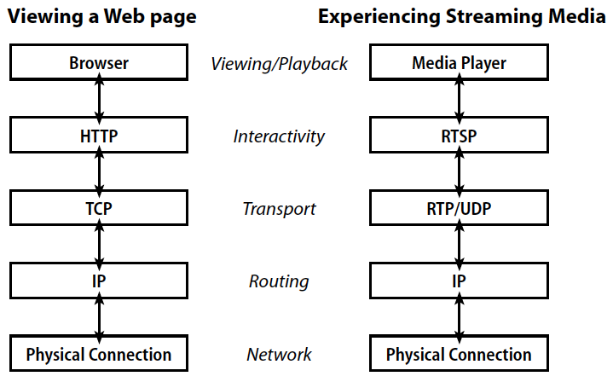
Communication Protocols
Adobe. Streaming Media Primer. Pg 17.

Slide 14
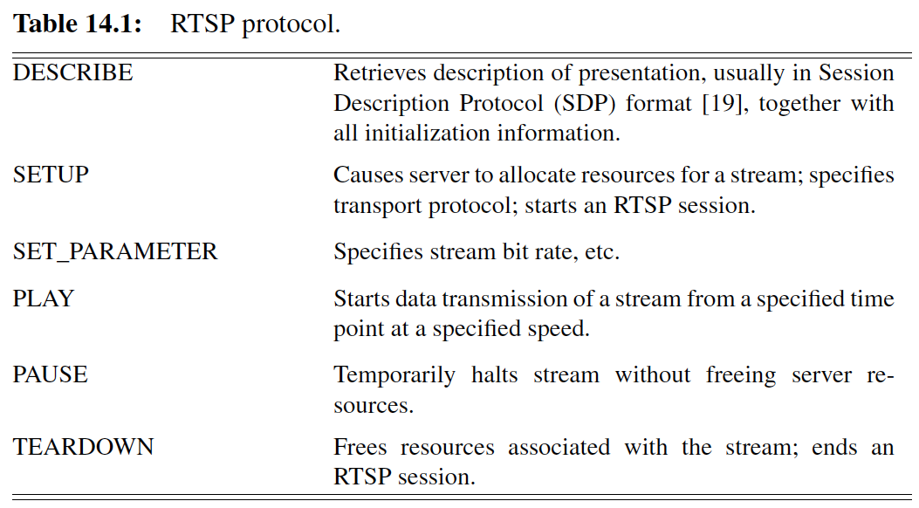
RTSP Commands
(Dynamic stream / protocol selection)
Multimedia over IP and Wireless Networks. Pg 459, Table 14.1

Slide 15
Communication Protocols
Data transport protocol
Real-time Transfer Protocol (RTP)
RTP over UDP , RTP over TCP
Standardized with RTSP
Preferred for bandwidth efficiency
RTP over UDP : error & transmission rate control → the application!
HTTP over TCP
Avoid firewall issues
Appropriate only for playback (e.g. YouTube)

Slide 16
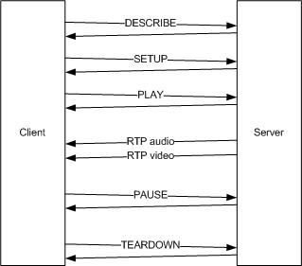
RTSP Commands
SDP
Real Time Control Protocol
- Usually paired with RTP.
- Provide statistical feedback to the sender.
RTCP
Adapted from W3C. Ret 2010

Slide 17
Communication Protocols
RTP over UDP: Windows Media system
Transmission Rate Control
constant bit rate transmission at the source coding rate
client monitors its buffer for congestions
signal to the sender to switch the coding rate down
absence of congestion can raise up the rate again
Error control
Selective retransmission (gaps in sequence)
Highest priority: Audio packets
Lowest priority: Video packets closest to the deadline
stall if lost audio packets – skip lost video packets.

Slide 18
File Formats
Media on Demand
Encoder cannot predict network & clients conditions
must consider flexibility in files.
adaption is left to the server in real time conditions.
Raw (uncompressed) files?
the file → huge storage space needed.
real-time encoding → high computational complexity
Less extreme:
high bit rate encoding for file’s content
online transcode / recompress content for each client.
Opposite end! ← no adaptation
Fixed encoding. Simply copied onto network connection.

Slide 19
File Formats
Better engineering:
Maintain flexibility. Provide indexing for contents.
Streaming file formats
MPEG-4 - Apple’s QuickTime
RealNetworks’ RealMedia - Microsoft’s ASF
Common Characteristics
Contain multiple version of each medium.
Each version is recorded in a track.
Each track is decomposed into a sequence of chunks.
Chunks contain actual media data.
header structures in each file contain static metadata
relate to overall file as well as to specific tracks.

Slide 20
File Formats
Metadata
Title, author, date of composition, encryption, copyrights, table of contents…
track enumeration, relationships…
Individual track properties: start time, duration, bit rate, buffer size, sampling rate…
Time-varying metadata associated with each track: e.g. network packetization info, SMPTE time codecs…
Differences between formats in how these metadata are associated with individual chunks.

Slide 21
File Formats
Media data
Only appropriate subset of the data to be transmitted.
Subset selection : coarse-grained or fine-grained
Coarse-garined
Per-stream basis
Change on a timescale > data unit
Fine-grained
Selection at the data unit level
Also portion of each data unit can be selected.

Slide 22
File Formats
Source coding rate control
Multibit rate (MBR): independent streams
Scalable coding: enhancement layers
Transmission
After the selection of data units, they are prepared for transmission
Packetization: re-encapsulate the encoded media data from one transport protocol (the file format) into another (e.g. RTP).

Slide 23
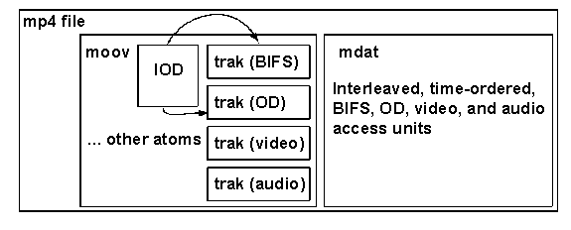
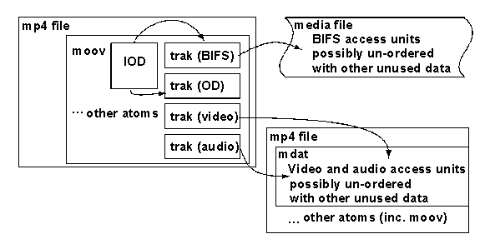
MPEG-4 File Format
- Structures “atoms”
- Unique tag & length
- Atoms are in moov
- Data can be in mdat
or referenced via URL
MPEG-4 Overview. ISO/IEC JTC1/SC29/WG11 (2002). Fig 13 & 14.

Slide 24
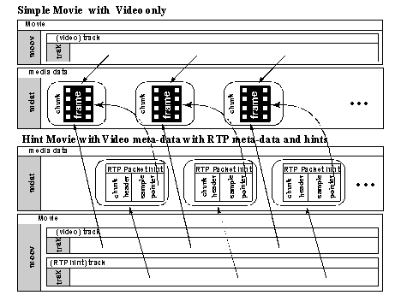
Hint Tracks & Indexing
Indexing to allow seeking in each track (search efficiency)
Fixed length records unit of time (e.g. 1-s interval)
Each record contains a pointer into each track
MPEG-4 Overview. ISO/IEC JTC1/SC29/WG11 (2002). Fig 16.

Slide 25
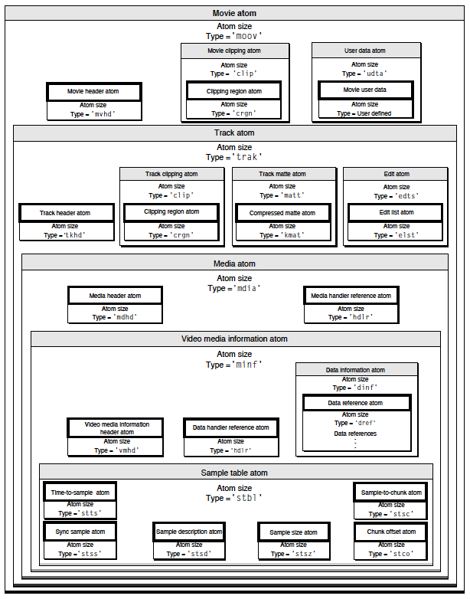
MOV File Format
- Highly Extensible
- Unique codes & GUIDs
- Extensions must be understandable by servers and clients to use it
- Static metadata: transmitted.
- Indexing info: not transmitted.
Apple QuickTime File Format. Ret 2001.

Slide 26
Outline
Introduction
Multimedia Architecture, Protocols, and Files Formats
Live Broadcast
Fundamental Abstractions
Streaming Media over Packet Networks
26
Notes:
26

Slide 27
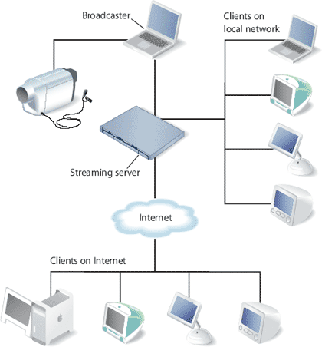
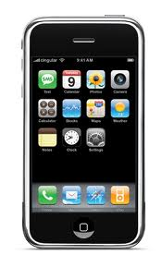
Live Broadcast
Major issue: heterogeneity across clients in
Channels
Error control & bit rate
Devices
Resolution
Computational power
Single encoding is not sufficient!
Apple QuickTime. Ret 2010

Slide 28
Live Broadcast: bit rate adaption
Simulcast
E.g. simultaneously broadcasting standard definition and HD TV.
Analogues to multibit rate files.
Simulcast streams with different bit rates, error protection, source resolution, and decoding requirements.
Clients tune in to the appropriate channel
Layered Multicast
Based on scalable coding
Each layer is multicast to different address
Client subscribe/unsubscribe from the topmost enhance layer
More efficient.

Slide 29
Live Broadcast: error control
Packet retransmission?
Limitation on feedback to the server
Timely feedback (ACK or NACK) → feedback implosion
Does not scale to large numbers of clients
Statistical feedback
E.g. RTCP
Client: average packet-loss rate
Server: understand clients population. Tailor streams.
Protection
Forward Error Correction (FEC)
Priority Encoded Transmission (PET) (scalable)

Slide 30
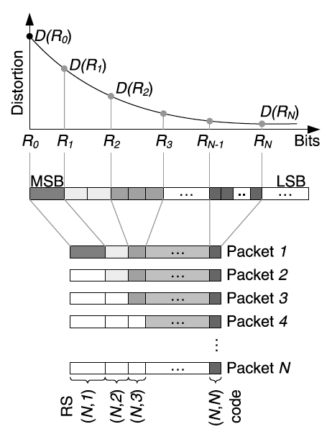
PET packetization
Layers
Layer K is protected
(N, K) RS code
Any K out of N packets
received can recover the first K layers.
Multimedia over IP and Wireless Networks. Pg 492, Fig 14.12

Slide 31
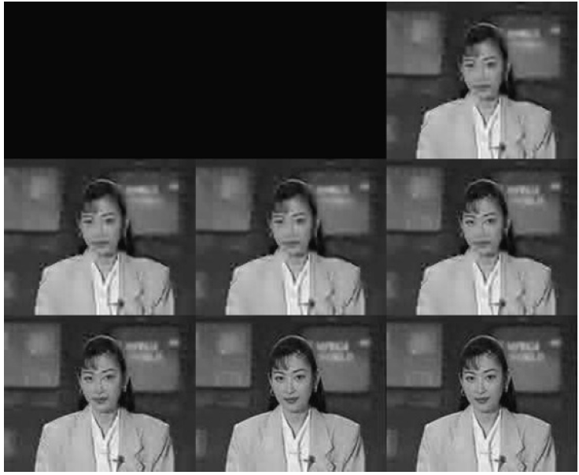
PET quality
Zero packets
received
8 out of 8 packets received
Multimedia over IP and Wireless Networks. Pg 493, Fig 14.13

Slide 32
Error & Bit rate controls
Error Protection (FEC or PET) with
Simulcast (straight forward)
Apply FEC or PET on each stream with a certain bit rate.
Layered multicast
Insufficient protection of a lower layer will render a higher layer irrelevant.
The lower layers need more error protection than the higher layers.
New enhancement layer → add more protection to preceding layers.

Slide 33
Conclusion
Media on Demand
More flexibility in protocols, error, and transmission control.
Use standard protocols to ensure interoperability.
Streamable file formats: flexible, extensible, and provide easy access to required contents.
Live Broadcasting
Biggest challenge in heterogeneous clients and real time requirements.
Combine protection from errors with variable bit rate coding for efficient use of resources.

Slide 34
Outline
Introduction
Multimedia Architecture, Protocols, and Files Formats
Live Broadcast
Fundamental Abstractions
Streaming Media over Packet Networks
34
Notes:
34

Slide 35
Context for Fundamental Abstractions
Context:
The Internet is not reliable
We assume it is reliable in our discussion
Focus is on buffering and transmission of encoded signals
Encoding and Decoding assumed to be instantaneous
Goals:
Understand fundamental abstractions of streaming media on demand
Understand Leaky Bucket models for idealized bit streams
Understand when it is safe for a client to begin playback
Understand terms: CBR vs VBR Streams, Preroll Delay, Timestamps

Slide 36
Buffering and Leaky Bucket Models
Communication Pipeline
Constant Bit Rate (CBR) Transmission
Variable Bit Rate (VBR) Transmission
Buffer Tubes
Leaky Buckets

Slide 37
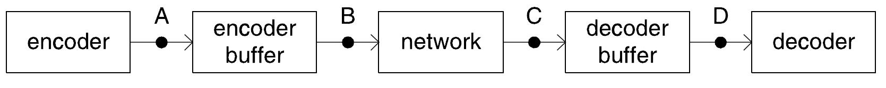
Communications Pipeline
On-Line Streaming Models:
Isochronous (synchronous) noiseless communication channel
Encoder constant bit-rate transmission rate over the channel
Instantaneous source coding rate
To match encode/decode rates to transmission rate:
Encoding Buffer required between Encoder and the Channel
Decoding Buffer required between Channel and the Decoder
I call it rate regulation!
Point A – captured frames instantaneously encoded and put into the encoder buffer
Point B – when bits enter the communication channel
Point C – when bits leave the communication channel
Point D – when frames removed from decoder buffer and instantaneously decoded
MULTIMEDIA OVER IP AND WIRELESS NETWORKS, pg 465 FIGURE 14.3

Slide 38
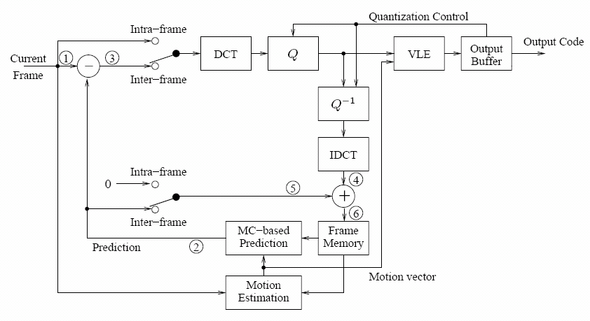
Constant Bit Rate (CBR) Media Streams
Used by On-Line Media on Demand Streaming when:
Constrained by maximum transmission bit rate
Consistent bit-rate more important than Quality
Encoder uses Quantization Control to control bit rate of Encoded stream
Quantization Control
Quantization Control

Slide 39
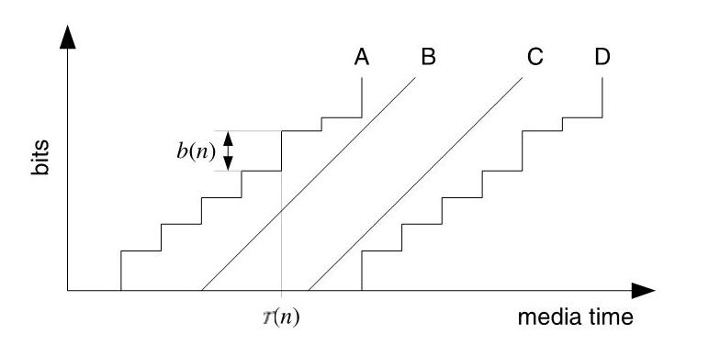
Coded Bit Stream Schedules
Coding Schedule: Sequence of times at which successive bits in the coded bit stream pass a given point in the communications pipeline
Schedule A – Staircase function which increases by b(n) bits at time T(n)
Schedule B – when bits enter the communication channel with slope R bits/second
Schedule C – when bits leave the communication channel with slope R bits/second
Schedule D – when frames removed from decoder buffer and instantaneously decoded
MULTIMEDIA OVER IP AND WIRELESS NETWORKS, pg 465 FIGURE 14.4

Slide 40
Coded Bit Stream Schedules (cont.)
Gap between A and B represents, at any point in time, the number of bits in encoder buffer
Gap between B and C is transmission delay
Gap between C and D represents, at any point in time, the number of bits in decoder buffer
Line A and D are the same shaped line ← defined by frame sizes
Line B is the lower bound to schedule A (if A goes slower than B, buffer will empty) ← Underflow
Line C is upper bound to schedule D (D can’t go any faster than C) ← Overflow
MULTIMEDIA OVER IP AND WIRELESS NETWORKS, pg 465 FIGURE 14.4

Slide 41
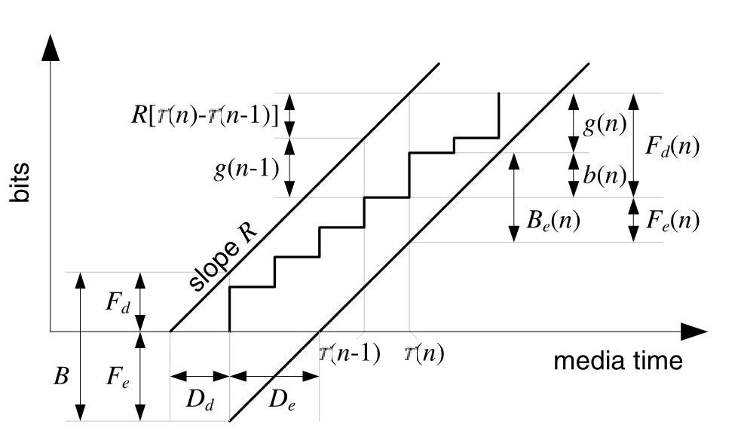
Buffer Tube contains a Coding Schedule
Buffer Tube: Contains the source coding schedule (line A or D)
Encoder uses a “rate control” algorithm to assign number of bits b(n) to each frame to maintain buffer within Tube
Resultant Bit Stream is called a CBR bit stream with average rate R
Used by On-Line source encoder to ensure output will not cause decoder to overflow/under-run buffer ← called HRD model in H.264/SVC
MULTIMEDIA OVER IP AND WIRELESS NETWORKS, pg 466 FIGURE 14.5

Slide 42
Buffer Tube contains a Coding Schedule (cont.)
Buffer Tube characterized by three parameters (R, B, F_{d})
Slope R = transmission speed in bits/second
Height B = Capacity in bits of each buffer (end-to-end delay = B/R seconds)
F_{d} = Number of bits in decoder buffer before it starts presenting the data (F_{d} = B – F_{e}) (delay D_{d} = F_{d}/R)
F_{e} = Number of bits in encoder buffer before it starts transmitting the data (delay D_{e} = F_{e}/R)
MULTIMEDIA OVER IP AND WIRELESS NETWORKS, pg 466 FIGURE 14.5

Slide 43
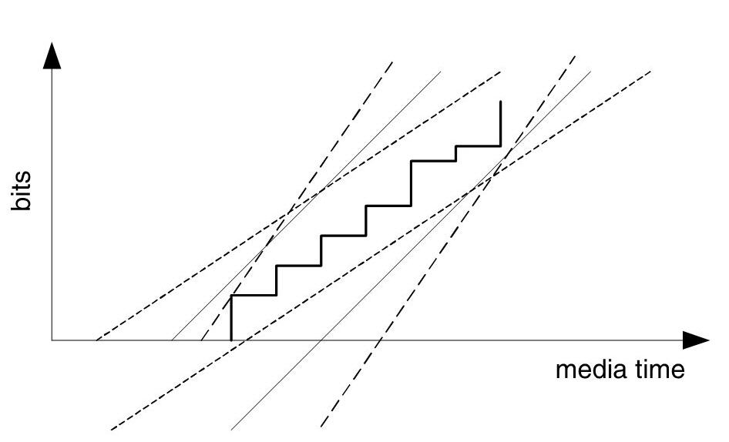
Selecting the best Buffer Tube
Infinite number of buffer tubes can contain a finite-duration bit stream
Slope R, width B, and offset F_{e} are not unique
Lower channel bit rate R can be accommodated with more buffering B
Selecting the best Buffer Tube, select slope R:
with tightest fit to stream’s schedule {(b(n), T(n))}
with average bit rate = (Total Number of Bits)/(Duration of Bit Stream)
MULTIMEDIA OVER IP AND WIRELESS NETWORKS, pg 467 FIGURE 14.6

Slide 44
Preroll Delay
Decoder buffer delay D_{d} also referred to as Preroll Delay
Typically largest component of start up delay for Streaming Media on Demand
For off-line source encoding, encoder delay not important
Focus is on decoder buffer delay D_{d} = F_{d}/R only
trade-off between reduced preroll delay and initial frame quality
See 14.4 for more details
Also called initial buffering delay

Slide 45
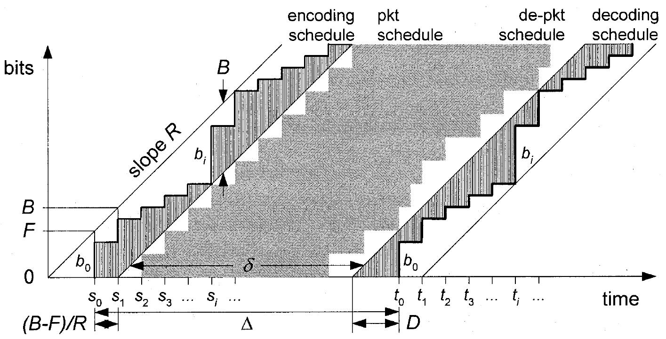
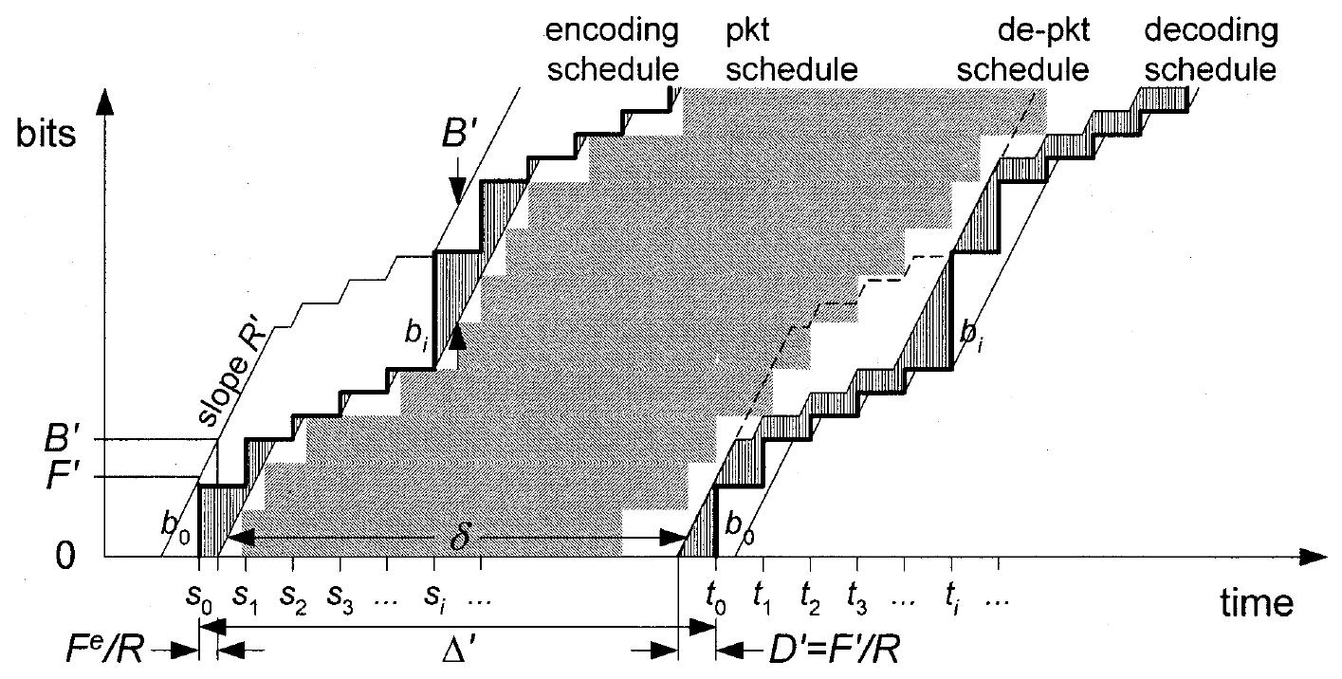
Variable Bit Rate (VBR) Streams
VBR Used for producing Media Stream with constant distortion for consistent quality
Can not maintain constant bit rate using QC to control encoded frame size b(n)
A VBR steam model is a generalization of the CBR stream model:
Both CBR and VBR have schedules with finite sequences of frame sizes over time
Both can be contained in Buffer Tubes with the appropriate (R, B, F_{d})
VBR requires wider Buffer Tube than for equivalent CBR stream
VBR requires larger preroll delays than CBR due to variability in bit rate
- allows the decoder to have more bits in its buffer to prevent decoder buffer under-run
CBR
VBR
Jordi Ribas-Corbera [2], pg 674 FIGURE 1
Jordi Ribas-Corbera [2], pg 675 FIGURE 2

Slide 46
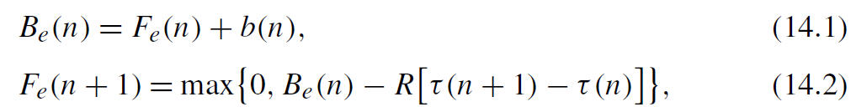
Leaky Bucket
Extend model to case where encoder does not use channel continuously
Peak transmission rate R higher than average bit rate of stream
When encoder has bits to send, it sends them at rate R, idle otherwise
More realistic model for packet networks
Modelled as a Leaky Bucket: (R, B ,F_{e})
Encoder dumps b(n) bits into leaky bucket at time T(n)
Bits leak out of the bucket and into the channel at rate R
Bucket has capacity B and initial fullness of F_{e} bits
B_{e}(n): Encoder buffer fullness after frame n added to buffer
F_{e}(n): Encoder buffer fullness before frame n added to buffer
Given initial Leaky Bucket Fullness F_{e} before bit transmission starts,
The system can be modelled as:

Slide 47
The Tightest Leaky Bucket
A leaky bucket (R, B, F_{e}) is said to contain a bit stream with schedule
{(b(n), τ(n))}
if the bucket does not overflow, that is, B_{e}(n) ≤ B for all n = 0, 1, . . . , N
For a given stream, want the Tightest Leaky Bucket which contains it.
Define minimum bucket capacity given leak rate R and initial fullness F_{e} as:
Define the corresponding initial decoder buffer fullness as:
Define the corresponding initial decoder buffer fullness as:
Denote the minimum of each of these over F_{e} as:
Denote the minimum of each of these over F_{e} as:
Each is minimized by the same value of F_{e} which is equal to:

Slide 48
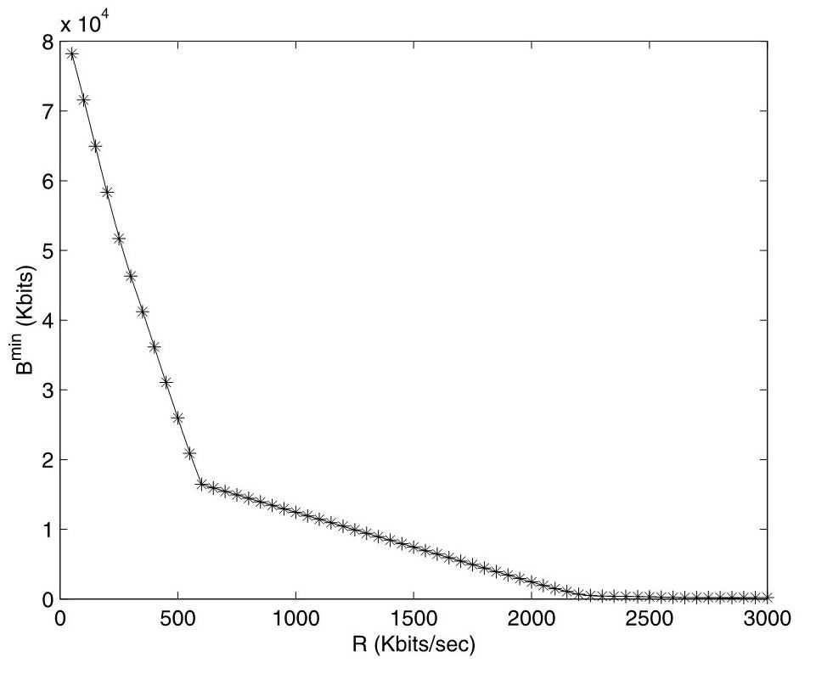
Leaky Bucket Parameters as a function of R
Buffer size B^{min} depends on Bucket Leak Rate R
For R < Rc, larger and larger buffers are required
For R >> Rc, buffers seldom filled and few required
For off-line encoding of media on demand,
Value of R used by client often differs from source coding rate R_{c}
Encoder pre-computes required buffer size and preroll delay for various values of R
Pre-computed values for various R can be stored in header as (R, B^{min}, F_{d}) triplets
R_{c} = 600Kbps
MULTIMEDIA OVER IP AND WIRELESS NETWORKS, pg 470 FIGURE 14.7

Slide 49
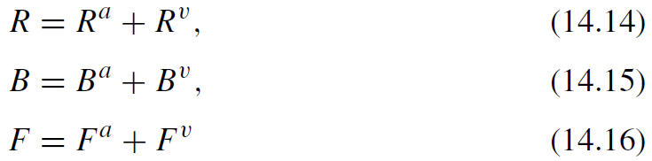
Compound Streams
Streaming Media files often contain multiple independent streams
Audio Stream
Video Streams
Leaky bucket for aggregate stream:
Derived as sum of leaky buckets containing each component stream
Will contain the combined stream, but not strictly the tightest possible
Given:
Audio stream with leaky bucket (Rª, Bª, Fª)
Video stream with leaky bucket (R^{v}, B^{v}, F^{v})
Compute aggregate stream leaky bucket as follows:

Slide 50


Temporal Coordinate Systems
Media time refers to clock running on capture device
Monotonically increasing timestamps of the original content
One second of media time elapses in one second of real time
Client time t refers to playback time at client
Time of media playback at client
Content may be played back at different values of V
V < 1 for Slow-Motion
V = 1 for PLAY
V > 1 for Fast-Forward
Conversion from media time to client time:

Slide 51
Timestamps
Decoder timestamp (DTS)
arrival deadline for decoding the frame at the client
Provides decoding dependency order for P and B Frames
Presentation timestamp (PTS)
Tells renderer when to render and present the frames
Useful for synchronizing concurrent streams
Decoder and Presentation order can differ
Presentation Order: I₀B₁B₂P₃B₄B₅P₆
Decoding Order: I₀P₃B₁B₂P₆B₄B₅

Slide 52
Conclusions
Media on Demand streams modelled by Encoder using Buffer Tubes
Leaky Bucket model more appropriate for transmission over packet networks
Leaky Bucket parameters can be summed for aggregate streams
Preroll Delay a function of Buffer requirements and Transmission Rate R

Slide 53
Backup

Slide 54
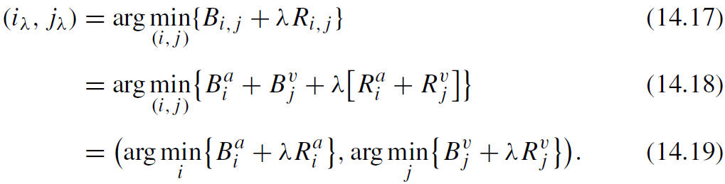


Component Streams with Multiple Leaky Buckets
Given Lª audio and L^{v} video leaky buckets:
There are (Lª x L^{v}) possible pairs but only (Lª + L^{v}) pairs are of interest.
They lie on lower convex hull of set used to compute B_{e}^{min}(R) & F_{d}^{min}(R)
Indices for pairs easily found by minimizing the Lagrangian for some positive Lagrange multiplier λ>0 :
Chose Lª audio leaky buckets by minimizing the Lagrangian:
Chose L^{v} video leaky buckets by minimizing the Lagrangian:
Pair up Audio and Video leaky buckets with same λ

Slide 55
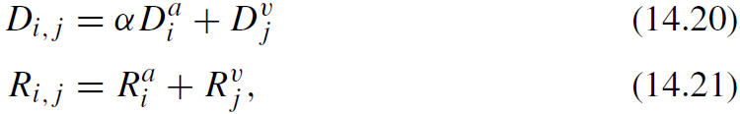
MBR and Scalable Streams
MBR adds choice of streaming from set of mutually exclusive media streams, each with a different coding rate.
Scalable Streams similar to compound streams except must chose sets of layers.
Lots of combinations! Most are not useful.
Choose based on selecting a desired distortion level versus bit rate.
For each combined stream (i,j), define an over-all distortion and source rate:
Select a “desirable” subset of audio/video combinations (i,j) such that:
D_{i,j} ≤ D_{i’,j’} for all (i’,j’) such that R_{i’,j’} ≤ R_{i,j}
As with compound streams, use Lagrangian method to find desirable pairs.

