Slide 1
Department of Computer Science
National Tsing Hua University
CS 5262: Multimedia Networking and Systems
Basics of Video Coding
Instructor: Cheng-Hsin Hsu
Acknowledgement: The instructor thanks Prof. Mohamed Hefeeda at Simon Fraser University for sharing his course materials

Slide 2
Outline
Video Coding Standard
Intra and Inter-frame Compression
MPEG Video Compression
Scalable Video Coding
Error Propagation
Introduction to H.264/AVC
2
Notes:
2

Slide 3
Video
Enabled by two properties of human vision system
Persistence of vision:
  Tendency to continue to see something for a short period after it is gone
Flicker fusion:
  The ability of human vision system to fuse successive images into one fluid moving image
Interesting discussion on video capturing, editing, processing, standards, etc. in [Ch. 6, 7 of Burg09]
  We focus on video coding/compression

Slide 4
Video Coding Standards
lTU: International Telecommunication Union
  Coordinates global telecom networks and services
  3 sectors: ITU-T (telecom); ITU-R (radio); ITU-D (development)
  Video Coding Expert Group (subcommittee for ITU-T) produced the H.26* codec series, where * is replaced by a digit, e.g., 1, 2, 3, 4
  H.261 (~1990): for video conferencing and video over ISDN
  H.263 (~1995): improved H.261 to transmit video over phone lines
  H.264/AVC (~2003): most common, high compression ratios
    Also known as MPEG-4 Part 10 or MPEG-4/AVC
NOTE: Most video coding standards only specify decoder operation and stream syntax ➔ lots of room for innovation at the encoder side

Slide 5
Video Coding Standards
MPEG: Motion Picture Expert Group
  From ISO (International Organization for Standardization) and IEC (International Electrotechnical Commission)
  Audio and video coding for a wide range of multimedia applications
  Several versions: MPEG-1, -2, -4, (-7 & -21: for content description)
    MPEG-1 = ISO/IEC 11172 Standard
  Each version has several Parts; each has multiple Profiles
  Each Part is related to specific component: audio, video, system, etc
    MPEG-1 has 6 parts, MPEG-2 has 9, and MPEG-4 has 23
    MPEG-4 Part 10: Advanced Video coding = H.264/AVC
  Each Profile identifies subset of features to be implemented, e.g., sub-sampling type, quantization methods, etc
  Each Profile can have multiple levels
    Level indicates encoding computation complexity

Slide 6
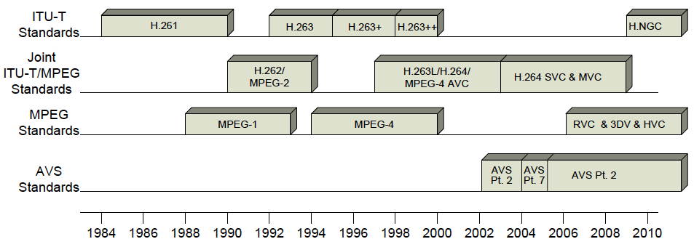
Timeline for Video Coding Standards
J. Dong and K. Ngan, Present and Future Video Coding Standards, book chapter at http://jdong.h265.net/2010_chapter.pdf
Notes:
MPEG-2: an enabling technology for digital television systems
initially designed to extend MPEG-1 and support interlaced video coding
Used by transmission of SD/HD TV signal and storage of SD video onto DVDs.
H.263/+/++: conversation/communication application
Support diversified networks and adapted to their characteristics, e.g. PSTN, mobile, LAN/Internet
Considering loss and error robustness requirements
MPEG-4 Visual: object-based video coding
Provide shape coding

Slide 7
Video Coding
Video is a sequence of images
  Typical frame rates (fps): 29.97, 24, 15
Common method for compressing videos
  Remove redundancies inside the frame
    Intraframe compression or spatial compression
    Usually using transform encoding (e.g., in JPEG)
  Remove redundancies across frames
    Interframe compression or temporal compression
    Visual scenes do not change much in neighboring frames ➔
    Detect how objects move from one frame to another
      motion vector; computed by motion estimation
    Use motion vectors and differences among frames
      Differences are small ➔ good for compression

Slide 8
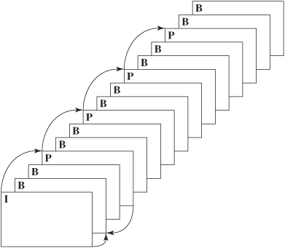
MPEG Compression: Basics
Divide video into groups of pictures (GOPs), identifying I, P, B frames
I frame (intraframe):
  Compressed spatially with JPEG
P frame (forward prediction frame):
  Compressed temporally relative
  to a preceding I or P frame
  Then compressed spatially
B frame (bidirectional frame):
  Compressed temporally relative
  to preceding and following I and/or
  P frames
  Then compressed spatially

Slide 9
Spatial Compression
Frames are divided into 16 x 16 macroblocks
Chroma subsampling is usually used, e.g., 4:1:1, 4:2:0
➔ We get 8 x 8 blocks for Y and CbCr
Then we apply DCT and the rest of JPEG compression

Slide 10
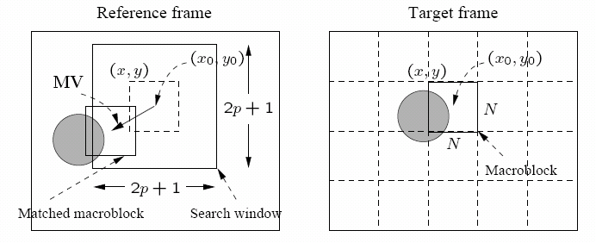
Temporal Compression: Motion Compensation
Motion compensation is performed at macroblock level
Current frame is referred to as Target Frame
Closet match is found in previous and/or future frame(s), called Reference Frame(s)
  Search is usually limited to small neighborhood: range [−p, p] ➔ search window size: (2p + 1) x (2p + 1)
  Displacement is called Motion Vector (MV)

Slide 11
Search for Motion Vectors
Difference between two macroblocks can be measured by Mean Absolute Difference (MAD):
  N: size of macroblock
  k, l: indices for pixels in macroblock
  i, j: horizontal and vertical displacements
  T ( x + k, y + l ): pixels in macroblock in Target frame
  R ( x + i + k, y + j + l ): pixels in macroblock in Reference frame
We want to find the MV with minimum MAD ← Why?

Slide 12
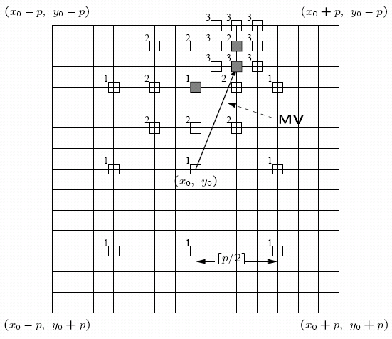
Search for Motion Vectors
  Full search: check the (2p + 1) x (2p + 1) window ← expensive
  ➔ Time complexity: O (p² N²) ← conservative: sub-pixel, multiple-reference
  2D Logarithmic search
  Compare 9 blocks evenly spaced
  within distance p and find best
  matching macroblock
  Compare 9 blocks within p/2
  And so on
  Complexity: O (log(p) N²)

Slide 13
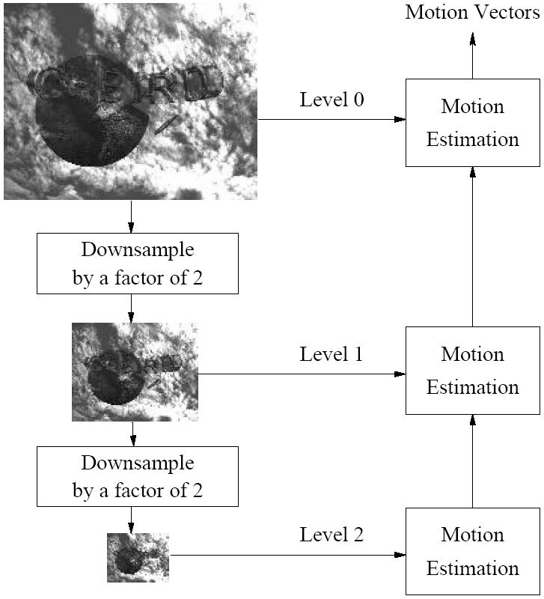
Search for Motion Vectors
Hierarchical search
  multi-resolutions
  by down sampling
  Search for MV in
  reduced resolutions
  first (faster)

Slide 14
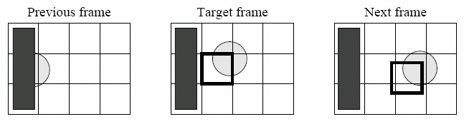
The Need for B Frame
Sometimes a good match cannot be found in previous frame, but easily found in next frame
B-frames can use one or two motion vectors
  1 MV: if either previous or next frame is used
  2 MVs: if both frames are used
    Difference is computed between target frame and the average of both previous & next frames ← weighted sum is also possible
14
Notes:
14

Slide 15
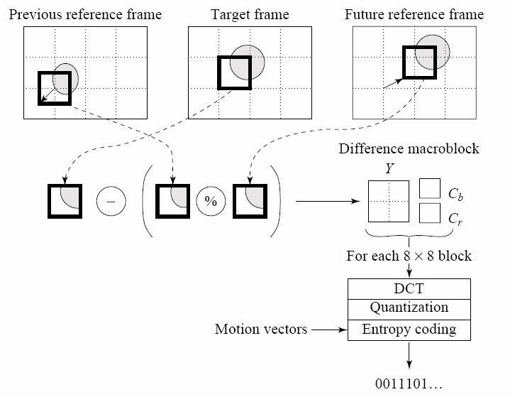
B-frame coding

Slide 16
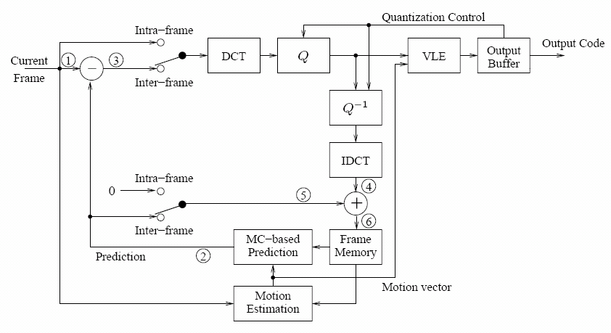
Basic Video Encoder

Slide 17
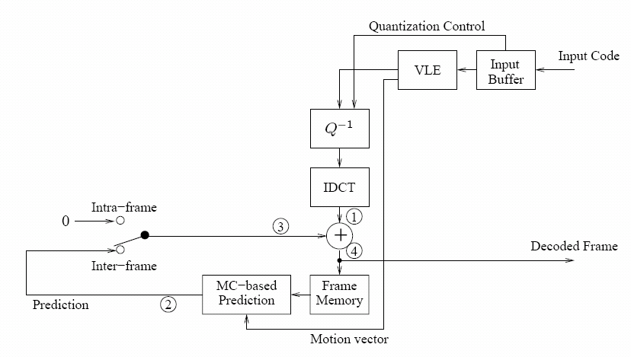
Basic Video Decoder

Slide 18
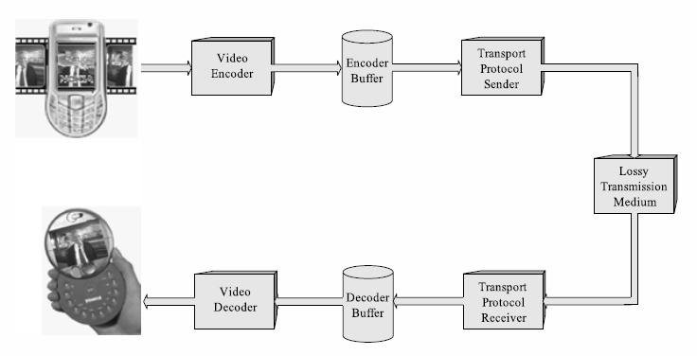
Errors and Video Coding Tools
Video is usually transmitted over lossy channels, e.g., wireless network and the Internet
  ➔ some video data may not arrive at the receiver
Video data is also considered lost if it arrives late

Slide 19
Error Propagation
Because of temporal compression, decoding of a video frame may depend on a previous frame
  ➔ Thus, even if a frame arrives on time, it may not be decoded correctly
Example: to decode a P-frame, we need its reference frame (previous I or P-frame in the GoP)
What do we do if the reference frame is lost/damaged?
Try to conceal the lost frame
Simplest approach is:
  Decoder skips decoding the lost frame and the display buffer is not updated

Slide 20
Error Propagation
Problems with the simple error concealment approach?
Some loss in the smoothness of the motion
  We display the same frame for twice its time
And ….
some future frames could be damaged (error propagation). Why?
Because the decoder will use a different reference frame in decoding than one used during encoding
  Known as reconstruction mismatch

Slide 21
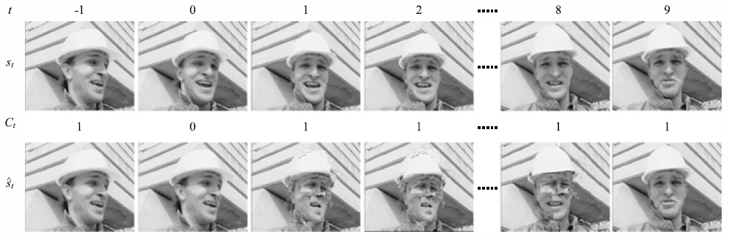
Error Propagation: Example
Frame at t = 0 is lost ➔ use frame at t = -1 as reference for decoding frames at t = 1, 2, …, 8 ➔
Frames 1—8 are not perfectly reconstructed, although they were received correctly ➔ error propagated through all of them
Error stooped with an new intra-coded (I) frame (at t = 9)
Original sequence
Reconstructed sequence

Slide 22
Handling Error
  Note: Most error-resilience coding tools (e.g., using intra-coded macro blocks, slice coding, …) decrease compression efficiency
  Trade off: error resiliency ⬅➔ compression efficiency
Shannon’s Separation Principle
  Separate compression (source coding) from transport (channel coding), that is:
  Employ link features (e.g., retransmission, FEC) to avoid/recover from losses, and
  Maintain high compression efficiency (without worrying about error resiliency)
In many practical situations, we cannot totally avoid losses or recover from them, e.g., in low delay systems

Slide 23
Handling Error: Principles
Loss correction below codec layer
  Done in transport layer (i.e., coder is unaware of it) to minimize amount of losses
  Examples:
    TCP (retransmission)
    Forward Error Correction (FEC)
Error detection
  Detect and localize erroneous video data
Prioritization methods
  If losses are unavoidable, minimize losses for important data (e.g., motion vectors, reference frames)

Slide 24
Handling Error: Principles (cont’d)
Error recovery and concealment
  In case of losses, minimize visual impacts
Encoder-decoder mismatch avoidance
  Reduce encoder-decoder mismatch to reduce error propagation
Details are given [Ch 2, SC07]

Slide 25
Coding Tools for Error Resilience
We discuss coding tools to improve error resiliency
  These are used for both compression AND error resiliency
  E.g., Slice coding, Flexible Reference Frame, …
Different tools are used in different standards and in different profiles within the same standard
Most tools are included in the state-of-the-art MPEG-4/AVC (aka H.264/AVC) video coding standard

Slide 26
Slice Structured Coding
A video frame is divided in multiple slices
  Different parts of the frame have different visual complexities (i.e., data redundancies)
  A whole frame may be larger than a network packet size ➔ lower layers may divide it into multiple packets (and losing any of them makes decoding difficult)
Slice: group of macroblocks (an independent unit)
  Encoded and decoded independently of others
  intra prediction and motion vector prediction are not allowed across slices
  Has slice header
  Could have fixed number of blocks or
  fixed number of bits (preferred for network transmission)

Slide 27
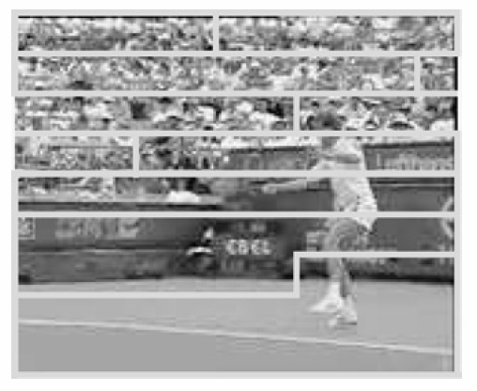
Slice Structured Coding: Example
Mapping of blocks to slices in raster-scan manner
  Simple (used in MPEG-1, MPEG-2, and H.263)
Any disadvantages of this simple mapping?
Not very efficient in error concealment: if MB is damaged, neighbouring blocks are used to estimate it
Does not support Region of Interest (ROI) protection:
  Video conference: Human face in frame ➔ higher protection against error ← Solution: Slice Group

Slide 28
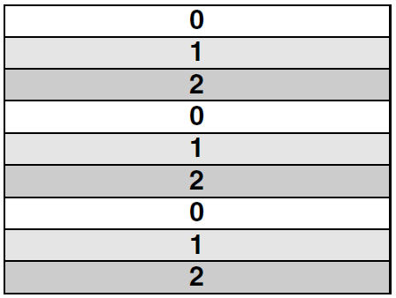
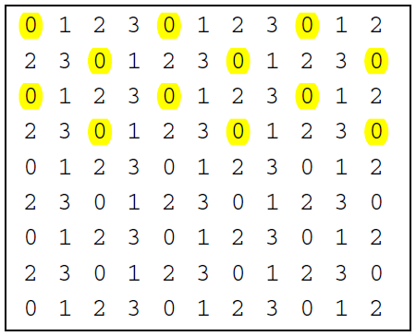
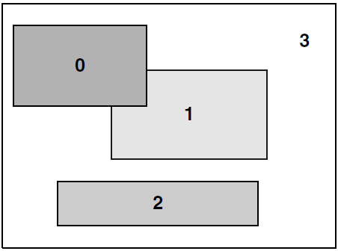
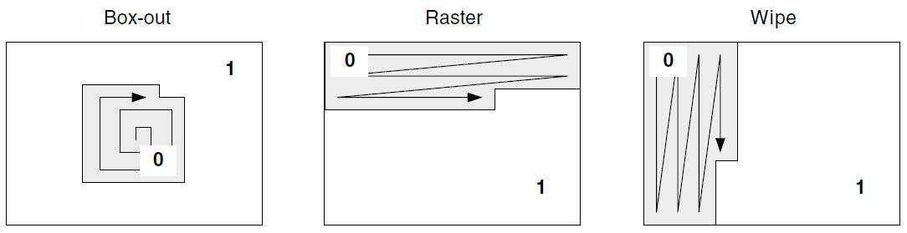
Flexible Macroblock Orderg in (FMO) in AVC
Foreground and Background
Interleaved
Dispersed

Slide 29
ASO in H.264/AVC
Arbitrary Slice Order (ASO) allows
  sending/receiving slices of frame in any order relative to each other
ASO can improve end-to-end delay in real-time applications
  For example, sending the ROI slices first
  particularly in networks having out-of-order delivery behavior

Slide 30
Scalability
Supports decoding at different extraction points with a single coded stream
  <Resolution, Frame Rate, QP>: {<VGA, 15 fps, 12>, <720P, 30 fps, 40>}
Often realized as embedded bit streams
  E.g., the stream with lower resolution is embedded in that with higher resolution
  Provides successive refinement
More details next week.

Slide 31
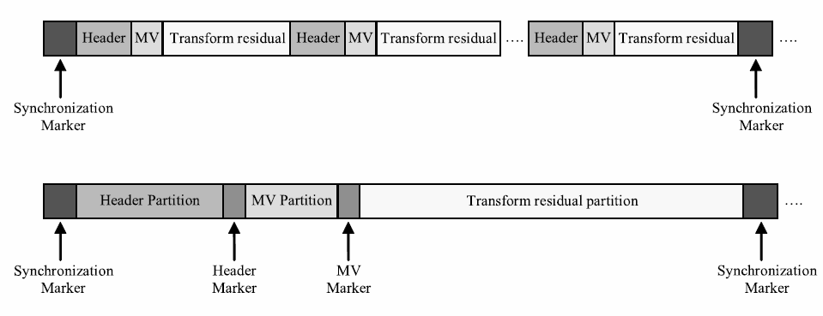
Data Partitioning
Before MPEG-4 and H.263++
MPEG-4, H.263++, H.264/AVC (more than this)
Some parts of data are more important than others
  Header > MV > Texture (Transform residual)
Group important info and apply UEP (Unequal Error Protection)

Slide 32
Redundant Slices
H.264/AVC encoder can transmit redundant slices
  Using possible different coding parameters
H.264/AVC decoder uses them in case of errors
  discards redundant slices if no errors
Example:
  Encoder can send a coarsely quantized (i.e., smaller size) version of ROI (e.g., face) as redundant slice
  In case of loss, the decoder can display ROI, with lower quality

Slide 33
Flexible Reference Frame
MPEG-2 and H.263:
  1 reference frame for P-frame and up to 2 for B-frame
But there could be similarity with more than one frame
  Target frame may be closer to frame r₁, which is different from predetermined reference frame r₂
  More flexible prediction structure➔ higher compression and better error resiliency
MPEG-4 and H.263+:
  Supports Reference Picture Selection (RPS) ➔ temporal prediction is possible from other correctly received frames
H.264/AVC:
  Generalized this to macroblock level

Slide 34
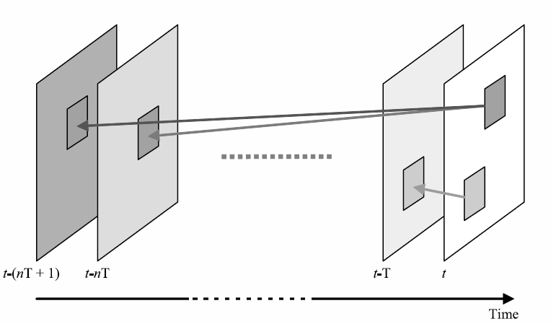
Flexible Reference Frame (cont’d)
A MB can be predicted from multiple reference MBs or a combination of them in H.264/AVC
Multiple frames are kept in the buffer for prediction

Slide 35
Summary
Video coding: Spatial and temporal compression
Most common (MPEG, H.26x)
  Transform coding
  Hybrid coding
  Predictive coding
Main steps for video coder and decoder
Errors/losses can have severe impacts on video quality
  Dependency among frames ➔ error propagation
  Tools for error resilience coding: Slice, FMO, partitioning, …
  Error concealment (later)

Slide 36
A Quick Overview of H.264/AVC

Slide 37
Design Goals of H.264/AVC
Cut the bit rate by at least half, compared to previous standards (MPEG-2)
  Reduce the network load or
  Increase video quality
Make it flexible and suitable to various applications
  Replace MPEG-2 for pre-recorded videos
  Replace H.263 for live videos
Keep the complexity manageable
  So it will be implemented at reasonable cost

Slide 38
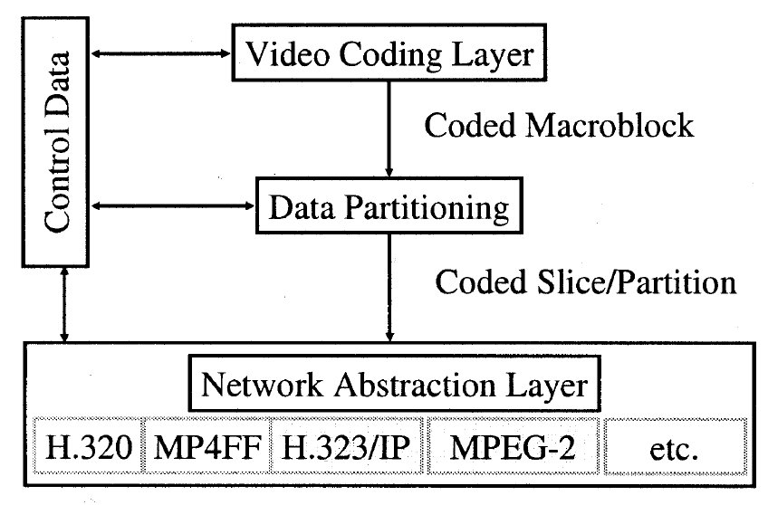
Layered Design
Network Abstraction Layer (NAL)
  Formats video and meta data for variety of networks
  Transport specific features
Video Coding Layer (VCL)
  Represents (encodes) video in an efficient way
  Coding specific features
Scope of H.264 standard
Network Protocols
Container file formats or transport protocols
Notes:
To address the heterogeneity of applications and networks, H.264/AVC adopt a layered design, where …

Slide 39
Network Abstraction Layer
To be network friendly, supports various transports
  RTP/IP for Internet applications
  MPEG-2 streams for broadcast services
  ISO File formats for storage applications
Essentially are packets consist of video data
  short packet header: one byte
Support two types of transports
  stream-oriented: no free unit boundaries ← use a 3-byte start code prefix
  packet-oriented: start code prefix is a waste
Have two types:
  VCL units: data for video pictures
  Non-VCL units: meta data and additional info
Notes:
The main objective of NAL is to enable simple and effective customization of sending video data over different network systems.

Slide 40
Network Abstract Layer Format
Each NAL unit contains an RBSP
Raw Byte Sequence Payload (RBSP)
  a set of data corresponding to coded video data or header information.
Sequence of NAL units (Access Unit)

Slide 41
Access Units
A set of NAL units
Decoding an access unit results in one picture
Structure:
  Delimiter: for seeking in a stream
  SEI (Supp. Enhancement Info.): timing and other info
  primary coded picture: VCL
  redundant coded picture: for error recovery
Notes:
Now, we know the building blocks. But how to put NAL units together to represent ONE picture?
* Delimiter for seeking in byte-stream format
* SEI: timing information and other supplemental data that may enhance application usability.
* Consist of a set of VCL NAL units which together compose a primary coded picture.
* Several redundant slices for error recovery.
Redundant coded pictures are usually not decoded. Only when decoders fail to decode the primary coded picture, they will try to decode redundant coded picture.

Slide 42
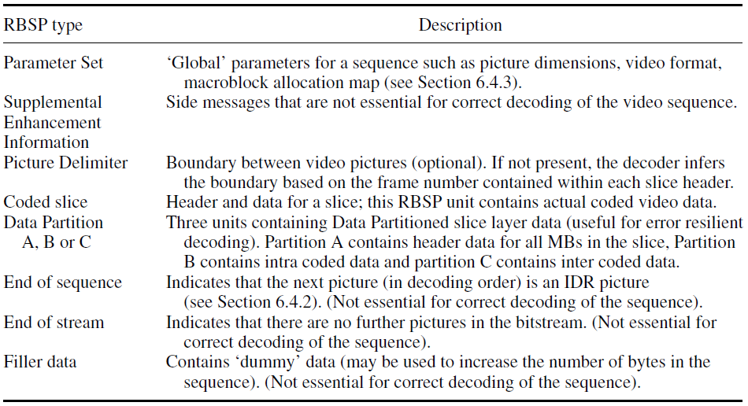
RBSP Format

Slide 43
Video Sequences and IDR Frames
Sequence: a sequence of decodable NAL units
  With one sequence parameter set
  Starts with an instantaneous decoding refresh (IDR) access unit
IDR frames: random access points
  Intra-coded frames
  No future frame will refer to frames prior to an IDR frame ← main difference from I-frames
  Decoders flush buffered reference pictures once seeing an IDR frame
Notes:
Intuitively, aggregating several access units (pictures) gives us a sequence. But, video sequence carries other requirement in H.264/AVC.

Slide 44
Video Coding Layer Features (1/3)
Features for enhancement of prediction
  Directional spatial prediction for intra coding
  Variable block-size motion compensation with small block size
  Quarter-sample-accurate motion compensation
  Motion vectors over picture boundaries
  Multiple reference picture motion compensation
  Decoupling of referencing order form display order
  Decoupling of picture representation methods from picture referencing capability
  Weighted prediction
  Improved “skipped” and “direct” motion inference
  In-the-loop deblocking filtering

Slide 45
Video Coding Layer Features (2/3)
Features for improved coding efficiency
  Small block-size transform
  Exact-match inverse transform
  Short word-length transform
  Hierarchical block transform
  Arithmetic entropy coding
  Context-adaptive entropy coding

Slide 46
Video Coding Layer Features (3/3)
Features for robustness to data errors/losses
  Flexible slice size
  Flexible macroblock ordering (FMO)
  Arbitrary slice ordering (ASO)
  Redundant pictures
  Data Partitioning
  SP/SI synchronization/switching pictures

Slide 47
H.264 Slice Modes
Recall: Slice is a set of MBs that can be decoded
Slice Type | Description | Profile(s)
I (Intra) | Contains only I macroblocks (each block or MB is predicted from previously coded data within the same slice). | All
P (Predicted) | Contains P macroblocks (each MB is predicted from one list 0 reference picture) and/or I MBs. | All
B (Bi-predictive) | Contains B macroblocks (each MB is predicted from a list 0 and/or a list 1 reference picture) and/or I macroblocks. | Extended and Main
SP (Switching P) | Facilitates switching between coded streams; contains P and/or I macroblocks. | Extended
SI (Switching I) | Facilitates switching between coded streams; contains SI macroblocks (a special type of intra coded MB). | Extended
Notes:
An H.264 encoder may optionally insert a picture delimiter RBSP unit at the boundary
between coded pictures. This indicates the start of a new coded picture and indicates which
slice types are allowed in the following coded picture. If the picture delimiter is not used, the
decoder is expected to detect the occurrence of a new picture based on the header of the first
slice in the new picture.

Slide 48
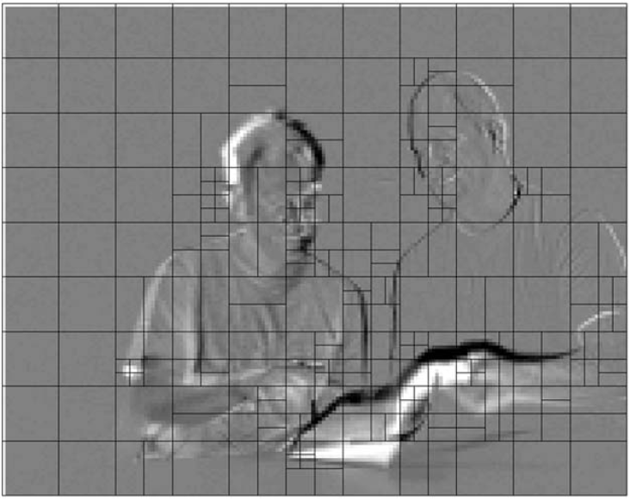
Inter Prediction
H.264/AVC supports a range of block sizes (from 16 × 16 down to 4×4) and fine subsample (1/4-pixel) motion vectors
Partitioning MBs into motion compensated sub-blocks of varying size is known as tree structured motion compensation
Intuitions:
  MV are expensive
  Smooth areas → larger
  Detailed areas→ smaller

Slide 49
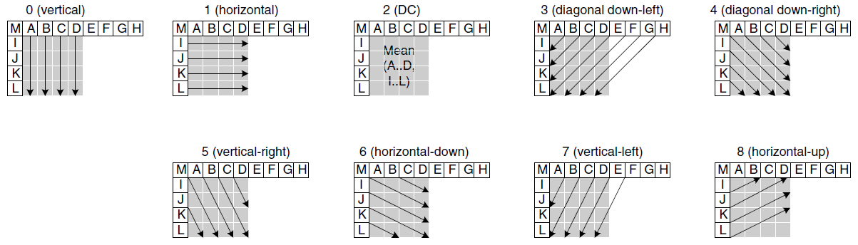
Intra Prediction
Intra prediction in H.264 is conducted in the spatial domain
Intra prediction is restricted to Intra-coded neighboring MBs ← to avoid error propagation
4x4 (for detailed areas, 9 modes) and 16x16 (for smooth areas, 4 modes) predictions

Slide 50
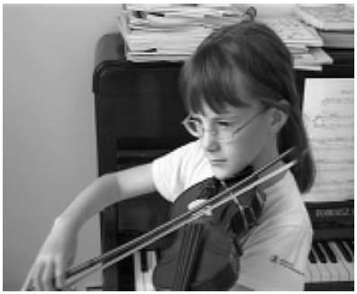
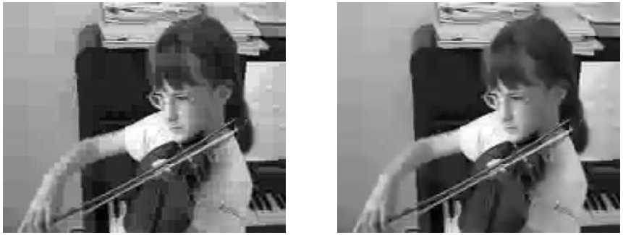
Deblocking Filter
Smooth out block edges
After inverse DCT (both encoder/decoder)
Idea:
  large diff. between pixels across block edges →blocking artifacts
  But if the diff. is very large → probably real edges in original frame
Original Frame
Reconstructed, QP=36 (no filter)
Reconstructed, QP=36 (with filter)

Slide 51
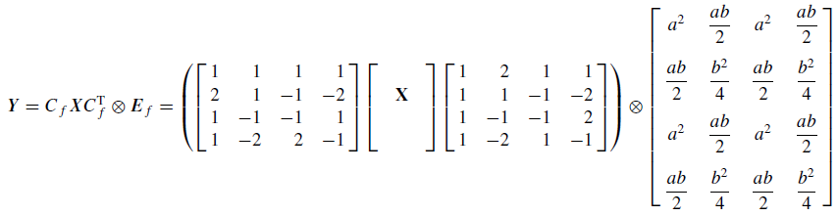

4x4 Integer Transform
Why smaller transform
  Only use add and shift, an exact inverse transform is possible ← no decoding mismatch
  Not too much residue to code ← ME is good enough
  Less noise around edge (ringing or mosquito noise)
  Less computations and shorter data type (16-bit)
An approximation to 4x4 DCT
Notes:
It would be desirable if only 16-bit multiplications were required, since many processors cannot perform 32-bit multiplications with a single instruction
Ringing is still there, just they are smaller, and harder to see.

Slide 52
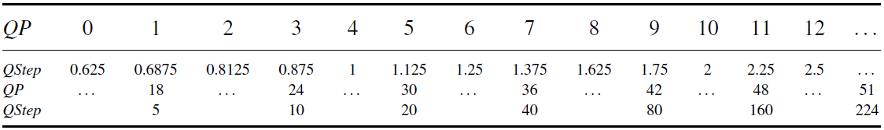
Quantization
A total of 52 values of Q_{step} are supported by the standard, indexed by a Quantisation Parameter, QP.
Q_{step} doubles in size for every increment of 6 in QP.
Notes:
The wide range of quantiser step sizes makes it possible for an encoder to control the tradeoff accurately and flexibly between bit rate and quality. The values of QP can be different for luma and chroma.

Slide 53
Entropy Coding
Non-transform coefficients: Exp-Golomb ← loseless
Transform coefficients:
  Context-Adaptive Variable Length Coding (CAVLC)
    several VLC tables are switched dep. on prior transmitted data ← better than a single VLC table
  Context-Adaptive Binary Arithmetic Coding (CABAC)
    flexible symbol probability than CAVLC ← 5 – 15% rate reduction
    multiplication free
Notes:
Previous standards usually have SEPARATE VLC tables for different elements, because they tend to have different probability characteristics
In H.264/AVC a simple and efficient infinite-extent codeword table is shared by all elements
For different element, only a mapping to this single codeword book is required.
Arithmetic coding: non-integer number of bit to each symbol

Slide 54
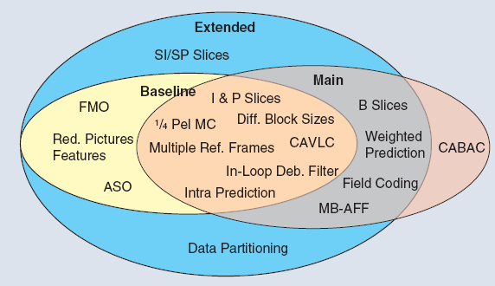
H.264 Profiles

Slide 55
Potential Applications
Baseline (low latency)
  H.320 conversational video services
  3GPP conversational H.324/M services
  H.323 with IP/RTP
  3GPP using IP/RTP and SIP
  3GPP streaming using IP/RTP and RTSP
Main (moderate latency)
  Modified H.222.0/MPEG-2
  Broadcast via satellite, cable, terrestrial or DSL
  DVD and VOD
Extended
  Streaming over wired Internet
Any (no requirement on latency)
  3GPP MMS
  Video mail

Slide 56
Performance of H.264/AVC
Specific video
Tempete CIF 30Hz
38
Range is small (dB)
37
36
35
34
33
Quality
Y-PSNR [dB]
32
31
30
29
JVT/H.264/AVC
28
MPEG-4
Visual
27
MPEG-2
26
H.263
25
0
500
1000
1500
2000
2500
3000
3500
R-D (rate-distortion) curves
  Encode at different bit rates
  Decode and compare quality (distortion) relative to original video
EX: to get 35 dB ➔ ~ 900 Kbps (AVC), 2.1 Mbp (MPEG-2)
Bit-rate [kbit/s]

Slide 57
Conclusion
H.264 includes many coding tools for high coding efficiency
H.264 supports various kinds of multimedia communication applications
H.264 indeed achieves the design goal of reducing the bit rate by half

