Slide 1
Department of Computer Science
National Tsing Hua University
CS 5262: Multimedia Networking and Systems
Scalable Video Coding
Instructor: Cheng-Hsin Hsu
Acknowledgement: The instructor thanks Prof. Mohamed Hefeeda at Simon Fraser University for sharing his course materials

Slide 2
Motivation
Receivers of video stream are heterogeneous
  Connection bandwidth
  Display resolution
  Processing power
  Battery level
Dynamic conditions
  Even for the same receiver
  Internet bandwidth is changing
  Wireless conditions and mobility
➔ Need stream adaptation methods

Slide 3
Stream Adaptation
Transcoding
  Transform the encoded stream to different format/bitrate/resolution
  Simple approach: decode then encode again with different parameters
  There are more sophisticated transcoding schemes, e.g., work in the compressed domain
  Disadvantages?
    Computational cost

Slide 4
Stream Adaptation
Simulcasting (or Stream Switching)
  Encode a video stream multiple times
  E.g., high, medium, low quality
  Or high and low resolutions
  Switch among streams during the session
  Advantages: simple
  Disadvantages?
    Managing multiple versions of same video
    Larger storage requirements
    Switching streams is not easy: need to synchronize at I-frames

Slide 5
Stream Adaptation
Muti-Descritpion Coding (MDC)
  Encode each stream into multiple descriptions
  Each description improves the received quality
  Any subset of descriptions can be decoded
  Advantages:
    Very flexible
  Disadvantages?
    Coding inefficiency (the aggregate bit rate of MDCs is much higher than single-layer (nonscalable stream) at the same quality)

Slide 6
Stream Adaptation
Scalable Video Coding (SVC)
  Goal: Each stream is encoded once, but can be decoded/adapted in many different ways
  Idea: each stream has multiple layers, and subsets of layers can be decoded (some restrictions on layers)
Started early on
  H.262/MPEG-2, H.263, MPEG-4 Visual, …
  But was not widely deployed:
    Coding/decoding complexity and
    Coding inefficiency, e.g., 2-5 dB gap is common for MPEG-4 FGS (fine-grained scalability) streams when compared against MPEG-4 streams

Slide 7
H.264/SVC
Most recent: H.264/SVC
  Tries to avoid previous problems
  Gaining momentum (some companies already used it)
Our discussion is mostly focused on H.264/SVC
  Read: Schwarz et al., Overview of the Scalable Video Coding Extension of the H.264/AVC Standard, IEEE Trans. on Circuits and Systems for Video Technology, 17(9), 2007
Notes:
Similar coding efficiency: similarity means: for each substream: 10% to up to 50%, depending on the specific needs of an application.
Non-VCL NAL units: Information that change infrequently.
Video sequence: independently decodable part of a NAL unit bitstream.
IDR is an access unit.

Slide 8
H.264/SVC
SVC tries to achieve (scalability wish list)
  Similar coding efficiency to single-layer coding (10% bit rate increase at most)
  Support for temporal, spatial, quality scalability
  Backward compatibility of the base layer
  Support for simple bitstream adaptations after encoding
  Little increase in decoding complexity (arguably failed)
SVC has many potential applications
  Support heterogeneous receivers (wired and wireless)
  Unequal error protection
  Archiving in surveillance applications (store base quality)
  ….
Notes:
Similar coding efficiency: similarity means: for each substream: 10% to up to 50%, depending on the specific needs of an application.
Non-VCL NAL units: Information that change infrequently.
Video sequence: independently decodable part of a NAL unit bitstream.
IDR is an access unit.

Slide 9
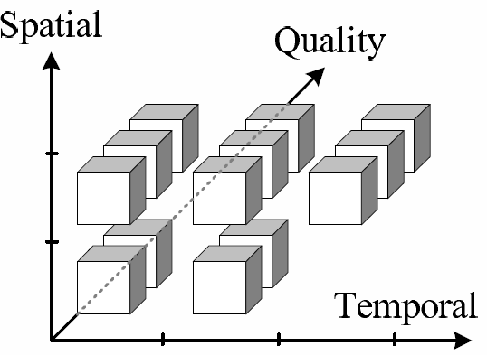
H.264/SVC: 3-D Scalability
Temporal scalability
  Frame rate
Spatial scalability
  Resolution (picture size)
Quality scalability
  (Fidelity or SNR)
SVC ➔ Very flexible adaptation
Notes:
Background: types of scalability, applications, and requirements

Slide 10
Temporal Scalability
Divide sequence into temporal layers
  Restrict motion-compensated prediction
➔ Hierarchical prediction structure
  Already provided by H.264/AVC

Slide 11
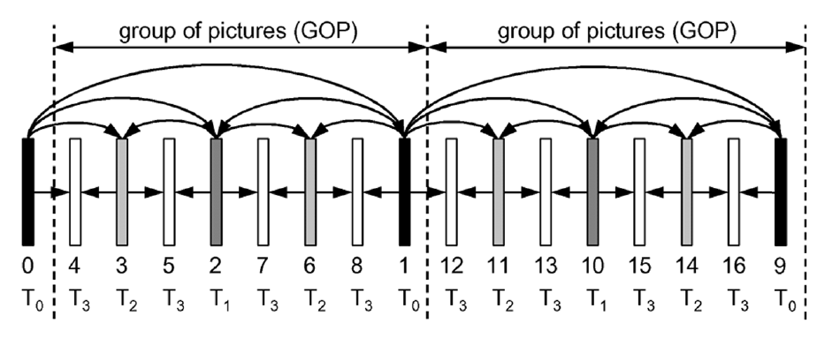
Temporal Scalability: Example
4 temporal layers: T0, …, T3
  T0 = 1 frames per GoP
  T1 = T0 + 1 = 2 frames per GoP
  T2 = T1 + 2 = 4 frames per GoP
  Numbers below frames indicate decoding order
  Arrows show prediction dependency
  Dyadic (power of 2) temporal enhancement layers
Notes:
GoP,
Temporal layer IDs,
Decoding order,

Slide 12
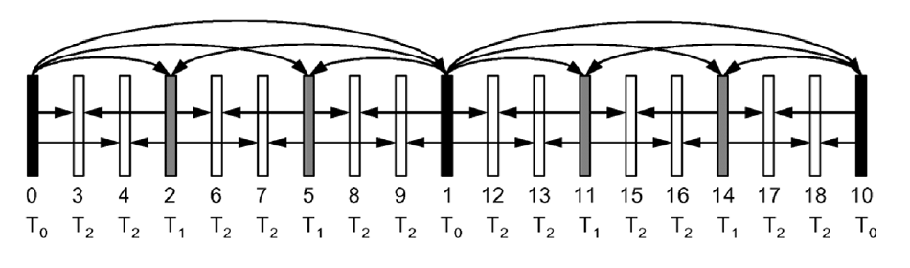
Temporal Scalability: Example 2
Non-dyadic structure is also possible
  T0 = 1/9 of full frame rate
  T1 = 1/3 of full frame rate
  T2 = full frame rate

Slide 13
Temporal Scalability
SVC also supports
  Changing the hierarchical prediction structure over time
  Having the reference frame in the same temporal layer as the target frame
  Having multiple reference frames (as in H.264/AVC)
Notes:
Also, prediction structure of the base layer can be arbitrarily modified, e.g., such as for increasing coding efficiency.

Slide 14
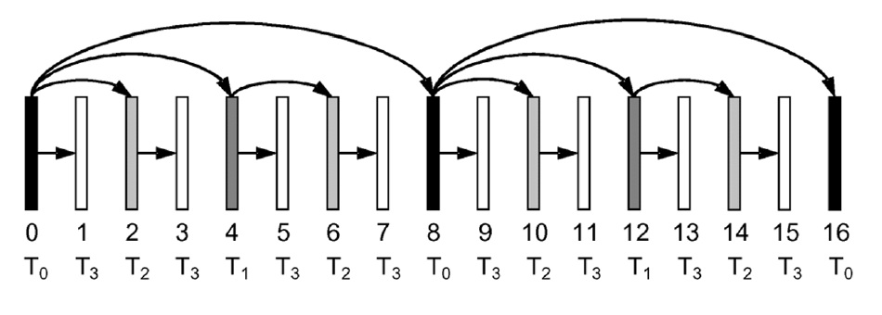
Temporal Scalability: Delay
Hierarchical structure could increase decoding delay
  Some frames cannot be decoded until receiving future frames
  Not desired in interactive multimedia applications (e.g., video conf)
SVC can limit predictions to preceding frames only
  Cost?
  Decreased coding efficiency

Slide 15
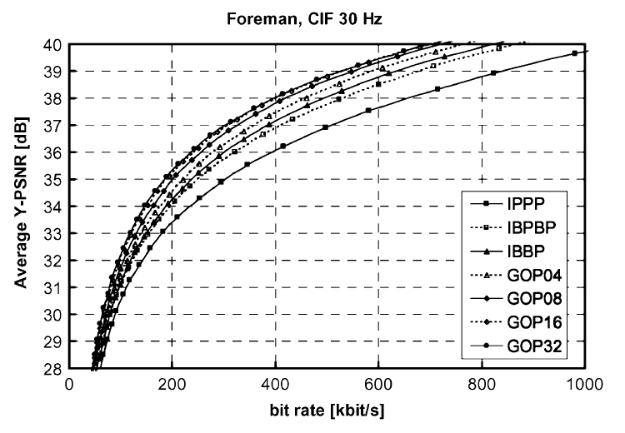
Temporal Scalability: Coding Efficiency
Comparing dyadic hierarchical B-pictures (no decoding delay constraint)
vs IPPP, IBPBP, and IBBP
Hierarchical B-pictures achieve PSNR gain >= 1 dB compared to the widely used IBBP coding structure
Gain is higher for large GoP sizes
Notes:
Foreman, CIF, 30 Hz.
Coding efficiency is continuously improved by increasing GoP size.
In comparison to the widely used IBBP coding structure, PSNR gain of more than 1 dB can be obtained for medium bitrates.

Slide 16
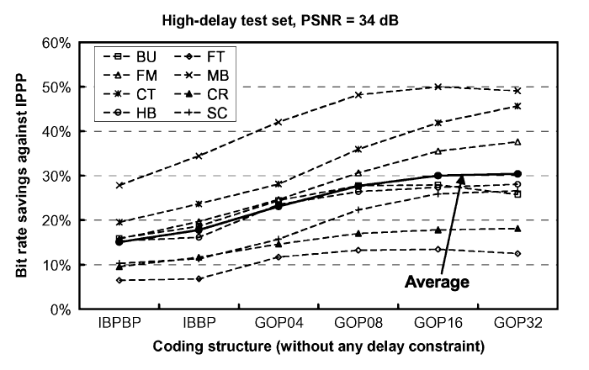
Temporal Scalability: Coding Efficiency
Using high-delay test set (non-conversational sequences), CIF 30Hz, 34dB, compared to IPPP
➔ significant saving in bitrate

Slide 17
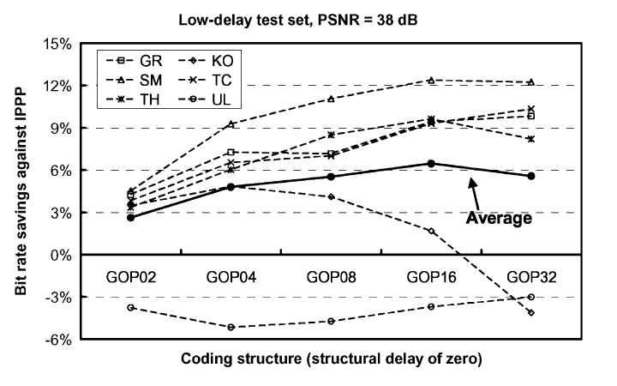
Temporal Scalability: Coding Efficiency
Using low-delay (delay = 0) test set (conversational sequences), 365x288, 25-30Hz, 38 dB vs IPPP
  Still some gain but not as high as before
Notes:
Low delay test set: video conferencing sequences.
Coding efficiencies are significantly smaller than the previous slide.

Slide 18
Temporal Scalability: Summary
Achieved using hierarchical temporal structures
Typically no negative impact on coding efficiency
  Significant improvement, especially when higher delays are tolerable
  Minor losses in coding efficiency are possible when low delay is required

Slide 19
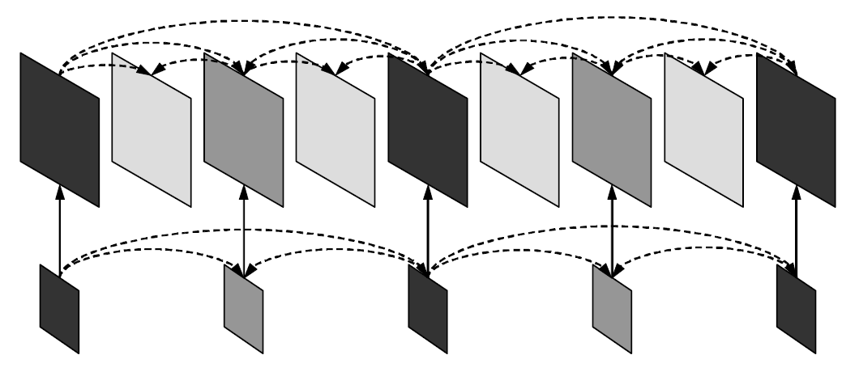
Spatial Scalability
Basic Idea:
  Multiple layers with different resolutions
  Each layer is treated as if it were single-layer coding:
    i.e., uses motion-compensated prediction and intra-prediction
  All layers share the same encoding order ← for low complexity
  Inter-layer prediction is also possible
Notice temporal and spatial scalabilities can exist
  Inter-layer prediction is only performed at access units
Notes:
Access units: lower layer pictures do not need to be present in all access units.
Combination of spatial and temporal scalabilities.
19

Slide 20
Spatial Scalability: Inter-Layer Prediction
Inter-layer prediction
  Up-sample lower layer signal (reconstructed samples) and perform prediction ← early standards only support this
  Perform temporal prediction inside higher-resolution layer (in the enhancement layer)
  You can either use the first prediction and/or the second
    Averaging in case of using both
Note: same-layer temporal prediction can provide better compression in case of low motion videos with detailed resolution
Notes:
Two additional inter-layer prediction concepts …
20

Slide 21
Spatial Scalability: Improving Efficiency
To improve the coding efficiency of inter-layer prediction, two coding tools were added
  Prediction of macroblock modes and associated motion parameters
  Prediction of the residual signal
A new macroblock type is defined
  Transmits a residue signal
  No intra-prediction mode nor motion parameters
  If the corresponding macroblock in the reference layer is
    Intra-coded→intra prediction: upsample reference layer
    Inter-coded→motion prediction: motion vectors are scaled up
Notes:
Two additional inter-layer prediction concepts …
21

Slide 22
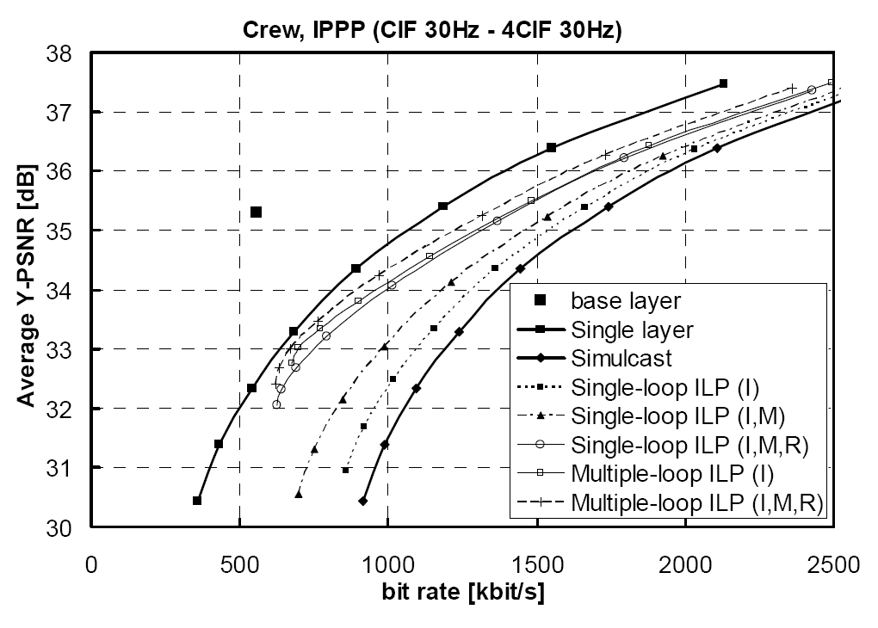
Spatial Scalability: Coding Efficiency
Single-loop vs. multiple-loop decoding
  Reconstructing inter-coded reference layer or not…
Coding tools: Intra-layer prediction (I), motion prediction (M), residual prediction (R)
Take-Away
  I, M, R are beneficial
  But multiple-loop leads
  to minor enhancements,
  while incurring high
  decoding overhead
Notes:
Two additional inter-layer prediction concepts …
22

Slide 23
Quality Scalability
Basic Idea:
  Multiple layers created with same resolution but different fidelity (picture quality)
  Different qualities can be achieved by controlling quantization step
H.264/SVC quality scalability models
  Coarse-Grained Scalability (CGS)
    Few layers
  Medium-Grained Scalability (MGS)
    More flexible
Notes:
23

Slide 24
Quality Scalability: CGS
Similar to spatial scalability, but with same resolution
Use different quality parameters in different layers
Supports a few (typically 3 to 6) different bit-rates/layers
Too many layers → high overhead → low coding efficiency
Notes:
24

Slide 25
Quality Scalability: MGS
Medium-Grained Scalability (MGS) improves:
  Flexibility of the stream
    Packet-level quality scalability
  Error robustness
    Controlling drift propagation
  Coding efficiency
    Use of more information for temporal prediction
Notes:
25

Slide 26
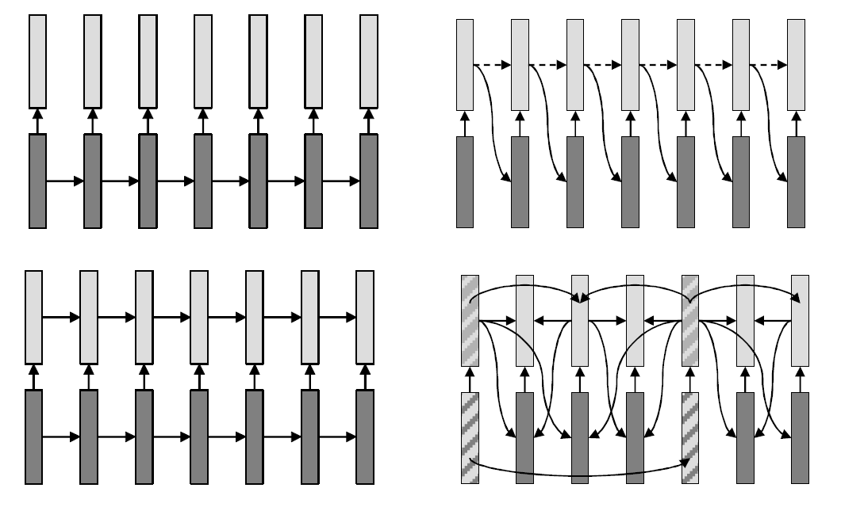
Quality Scalability: MGS Prediction Structure
MPEG-4 FGS
MPEG-2 Quality Scalable
MPEG-2 Spatial Scalable
H.264/SVC MGS
Notes:
26

Slide 27
Quality Scalability: MGS Key Frames
Video frames of coarsest temporal layer are called key frames
Key frames only use base-layer frames for predictions ← robustness
Non-key frames can only highest possible layers for prediction ← coding efficiency
Notes:
27

Slide 28
Quality Scalability: MGS
MGS: flexibility of the stream
  Enhancement layer transform coefficients can be distributed among several slices
  Packet-level quality scalability
Notes:
28

Slide 29
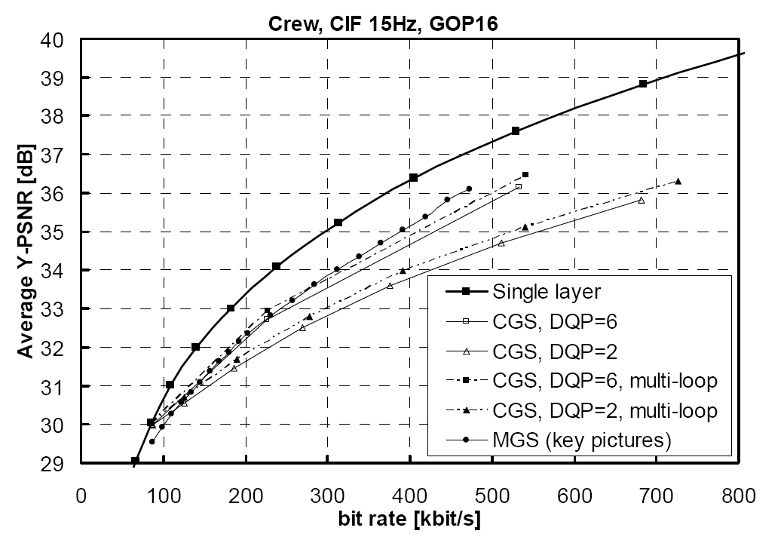
Quality Scalability: MGS vs. CGS
Notes:
29

Slide 30
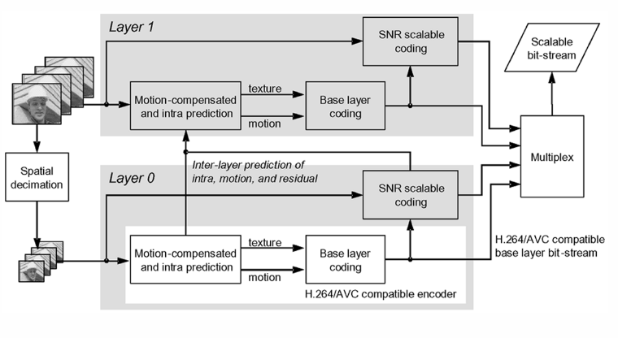
SVC Encoder Structure
Simple example for 2 spatial layers

Slide 31
Summary
Different models of scalability
  Simulcast, MDC, SVC
SVC
  Temporal
  Spatial
  Quality
H.264/SVC tried to improve coding efficiency while reducing complexity
  It achieves the former goal: gap between H.264/SVC and MPEG-4 is reported to be as low as 10%
  It arguably fails the later goal: very few SVC chip designs are out there, mostly due to memory limitation

Slide 32
Compiling JSVM (and other ref. sw)
Create working folder: mkdir JSVM; cd JSVM
CVS login: cvs -d :pserver:jvtuser:jvt.Amd.2@garcon.ient.rwth-aachen.de:/cvs/jvt login
CVS checkout: cvs -d :pserver:jvtuser@garcon.ient.rwth-aachen.de:/cvs/jvt checkout jsvm
Get into the build directory (using Linux as example): cd jsvm/JSVM/H264Extension/build/linux
Compile: make
The resulting binary files are under JSVM/jsvm/bin

Slide 33
JSVM Utilities
H264AVCEncoderLibTestStatic: reference encoder
H264AVCDecoderLibTestStatic : reference decoder
BitStreamExtractorStatic : extract a substream from the global scalable stream
PSNRStatic, YUVCompareStatic : compare two yuv files for PSNR
FixedQPEncoderStatic: binary search algorithm for rate control (there is no rate control algorithms in JSVM)
H264AVCVideoIoLibStatic: library for read and write NAL units ← useful for your term projects

Slide 34
Encoding a Two Layer CGS Stream (1/5)
Prepare the configure files
  One main configuration file: main.cfg
  One layer configuration file for each layer: layer0.cfg and layer1.cfg
Download the YUV files
  wget http://nsl.cs.sfu.ca/video/library/YUV/4CIF/CREW_704x576_30_orig_01.yuv
  wget http://nsl.cs.sfu.ca/video/library/YUV/4CIF/CREW_352x288_30_orig_01.yuv

Slide 35
Encoding a Two Layer CGS Stream (2/5)
main.cfg
# JSVM Main Configuration File
OutputFile CS5262.264 # Bitstream file
FrameRate 30.0 # Maximum frame rate [Hz]
FramesToBeEncoded 150 # Number of frames (at input frame rate)
GOPSize 16 # GOP Size (at maximum frame rate)
BaseLayerMode 2 # Base layer mode (0,1: AVC compatible,
# 2: AVC w subseq SEI)
SearchMode 4 # Search mode (0:BlockSearch, 4:FastSearch)
SearchRange 32 # Search range (Full Pel)
NumLayers 2 # Number of layers
LayerCfg layer0.cfg # Layer configuration file
LayerCfg layer1.cfg # Layer configuration file

Slide 36
Encoding a Two Layer CGS Stream (3/5)
layer0.cfg
# JSVM Layer Configuration File
InputFile CREW_352x288_30_orig_01.yuv # Input file
SourceWidth 352 # Input frame width
SourceHeight 288 # Input frame height
FrameRateIn 30 # Input frame rate [Hz]
FrameRateOut 30 # Output frame rate [Hz]

Slide 37
Encoding a Two Layer CGS Stream (4/5)
Encode the video
  ../bin/H264AVCEncoderLibTestStatic –pf main.cfg –lqp 0 30 –lqp 1 32
Decode at the full quality
  ../bin/H264AVCDecoderLibTestStatic CS5262.264 full.yuv
Playout the reconstructed yuv file
  mplayer -demuxer rawvideo -rawvideo fps=10:w=704:h=576:format=i420 -loop 0 full.yuv

Slide 38
Encoding a Two Layer CGS Stream (5/5)
Extract a lower resolution stream
  ../bin/BitStreamExtractorStatic CS5262.264 CS5262_LoFi.264 -l 0
Decode the video
  ../bin/H264AVCDecoderLibTestStatic CS5262_LoFi.264 LoFi.yuv
Play the low resolution reconstructed video
  mplayer -demuxer rawvideo -rawvideo fps=10:w=352:h=288:format=i420 -loop 0 LoFi.yuv

Slide 39
Compute PSNR
../bin/PSNRStatic 704 576 CREW_704x576_30_orig_01.yuv full.yuv
0 38,9117 43,1924 43,8809
1 34,3800 39,0224 39,2633
2 37,0061 42,5263 42,8077
3 36,7575 42,3130 42,4146
……………………………………………
147 33,8073 39,1530 39,1838
148 35,4138 39,7400 39,5863
149 34,3667 39,4859 39,0969
total 35,1929 40,6697 40,6936

Slide 40
Compile and Use OpenSVC
Download the source code from Sourceforge
  http://sourceforge.net/projects/opensvcdecoder/
unzip the source code
cd to Mplayer/ folder
Configure:
  CPPFLAGS="-I/opt/local/include/" LDFLAGS="-L/opt/local/lib" CC=gcc-4.2 ./configure --enable-svc
make
Decode the 4CIF version
  ./mplayer -fps 30 -loop 0 ../../jsvm/CS5262/CS5262.264
Decode the CIF version
  ./mplayer -fps 30 -setlayer 0 -loop 0 ../../jsvm/CS5262/CS5262.264
OpenSVC supports switching among layers, but it doesn’t work on our 264 file, why? How can we fix it? ← homework assignment?

