Slide 1
Department of Computer Science National Tsing Hua University
CS 5262: Multimedia Networking and Systems
Network-Adaptive Media Transport
Instructor: Cheng-Hsin Hsu
Acknowledgement: The instructor thanks Prof. Mohamed Hefeeda at Simon Fraser University for sharing his course materials

Slide 2
Outline
Introduction
Rate Distortion Optimized Framework
Basic Framework
Receiver Driven Streaming
Rich Acknowledgements
Multiple Deadlines
Dependant Packet Delay
Congestion Distortion Optimized Streaming
Conclusion

Slide 3
Introduction
Internet Packet Delivery
Loss
Throughput
Delay
Challenge : Maximize quality of audio and video considering transmission rate and latency constraints
Network Adaptive

Slide 4
Multimedia Streaming Systems
Client Application
Error detection and concealment
Transport Mechanism
Congestion control by retransmission and packet drops
Encoder
Rate scalable coding
Media Server
Intelligent transport by sending the right packet at the right time

Slide 5
Rate Distortion Optimized Framework
Framework has been propose by Chao and Miao
Goal : Compute which packets to send and when to minimize the reconstructed distortion
To maximize the video quality

Slide 6
Basic Framework
Media Server has media streams packetized into data units
Framework chooses optimal set of data units to transmit at successive transmission opportunities
Scheduler decides based on an entire optimized plan

Slide 7
Parameters
Data unit : l
Size : B(l)
Deadline :
The maximum arrive time to be useful for decoding
: distortion reduction
which is decrease in distortion rate if l is decoded
N : transmission opportunities
π : transmission policy
It has N binary vector π(l) for each data unit l
ε(l): error probability
data unit l received late or not at all
P(l) :
number of times packet has been sent

Slide 8


Basic Framework
Policy π wants to find the best tradeoff between expected transmission rate and distortion construction
Formally , minimize Lagrangian function:
# of transmissions
Maximum distortion
Quality improvement

Slide 9
Needs of RaDiO Framework
Packet loss and delay are considered independently
Packet Loss Bernoulli Function
Delay Shifted τ-distribution
Exhaustive Search is not useful. The search space grows exponentially
Chao and Miao proposed RaDiO framework

Slide 10
ISA Algorithm
The radio framework uses conjugate direction search
The Iterative Sensitivity Algorithm minimizes the Lagrangian function
The policy for π(l) is optimized while others are fixed.
It runs for every l in round robin fashion in order for π to achieve a (local) minimum

Slide 11

ISA Algorithm (cont.)
where
is the rate distortion tradeoff multiplier
is the data unit size
is the sensitivity of overall distortion to error probability of data unit l

Slide 12
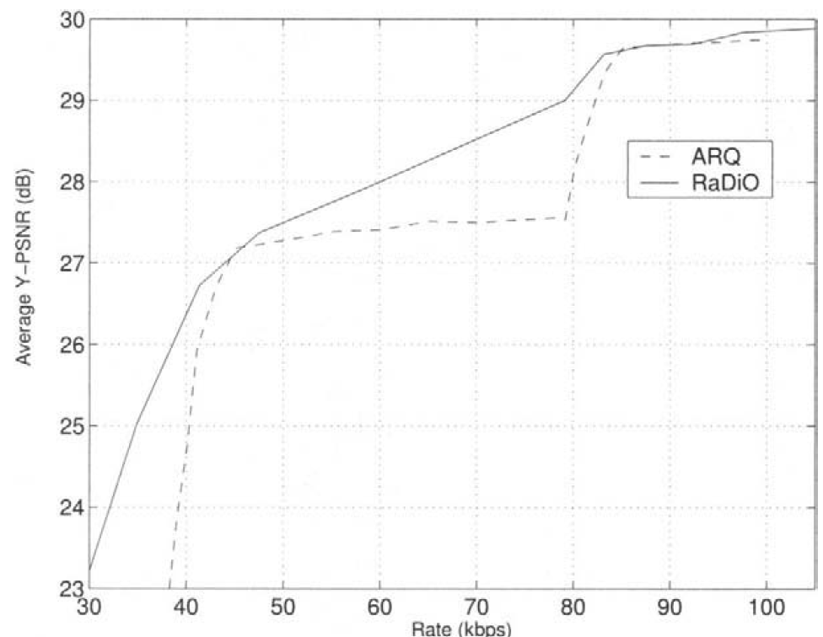
Performance Comparison
RaDiO improves video streaming performance

Slide 13
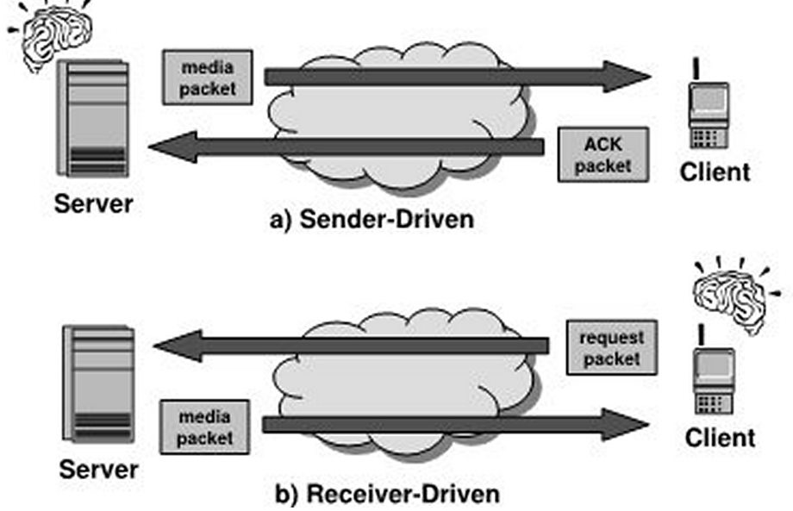
Receiver versus. Sender Driven Streaming

Slide 14
Receiver Driven Streaming
Transmitting many video and audio make the server become computationally overwhelmed.
Shift Computation to the client as much as possible

Slide 15
Strategy
Client will be provided with information about size, distortion reduction values , interdependencies of data.
Such R-D overhead is small ← several bytes versus KB of video data
It computes optimized scheduler and compute sequence of requests that specify data units.

Slide 16
Hybrid Solution
Combining sender driven and receiver driven approach can be used to R-D optimized algorithm to diverse network topologies.
Example : Using radio framework in a proxy between network backbone and last hop link.

Slide 17
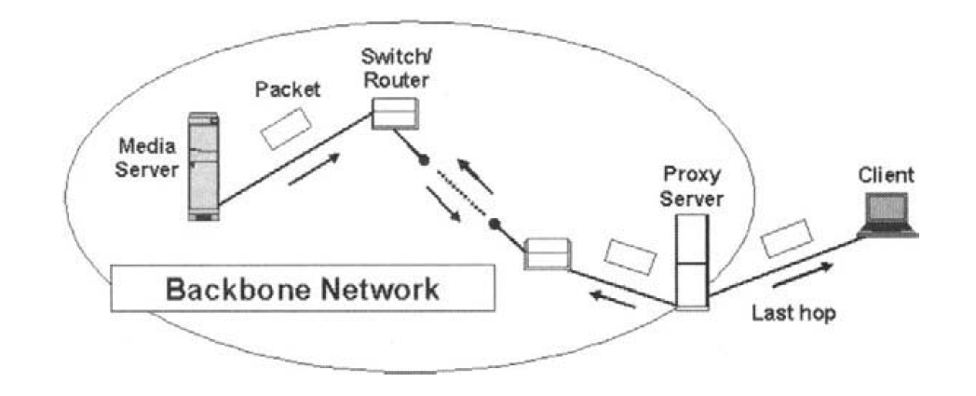
Architecture
Proxy Driven RaDiO Streaming

Slide 18
Benefits
Proxy uses hybrid of sender and receiver streaming.
It improves the end-to-end performance. The traffic caused by retransmission of lost packets is not traversed to server and stays in last hop

Slide 19
Rich Acknowledgements
Instead of sending ACK for each received packet , send the state of received packets periodically that ACKs received packets and NACKs lost packets.
Needs changes in the basic framework

Slide 20
Markov Decision Process
Transmission policy of a data unit can be modeled by Markov Decision Process.
At time t(i), server makes observation o(i) and takes action a(i) which is send or don’t send .
The sequence of <o(i) , a(i)> forms a Markov decision tree.

Slide 21
Actions and Observations
Possible actions :
Send
Don’t send
Possible observations :
∅ no relevant feedback has arrived
ACK feedback packet acknowledged received data unit
NACK feedback packet indicate lost data unit

Slide 22
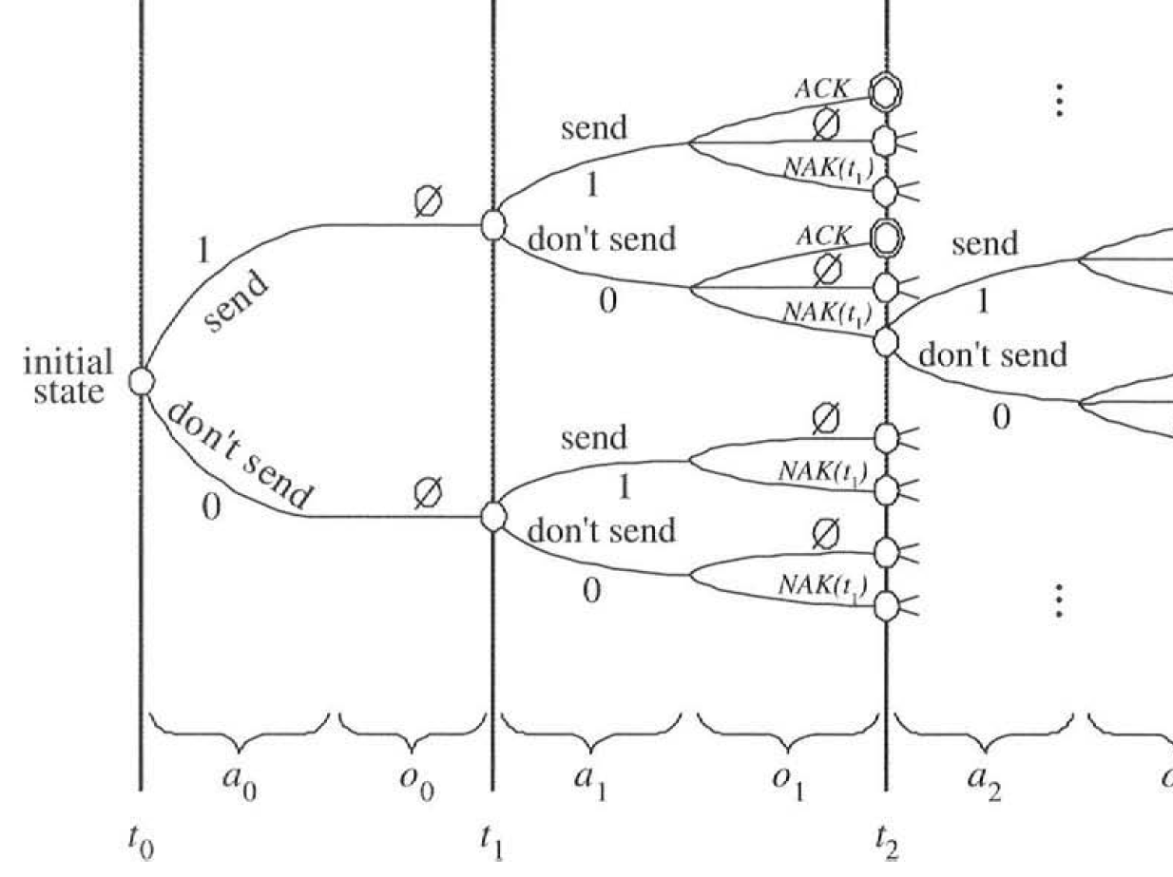
Markov Decision Tree

Slide 23
Optimization Algorithm
Optimization algorithm calculates the probabilities through each path given the policy and find the best tradeoff between expected number of transmission p(l) and loss probability e(l)

Slide 24
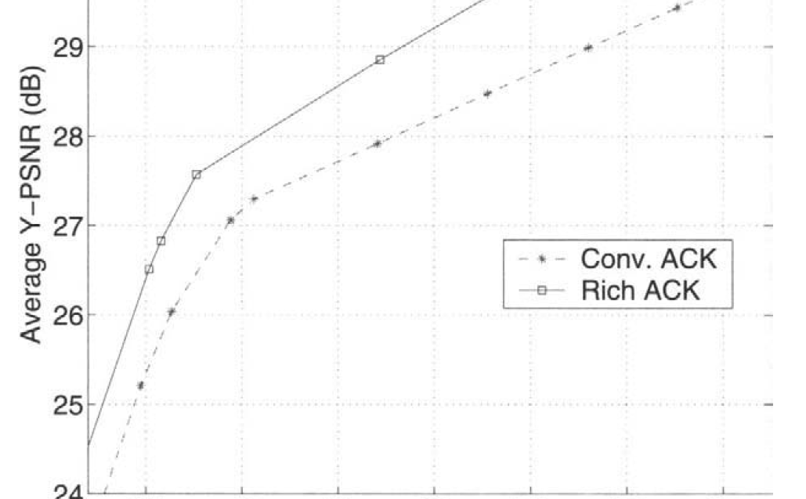
Versus Conventional Acknowledgement
Sample results from QCIF foreman

Slide 25
Reasons of Improvements
Effect of lost ACK packet is mitigated because subsequent feedback packets contain same information
Less ambiguity for server by having NACKs

Slide 26
Multiple Deadlines
Instead o discarding the frame arrive later than the associated deadline, we consider that frame will be useful for decoding other frames or at least itself.
We associate multiple deadlines to one frame

Slide 27
Accelerated Retroactive Decoding (ARD)
Example :
We have a set of frames IBBBP. If frame p arrives later than deadline, it still can help in decoding the next B frames.
Decoders that allow Accelerated Retroactive Decoding (ARD)
It allows many streaming clients to decode video faster than real time. When the late frame arrives, it goes back to dependant frames and decode the dependent frames up to play-out time. ← in contrast to waiting for late frames!

Slide 28


Formulation
Need changes in the formulation :
We have to add the error probability for each deadline
In the above equation, is the sensitivity factor that depends on each deadline and is the sensitivity of overall distortion if data unit arrives in .

Slide 29
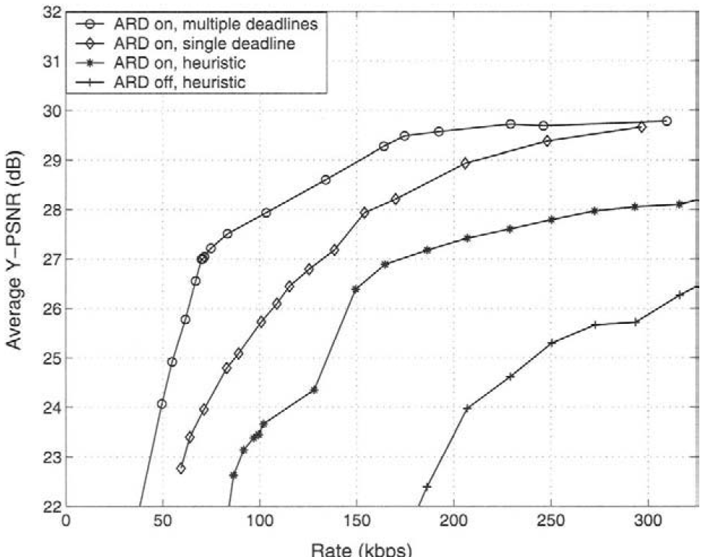
Results
ARD ←multiple deadlines

Slide 30
Discussion
Multiple deadline approach take the benefit of using the information of late arrived packet, therefore they improve PSNR compared to single-deadline scheme.

Slide 31
Dependent Packet Delays
In the original framework :
Packet Delay : Shifted -distribution
Loss : Bernoulli Model
Packet delays are assumed to be independent of each other which simplifies the calculation of error probability
This is not realistic Suboptimal performance

Slide 32
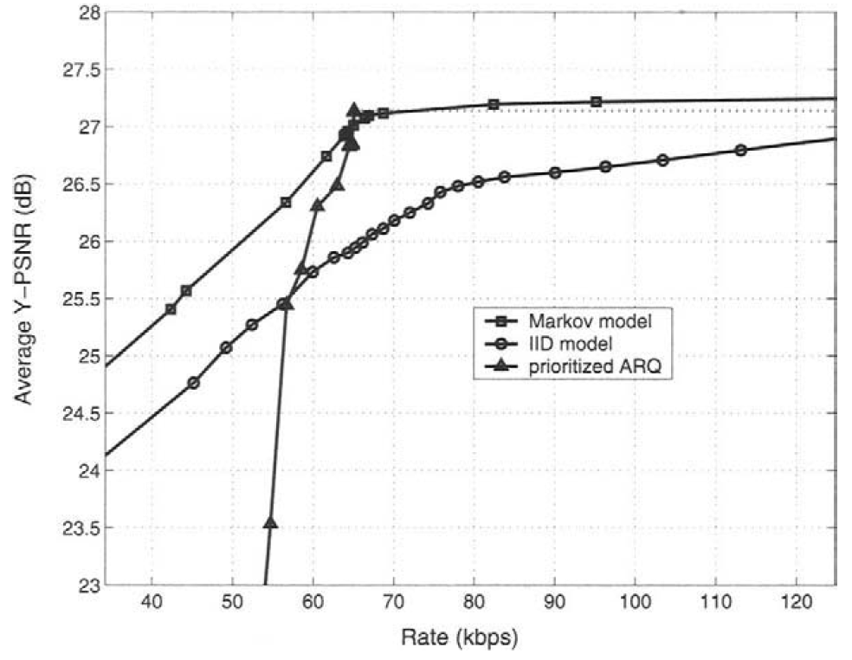
Problem with i.i.d. Assumption
Rate distortion performance scheduler for Foreman sequence streamed over measured Internet delay trace

Slide 33
Benefits of ARD
In higher rate, heuristic ARD (multi-deadline) will outperform i.i.d.- model:
The algorithm mistakenly believes that if a data unit arrives late, other data units will arrive on time or earlier. Therefore, it sends packets multiple times even though packet loss in low (0-14%)

Slide 34
Improvement
Model the delay at successive transmission time slots as a first order Markov random process.
Feedback packets will inform server about the delay over channel in the recent past.

Slide 35
Congestion Distortion Optimized Streaming
In RaDiO streaming approach, packet delay is not affected by transmitted packets.
Delay is a random variable with parameterized distribution that adapts slowly according to feedback information.
Media steam transmitted at negligible rate to bandwidth , model is acceptable. But, in higher rates it is not.

Slide 36
Improvement
Congestion distortion optimized streaming (CoDiO)
Effects of transmitted packets is considered. It gets an optimal tradeoff between congestion and reconstructed distortion.
It assumes a succession of high bandwidth link followed by a bottleneck last hop used by media streams.

Slide 37
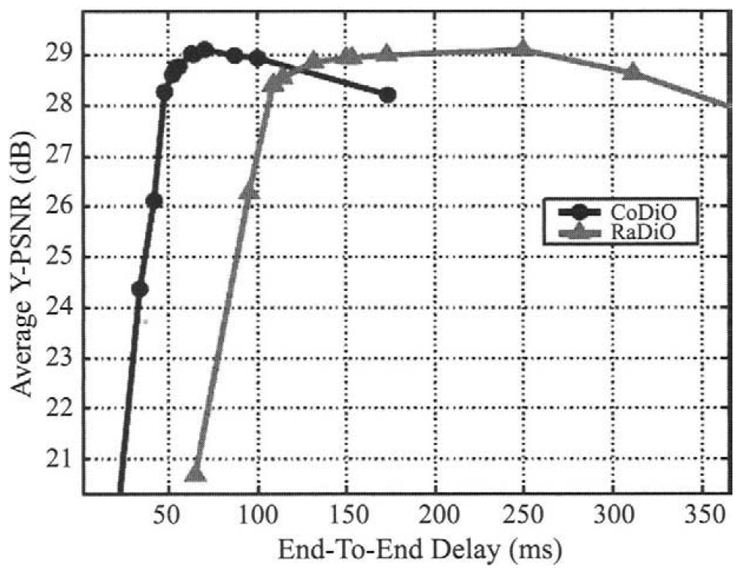
Performance Comparison: RaDiO and CaDiO
Performance Comparison of Codio and Radio Streaming
for video streaming over a bottleneck link

Slide 38
Observation
CoDiO outperforms Radio:
It transmits packets as late as safely possible. This reduces the congestion in backlog and therefore end-to-end delay.

Slide 39
Conclusion
To get better quality of audio and video streams , media streaming should be network adaptive
Media server can decide which packets and when to send to optimized the distortion of decoded video
Radio Framework proposed to avoid exhaustive search
There are several extensions to the basic framework which improve performance
Rich Acknowledgement
Multiple Deadline
Dependant Packet Delay
Congestion Distortion Optimized Streaming

