Slide 1
National Tsing Hua University, Hsinchu, Taiwan
CS 5262: Multimedia Networking and Systems
QoS Requirements for Multimedia Applications
(Part 2)
Instructor: Cheng-Hsin Hsu

Slide 2
Protocols For Multimedia Applications
To manage and stream multimedia data
RTSP: Real-Time Streaming Protocol
RTP: Real-Time Protocol
RTCP: Real-Time Control Protocol
SIP: Session Initiation Protocol

Slide 3
Real-Time Streaming Protocol (RTSP)
RFC 2326
client-server application layer protocol
Used to control a streaming session
  rewind, fast forward, pause, resume, repositioning, etc…
What it doesn’t do:
doesn’t define how audio/video is encapsulated for streaming over network
doesn’t restrict how streamed media is transported (UDP or TCP possible)
doesn’t specify how media player buffers audio/video

Slide 4
RTSP: out of band control
FTP uses an “out-of-band” control channel:
file transferred over one TCP connection.
control info (directory changes, file deletion, rename) sent over separate TCP connection
“out-of-band”, “in-band” channels use different port numbers
RTSP messages also sent out-of-band:
RTSP control messages use different port numbers than media stream: out-of-band.
  port 554
media stream is considered “in-band”.

Slide 5
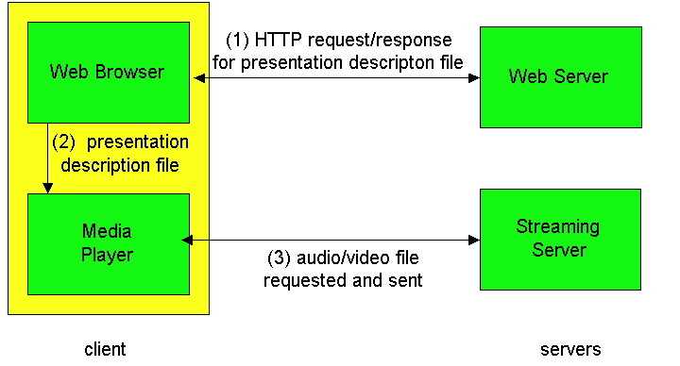
RTSP Example
metafile communicated to web browser
browser launches player
player sets up an RTSP control connection, data connection to streaming server

Slide 6
Metafile Example
<title>Twister</title>
<session>
<group language=en lipsync>
<switch>
<track type=audio
e="PCMU/8000/1"
src = "rtsp://audio.example.com/twister/audio.en/lofi">
<track type=audio
e="DVI4/16000/2" pt="90 DVI4/8000/1"
src="rtsp://audio.example.com/twister/audio.en/hifi">
</switch>
<track type="video/jpeg"
src="rtsp://video.example.com/twister/video">
</group>
</session>

Slide 7
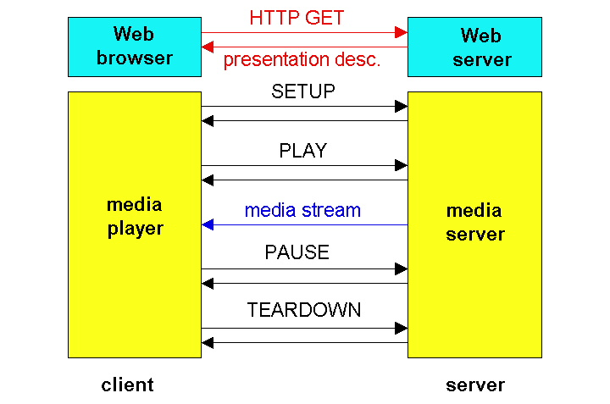
RTSP Operation

Slide 8
RTSP Exchange Example (simplified)
C: SETUP rtsp://audio.example.com/twister/audio RTSP/1.0
Transport: rtp/udp; compression; port=3056; mode=PLAY
S: RTSP/1.0 200 OK
Session 4231
C: PLAY rtsp://audio.example.com/twister/audio.en/lofi RTSP/1.0
Session: 4231
Range: npt=0-
C: PAUSE rtsp://audio.example.com/twister/audio.en/lofi RTSP/1.0
Session: 4231
Range: npt=37
C: TEARDOWN rtsp://audio.example.com/twister/audio.en/lofi RTSP/1.0
Session: 4231
S: 200 OK

Slide 9
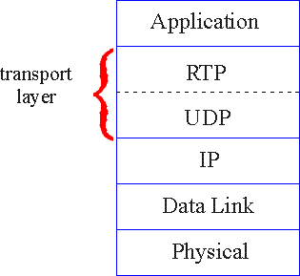
Real-Time Protocol (RTP): FRC 3550
RTP specifies packet structure for audio and video data
  payload type identification
  packet sequence numbering
  time stamping
RTP runs in the end systems
RTP packets are encapsulated in UDP segments
RTP does not provide any mechanism to ensure QoS
  RTP encapsulation is only seen at the end systems

Slide 10

RTP Header
Payload Type (7 bits): Indicates type of encoding currently being
used: e.g.,
  Payload type 0: PCM mu-law, 64 kbps
  Payload type 33, MPEG2 video
Sequence Number (16 bits): Increments by one for each RTP packet
sent, and may be used to detect packet loss
Timestamp field (32 bytes long). Reflects the sampling instant of the first byte in the RTP data packet.
SSRC field (32 bits long). Identifies the source of the RTP stream. Each stream in a RTP session should have a distinct SSRC.
Notes:
For audio, timestamp clock typically increments by one for each sampling period (for example, each 125 usecs for a 8 KHz sampling clock)
if application generates chunks of 160 encoded samples, then timestamp increases by 160 for each RTP packet when source is active. Timestamp clock continues to increase at constant rate when source is inactive.

Slide 11
RTP Example
consider sending 64 kbps PCM-encoded voice over RTP.
application collects encoded data in chunks, e.g., every 20 msec = 160 bytes in a chunk.
audio chunk + RTP header form RTP packet, which is encapsulated in UDP segment
RTP header indicates type of audio encoding in each packet
  sender can change encoding during conference.
RTP header also contains sequence numbers, timestamps.

Slide 12
Real-Time Control Protocol (RTCP)
Also in RFC 3550 (with RTP)
  works in conjunction with RTP
  Allows monitoring of data delivery in a manner scalable to large multicast networks
  Provides minimal control and identification functionality
each participant in RTP session periodically transmits RTCP control packets to all other participants.
each RTCP packet contains sender and/or receiver reports
  report statistics useful to application: # packets sent, # packets lost, interarrival jitter, etc.
  used to control performance, e.g., sender may modify its transmissions based on feedback

Slide 13
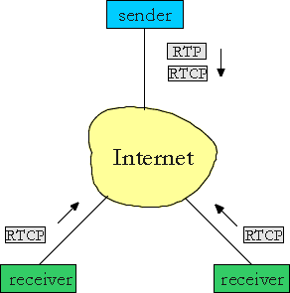
RTCP - Continued
Each RTP session typically uses a single multicast address
All RTP/RTCP packets belonging to session use multicast address
RTP, RTCP packets distinguished from each other via distinct port numbers
To limit traffic, each participant reduces RTCP traffic as number of conference participants increases

Slide 14
RTCP Packets
Receiver report packets:
fraction of packets lost, last sequence number, average interarrival jitter
Sender report packets:
SSRC of RTP stream, current time, number of packets sent, number of bytes sent
Source description packets:
e-mail address of sender, sender's name, SSRC of associated RTP stream
provide mapping between the SSRC and the user/host name

Slide 15
Synchronization of Streams
RTCP can synchronize different media streams within an RTP session
consider videoconferencing app for which each sender generates one RTP stream for video, one for audio.
timestamps in RTP packets tied to the video, audio sampling clocks
  not tied to wall-clock time
each RTCP sender-report packet contains (for most recently generated packet in associated RTP stream):
  timestamp of RTP packet
  wall-clock time for when packet was created.
receivers uses association to synchronize playout of audio, video

Slide 16
RTCP Bandwidth Scaling
RTCP attempts to limit its traffic to 5% of session bandwidth.
Example
Suppose one sender, sending video at 2 Mbps. Then RTCP attempts to limit its traffic to 100 Kbps.
RTCP gives 75% of rate to receivers; remaining 25% to sender
75 kbps is equally shared among receivers:
  with R receivers, each receiver gets to send RTCP traffic at 75/R kbps.
sender gets to send RTCP traffic at 25 kbps.
participant determines RTCP packet transmission period by calculating avg RTCP packet size (across entire session) and dividing by allocated rate

Slide 17
SIP: Session Initiation Protocol [RFC 3261]
SIP long-term vision:
all telephone calls, video conference calls take place over Internet
people are identified by names or e-mail addresses, rather than by phone numbers
you can reach callee, no matter where callee roams, no matter what IP device callee is currently using

Slide 18
SIP Services
Setting up a call, SIP provides mechanisms ...
  for caller to let callee know she wants to establish a call
  so caller, callee can agree on media type, encoding
  to end call
determine current IP address of callee:
  maps mnemonic identifier to current IP address
call management:
  add new media streams during call
  change encoding during call
  invite others
  transfer, hold calls

Slide 19
Setting up a call to known IP address
Alice’s SIP invite message indicates her port number, IP address, encoding she prefers to receive (PCM ulaw)
Bob’s 200 OK message indicates his port number, IP address, preferred encoding (GSM)
SIP messages can be sent over TCP or UDP; here sent over RTP/UDP.
default SIP port number is 5060.

Slide 20
Setting up a call (more)
codec negotiation:
  suppose Bob doesn’t have PCM ulaw encoder
  Bob will instead reply with 606 Not Acceptable Reply, listing his encoders Alice can then send new INVITE message, advertising different encoder
rejecting a call
  Bob can reject with replies “busy,” “gone,” “payment required,” “forbidden”
media can be sent over RTP or some other protocol

Slide 21
Example of SIP message
INVITE sip:bob@domain.com SIP/2.0
Via: SIP/2.0/UDP 167.180.112.24
From: sip:alice@hereway.com
To: sip:bob@domain.com
Call-ID: a2e3a@pigeon.hereway.com
Content-Type: application/sdp
Content-Length: 885
c=IN IP4 167.180.112.24
m=audio 38060 RTP/AVP 0
Notes:
HTTP message syntax
sdp = session description protocol
Call-ID is unique for every call.
Here we don’t know
Bob’s IP address.
Intermediate SIP
servers needed.
Alice sends, receives SIP messages using SIP default port 5060
Alice specifies in header that SIP client
sends, receives SIP messages over UDP

Slide 22
Name translation and user locataion
caller wants to call callee, but only has callee’s name or e-mail address.
need to get IP address of callee’s current host:
  user moves around
  DHCP protocol
  user has different IP devices (PC, PDA, car device)
result can be based on:
  time of day (work, home)
  caller (don’t want boss to call you at home)
  status of callee (calls sent to voicemail when callee is already talking to someone)
Service provided by SIP servers:
SIP registrar server
SIP proxy server

Slide 23
SIP Registrar
when Bob starts SIP client, client sends SIP REGISTER message to Bob’s registrar server
(similar function needed by Instant Messaging)
Register Message:
REGISTER sip:domain.com SIP/2.0
Via: SIP/2.0/UDP 193.64.210.89
From: sip:bob@domain.com
To: sip:bob@domain.com
Expires: 3600

Slide 24
SIP Proxy
Alice sends invite message to her proxy server
  contains address sip:bob@domain.com
proxy responsible for routing SIP messages to callee
  possibly through multiple proxies.
callee sends response back through the same set of proxies.
proxy returns SIP response message to Alice
  contains Bob’s IP address
proxy analogous to local DNS server

Slide 25
Example
Caller jim@umass.edu
with places a
call to keith@upenn.edu
(1) Jim sends INVITE
message to umass SIP
proxy. (2) Proxy forwards
request to upenn
registrar server.
(3) upenn server returns
redirect response,
indicating that it should
try keith@eurecom.fr
(4) umass proxy sends INVITE to eurecom registrar. (5) eurecom registrar forwards INVITE to 197.87.54.21, which is running keith’s SIP client. (6-8) SIP response sent back (9) media sent directly
between clients.
Note: also a SIP ack message, which is not shown.

Slide 26
Comparison with H.323
H.323 is another signaling protocol for real-time, interactive
H.323 is a complete, vertically integrated suite of protocols for multimedia conferencing: signaling, registration, admission control, transport, codecs
SIP is a single component. Works with RTP, but does not mandate it. Can be combined with other protocols, services
H.323 comes from the ITU (telephony).
SIP comes from IETF: Borrows much of its concepts from HTTP
  SIP has Web flavor, whereas H.323 has telephony flavor.
SIP uses the KISS principle: Keep it simple stupid.

Slide 27
Summary: Protocols
Several protocols to handle multimedia data
RTP: Real-Time Protocol
  Packetization, sequence number, time stamp
RTSP: Real-Time Streaming Protocol
  Establish, Pause, Play, FF, Rewind
RTCP: Real-Time Control Protocol
  Control and monitor sessions; synchronization
SIP: Session Initiation Protocol
  Establish and manage VoIP sessions
  Simpler than the ITU H.323
NONE enforces QoS in the network

