Slide 1
National Tsing Hua University, Hsinchu, Taiwan
CS 5262: Multimedia Networking and Systems
Introduction and
QoS Requirements for Multimedia Applications
(Part 1)
Instructor: Cheng-Hsin Hsu
Acknowledgement: The instructor thanks Prof. Mohamed Hefeeda at Simon Fraser University for sharing his course materials

Slide 2
About the Course
Format:
The lectures will be given in English
All written reports, assignments, and slides must be in English
Students are encouraged to give oral presentations in English
In-class discussion, questions, and comments can be in Mandarin
Course Website, please read carefully:
http://nmsl.cs.nthu.edu.tw/index.php/courses

Slide 3
Course Objectives
Understand fundamentals of networked multimedia systems
Know current research issues in multimedia systems
Develop research skills through hands-on experiences (term projects)
Have fun

Slide 4
Textbooks and References
Textbooks
[KR08] Kurose and Rose, Computer Networking: A top-down Approach Featuring the Internet, 4th edition, Addison Wesley, 2008 ← more recent versions also work
[Burg09] Burg, The Science of Digital Media, Prentice Hall, 2009
[SC07] Schaar and Chou (editors), Multimedia over IP and Wireless Networks: Compression, Networking, and Systems, Elsevier, 2007 ← ecopy available at the library
Complemented by research papers
References
[WOZ02] Wang, Ostermann, and Zhang, Video Processing and Communications, Prentice Hall, 2002.
[LD04] Li and Drew, Fundamentals of Multimedia, Pearson Education, 2004.
[SN04] Steinmetz and Nahrstedt, Multimedia Systems, Springer, 2004.

Slide 5
Grading
Assignments: 10%
Very few (probably four) written assignments
Programming Projects: 10%
A few (two or three) programming projects
Quizzes and Class Participation: 20%
Four random quizzes will be given before the lectures; email me if you have to skip a lecture (before that lecture), and like to take a makeup quiz
Read the textbook before lectures and participate in discussion
No Final Exam, actually no exam at all

Slide 6
Grading (cont.)
Term Project: 60%
Three types:
New research idea (publishable ➔ A+)
Quantitative and qualitative comparisons of multiple already-published algorithms/techniques/systems.
A survey of a multimedia topic
Live demos lead to bonus points
Check web page for potential topics; please feel free to suggest new topics
Deliverables of Term Project:
Written proposal, mid-term report, and final technical report ← incremental
Short presentation for each report, and optional demo in the final presentation
Paper presentation ← a 60-min presentation

Slide 7
Topics
Introduction
Overview of the big picture
QoS Requirements for Multimedia Systems
QoS in the Network
Principles
DiffServ and IntServ
Multimedia Protocols
RTP, RTSP, RTCP, SIP, …
Image Representation and Compression
Sampling, quantization, DCT, compression
Color Models
RGB, CMY, YIQ

Slide 8
Topics
Video Coding
Compression methods
Video Coding standards
Scalable video coding
Internet Characteristics and Impact on Multimedia
Channel modeling
Internet measurement study
Error Control for Video Coding and Transmission
Tools for error resilient video coding
Error concealment
Multimedia Streaming
Fundamentals
On-demand streaming and live broadcast

Slide 9
Topics
Network-adaptive media transport
Rate-distortion optimized streaming
Recent Developments of 3D and Stereoscope Video
Wireless Multimedia (time permits)
WLANs and QoS
Cross-layer design
QoS Support in mobile operating systems

Slide 10
Course Info
Please read through the course web pages, and let me know if you have any question/concern
Feel free to email me (chsu AT nthu.cs.edu.tw) any time
Questions? Comments?

Slide 11
Introduction
Motivations
Definitions
QoS Specifications & Requirements

Slide 12
Definitions and Motivations
“Multimedia” is an overused term
Means different things to different people
Because it touches many disciplines/industries
Computer Science/Engineering
Telecommunications Industry
TV and Radio Broadcasting Industry
Consumer Electronics Industry
….
For users
Multimedia = multiple forms/representation of information (text, audio, video, smell, touch,……)

Slide 13
Definitions and Motivations
Why should we study/research multimedia topics?
Huge interest and opportunities
High speed Networks
Powerful (cheap) computers (desktops … smartphones)
Abundance of multimedia capturing devices (cameras, microphones, …)
Tremendous demand from users (mm content makes life easier, more productive, and more fun)
Here are some statistics …

Slide 14
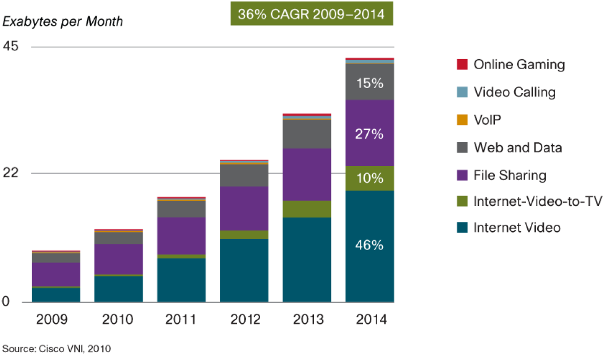
Some video statistics
Growth of various video traffic [Cisco 2010]
Video streaming accounts for 56% Internet traffic by 2014
All forms of video (including P2P and downloaded videos) account for 91% Internet traffic by 2014

Slide 15
Some video statistics
YouTube: fastest growing Internet server in history
Serves about 3 billion views per day as of 2011
Has 275 million videos, and the number is increasing!
Adds (uploads) 48 hour new videos per minute
CBS streamed the NCAA March Madness basketball games in 2007 online
Had more than 200,000 concurrent clients
And at peak time there were 150,000 Waiting
AOL streamed 8 live concerts online in 2006
There were 180,000 clients at peak time
Plus …
All major web sites have multimedia clips/demos/news/broadcasts/…

Slide 16
Definitions and Motivations
Given all of this, are users satisfied?
Not Really!
We still get tiny windows for video
Low quality
Glitches, rebuffering
Limited scalability (same video clip on PDA and desktop)
Server/network outages (capacity limitations)
Users want high-quality multimedia, anywhere, anytime, on any device!
We (researchers) still strive to achieve this vision in the future!

Slide 17
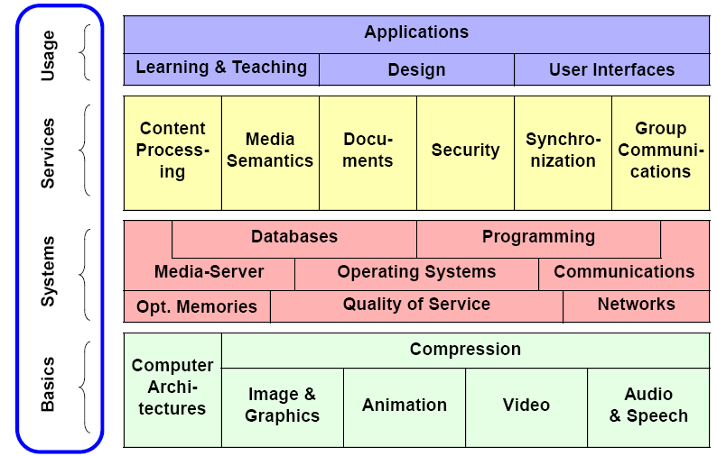
Multimedia:The Big Picture [SN04]

Slide 18
QoS in Networked Multimedia Systems
Quality of Service = “well-defined and controllable behavior of a system according to quantitatively measurable parameters”
There are multiple entities in a networked multimedia system
User
Network
Local system (memory, processor, file system, …)

Slide 19
QoS in Networked Multimedia Systems
Different parameters belong to different entities ➔ QoS Layers

Slide 20
QoS Layers
User
Perceptual
(e.g., window size, security)
Subjective Quality Metrics
Application
Media Quality
(e.g., frame rate, adaptation rules)
Objective Quality Metrics
System
Traffic
(e.g., bit rate, loss,
delay, jitter)
Local Devices
Network
Processing
(e.g., CPU scheduling, memory, hard drive)

Slide 21
QoS Layers
QoS Specification Languages
Mostly application specific
XML based
See: Jin & Nahrstedt, QoS Specification Languages for Distributed Multimedia Applications: A Survey and Taxonomy, IEEE MultiMedia, 11(3), July 2004
QoS mapping between layers
Map user requirements to Network and Device requirements
Some (but not all) aspects can be automated
For others, use profiles and rule-of-thumb experience
Several frameworks have been proposed in the literature
See: Nahrstedt et al., Distributed QoS Compilation and Runtime Instantiation, IWQoS 2000

Slide 22
QoS Layers
QoS enforcement methods
The most important/challenging aspect
How do we make the network and local devices implement the QoS requirements of MM applications?
We will study (briefly)
Enforcing QoS in the Network (models/protocols)
Enforcing QoS in the Processor (CPU scheduling for MM)
When we combine them, we get end-to-end QoS
Notice:
This is enforcing application requirements, if the resources are available
If not enough resources, we have to adapt (or scale) the MM content (e.g., use smaller resolution, frame rate, drop a layer, etc)

Slide 23
QoS Support in IP Networks
Principles
IntServ
DiffServ
Multimedia Protocols
Reading: Ch. 7 in [KR08]

Slide 24
QoS in IP Networks: Two Models
Guaranteed QoS
Need to reserve resources
Statistical (or Differential) QoS
Multiple traffic classes with different priorities
In both models, network devices (routers) should be able to perform certain functions (in addition to forwarding data packets)

Slide 25
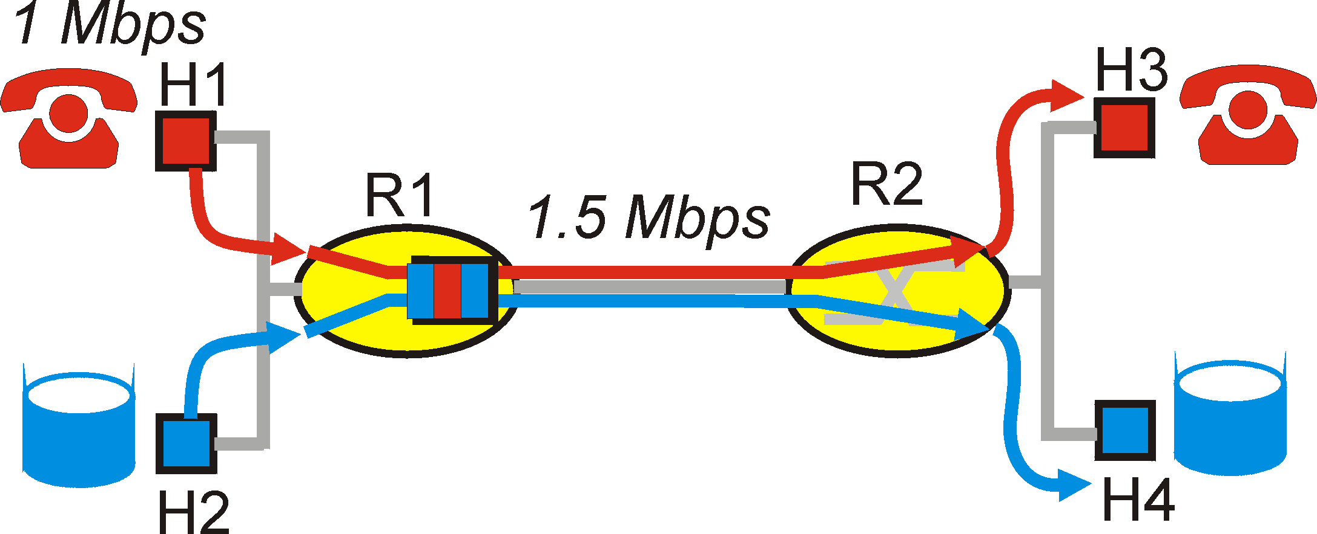
Principles for QoS Guarantees
Let us explore these functions using a simple example
1Mbps IP phone, FTP share 1.5 Mbps link.
bursts of FTP can congest router, cause audio loss
want to give priority to audio over FTP
Principle 1
packet marking needed for router to distinguish between different classes; and new router policy to treat packets accordingly

Slide 26
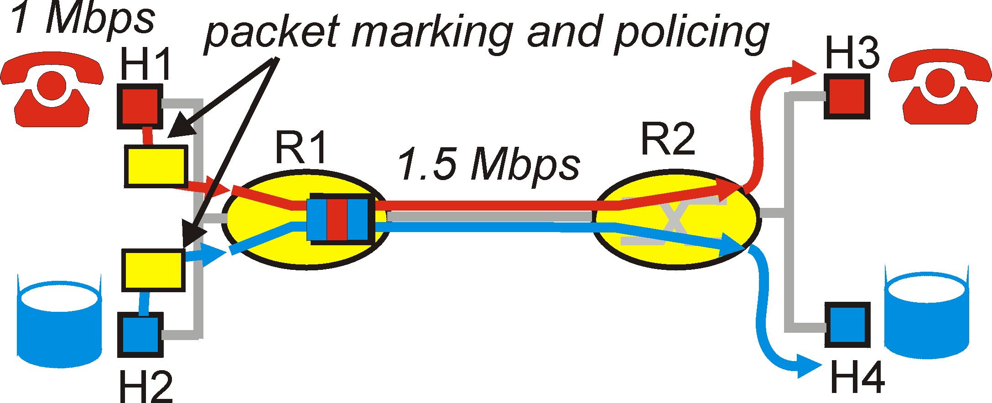
Principles for QoS Guarantees (more)
what if applications misbehave (audio sends higher than declared rate)
policing: force source adherence to bandwidth allocations
marking and policing at network edge:
Principle 2
provide protection (isolation) for one class from others

Slide 27
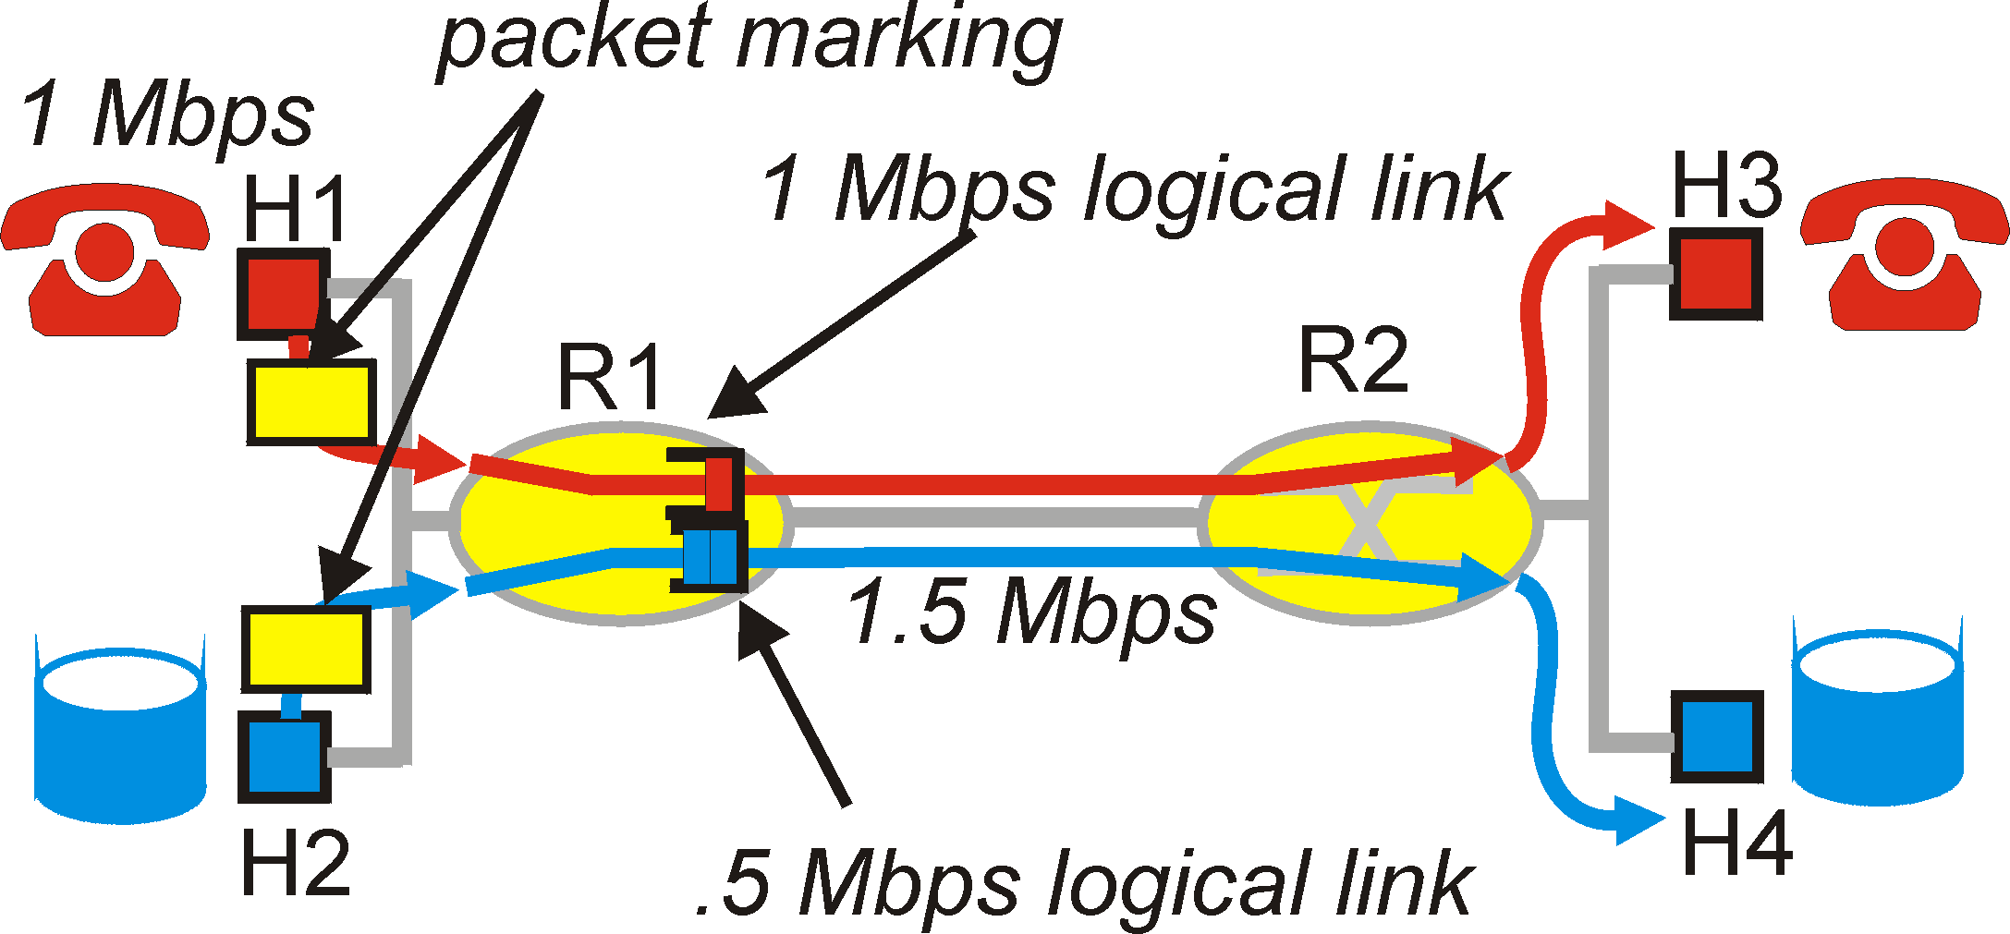
Principles for QoS Guarantees (more)
Allocating fixed (non-sharable) bandwidth to flow: inefficient use of bandwidth if flows doesn’t use its allocation
Principle 3
While providing isolation, it is desirable to use
resources as efficiently as possible

Slide 28
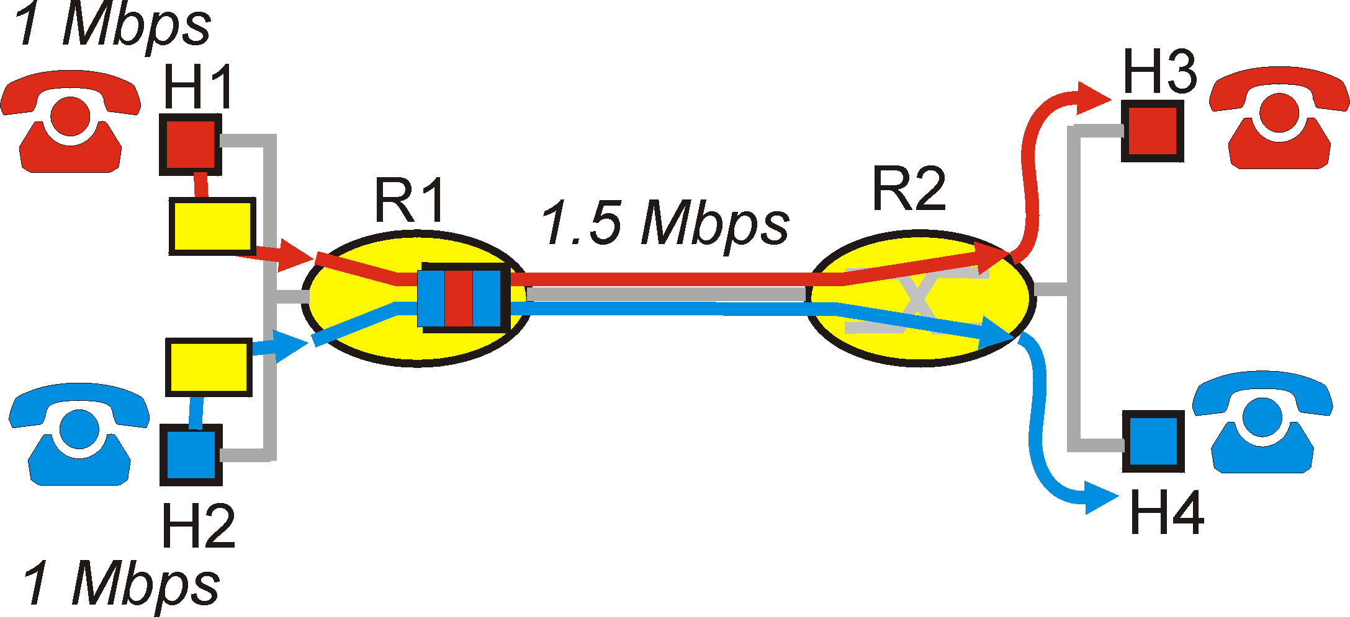
Principles for QoS Guarantees (more)
Basic fact of life: can not support traffic demands beyond link capacity
Principle 4
Call Admission: flow declares its needs, network may
block call (e.g., busy signal) if it cannot meet needs

Slide 29
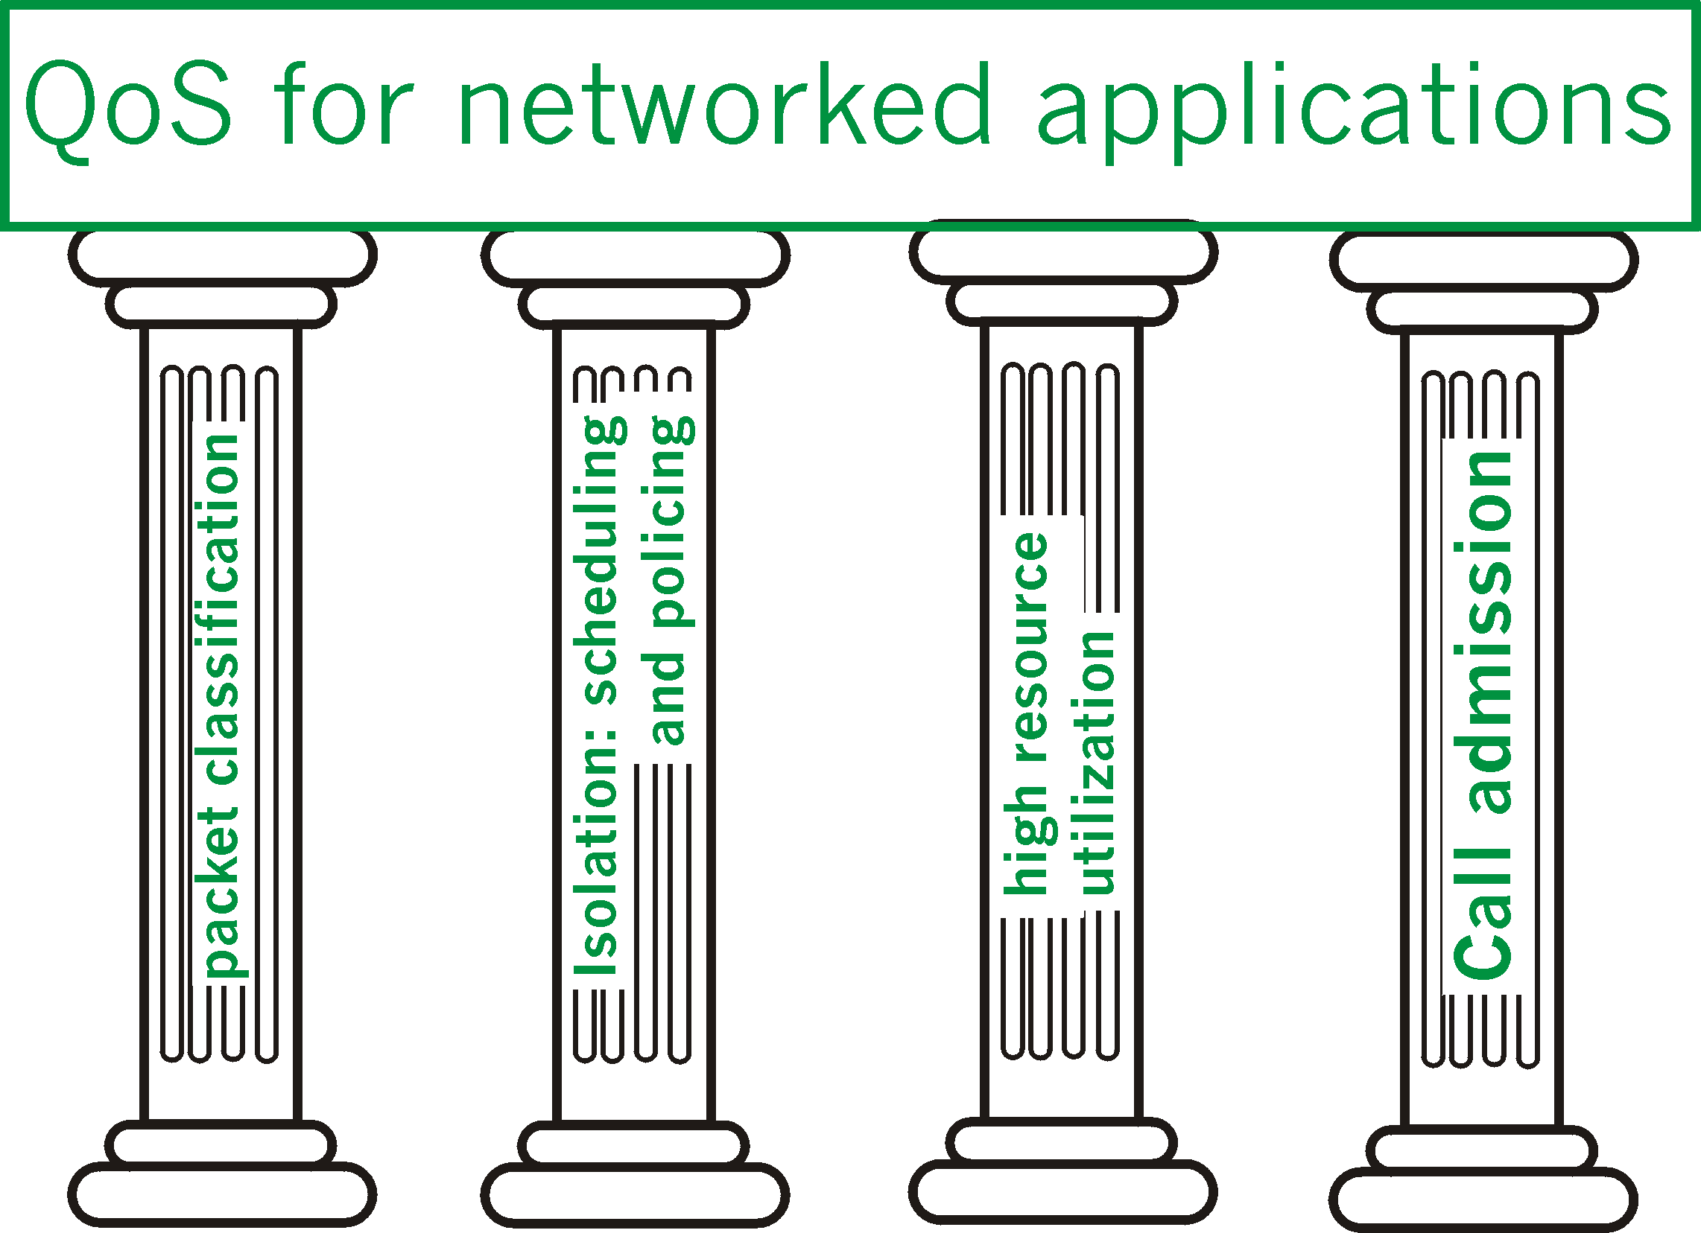
Summary of QoS Principles
Let’s next look at mechanisms for achieving this ….

Slide 30
Scheduling And Policing Mechanisms
scheduling: choose next packet to send on link
FIFO (first in first out) scheduling: send in order of arrival to queue
discard policy: if packet arrives to full queue: who to discard?
Tail drop: drop arriving packet
priority: drop/remove on priority basis
random: drop/remove randomly

Slide 31
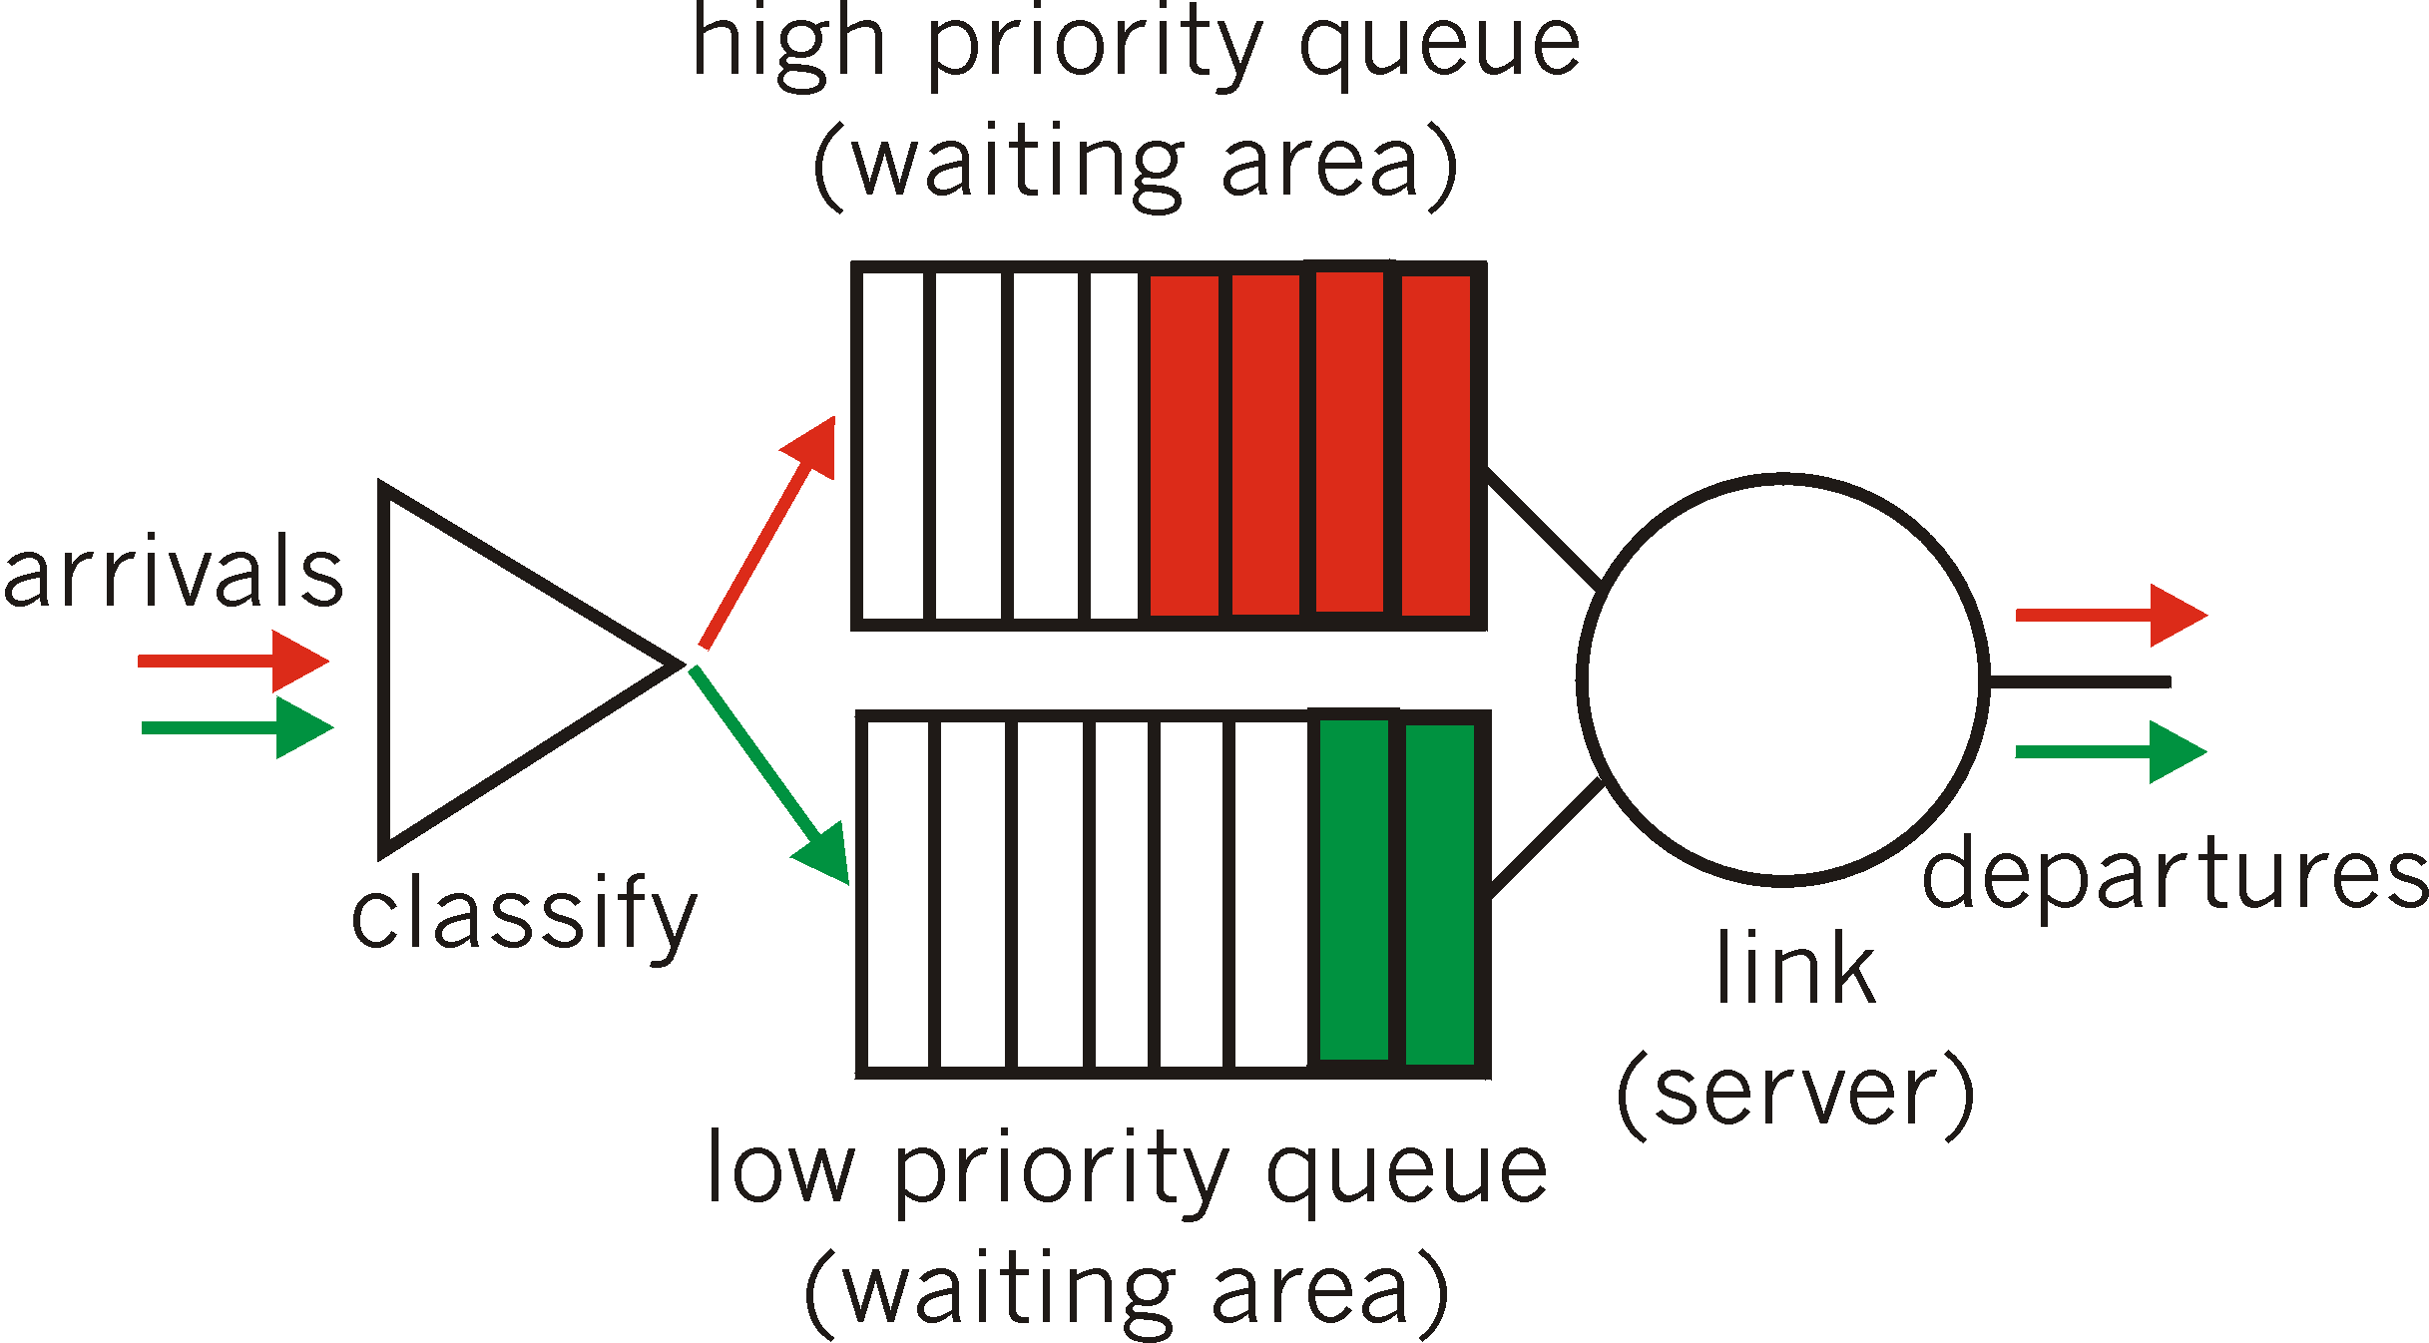
Scheduling Policies: more
Priority scheduling: transmit highest-priority queued packet
multiple classes, with different priorities
class may depend on marking or other header info, e.g. IP source/dest, port numbers, etc..

Slide 32
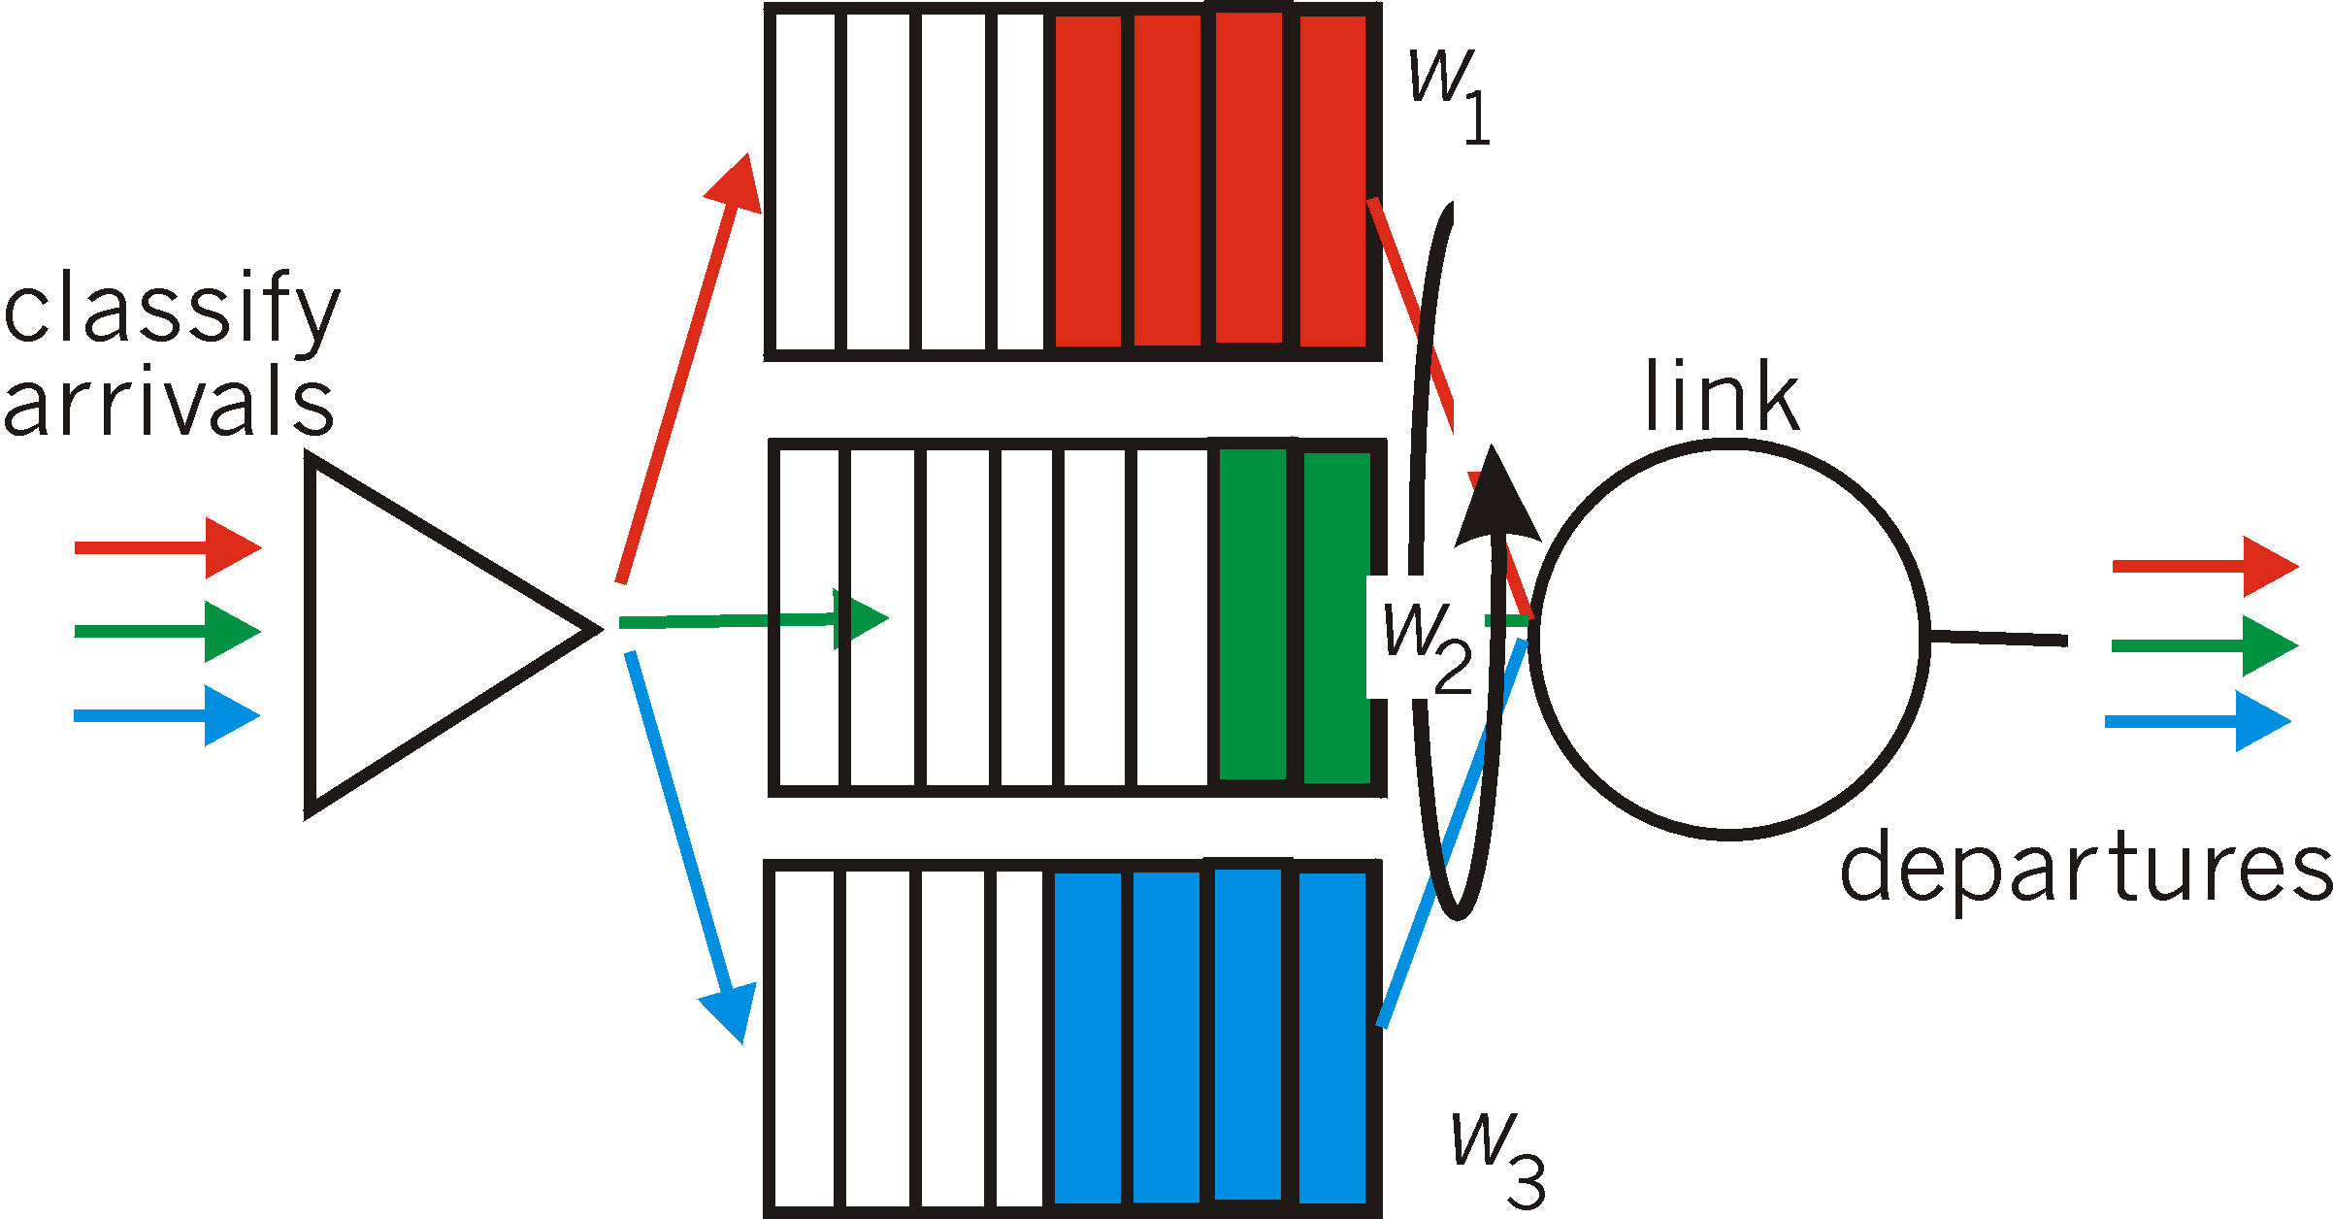
Scheduling Policies: still more
Weighted Fair Queuing:
generalized Round Robin
each class gets weighted amount of service in each cycle

Slide 33
Policing Mechanisms
Goal: limit traffic to not exceed declared parameters
Three common-used criteria:
(Long term) Average Rate: how many pkts can be sent per unit time (in the long run)
crucial question: what is the interval length: 100 packets per sec and 6000 packets per min (ppm) have same average!
Peak Rate: e.g.,
Avg rate: 6000 ppm
Peak rate: 25 pps (= 1500 ppm)
(Max.) Burst Size: max. number of pkts sent consecutively (with no intervening idle)

Slide 34
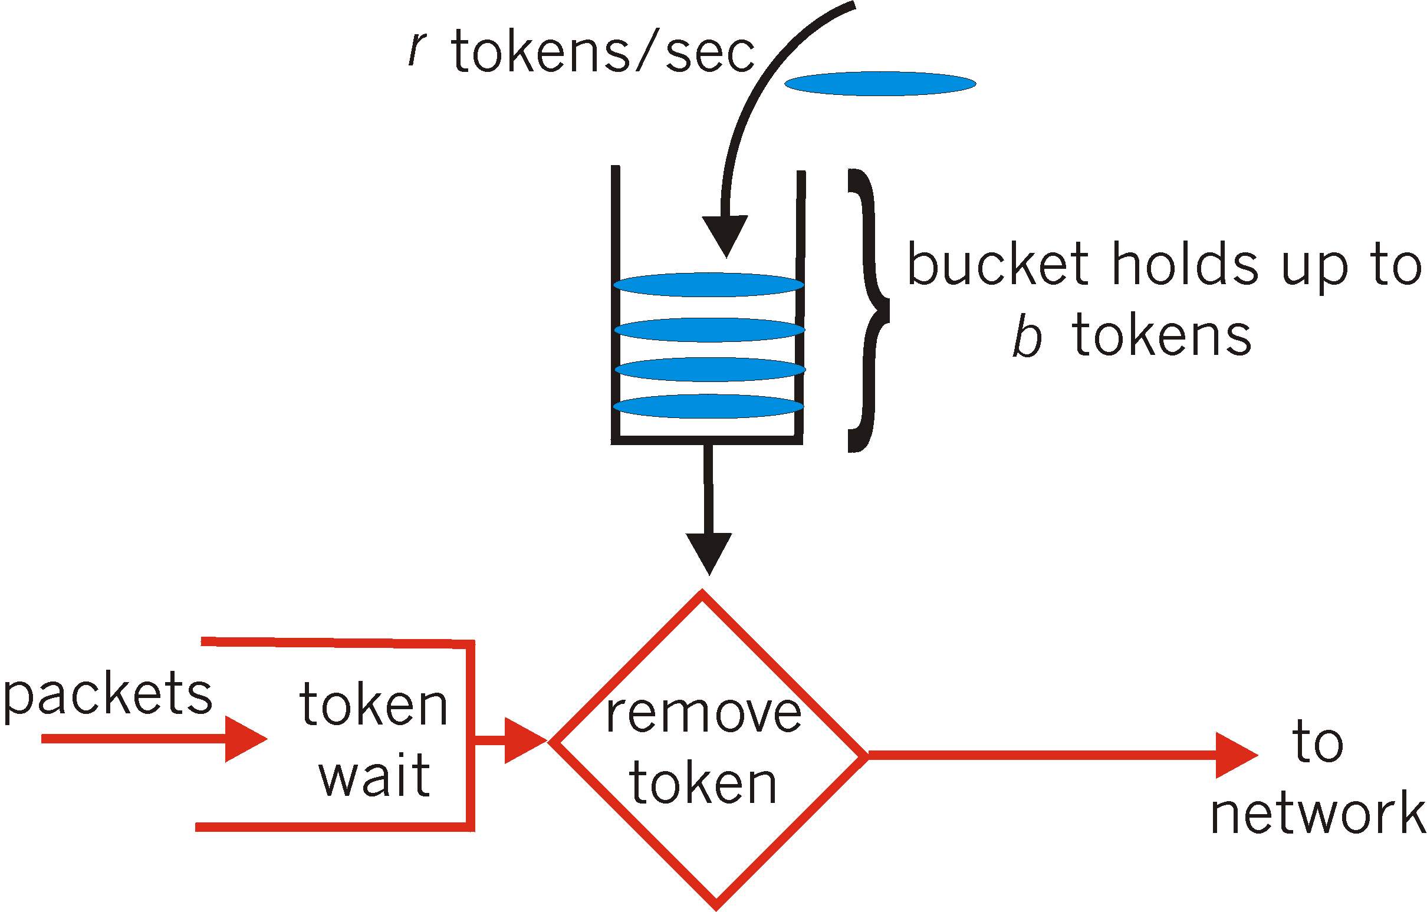
Policing Mechanisms
Leaky Bucket: limit input to specified Burst Size and Average Rate.
bucket can hold b tokens
tokens generated at rate r token/sec unless bucket full
over interval of length t: number of packets admitted less than or equal to (r t + b).

Slide 35
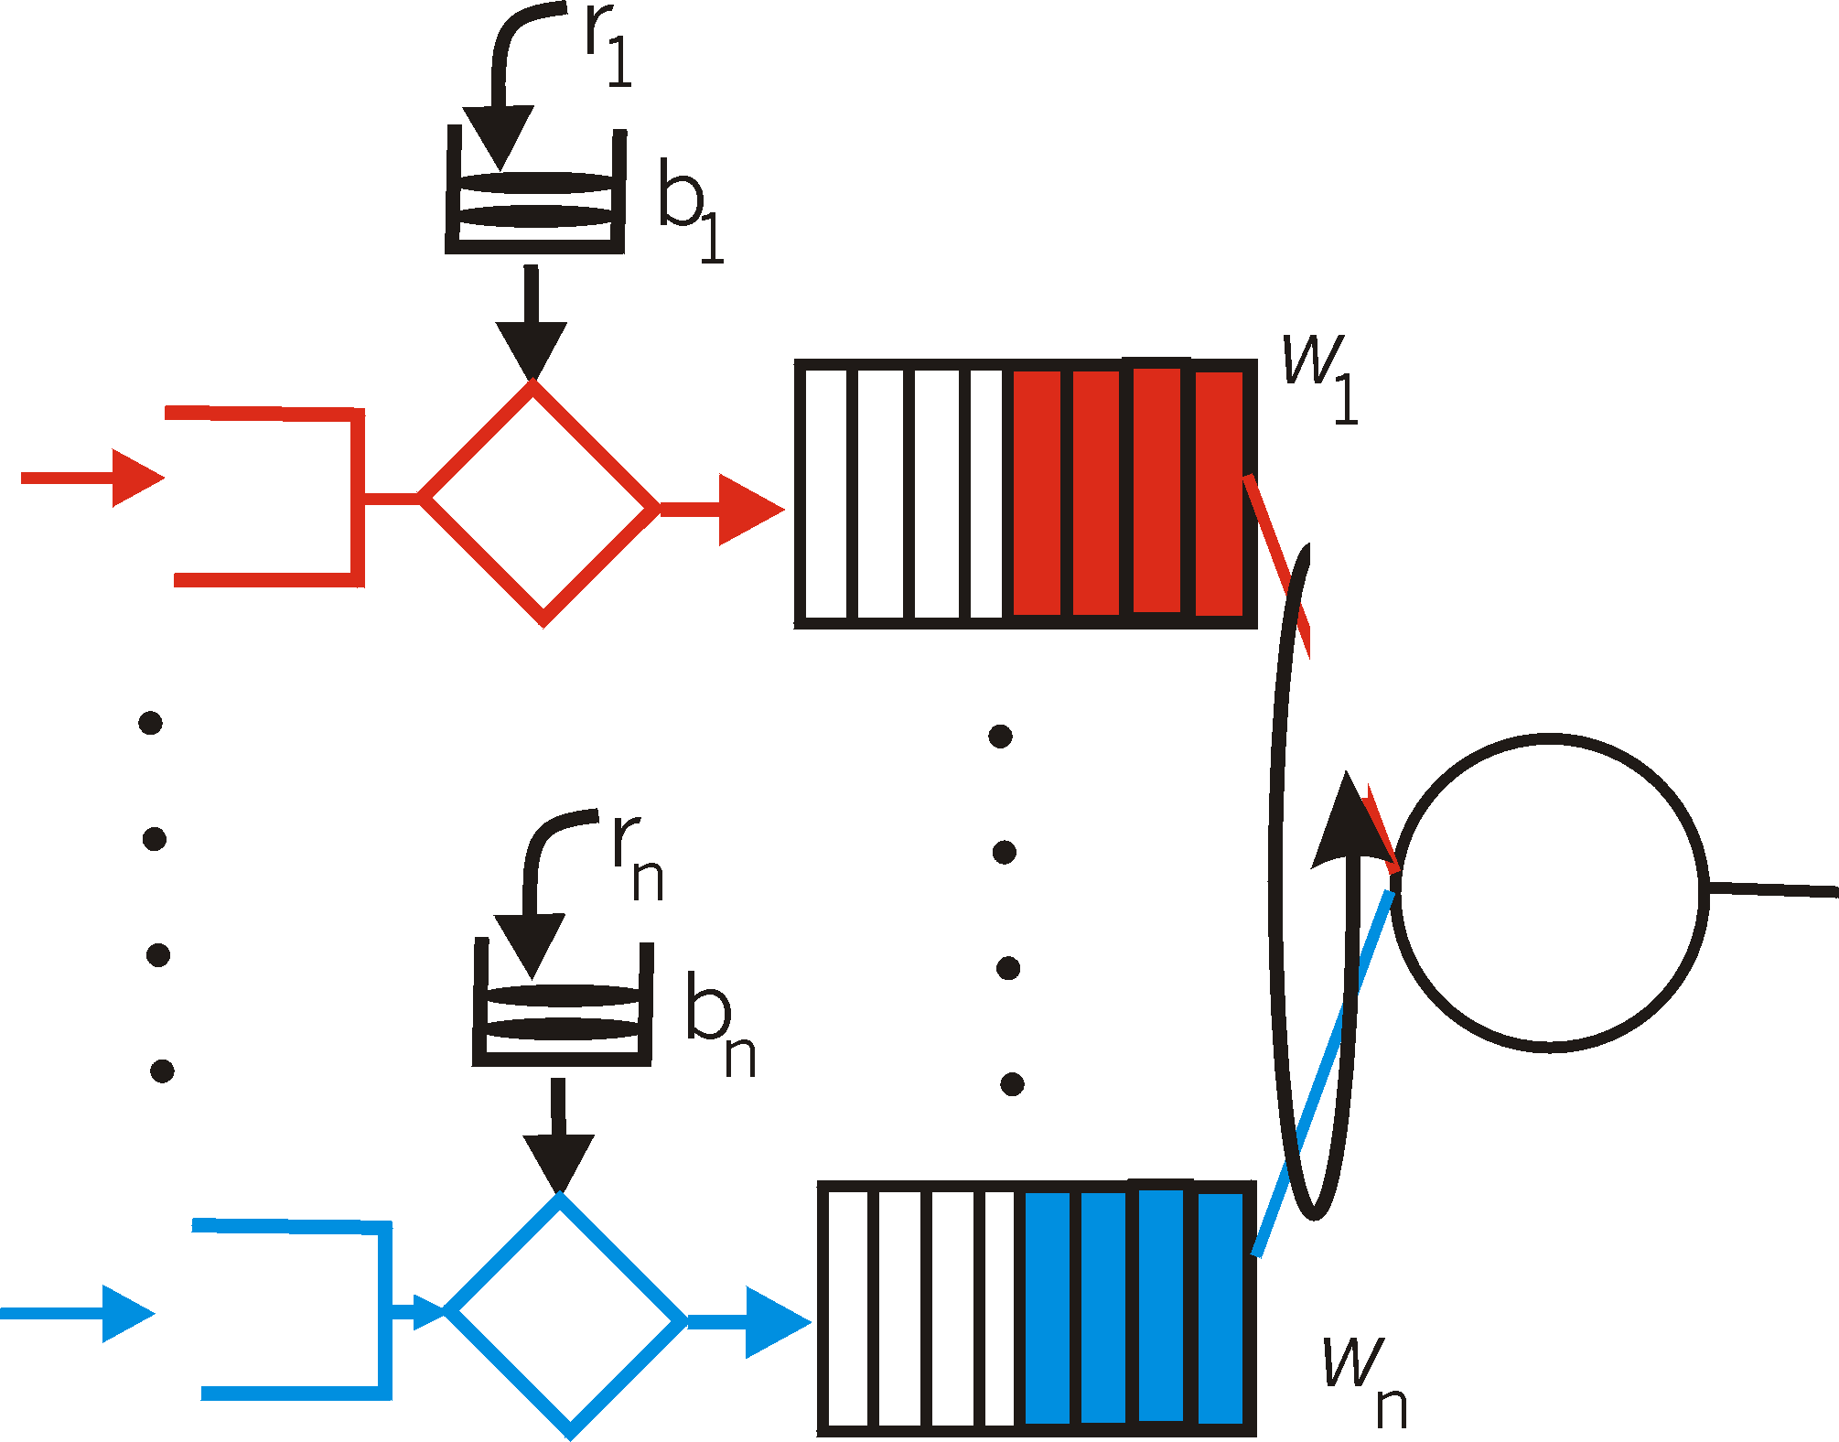
Policing Mechanisms (more)
Leaky bucket + WFQ ➔ provide guaranteed upper bound on delay, i.e., QoS guarantee! How?
WFQ: guaranteed share of bandwidth
Leaky bucket: limit max number of packets in queue (burst)

Slide 36
IETF Integrated Services (IntServ)
architecture for providing QoS guarantees in IP networks for individual application sessions
resource reservation: routers maintain state info of allocated resources, QoS req’s
admit/deny new call setup requests:

Slide 37
IntServ: QoS guarantee scenario
Resource reservation
call setup, signaling (RSVP)
traffic, QoS declaration
per-element admission control
request/
reply
QoS-sensitive scheduling (e.g., WFQ)

Slide 38
Call Admission
Arriving session must:
declare its QoS requirement
R-spec: defines the QoS being requested, e.g., bandwidth needed
characterize traffic it will send into network
T-spec: defines traffic characteristics, e.g., average bit rate and maximum burst size
signaling protocol: needed to carry R-spec and T-spec to routers (where reservation is required)
RSVP
Notes:
Example: Use Leaky bucket. T-Spec: r (avg bitrate) and b (max burst size) and R-Spec: bandwidth needed

Slide 39
IntServ QoS: Service models [rfc2211, rfc 2212]
Guaranteed service:
worst case traffic arrival: leaky-bucket-policed source
simple (mathematically provable) bound on delay [Parekh 1993, Cruz 1988]
arriving
traffic
token rate, r
bucket size, b
per-flow
rate, R
WFQ
D = b/R
max

Slide 40
IETF Differentiated Services
Concerns with IntServ:
Scalability: signaling, maintaining per-flow router state difficult with large number of flows
Example: OC-48 (2.5 Gbps) link serving 64 Kbps audio streams ➔ 39,000 flows! Each require state maintenance.
Flexible Service Models: Intserv has only two classes. Also want “qualitative” service classes
relative service distinction: Platinum, Gold, Silver
DiffServ approach:
simple functions in network core, relatively complex functions at edge routers (or hosts)
Don’t define service classes, provide functional components to build service classes

Slide 41
DiffServ Architecture
Edge router:
per-flow traffic management
Classifies (marks) pkts
different classes
within a class: in-profile and out-profile
marking
r
scheduling
.
b
.
.
Core router:
per class traffic management
buffering and scheduling based on marking at edge
preference given to in-profile packets

Slide 42
Edge-router Packet Marking
profile: pre-negotiated rate A, bucket size B
packet marking at edge based on per-flow profile
Rate A
B
User packets
Possible usage of marking:
class-based marking: packets of different classes marked differently
intra-class marking: conforming portion of flow marked differently than non-conforming one

Slide 43
Edge-router: Classification and Conditioning
Packet is marked in the Type of Service (TOS) in IPv4, and Traffic Class in IPv6
6 bits used for Differentiated Service Code Point (DSCP) and determine Per-Hop Behavior (PHB) that the packet will receive
2 bits are currently unused

Slide 44
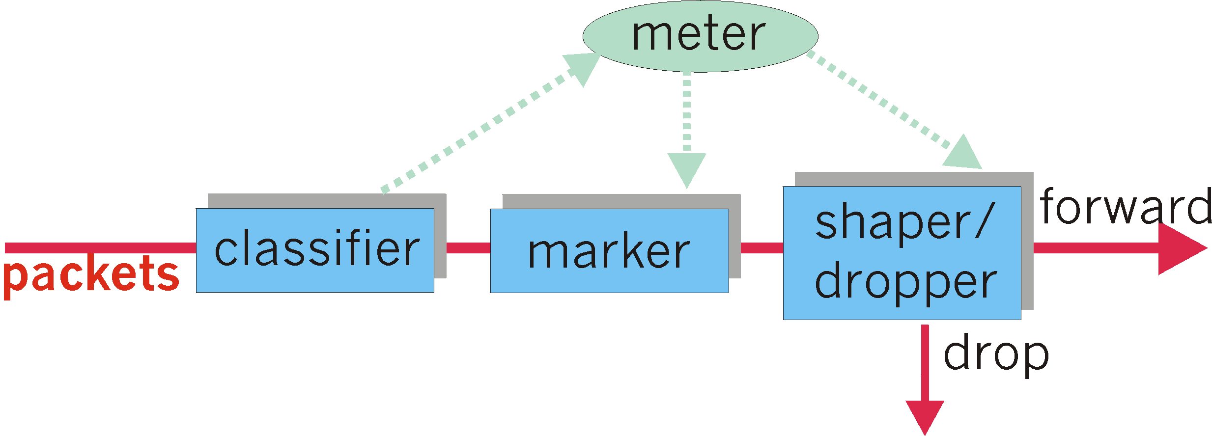
Edge-router: Classification and Conditioning
may be desirable to limit traffic injection rate of some class:
user declares traffic profile (e.g., rate, burst size)
traffic metered, shaped if non-conforming

Slide 45
Core-router: Forwarding (PHB)
PHB result in a different observable (measurable) forwarding performance behavior
PHB does not specify what mechanisms to use to ensure required PHB performance behavior
Examples:
Class A gets x% of outgoing link bandwidth over time intervals of a specified length
Class A packets leave first before packets from class B

Slide 46
Core-router: Forwarding (PHB)
PHBs being developed:
Expedited Forwarding (EF): pkt departure rate of a class equals or exceeds specified rate
Logical link with a minimum guaranteed rate
May require edge routers to limit EF traffic rate
Could be implemented using strict priority scheduling or WFQ with higher weight for EF traffic
Assured Forwarding (AF): multiple traffic classes, treated differently
Amount of bandwidth allocated, or drop priorities
Can be implemented using WFQ + leaky bucket or RED (Random Early Detection) with different threshold values.
See Sections 6.4.2 and 6.5.3 in [Peterson and Davie 07]

