Slide 1
Department of Computer Science National Tsing Hua University
CS 5262: Multimedia Networking and Systems
Digital Image Compression
Instructor: Cheng-Hsin Hsu
Acknowledgement: The instructor thanks Prof. Mohamed Hefeeda at Simon Fraser University for sharing his course materials

Slide 2
Compression Methods
Audio, image, and video require huge storage and network bandwidth if not compressed
Example:
10-min video clip (with no audio)
30 frames per sec
Frame resolution = 720 pixels x 480 pixels
Bits per pixel = 8 x 3 = 24
Video file size ~= 17.4 GB
Bandwidth required for streaming > 240 Mb/s
2
Notes:
2

Slide 3
Types of Compression
Lossless Compression: no information is lost
Run-Length Encoding (RLE)
Entropy Encoding
Shannon-Fano, Huffman
Arithmetic Encoding
Lossy Compression: some (unimportant) information is lost
E.g., frequencies not heard in audio, subtle details not noticed in image ➔ high compression ratios
3
Notes:
3

Slide 4
Run-Length Encoding
Idea: consider the following pixel values
255, 255, 255, 255, 240, 240, 240, 150, 150, 150
RLE (value, repetition): (255,4), (240, 3), (150, 2)
Size of compressed string?
Value: needs 8 bits (ranges from 0 to 255)
Repetition: depends on the longest run in the image
Assume repetition takes 8 bits for the above example ➔
Compression ratio = (10 x 1 byte ) / (3 x 2 bytes) = 1.67
RLE used in image/video compression
Usually there are rows of pixels with same color
Or rows of zero AC coefficients
RLE may increase size in some situations!
255, 255, 240, 210➔ (255, 2), (240,1), (210,1) ➔ ratio = 4/6=0.67
4
Notes:
4

Slide 5
Entropy Encoding
Entropy of information source S generating symbols is:
p_{i} : probability of symbol i appearing
Entropy measures the degree of randomness (uncertainty) of symbols generated by the source
S always generates same specific symbol ➔ H(S) = 0
H(S) increases as uncertainty increases, max when all symbols are equally likely to appear
Shannon showed that:
The minimum average number of bits needed to represent a string of symbols equals to its entropy
5
Notes:
5

Slide 6
Entropy Encoding: Examples
Ex1: image with 256 pixels, each with different color ➔
p_{i} = 1/256 for i = 0,1,2, …, 255 ➔ Entropy = 8
That is, average #bits to encode each color is 8 (cannot do better)
Ex2: image with 256 pixels, with the following
Entropy = 2.006 ➔ min avg #bits to represent a color
We can achieve this by assigning different #bits (codes) to different colors (variable length encoding)
Huffman and Shannon-Fano algorithms approximate this
Color | Freq | p_{i} | Min #bits
black | 100 | 0.391 | 1.356
white | 100 | 0.391 | 1.356
yellow | 20 | 0.078 | 3.678
orange | 5 | 0.020 | 5.678
red | 5 | 0.020 | 5.678
purple | 3 | 0.012 | 6.415
blue | 20 | 0.078 | 3.678
6
Notes:
6

Slide 7
Huffman Algorithm
Variable Length Encoding:
Fewer number of bits for more frequent colors
Prefix-free code:
No ambiguity during decoding → space saving (otherwise, we need either length field or terminating sequence)
Two passes:
Determine the codes for the colors
Compute frequencies
Build Huffman tree (bottom up)
Assign codes (top down)
Replace each color by its code
7
Notes:
7

Slide 8
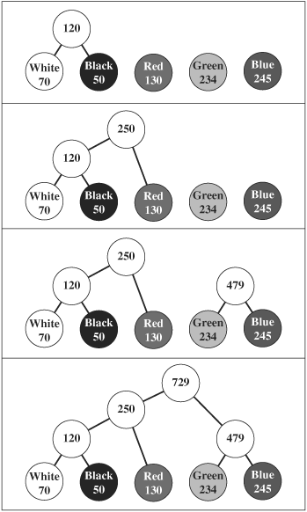

Huffman Algorithm: Example
Image with five colors
Huffman tree
8
Notes:
8

Slide 9
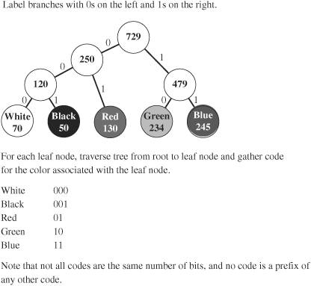
Huffman Algorithm: Example (cont’d)
Assigning codes top down
Decoding
Need frequencies (or the tree)
Bits from the compressed file are matched (left=0 & right=1) from root down
Note: each color needs integer number of bits, although the optimal (according Shannon) may be fractional ➔
Arithmetic Encoding
9
Notes:
9

Slide 10
Arithmetic Encoding
Avoids the disadvantage of Huffman encoding
Comes closer to the optimal
Still uses statistical analysis (entropy coding)
It encodes a whole string of symbols in one floating point number
Each symbol is assigned a probability interval with size proportional to its frequency of occurrence
The code (floating point number) of a sequence of symbols is created by successively narrowing the range between 0 and 1 for each symbol
10
Notes:
10

Slide 11
Arithmetic Encoding: Example
100 pixels with frequencies ➔
Consider encoding 6 pixels: W K K Y R B
W: interval 0.4 – 0.65
K: interval 0 – 0.4 of the W’s interval
And so on …
Color | Frequency | Probability Interval
black (K) | 40/100 = 0.4 | 0–0.4
white (W) | 25/100 = 0.25 | 0.4–0.65
yellow (Y) | 15/100 = 0.15 | 0.65–0.8
red (R) | 10/100 = 0.1 | 0.8–0.9
blue (B) | 10/100 = 0.1 | 0.9–1.0
11
Notes:
11

Slide 12
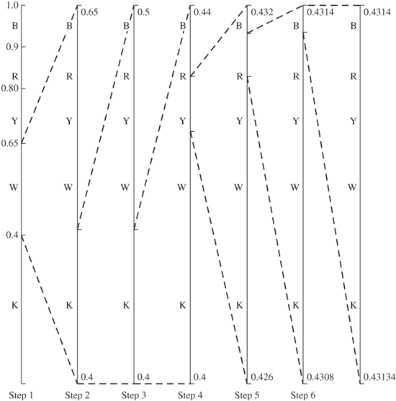
Arithmetic Encoding: Example
Encoding of W K K Y R B
12
Notes:
12

Slide 13
Arithmetic Encoding: Example
Decoding:
Assume final number (code) is 0.43137
Falls in W’s interval ➔ first symbol is W
Subtract low value of W’s interval and scale by its width ➔ (0.43137 – 0.4)/0.25 = 0.12548
which is in K’s interval ➔ second symbol is K
… and so on
13
Notes:
13

Slide 14
Arithmetic Encoding: Notes
Form of entropy encoding
But gives closer to optimal results (more compression) than Huffman encoding
Can be done using only integer operations
IBM and other companies hold patents on algorithms for arithmetic encoding
Used in recent video coding standards (H.264/AVC)
14
Notes:
14

Slide 15
JPEG Compression
Divide image into 8 × 8 pixel blocks
Convert image to luminance/chrominance model, e.g., YCbCr
Optional; could apply same algorithm on each of the R, G, B components
Apply 2d DCT
Shift pixel values by -128 (makes image more centered around 0)
Quantize DCT coefficients
Store DC value (upper left corner) as the difference between current DC value and DC from previous block
Do run-length encoding
in zigzag order
Do entropy encoding, e.g., Huffman
Store file in standard format (header contains info for decoder, e.g., quantization tables, Huffman codes, …)
15
Notes:
15

Slide 16
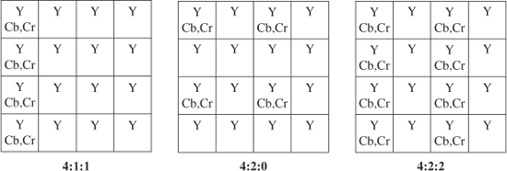
Chroma Subsampling
Eye is more sensitive to changes in light (luminance) than in color (chrominance) ➔ subsample CbCr
Subsampling notation: a:b:c
From 4 x 4 block: take a samples from Y; b samples from each of Cb & Cr from top row; and c samples from each of Cb & Cr from bottom row
Common examples: 4:1:1; 4:2:0; 4:2:2
Ex: 4:2:0 yields a saving of (16 * 3) / (16 + 4 * 2) = 2

Slide 17
Subsampling and Macroblocks
With subsampling (i.e., if YCbCr is used), we create 8 x 8 blocks as follows:
Divide the image into 16 x 16 macroblocks
➔ four 8 x 8 blocks for Y (no subsampling for Y)
#of blocks for CbCr depends on the subsampling
E.g., 4:2:0 & 4:1:1 ➔ one block for Cb & one for Cr
S
16 x 16
S
16 x 16
Y
Y
Cb
S
16 x 16
Y
Y
Cr

Slide 18
Quantize DCT Coefficients
Uniform Quantizer: Divide each coefficient by integer and round
The only lossy operation in the whole compression algorithm
Larger integers ➔ Larger compression AND larger distortion/error
High frequency coefficients are usually small ➔ become zeros ➔ more compression
Quantization Table
Each coefficient could have a different quantizer
Larger quantizers for high frequency coefficients
uint_8 luminance_quant_tbl[DCTSIZE2]={
16, 11, 10, 16, 24, 40, 51, 61,
12, 12, 14, 19, 26, 58, 60, 55,
14, 13, 16, 24, 40, 57, 69, 56,
14, 17, 22, 29, 51, 87, 80, 62,
18, 22, 37, 56, 68, 109, 103, 77,
24, 35, 55, 64, 81, 104, 113, 92,
49, 64, 78, 87, 103, 121, 120, 101,
72, 92, 95, 98, 112, 100, 103, 99
};
u_int8 chrominance_quant_tbl[DCTSIZE2]={
17, 18, 24, 47, 99, 99, 99, 99,
18, 21, 26, 66, 99, 99, 99, 99,
24, 26, 56, 99, 99, 99, 99, 99,
47, 66, 99, 99, 99, 99, 99, 99,
99, 99, 99, 99, 99, 99, 99, 99,
99, 99, 99, 99, 99, 99, 99, 99,
99, 99, 99, 99, 99, 99, 99, 99,
99, 99, 99, 99, 99, 99, 99, 99
};

Slide 19
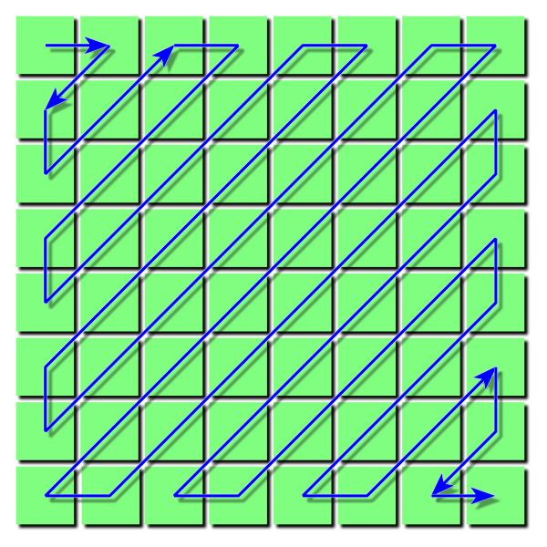
Run-length Encoding
Done in zigzag order
sorts values from low-frequency to high frequency components ➔
longer strings of 0’s (because high frequency components are usually 0)
Important: Work out the complete example in [Sec 3.1, Burg09]

Slide 20
Summary
Lossless compression: RLE, Entropy, Arithmetic
Lossy compression: ignores less important info to achieve higher compression ratios
Chroma subsampling: take fewer samplers from colors
de-emphasize color components because eyes are more sensitive to luminance
E.g., 4:2:2 → 4 samples Y, 2 samples CbCr each from even row, 2 samples CbCr from odd rows
JPEG compress
Blocks → convert to YCbCr → DCT → Quantize → zigzag RLE → Entropy coding

