Slide 1
Department of Computer Science National Tsing Hua University
CS 5262: Multimedia Networking and Systems
Color Models
Instructor: Cheng-Hsin Hsu
Acknowledgement: The instructor thanks Prof. Mohamed Hefeeda at Simon Fraser University for sharing his course materials

Slide 2
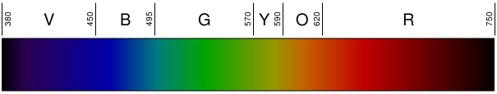
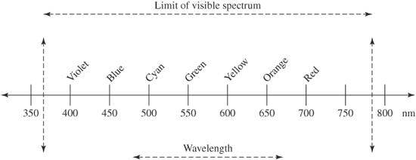
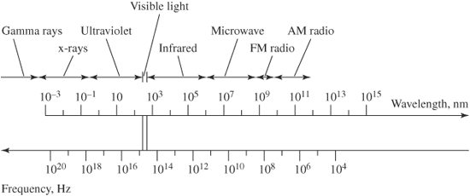
Colors & Color Models
Color is composed of electromagnetic waves
Humans: visible colors: 370 – 780 nm
Frequency spectrum
2
Notes:
2

Slide 3
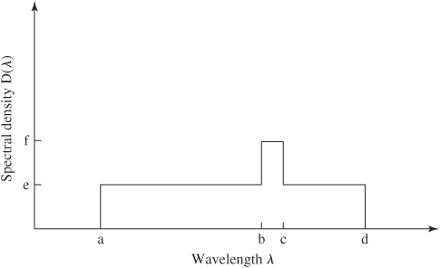
Colors
Pure color has a single wavelength
Could be generated for example by laser
Typically, we see a combination of wavelengths
Spectral analysis shows contribution of each wavelength
A color could be represented by
Hue: dominant wavelength
Wavelength at the spike
Saturation: color purity
Area under spike over total area
Luminance: ~brightness
Area under curve (power)
Hue
3
Notes:
3

Slide 4
Color Models
The hue, saturation, luminance representation is not well suited for computer monitors
CRT monitors use three phosphors beams Red, Blue, Green (RGB) of varying intensities
LCD: use Red, Blue, Green pixels
Common method to create wide range of colors is to combine three primary colors
Primary = cannot be generated from each other
RGB are good choices because the color receptors in the eyes are specially sensitive to them
4
Notes:
4

Slide 5
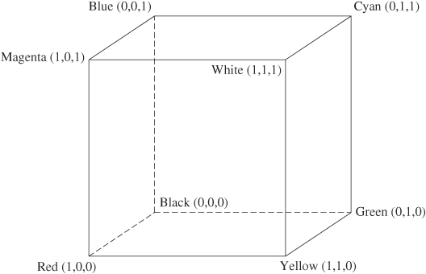
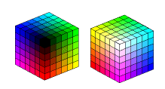
RGB Color Model
Increasing each component with same ratio ➔ increases brightness
(0.64, 0.96, 0.78) is brighter shade of green than (0.32, 0.48, 0.39)
Grayscale values on the cube’s diagonal from (0,0,0) to (1,1,1)
Same value for R,G,B
RGB to grayscale conversion: (R, G, B) ➔ (L, L, L)
L = 0.30 R + 0.59 G + 0.11 B
Eyes are most sensitive to green, and least sensitive to blue
5
Notes:
5

Slide 6


CMY Color Model
RGB is called additive model
CMY (Cyan, Magenta, Yellow) are complements of R,G,B
C = 1 - R; M = 1 – G; Y = 1 - B
➔ CMY is a subtractive model, i.e.,
The origin of the cube is White (not Black), and
(C, M, Y) means how much Red, Green, Blue are subtracted out
CMY is used in color printer
Typically with a fourth color: Black (K) ➔ CMYK
To give better clarity and save ink, because
(1,1,1) results in muddy brown not true black
6
Notes:
6

Slide 7
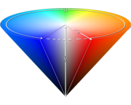
HSV and HLS Color Models
We mentioned before that a color can be represented by its
Hue (essential color)
Saturation (purity of color)
Luminance (or Value or Lightness)
➔ HSV (also called HSB) color model
Usually used in computer graphics applications
HLS is similar to HSV
Non linear transformations from RGB to HSV (or HLS) and vice versa
HSV model
7
Notes:
7

Slide 8
Luminance & Chrominance Color Models
Yet another method to represent color
Put all luminance information in one value (Y)
All color (chrominance) information in other two (IQ)
Why?
Allows us to treat components differently
Humans more sensitive to Y than IQ
More convenient for television broadcast (in early days)
All black & white info in one value (luminance) ➔
same transmission for black & white and color TVs
YIQ used for TV in North America (NTSC)
YUV for TV in Europe (PAL )
YCbCr (similar to YUV): Used in JPEG and MPEG
8
Notes:
8

Slide 9

YIQ Model
Y: weighted sum of R,G,B
Brightness in the image
Black & white image
I & Q add the color aspects
Original image
Y Component
I Component
Q Component

Slide 10

Luminance & Chrominance Color Models
YIQ ⬅➔ RGB using linear transformation
Note: Values in matrix depend on the choice of the primaries for RGB
10
Notes:
10

Slide 11
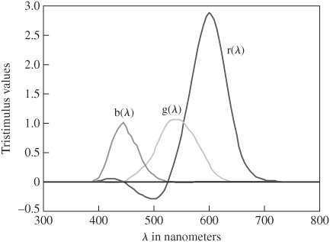
CIE XYZ Model and Color Gamut
RGB does not capture all visible colors
Some visible colors cannot be produced by adding RGB components
Color matching experiment
Produce pure colors
Ask observers to vary r, g, b mix till match
Some visible (pure) colors could not be matched unless we added R to them, i.e., subtract R from the mix
11
Notes:
11

Slide 12
CIE XYZ Model and Color Gamut
This means systems that use RGB model (e.g., monitors) may not able to produce all visible colors
Similarly for systems that use CMYK model (e.g., color printers)
➔ some colors can be produced on monitors but not on printers and vice versa
Color Gamut (or scope): is the range of colors that can be produced (displayed or printed)
CIE: Commission Internationale de l’Eclairage
Goal: define a model to represent ALL colors
Used to compare color gamut of different color models
12
Notes:
12

Slide 13
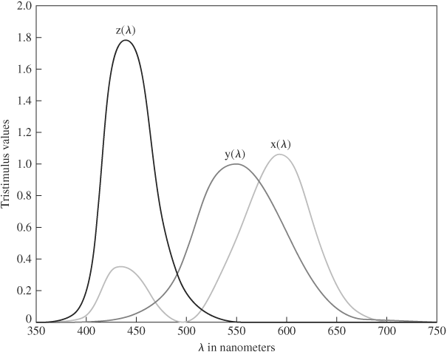
CIE XYZ Color Model
CIE defines three virtual primaries (X, Y, Z) from which all colors can be composed by positive amounts
Color given by
X, Y, Z are constants defined by CIE
For simplicity, we normalize:
13
Notes:
13

Slide 14
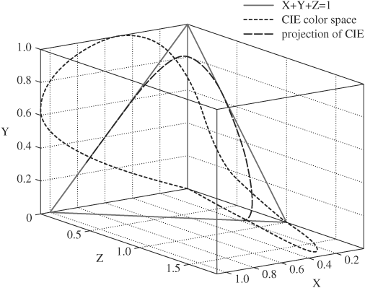
CIE XYZ Color Model
Thus, we have:
All perceived colors
Normalized plane
Projection Horseshoe shape
14
Notes:
14

Slide 15
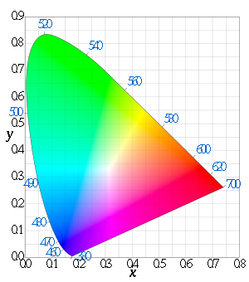
CIE Chromaticity Diagram
Projection on X,Y ➔ CIE Chromaticity Diagram
Represents all visible colors at unit energy
On the curved edge, fully saturated (pure, spectral) colors
On straight line base, colors that cannot be produced by a single wavelength (nonspectral)
A line joining any two colors represents colors that can be created by combining these two colors
15
Notes:
15

Slide 16
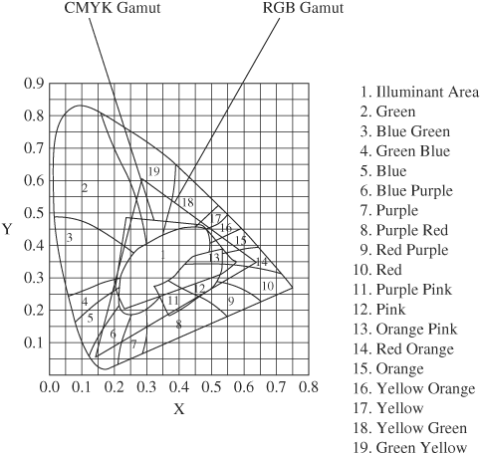
RGB vs. CMYK on Chromaticity Diagram
RGB range is larger, but it does not fully contain CMYK
Note: exact gamut depends on the specific constants used for RGB & CMYK
16
Notes:
16

Slide 17

RGB ⬅➔ CIE XYZ
Again depends on the specific constants for RGB
17
Notes:
17

Slide 18
Color Models: Summary
Different methods for representing colors
Additive (three primary colors: R, G, B)
Used in digital cameras, monitors, TVs
Subtractive (three primary colors: C, M, Y Plus K)
Good for printers
Luminance & Chrominance: YIQ, YUV, YCbCr
Luminance component (Y) and two chrominance components
YIQ & YUV used in B&W and color TV (same signal)
YCbCr used in JPEG and MPEG compressions
HSV & HSL: Hue, Saturation, Value (or Lightness)
Usually used in computer graphics applications
CIE XYZ:
Theoretical, comprehensive, used for comparing gamut
18
Notes:
18

