Slide 1
Department of Computer Science
National Tsing Hua University
CS 5262: Multimedia Networking and Systems
Channel Modeling and Wide-Scale Internet Streaming Measurements
Instructor: Cheng-Hsin Hsu
Acknowledgement: The instructor thanks Prof. Mohamed Hefeeda at Simon Fraser University for sharing his course materials

Slide 2
Outline
Channel Modeling
  Basic Probability Theory and Information Theory Concepts
  Discrete Memory-Less Channels (DMC)
  Channels with Memory
Internet Streaming Measurements

Slide 3
Motivation
Why need model channels ?
  Help us to develop networked multimedia systems
  For example, different packet loss recovery mechanisms, such as retransmission, FEC, or both can be used in multimedia systems based on channel models
We cover basic channel models for multimedia packets

Slide 4
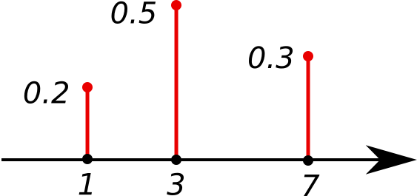
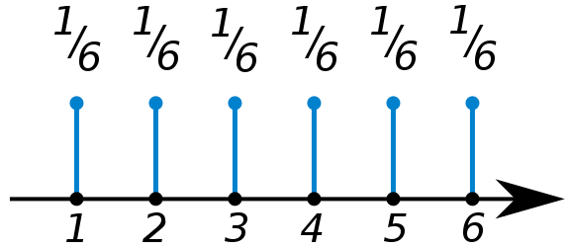
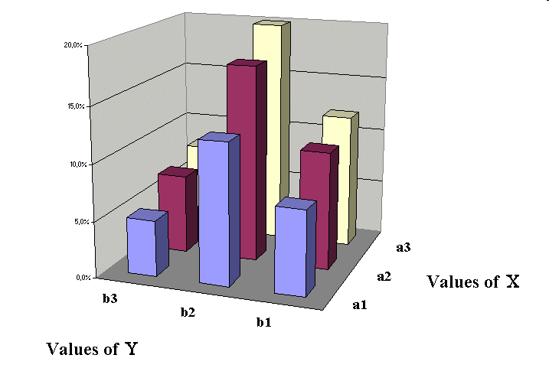
Discrete Random Variable
Probability Mass Functions:
Joint Probability Mass Functions
Example of pmf for d.r.v X
Marginal Probability Mass Functions:
Conditional Probability Mass Functions:
Independent Random Variables:
Joint pmf for two r.v X and Y

Slide 5
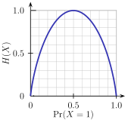

Entropy
Entropy (uncertainty):
measure of the amount of uncertainty (randomness) associated with the value of the discrete random variable X
0 <= H(X) <= Log L ;
where X have L possible values
Joint entropy
Conditional entropy (equivocation)

Slide 6
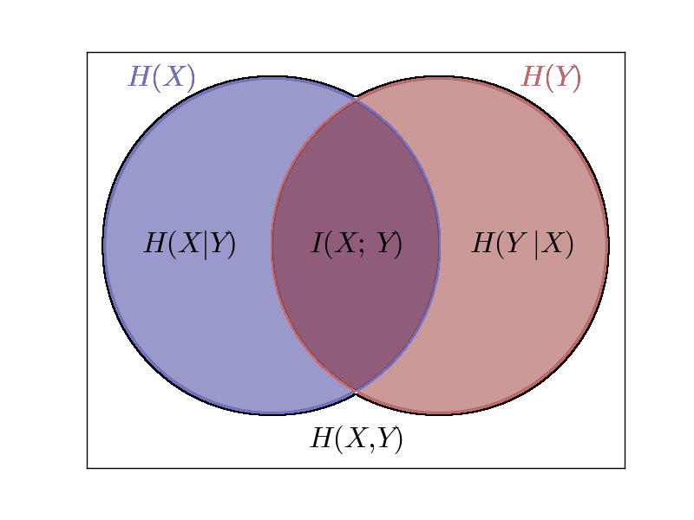
Mutual Information
What is Mutual Information I(X; Y)?

Slide 7
Mutual Information
Mutual information measures the information that X and Y share:
  How much knowing an r.v. reduces our uncertainty about the other one
Example:
  X and Y are indep. → knowing X does not give any information about Y and vice versa → I(X;Y)=0
  X and Y are identical → all information conveyed by X is conveyed by Y as well → I(X;Y)=I(X)=I(Y)
Some formulas:

Slide 8

Channel Capacity
Shannon capacity
  Max amount of error-free data (information) that can be sent over a communication channel with a given bandwidth
  Theoretical max data rate over the channel
Defined as the maximum of the mutual information between the input and output of the channel
  Under input distributions
bits or packets per channel use
Notes:
C= bits per channel use
B=channel uses per second
R=BC
R<=Min_i(Ri)=min_i(BiCi)

Slide 9
Discrete Memoryless Channels DMC
Communication system
P(Y|X)
  the probability of observing the output symbol Y given that we send the symbol X
The channel is said to be memoryless
  r.v. Y depends only on r.v. X at that time and is conditionally independent of previous X and Y

Slide 10
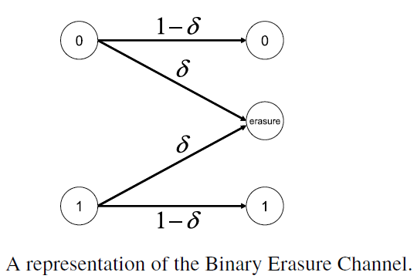
Binary Erasure Channel (BEC)
The input X: binary (Bernoulli) random variable (0 or 1)
: The loss (erased or deleted) probability
The output Y: ternary random variable (0,1 or erasure)

Slide 11
Binary Erasure Channel (cont.)
No Error occur over a BEC: Pr[Y=0 | X=1] = Pr[Y=1 | X=0] = 0
This capacity, measured in “bits” per “channel use,” is achieved when the channel input X is a uniform r.v.
Notes:
The expression for the capacity has some intuitive meaning: Since a proportion α of the bits are lost in the channel, we can recover (at most) a proportion 1 − α of the bits. Hence the capacity is at most 1 − α.
In many practical channels, the sender receives some feedback from the receiver. If feedback is available for the binary erasure channel, it is very clear what to do: If a bit is lost, retransmit it until it gets through.
Since the bits get through with probability 1 − α, the effective rate of transmission is 1 − α. In this way we are easily able to achieve a capacity of 1 − α with feedback.

Slide 12

Packet Erasure Channel (PEC)
Multimedia packets ← “bit-vectors”: bits of the same packet are either 100% received or erased
Inputs and outputs of PEC are r.v.’s
The capacity in this case is measured in “packets” per “channel use.”
is a binary random variable
Notes:
Similarly, a cascade of L links of PEC channels has an effective
loss probability δ = 1 −%L i=1(1 − δi ) and end-to-end capacity C = 1 − δ = 1− (1 −%L i=1(1 −δi )) =%L i=1(1 −δi ) in packets per channel use.

Slide 13

Cascaded BEC Channels
Consider two indep. BEC channels that are cascaded
The loss probability for the two channels could be different:
Capacity:
For L cascaded indep. BEC channels:
Channel capacity:

Slide 14

Cascaded BEC Channels (cont.)
The end-end path of L BEC channels == a BEC channel with a loss probability:
The capacity C of the end-to-end route is bounded by the capacity Cmin (the smallest capacity among all channels).
  C ≤ Cmin = min_{i}(Ci).
Notes:
Cmin should not be confused by the “bottleneck” bandwidth Bmin, the bottleneck bandwidth usually represents the maximum transmission rate (e.g., 1.544 Megabits per second for a T1 line) that a particular link within the end-to-end path could support, and where this link has the minimum transmission rate: Bmin = mini(Bi ). Here, Bi can be thought of as the number of channel uses per second for link i. In general, a multimedia application must use a total rate Rtotal taking into consideration both the bottleneck bandwidth and the minimum end-to-end capacity. the effective (maximum) throughput of a BEC link i in terms of bits per second can be expressed as Ri = BiCi . Hence, the total rate Rtotal used by an application should be bounded by the following effective performance throughput: Rtotal ≤ mini(Ri ) = mini(BiCi ) in bits per second.

Slide 15
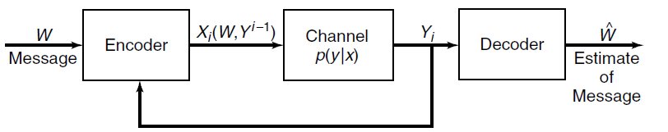
The BEC Channel with Feedback
Discrete memoryless channel with feedback
Channels may support some forms of feedback.
  For example, NACK for retransmission.
How to derive the performance bounds of such channels with feedback?
For any (DMC) Channel, feedback does not improve (or worsen for that matter) :

Slide 16
Cascaded BEC/PEC with Feedback
Feedback at end points:
Feedback link-by-link → the channel capacity is bounded by the capacity of a “bottlneck” link:
These are results for memoryless channels ← channels with memory could increase their capacity by employing feedback!

Slide 17
Packet Losses over Channel with Memory
Packet losses over Internet links and routes exhibit a high level of correlation and tend to occur in bursts ← Channels with memory!
The most popular tool is Markov channels
A two-state Markov channel is the Gilbert–Elliott (GE) channel
  Good State (G) : the receiver receives all packets correctly
  Bad State (B) : all packets are lost

Slide 18
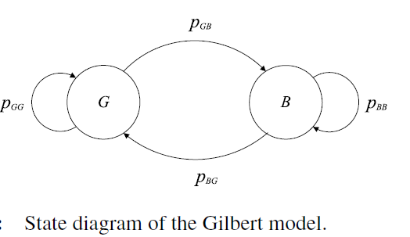
Gilbert–Elliott Channel
    p_{GG} = 1 - p_{GB} and p_{BB} = 1 – p_{BG}
    The steady state probabilities :

Slide 19
Recovery Probability
Probability of receiving i packets among n packets sent over GE channels
Extend the two-state GE model using the number of correctly received packets as the indexes (additional states)
Probability of sender sends n and receiver gets i packets == process starts at G₀ or B₀ and reaches G_{i} or B_{i} after n steps

Slide 20
Recovery Probability and FEC
Detailed derivation can be found in [R. Howard, Dynamic Probabilistic Systems. Wiley, 1971].
Let φ(n, i) be the probability of sender transmits n packets and the receiver receives i packets:
Sample applications: for a (n,k) FEC coders, the decodable probability is:
Notes:
An important performance measure for multimedia applications is the number
of packets received given that the transmitter sends n packets φ(n, i) . This measure, for example, could help application developers identify the level of resilience needed when transmitting a block of n video packets; this block of n packets may correspond to the number of packets in a Group of Pictures (GoP) of an MPEG stream. Another example could arise when the n packets may represent a Forward-Error-Correction (FEC) block with both k media data (e.g., video) packets and (n − k) parity packets that are used to recover lost packets within the n-packet FEC block

Slide 21
Packet Correlation over Channels with Memory
Another way to set system parameters:
  The average loss p
  the packet correlation ρ, where:
The steady state probabilities:
ρ reveals how the states of two consecutive packets are correlated
  when ρ = 0, the loss process is memoryless (BEC)
  ρ increases → the states of two consecutive packets become more and more correlated.

Slide 22
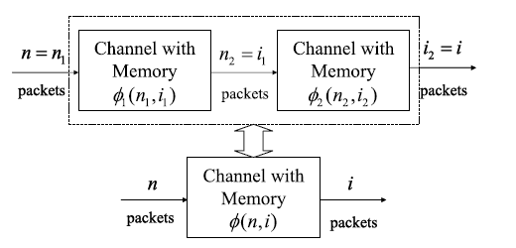
Packet Losses over Cascaded Channels with Memory
Close to the Internet ← many routers with memory
The reception of i packets when transmitting n packets over two-cascaded channels with memory.

Slide 23
Derivation of Probability (1/3)
The probability φ(n, i) of receiving i packets when the transmitter sends n packets into the first channel
That is,

Slide 24
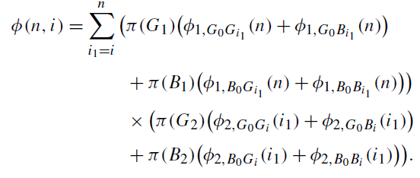
Derivation of Probability (2/3)
Since they are GE channels
Notes:
Here, φj,G0Gi (n) (φj,B0Bi (n)) is the probability that the transmitter sends n
packets and the receiver receives i packets over the j th channel given that the channel begins and ends in a good (bad) state. Also, π(Gj ) (π(Bj )) is the probability that the j th channel is in a good (bad) state.

Slide 25
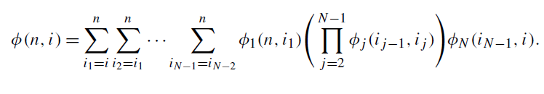
Derivation of Probability (3/3)
Now for N channels with memory:
More compact version:

Slide 26
Outline
Channel Modeling
  Basic Probability Theory and Information Theory Concepts
  Discrete Memory-Less Channels (DMC)
  Channels with Memory
Internet Streaming Measurements

Slide 27
Goal
Use actual mutimedia streaming application to measure the network performance of the Internet
  More specifically with analog modems

Slide 28
Previous Studies – TCP Perspective
Study the performance of the Internet
On backbone routers, campus networks
No studies represent how entertainment-oriented service will evolve
Ping, traceroute, UDP echo packets, multicast backbone audio packets

Slide 29
Problem?
Not realistic! Do not represent what people experience at home when using real-time video streaming

Slide 30
Study Real-Time Streaming
Use 3 different dial-up Internet Service Provider in the U.S.A.
Mimic their behaviour in the late 1990s-early 2000s
Real-Time streaming different than TCP because:
  TCP rate is driven by congestion control
  TCP uses an ACK for retransmission; real-time applications send an NACK which is different
  TCP relies on window-based flow control; real-time applications utilizes rate-based flow control

Slide 31
Setup
Unix video server to the UUNET backbone with a T1
AT&T WorldNet, Earthlink, IBM Global Network
56kbps, V.90 modems
All clients were in NY state, but dialed long-distance numbers to every 50 states to connect, from various major cities in the U.S.A. To the ISP via PPP
Issue a parallel traceroute to the server and then stream a 10-min long video

Slide 32
Setup (cont.)
Phone database of all numbers to dial
Dialer
Parallel Traceroute
  Implemented using ICMP (instead of UDP)
  Send all probes in parallel
  Record IP Time-to-live (TTL) for each returned messages

Slide 33
Success Streaming Sessions
Sustain the transmission of the 10-minute video sequence at the stream's target IP rate r
Aggregate packet loss is less than a specific threshold
Aggregate incoming bit rate above a specific bit rate
Experimentally found that this filter-out modem-related (last-mile) issues

Slide 34
When does the experiment end?
50 states (including AK and HI)
Each day separated into 8 chunks of 3 hours each
One week
50 x 8 x 7 = 2800 successful sessions per ISP

Slide 35
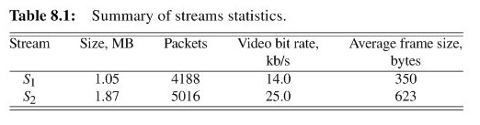
Streaming Sequences
5 frames per second, encoded using MPEG-4
576-byte IP packet that always start at the beginning of a frame
Startup delay: network independant: 1300ms, delay jitter: 2700ms. Total: 4000ms

Slide 36
Client-Server Architecture
Multi-threaded server, good for NACK requests
Bursts between 340 and 500ms for a low server overhead
Client uses NACK for lost packets
Client collects stats about received packets and decoded frames

Slide 37
Notation
D^{X}_{n} for Dataset collected by ISP_{x} (x = a, b, c) with Stream S_{n} (n = 1, 2)
D_{n} for the combined set {Dª_{n} U D^{b}_{n} U D^{c}_{n}}

Slide 38
Experimental Results
D₁
  3 clients performed 16,783 long-distance connections
  8429 successes
  37.7 million packets arrived at clients
  9.4 GB of data
D₂
  17,465 connections
  8423 successes
  47.3 million packets arrived at clients
  17.7 GB of data

Slide 39
Experimental Results (cont.)
Average time to measure an end-to-end path: 1731ms
D₁ encountered 3822 different Internet routers; D₂ 4449 and together, 5266
D₁ encountered on average 11.3 hops (from 6 to 17), 11.9 in D₂ (from 6 to 22)

Slide 40
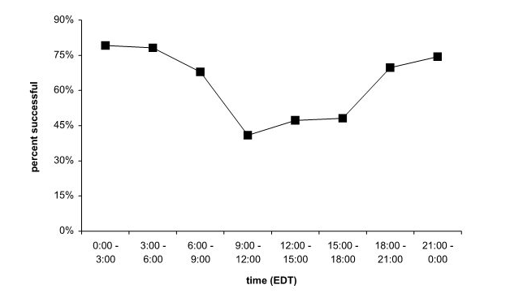
Succesful Sessions
Time dependent

Slide 41
Packet Loss
D_{1p} average packet lost was 0.53%, D_{2p} 0.58%
Much higher than what ISPs advertise (0.01 – 0.1%)
Therefore, suspect lost happens at the edges
38% of all sessions had no packet lost; 75% had loss rates < 0.3% and 91% rate lost < 2%
2% of all sessions have packet lost > 6%

Slide 42
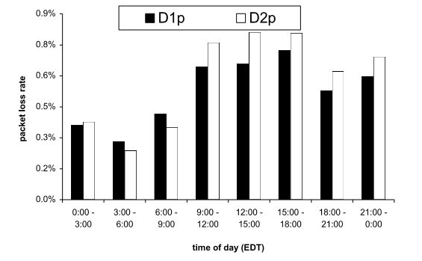
Packet Loss – Time Factor
Higher at rush hours

Slide 43
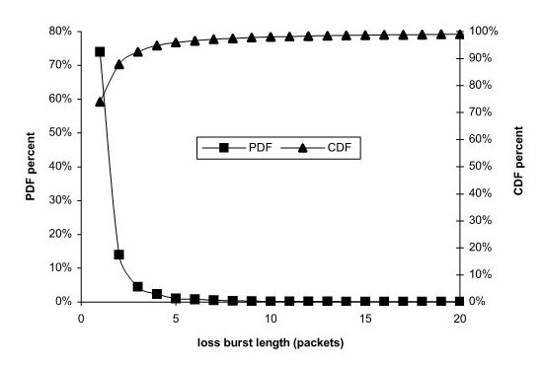
Loss Burst Lengths
207,384 loss bursts and 431,501 lost packets ← most of them are two packets

Slide 44
Loss Burst Lengths (cont.)
In each of D_{1p} and D_{2p}:
  Single packet bursts contained 36% of all lost packets
  Bursts <= 2 contained 49%
  Bursts <= 10 contained 68%
  Bursts <= 30 contained 82%
  Bursts >= 50 contained 13%

Slide 45
Loss Burst Durations
If a router's queue is full, and if packets are really close to one another within the burst, they might all be dropped
Loss-burst duration = time between the last packet received, and the one received after the burst loss
98% of loss-burst durations < 1second, which could be caused by data-link retransmission

Slide 46
Heavy Tails
Packet losses are dependant from one another; it can create a cascading effect
Future real-time protocols should account for bursty loss packets, and heavy tail distribution
How to model it?

Slide 47
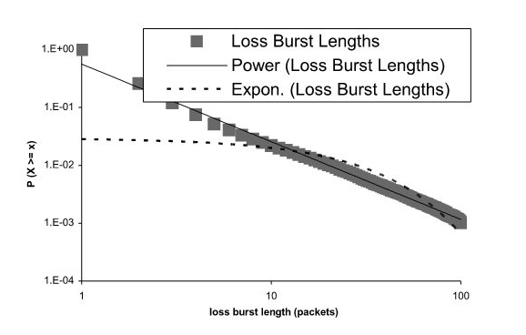
Heavy Tails (cont.)
Paretto function
  CDF: F(x) = 1 – (β/x)^{α}
  PDF: f(x) = αβ^{α}x^{-α-1}
  In the case, α = 1.34 and β = 0.65

Slide 48
Underflow Events
Packet loss: 431,501
159,713 (37%) were discovered missing when it was too late => no NACK
431,501 – 159,713 = 271,788 left
257,065 (94,6%) recovered before their deadline, 9013 (3.3%) were late and 5710 (2.1%) were never recovered

Slide 49
Underflow Events (cont.)
Two types of late packets:
  Packets that arrive after the last frame of their GoP is decoded => completely useless
  Packets that are late, but can still be used for predicting frames within their GoP => partially late
Of the 9013 late retransmission, 4042 (49%) were partially late

Slide 50
Underflow Events (cont.)
Total underflow by packet loss: 174,436
1,167,979 underflows in data packets, which were not retransmitted
1.7% of all packets caused underflows
Frame-freeze of 10.5s on average for D_{1p}, and 8.6s for D_{2p}

Slide 51
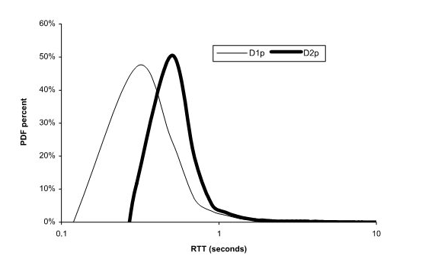
Round-Trip Delay
660,439 RTT for each D_{1p} and D_{2p}
75% < 600 ms, 90% < 1 s, 99.5% < 10 s and 20 > 75 s

Slide 52
Round-Trip Delay (cont.)
Depends on the time of the day
Correlated to the length of the end-to-end path (measured in hops with traceroute)
Very little correlation with geographical location

Slide 53
Delay Jitter
One-way delay jitter = difference between one-way delay of 2 consecutive packets
Using positive values for one-way delay jitter, highest value was 45 s, 97.5% < 140 ms, and 99.9% < 1 s
Cascading effect: many packets can then be delayed, causing many underflows

Slide 54
Packet Reordering
In Dª_{1p}, 1/3 missing packets was actually reordered
Frequency of reordering = % of reordered packets/total number of missing packets
In the experiment, this was 6.5% of missing packets, or 0.04% of all sent packets.
9.5% of sessions experienced at least one reordering
Independant of time of day and state

Slide 55
Asymmetric Paths
Using traceroute and TTL-expired packets, can establish number of hops between sender and receiver
If number is different, definitely asymmetric
If the same, we don't know and call it potentially symmetric

Slide 56
Asymmetric Paths (cont.)
72% of sessions were definitely asymmetric
Could happen because paths crosses over Autonomous Systems (AS) boundaries, where a “hot-potato” policy is enforced
95% of all sessions that had at least one reordering had asymmetrical paths
12,057 asymmetrical path sessions => 1522 had a reordering. 4795 possibly symmetric paths, only 77 had reordering

Slide 57
Conclusion
Internet study for video streaming
Use various tools such as traceroute to know the routers along a path
Analyze the percentage of request that fail
Packet loss and loss-burst durations
Underflow events
Round trip delay
Delay jitter
Reordering and asymmetric paths

